Slide 1
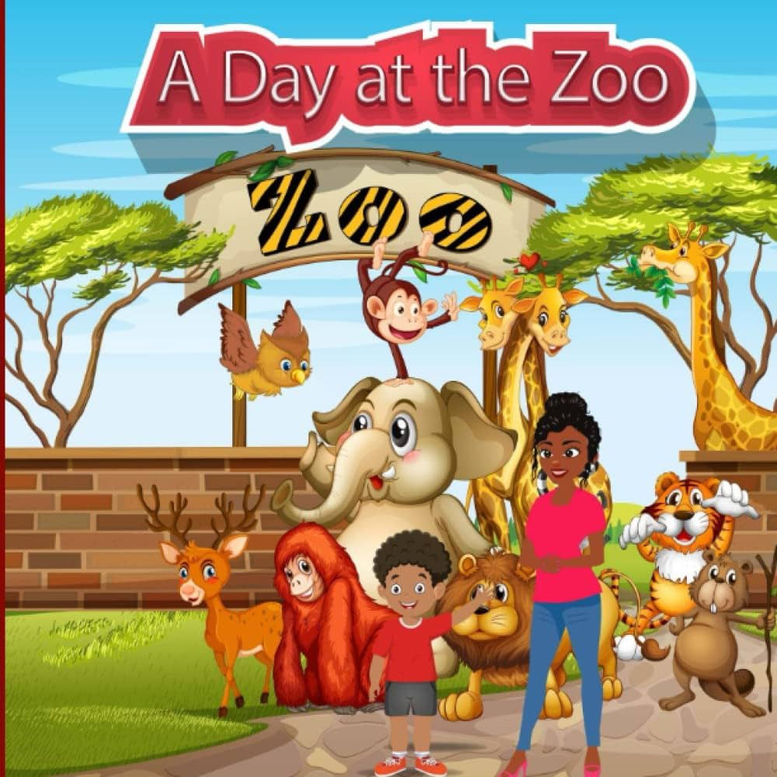


Slide 2
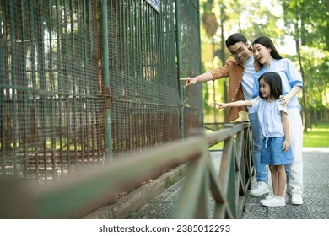
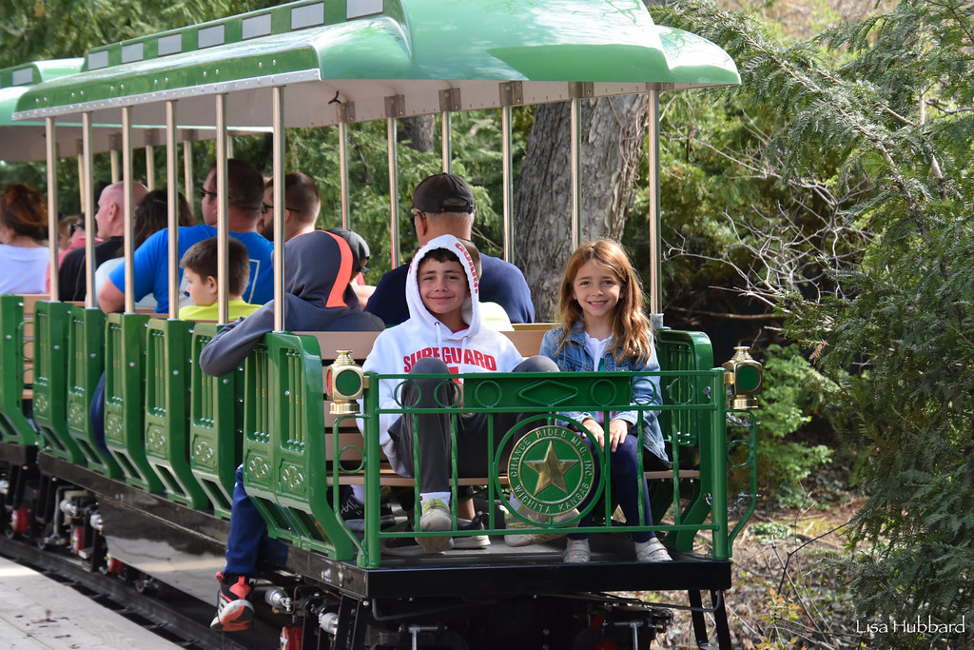
My brothers and I went to the zoo last Saturday. Mom took us to the zoo
for the whole day.
It was so much fun to see all the animals. First we took a train ride around the zoo.
2

Slide 3
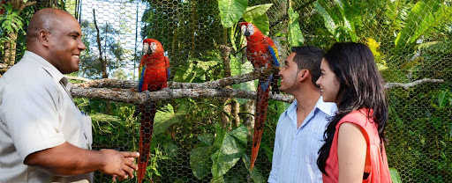
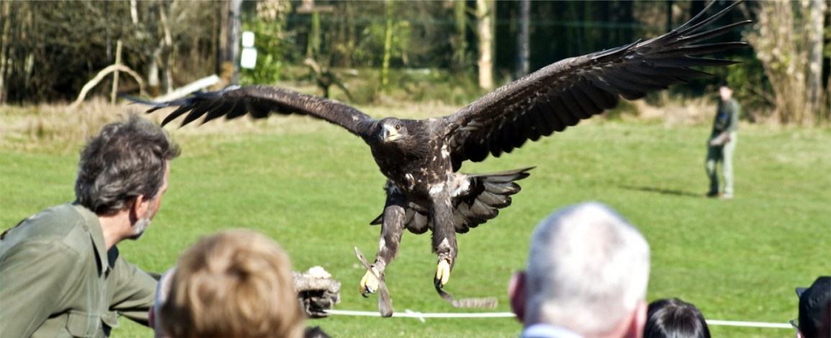
Next, we went to a show about birds.
I got to touch an eagle.
3

Slide 4
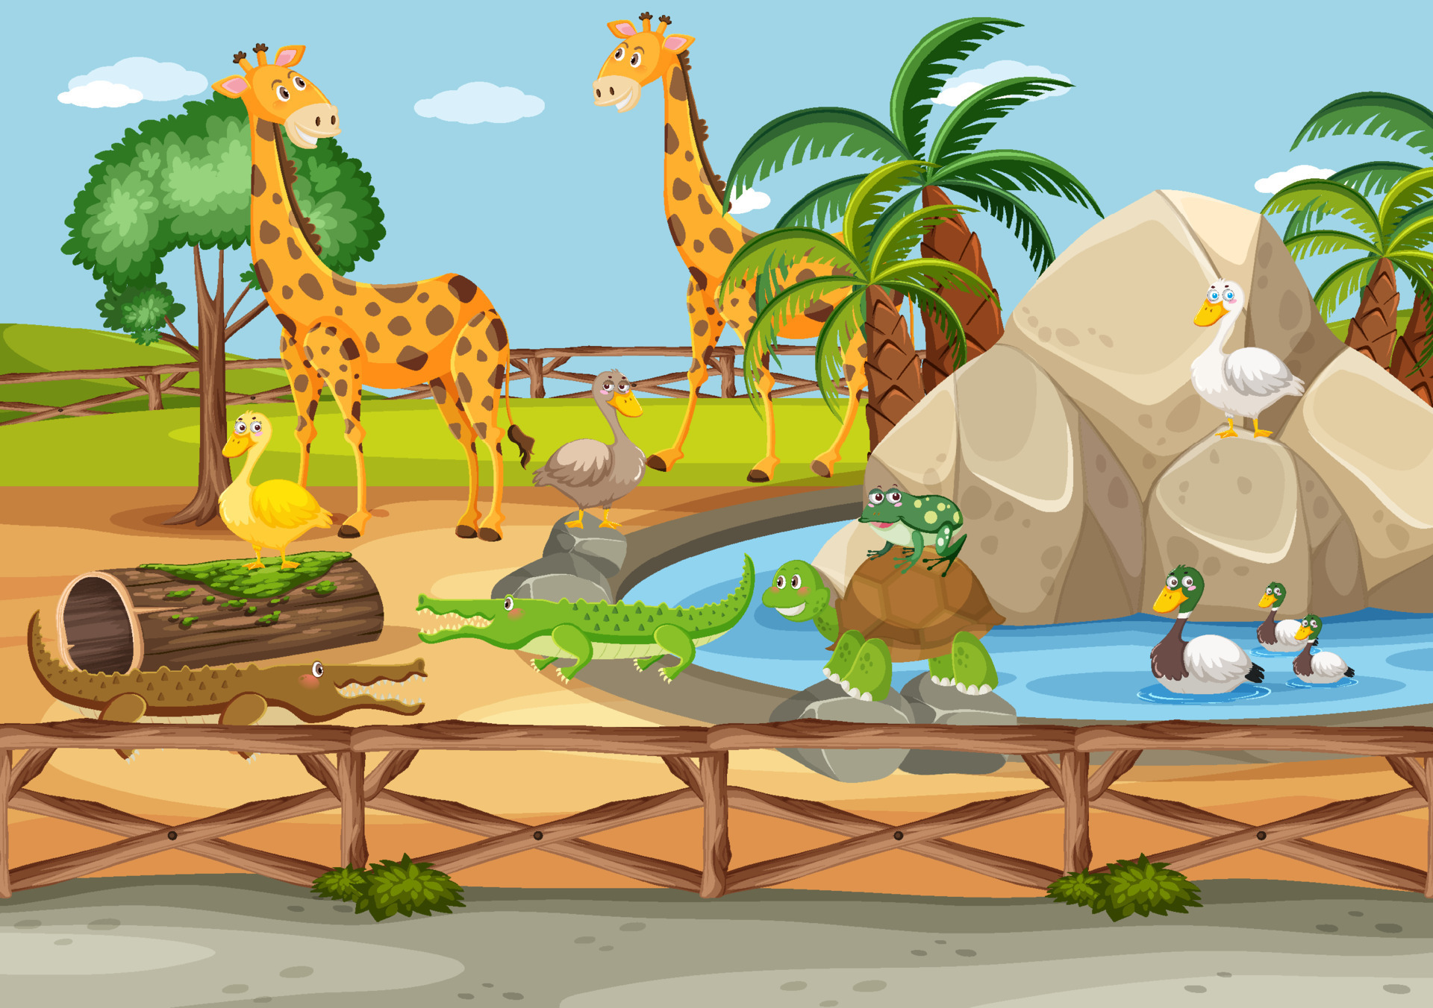
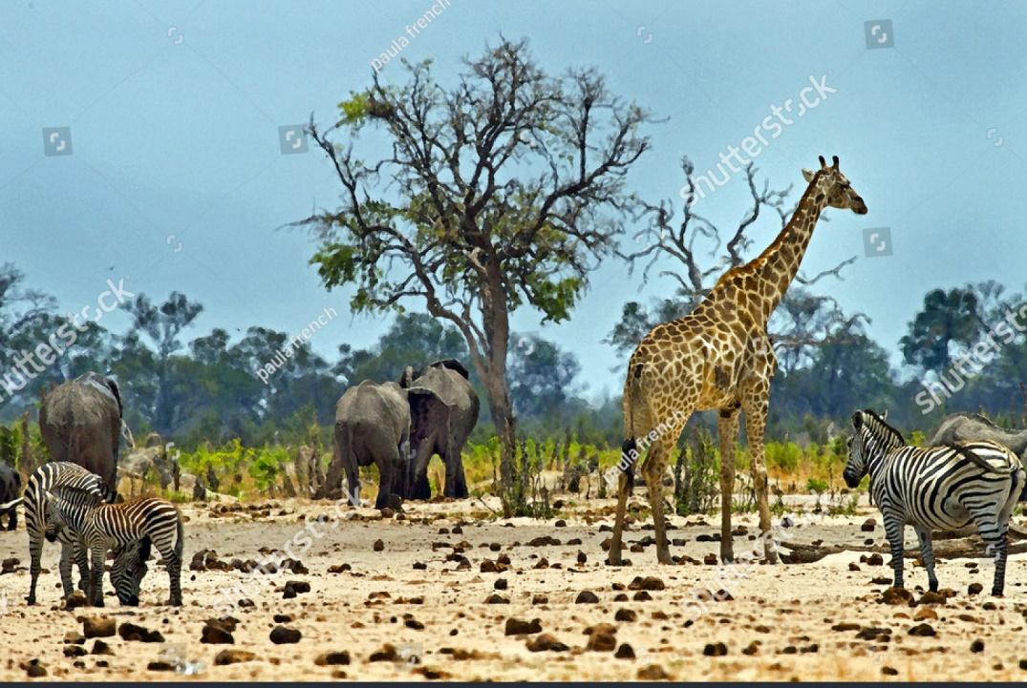
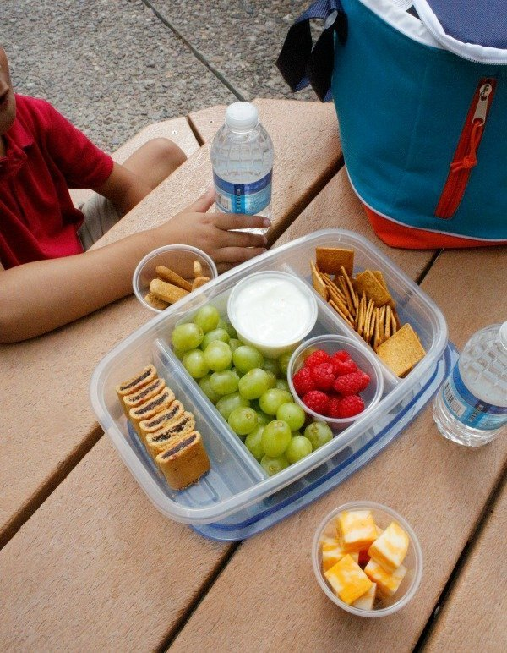
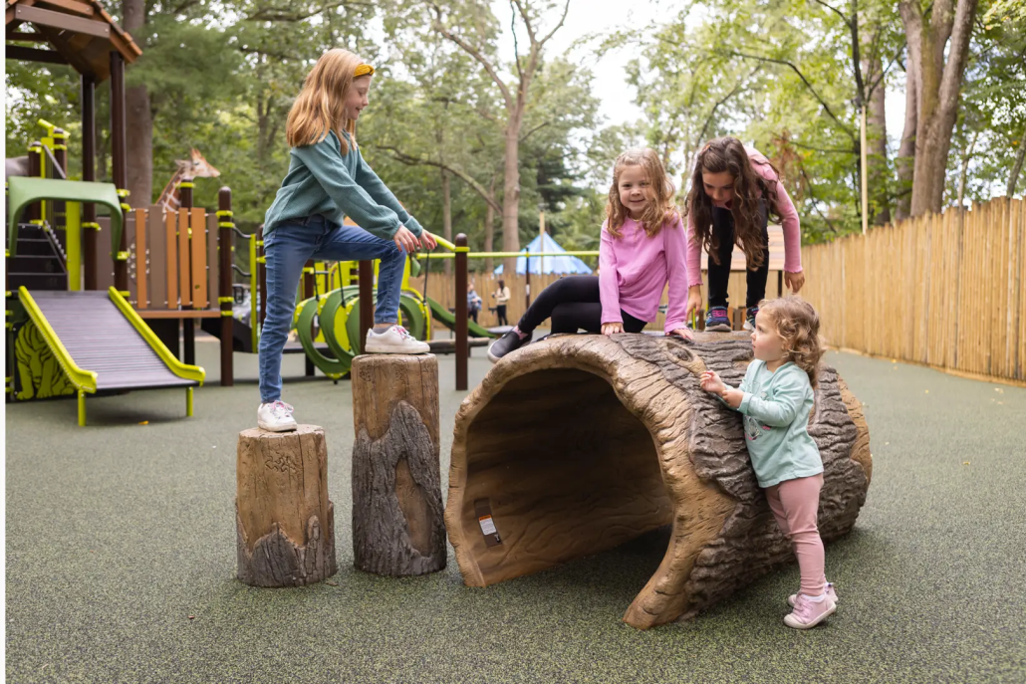
We spent the rest of the morning looking at giraffes, elephants, and zebras
We had a picnic lunch and played in the park.
4

Slide 5
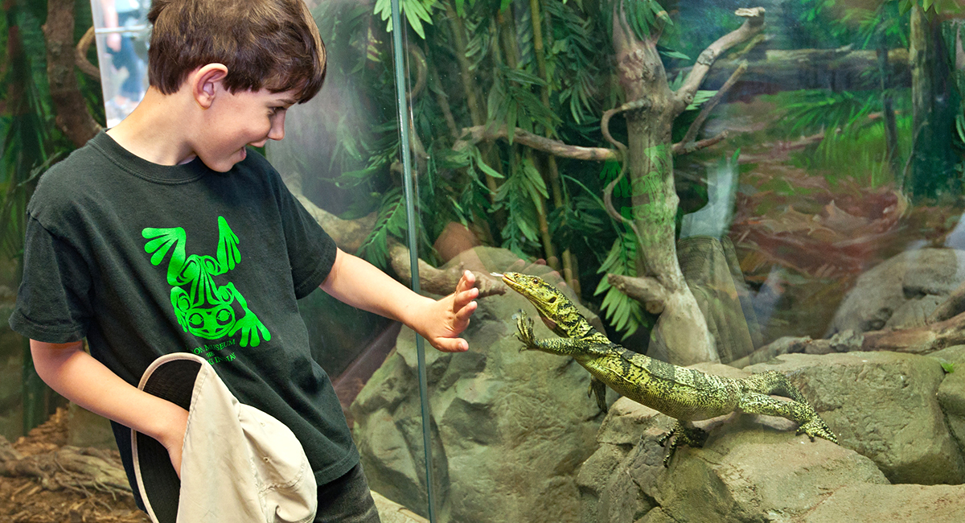
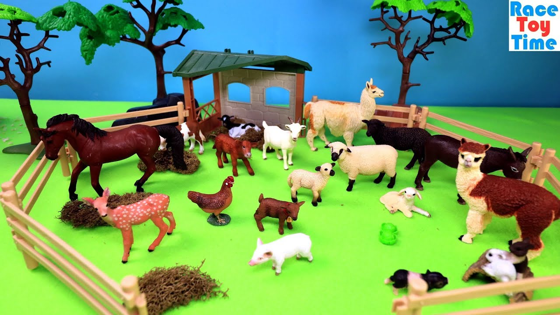
After lunch, our mom took us to see the reptiles and the farm animals.
5

Slide 6
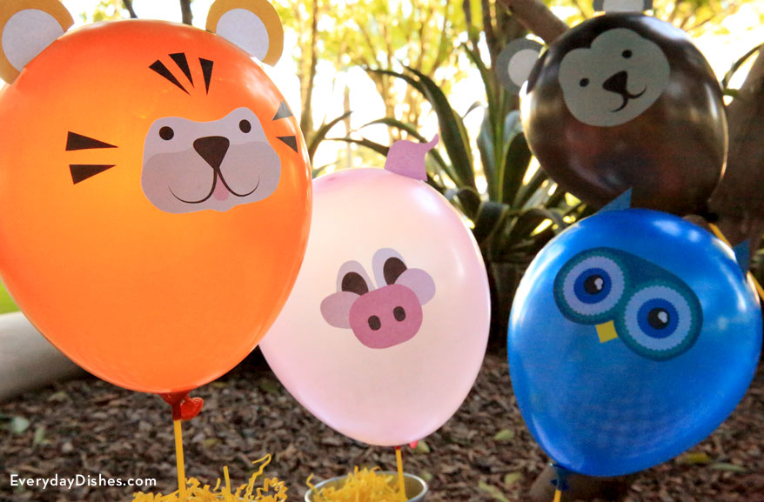
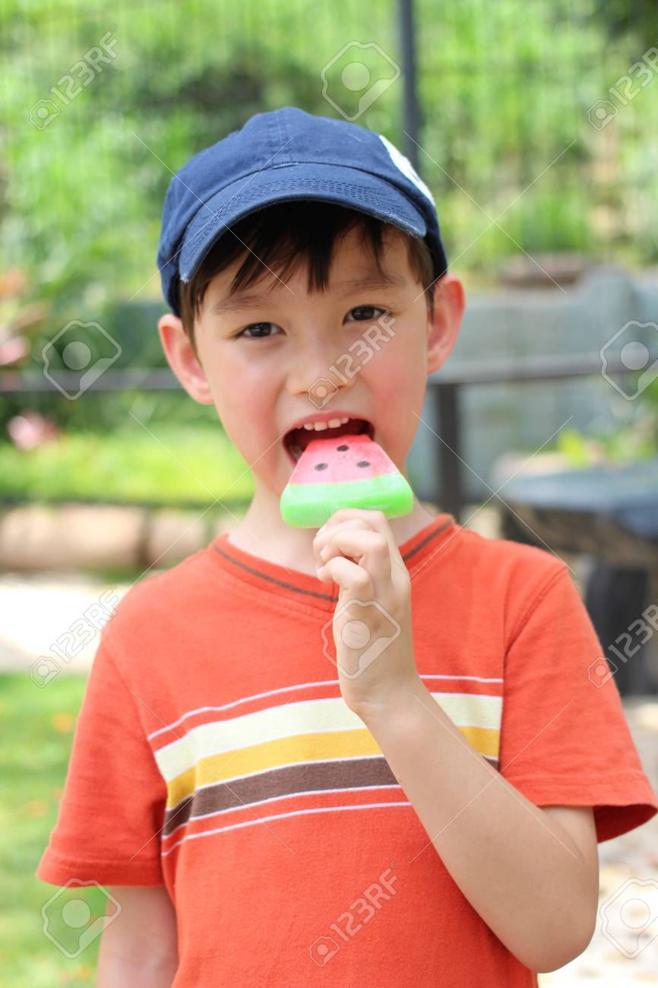
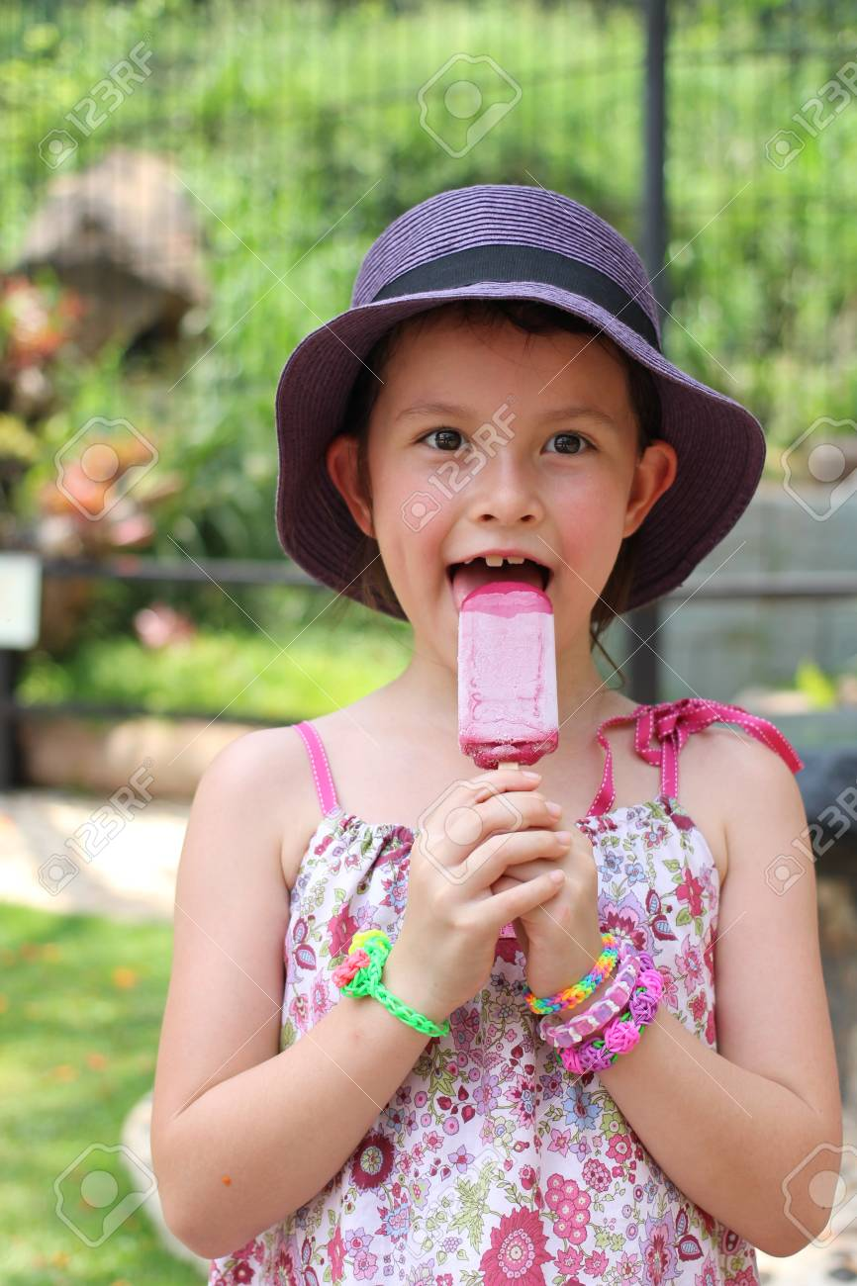
Mom bought us each a balloon and ice cream before we went home. It was a great day at the zoo.
6

Slide 7
Write the numbers 1-6 by each sentence to show the order of events in the story.
___________ Mom bought us a balloon and ice cream.
___________ We took a train ride around the zoo.
___________ Mom took us to see the reptiles and farm animals.
___________ We went to see a show about birds.
___________ We ate a picnic lunch and played in the park.
___________ We saw giraffes.
6
1
5
2
4
3
7

Slide 8

Can you guess the missing words?
A DAY AT THE ZOO
My brothers and I went to the zoo last Saturday. Mom took us to the zoo for the whole day. It was so much fun to see all the animals. First we took a train ride around the zoo. Next, we went to a show about birds. I got to touch an eagle. We spent the rest of the morning looking at giraffes, elephants, and zebras. We had a picnic lunch and played in the park. After lunch, our mom took us to see the reptiles and the farm animals. Mom bought us each a balloon and ice cream before we went home. It was a great day at the zoo.
8

Slide 9
Put the sentences in the right order.
After lunch, our mom took us to see the reptiles and the farm animals
8
4
10
First we took a train ride around the zoo
It was a great day at the zoo.
6
We spent the rest of the morning looking at giraffes, elephants, and zebras.
5
3
Next, we went to a show about birds. I got to touch an eagle.
It was so much fun to see all the animals.
7
We had a picnic lunch and played in the park.
9
1
Mom bought us each a balloon and ice cream before we went home.
My brothers and I went to the zoo last Saturday.
2
Mom took us to the zoo for the whole day.
9

Slide 10
They are in the right order.
My brothers and I went to the zoo last Saturday.
It was so much fun to see all the animals.
Mom took us to the zoo for the whole day.
We spent the rest of the morning looking at giraffes, elephants, and zebras.
Next, we went to a show about birds. I got to touch an eagle.
First we took a train ride around the zoo
After lunch, our mom took us to see the reptiles and the farm animals
Mom bought us each a balloon and ice cream before we went home.
We had a picnic lunch and played in the park.
It was a great day at the zoo.
10

Slide 11
Comprehension questions.
1- where did they go last night?
2- Who took them to the zoo?
3- what was fun to see?
4 what did they do first at the zoo?
5- what did they do next?
6- what big animals did they see?
7- did they have a picnic lunch and play in the park?
8- when did their mother take them to see the reptiles and the farm animals?
9- What did their mother buy them before they went home?
10- did they enjoy the day at the zoo?
11

