Slide 1



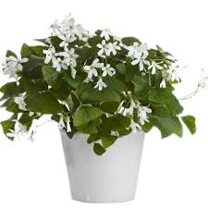




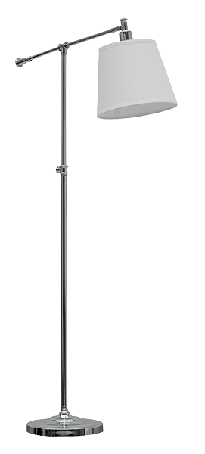





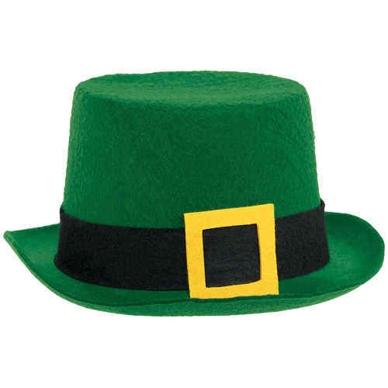


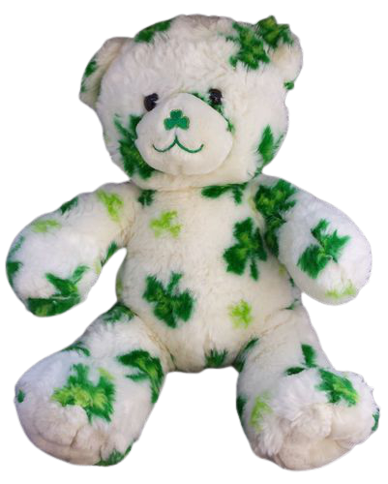


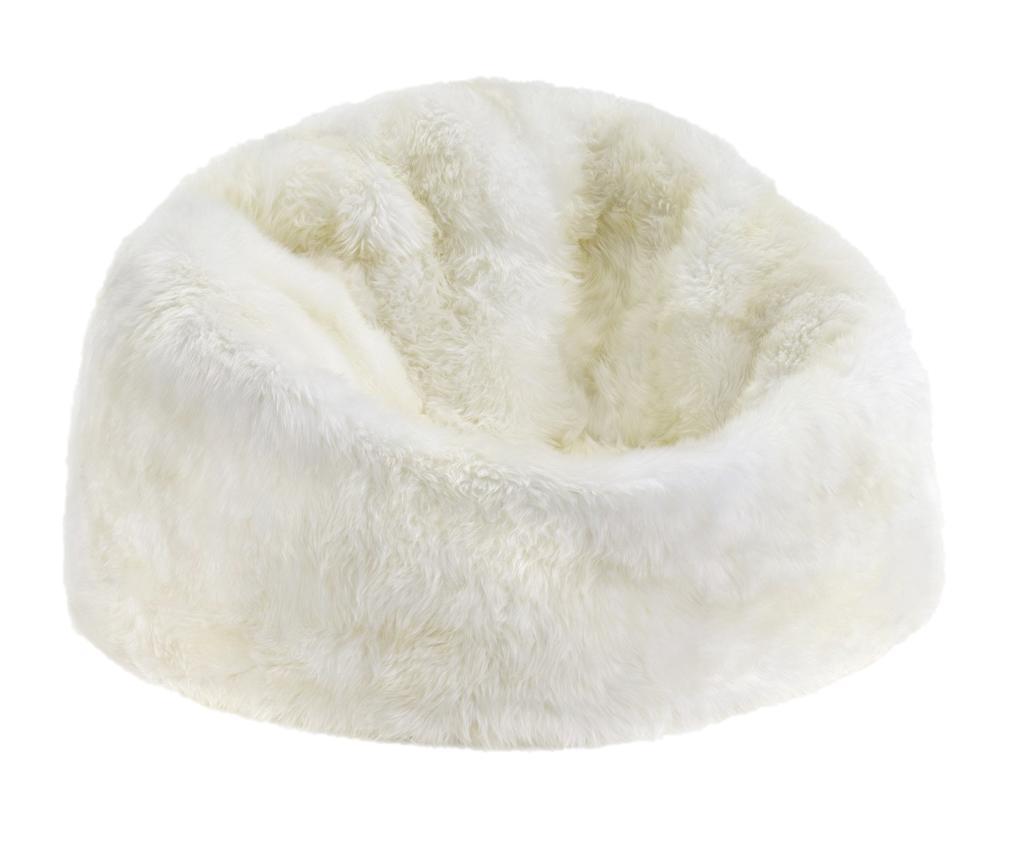

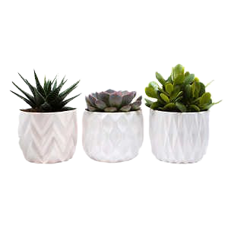

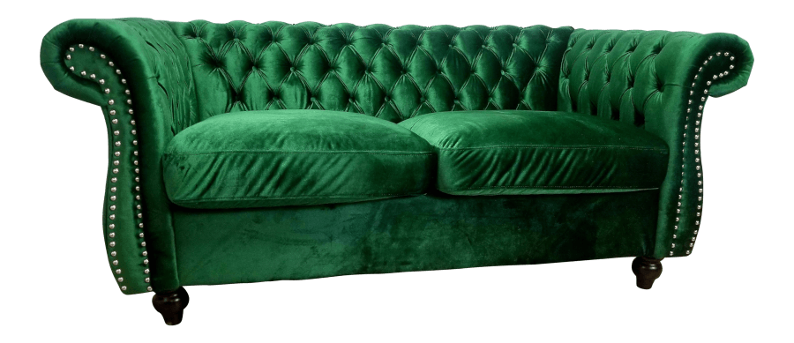



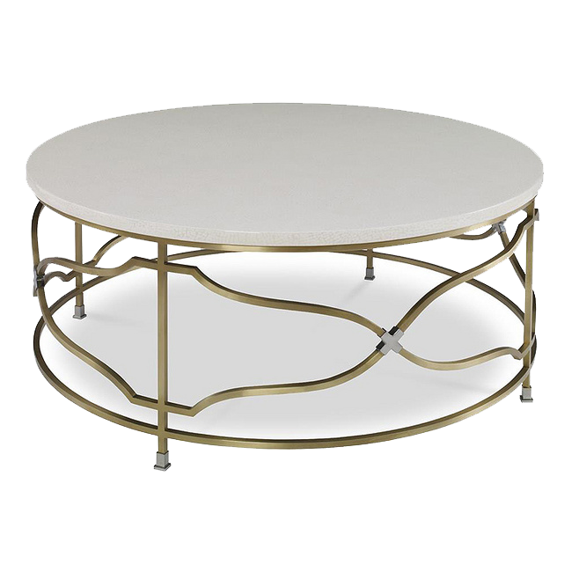


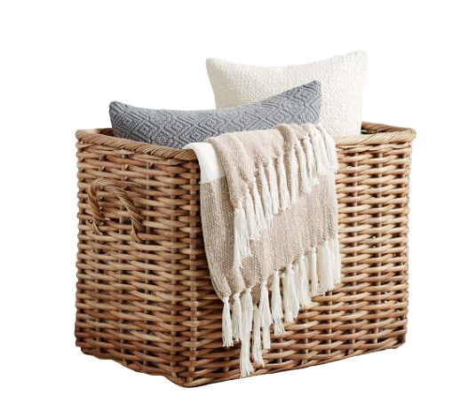
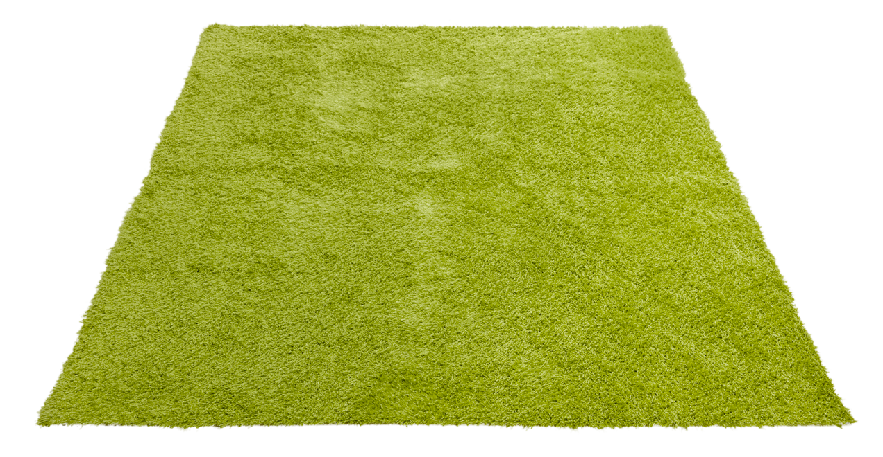
Mrs. Molina
3rd Grade

Slide 2
Mrs. Molina
3rd Grade

Slide 3

Mrs. Molina
3rd Grade

Slide 4
Mrs. Molina
3rd Grade

Slide 5

Mrs. Molina
3rd Grade

Slide 6

Mrs. Molina
3rd Grade

Slide 7
Mrs. Molina
3rd Grade

Slide 8
Mrs. Molina
3rd Grade

Slide 9

Mrs. Molina
3rd Grade

Slide 10
Mrs. Molina
3rd Grade

Slide 11
Mrs. Molina
3rd Grade

Slide 12
Mrs. Molina
3rd Grade

Slide 13
Mrs. Molina
3rd Grade

Slide 14

Mrs. Molina
3rd Grade

Slide 15
Mrs. Molina
3rd Grade

Slide 16
Mrs. Molina
3rd Grade

Slide 17
Mrs. Molina
3rd Grade

