Slide 1
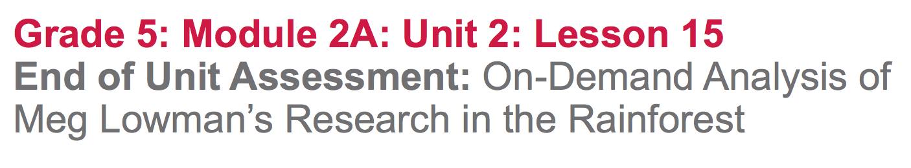

Slide 2
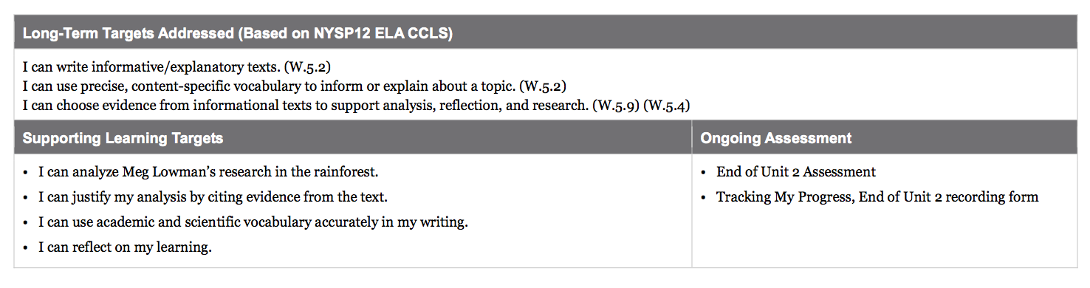

Slide 3
Opening
Reviewing Homework and Engaging the Reader (10 mins)

Slide 4
Take out your journal...
Share with your group:
two “academic” words that describe Meg Lowman’s thoughts or feelings about her research
two “scientific” words that describe what she studies.

Slide 5
Today you are going to complete the end of unit assessment. You will have time to plan, and then will write two separate paragraphs about how Meg Lowman explores the rainforest canopy, and what she learns about biodiversity.

Slide 6
Use your Meg Lowman, Rainforest Scientist KWL anchor chart and AQUA Biodiversity anchor charts to review what you have learned about Meg Lowman as a scientist.

Slide 7
Take into consideration…
What does Meg Lowman study?
How does she conduct her research.
Pair-Share what you have learned about Meg Lowman

Slide 8
Work Time
End of Unit Assessment: Analyzing Meg Lowman’s Research in the Rainforest

Slide 9
Learning Target
“I can analyze Meg Lowman’s research in the rainforest.”
“I can justify my analysis by citing evidence from the text.”
“I can use academic and scientific vocabulary accurately in my writing.”
analyze: examine, consider, evaluate
cite evidence: use quotes from the text; use details from the book
accurate: correct, true

Slide 10
End of Unit 2 Assessment
This will be a two paragraph essay. Let’s take a look at the Criteria for Success listed at the bottom of the assessment.

Slide 11
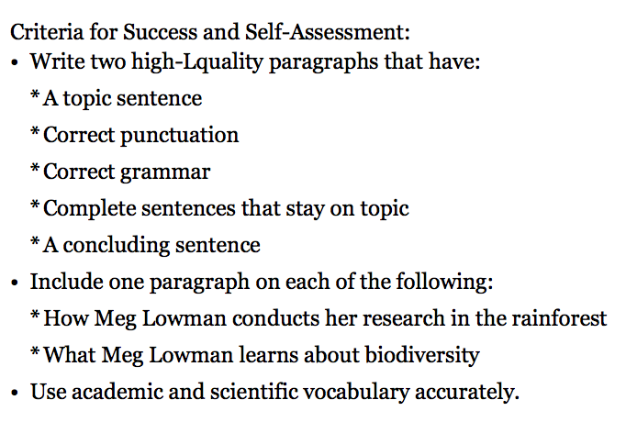
This is a two-part question. You will need to write a complete paragraph addressing each part of the question to fully answer the prompt/.

Slide 12
Part 1: Planning (15-20 mins)
Skim the assessment prompt once again
Locate information that addresses both parts of the prompt question from The Most Beautiful Roof in the World and your journals
Complete one Accordion graphic organizer for each paragraph

Slide 13
Part 2: Writing the Essay (20-25 mins)
Reread the prompt
Determine the sequence of your paragraphs
Review the criteria for success
Refer to the book, your journals, and anchor charts as needed

Slide 14
B. Learning Target Reflection (5 min)
“I can reflect on my learning.”
Independently complete the “tracking my progress” forms.

Slide 15
Closing and Assessment
Debrief (5 min)
Share your reflections with a partner

