Slide 1
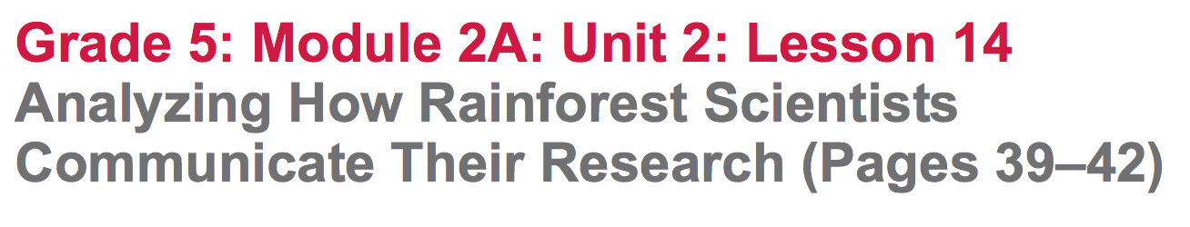

Slide 2
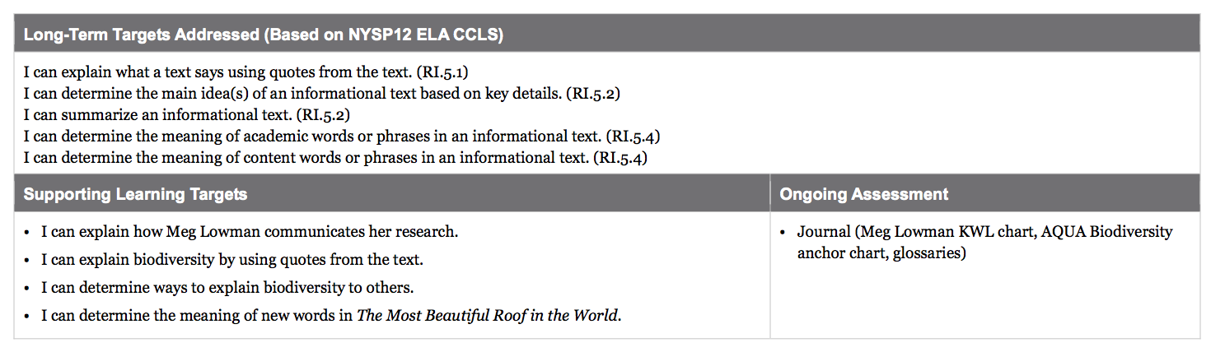

Slide 3
Opening
Reviewing Homework and Engaging the Reader (5 mins)

Slide 4
Learning Target
“I can explain how Meg Lowman communicates her research.”
What does it mean to communicate?

Slide 5
As I read the final pages aloud, think about how Meg Lowman communicates her research.
Turn to where we left off on page 39 and follow along as I read aloud. (“But we have to…”)

Slide 6
Discuss with your group:
How does Meg Lowman communicate her research?

Slide 7
Turn to the Meg Lowman, Rainforest Scientist, KWL anchor chart so we can record our ideas in the “Learned” column of the chart.

Slide 8
B. Group Work: Explaining Biodiversity (25 mins)
“I can explain biodiversity by using quotes from the text.”
What does it mean to explain?

Slide 9
You are going to begin to synthesize what you have learned from all of your reading about biodiversity by explaining what biodiversity is.

Slide 10
Remember that to synthesize something means to combine all your thinking and learning about a topic. Tomorrow, you will have a chance to write about rainforest scientist Meg Lowman, so it is important that today you continue to listen carefully and take good notes.

Slide 11
Each group has a task card. As a group, you will do the following: (10 mins)
Reread the section of text noted on the card
Record quotes from the text that help explain what biodiversity is
Review understandings from the AQUA biodiversity anchor chart
Discuss what you think biodiversity is based on the quotes you chose
Write a sentence that explains what biodiversity is.

Slide 12
You will now meet with another group that has a different task card. In these new groups, you should:
Share the sentence you wrote to explain biodiversity
Discuss:
What page from the text did you read?
What quotes from the text helped you?
How were our sentences about biodiversity similar? How were they different?

Slide 13
Return to your reading groups.
“I can determine ways to explain biodiversity to others.”
What does it mean to determine?

Slide 14
Look at the last column of our AQUA anchor chart, the ACTION column.
Discuss with your group:
What is taking action?

Slide 15
Brainstorm with your group about ways you could “take action” to explain biodiversity to others (peers, family members, friends, community members, etc.)

Slide 16
I’m going to give each of you a sticky note and I want you to tear it into thirds so you can flag the three pages from our task cards. You may want to use these pages during your assessment tomorrow.
Pages 12, 13, and 30

Slide 17
C. Key Vocabulary to Deepen Understanding (10 mins)
“I can determine the meaning of new words in The Most Beautiful Roof in the World.”

Slide 18
We have learned a lot about Meg Lowman through our close reading of The Most Beautiful Roof in the World. The words I have listed on the next slide focus on two things we have learned about her:
How Meg Lowman communicates her research
How she takes action to preserve biodiversity

Slide 19
balance, conservation, traces, concern,illuminated, enter, figures, pondering.
I’m going to give you 3-4 minutes to discuss in your group:
Which words relate to communicating research?
Which words relate to taking responsible actions?
**Look back at pages 39-42 for context clues**

Slide 20
balance:
conservation:
concern:
traces:
illuminated:
enter:
figures:
pondering:
(v) make things equal; keep steady (academic)
protection; preservation (scientific)
worry; fear (academic)
outlines; tracks (academic)
lit up; supplied with light (academic)
input; type in (academic)
totals; numbers (academic)
thinking about; considering (academic)

Slide 21
Closing and Assessment
Debrief (5 mins)
Think about the two big ideas you have discussed today:
How Meg Lowman communicates her research
What actions Meg Lowman takes to conserve biodiversity

Slide 22
Congratulations on completing your close read about rainforest Scientist Meg Lowman. Remember that tomorrow you will have an opportunity to share through writing all that you have learned about Meg Lowman and her exciting work.

Slide 23
Target check in-Red light, Green Light
“I can explain how Meg Lowman communicates her research.”
“I can explain biodiversity by using quotes from the text.”
“I can determine ways to explain biodiversity to others.”
“I can determine the meaning of new words in The Most Beautiful Roof in the World.”

Slide 24
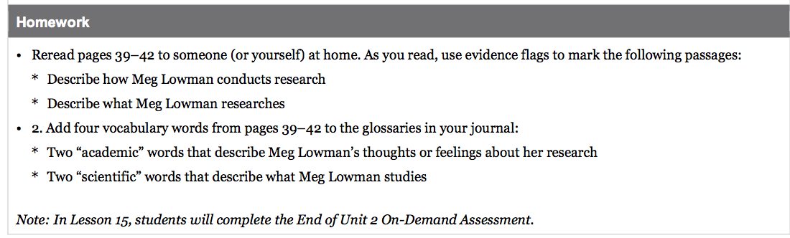
Homework

