Slide 1
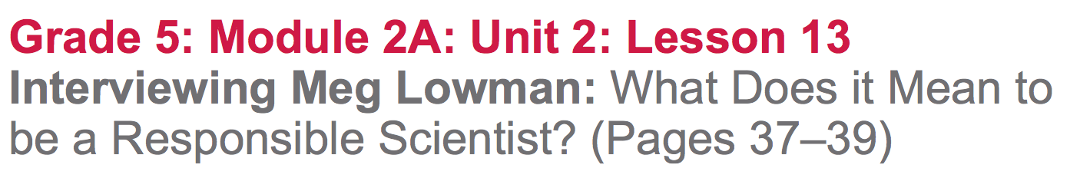

Slide 2
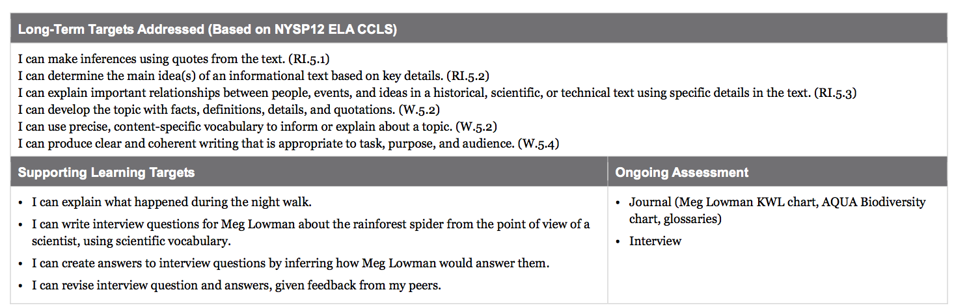

Slide 3
Opening
Reviewing Homework and Engaging the Reader (5 mins)

Slide 4
Take out your journals and share with a partner your homework from lesson 12:
One thing you added to each of the Meg Lowman KWL and AQUA charts
An academic and scientific word you selected to add to your glossaries
Why you chose those words.

Slide 5
Today you are going to write interview questions and answers from the perspective of scientists. Let’s think about the interviews with scientists we have read during this module.
What do you remember?
What is the purpose of interviewing a scientist?

Slide 6
Work Time
Read-aloud and Rereading: The Night Walk (15 mins)
Join your reading groups

Slide 7
Learning Target
“I can explain what happened during the night walk.”
What does it mean to explain?

Slide 8
To learn more about Meg Lowman’s research in the rainforest, we are going to read about a night walk Meg Lowman went on with her sons James and Edward.
Turn to page 37 in The Most Beautiful Roof in the World
Follow along as I read to pg 39 (“...justify the means?”

Slide 9
Now, reread this same chunk of text independently, considering this question:
What happened during the night walk?
When you’ve each finished, discuss this question with your group.

Slide 10
What strategies do you have for finding the meaning of these words?
winching:
identical:
inhabitant:
the ends justify the means:
pulling in; cranking
exactly the same
one who lives there; occupant
An expression meaning: “If you do something bad to accomplish something good, then it can sometimes be okay.”

Slide 11
B. Write a Short Interview with Meg Lowman (20 mins)
“I can write interview questions for Meg Lowman about the rainforest spider from the point of view of a scientist, using scientific vocabulary.”
“I can create answers to interview questions by inferring how Meg Lowman would answer them.

Slide 12
Now, working in pairs, you will create interview questions for Meg Lowman. Pretend that you are Eve Nilson, the teenage scientist we read about in Unit 1. What questions would you want to ask Dr. Lowman?
Writing from the point of view of a scientist like Eve Nilson helps us to think more deeply about why and how scientists conduct research.

Slide 13
With your partner, reread the first four sentences of paragraph 5 on page 39, starting with “Meg has an answer…” through “...good scientist.”

Slide 14
Think about...
What are some questions a young scientist like Eve Nilson might want to ask expert scientist Meg Lowman about her research on the slingshot spider?
Brainstorm with your partner potential interview questions.

Slide 15
What makes a good interview question?
asks for specific details
gets at why Meg Lowman researches
why she uses certain methods
helps us understand what makes her a “good” scientist
helps us find out more about what she researches
will use scientific and academic vocabulary

Slide 16
You will need to work with your partner to create four interview questions that Eve Nilson might ask Meg Lowman about her research of the slingshot spider. Include one question that specifically asks Dr. Lowman to justify why she took the slingshot spider to study.
Write your questions and answers on one shared page.

Slide 17
Next, you need to work with your partner to write answers from the point of view of Meg Lowman. You will need to infer what Meg Lowman’s answers would be, based on what you have read.

Slide 18
C. Critique and Feedback (15 mins)
“I can revise interview questions and answers given feedback from my peers.”
What does revise mean? How about feedback?
“Revising work based on specific feedback helps us to improve our writing skills.”

Slide 19
You’re going to join another pair. Each pair will have 2 minutes to share with the other pair just one question and answer for which they most want feedback.
One student reads the role of “Eve Nilson”
One partner reads the role of Dr. Lowman
The other pair will use the Praise-Question-Suggest protocol to offer feedback

Slide 20
Praise-Question-Suggest Protocol
After you read your peers’ questions and answers, you will need to offer one praise, ask one question about the interview, and make one suggestion for revision.

Slide 21
You’ll now have a few minutes to revise your interview questions and answers based on the feedback you received.

Slide 22
What feedback did you find most useful?
How did your revisions improve your writing?
How did writing questions and answers from scientists’ point of view help us to understand more about Meg Lowman’s research?

Slide 23
Closing and Assessment
Debrief (5 mins)
What did you learn about Meg Lowman? Add these ideas to the L column of the KWL chart.

Slide 24
Review Learning Targets
Fist to Five

Slide 25
