Slide 1
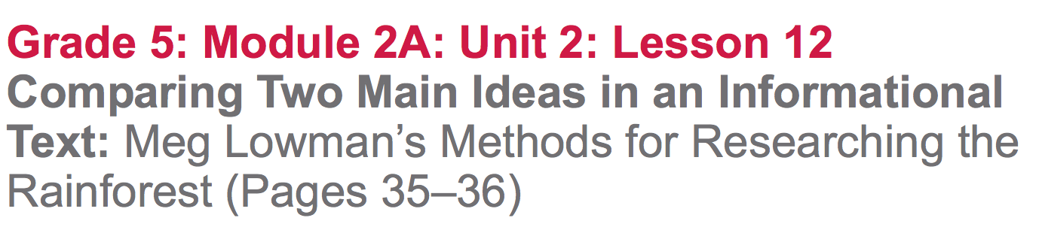

Slide 2
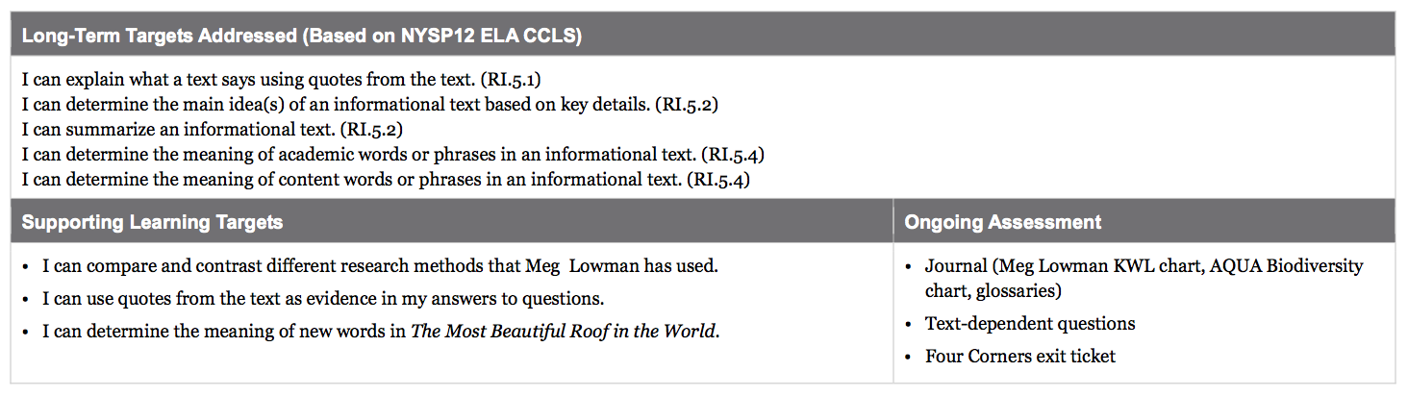

Slide 3
Opening
Reviewing Homework and Engaging the Reader (10 mins)

Slide 4
Take out your journals and share with a partner your homework from lesson 11:
examples of biodiversity that they noted in the poem
The vocabulary words you chose
What you think the word means
The context clues used to make these .

Slide 5
We have read a great deal about Meg Lowman’s research in the Blue Creek rainforest of Belize, but that is not the only place Meg Lowman conducts her studies. She also travels to different rainforests, found in other parts of the world. Today, we are going to read about how she conducts her research in two other locations, Cameroon and Panama.

Slide 6
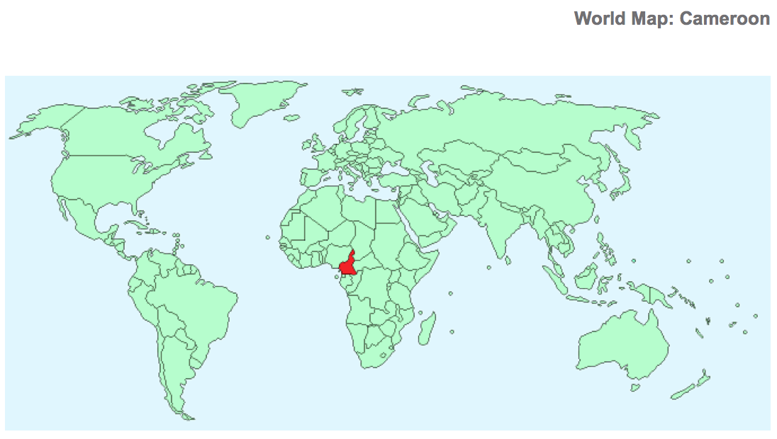
Is Cameroon a place you would expect to find a rainforest? Why or why not?
What do you remember reading about the rainforest in Panama during Unit 1 of this module?
Panama
Cameroon

Slide 7
Work Time
Guided Practice and Discussion: Comparing and Contrasting Research Methods
(20 mins)

Slide 8
Join your reading groups.
“I can compare and contrast different research methods that Meg Lowman has used.”
What does compare mean? Contrast?
What do you think methods means?

Slide 9
Turn to page 35 of The Most Beautiful Roof in the World. It begins with, “In Cameroon there…”
As I read the pages aloud, think about the following question:
How does Meg Lowman’s research in Cameroon and Panama compare or contrast to her work in Blue Creek?

Slide 10
Take a few minutes to think on your own and then discuss the question with your group.
You will now read small chunks of the text on your own.
Your purpose is to look for the details that describe the research methods that Meg Lowman uses in Cameroon and Panama

Slide 11
(3-4 mins)
Read paragraph 1 on page 35 (“In Cameroon…” through ...canopy itself.”
Discuss:
How did Meg Lowman conduct her research in Cameroon?

Slide 12
(3-4 mins)
Now, read the last paragraph on page 36 “In Panama…” through “..different canopy trees.”
Discuss:
How did Meg Lowman conduct her research in Panama?

Slide 13
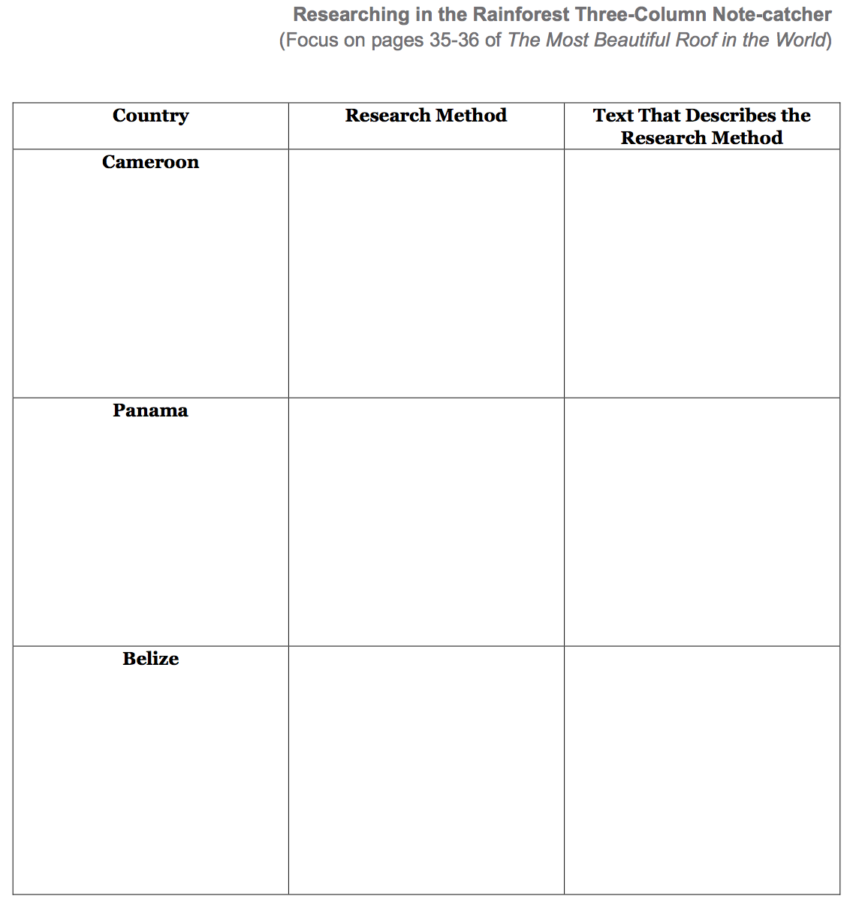
You will each receive on note-catcher, plus one for the group to fill out collectively.
Work together to fill out your own and also work together to fill out the group form.
*Look back at pgs 14-15 as well

Slide 14
Now that you’ve examined the text more closely:
How is Meg Lowman’s research in Cameroon and Panama different or similar to her work in the Blue Creek rainforest of Belize?

Slide 15
B. Group Read: Text-Dependent Questions (15 mins)
“I can use quotes from the text as evidence in my answers to questions.”
What do we mean by “quotes from the text”?

Slide 16
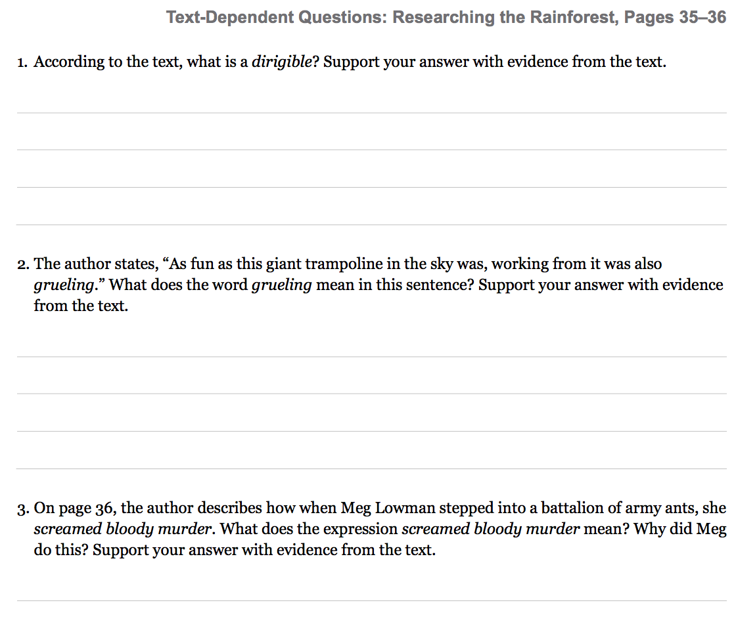
Read through the questions as a group and work together to answer them from pages 35-36

Slide 17
C. New Vocabulary Work: Key Vocabulary to Deepen Understanding (10 mins)
“I can determine the meaning of new words in The Most Beautiful Roof in the World.”
What are some strategies that we use to determine the meaning of new words?

Slide 18
Charades
We are going to play a game of charades. Each member of the group will choose a word from the list to silently perform for their group members to guess. Each member of the group should get a turn to act out at least one word.

Slide 19
immense:
inflatable:
dirigible:
pontoons:
numerous:
qualities:
consumed:
grueling:
lurked:
gondola:
huge; enormous
can be filled with air
blimp; airship
floating supports
many; a large number of
characteristics; traits
eaten; used up
difficult; terrible; hard
lay in wait; prowled
cable car; wide mouthed traveling container

Slide 20
steer:
linked:
thorough:
guide; turn; maneuver
connected; joined
careful; systematic; detailed

Slide 21
Closing and Assessment
Debrief: Four Corners (5 minutes)
I’ve posted the Four Corners sheets in different areas of the room.

Slide 22
You have read about the ways that Meg Lowman conducts research in the rainforest. Now, you are going to ‘vote’ for your favorite method by participating in Four Corners. The four choices are:
walkways, staples, floating raft, or crane
Move to your corner now.

Slide 23
Why did you choose this as your favorite method of research?

Slide 24
