Slide 1
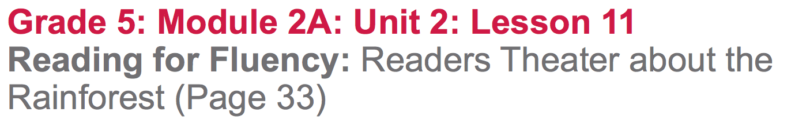

Slide 2
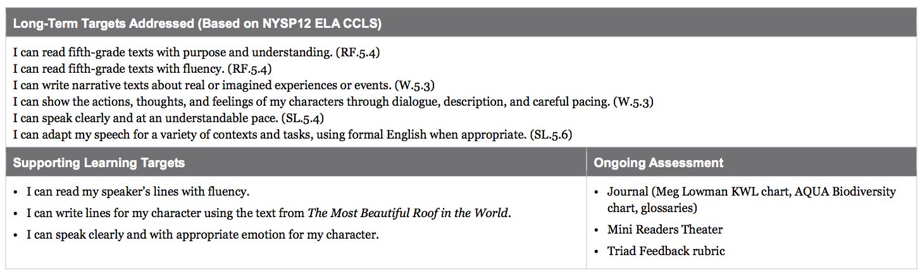

Slide 3
Reviewing Homework and Engaging the Reader (10 mins)
Take out your journals and share your thoughts on Meg Lowman’s sons’ first ascent to the canopy. Also, share one new vocabulary word that you added to your glossary.

Slide 4
Now, you are going to read a poem aloud with a partner. This poem will help you think more about what Meg Lowman’s life as a rainforest scientist is like. It also allows you the opportunity to practice reading aloud with a partner, as you will do with interview questions you create later in the lesson.

Slide 5
Learning Target
“I can read my speaker’s lines with fluency.”
Elements of reading with fluency:
tone, facial expression, pace, and volume

Slide 6
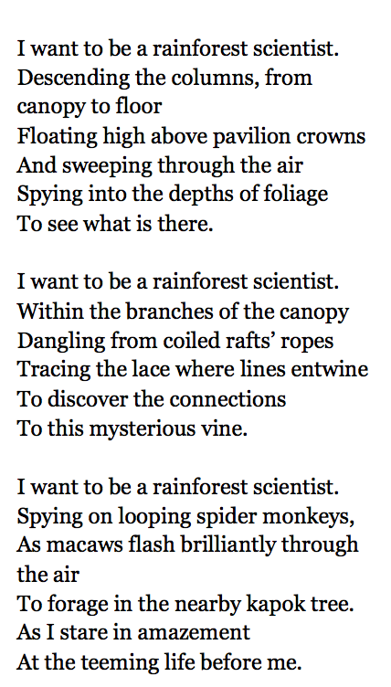
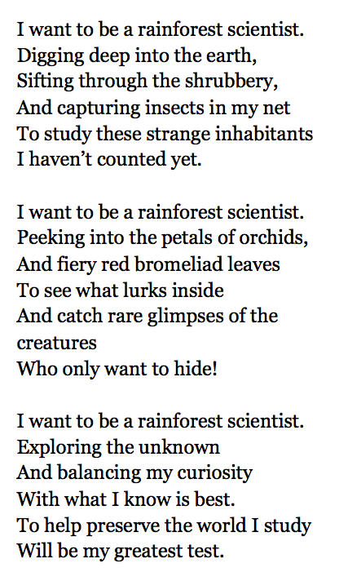
“I Want to Be a Rainforest Scientist”
Directions:
Partners will have alternating stanzas
Each partner reads his/her stanza silently, to become familiar with the text.
A pair, read the poem aloud, alternating stanzas.
Pay attention to how you read with fluency.
After you’ve read the poem aloud once, talk with your partner about one way you could each improve your fluency.

Slide 7
Review Readers Theater (10 mins)
Think about the Readers Theater that you participated in during Unit 3 of Module 1 about Esperanza Rising.
What does a Readers Theater script need to include and what are its components?

Slide 8
Readers Theater Elements
Speaking parts
narrator
dialogue
lines

Slide 9
What is the process for writing a Readers Theater script?
Narrow the dialogue
Choose only a few lines and quotes from the text
Script has a narrator introduction that tells where the scene takes place
the lines clearly name each character
Lines in an order that makes sense
Several character and narrator lines in the script

Slide 10
Today, you are going to create a mini Readers Theater script from page 33 of The Most Beautiful Roof in the World

Slide 11
B. Create Mini Readers Theater Scripts (20 mins)
“I can write lines for my speaker using the text from The Most Beautiful Roof in the World
What is meant by a “speaker”?
What is meant by “lines”?
A character with a speaking part in a book or play
Words the characters say

Slide 12
Page 33
Turn to page 33 in The Most Beautiful Roof in the World.
Pay attention to who is speaking on this page as I read it aloud.

Slide 13
Talk to your group...
Who was speaking on this page?
How could you tell?

Slide 14
You are now going to work in your reading groups to write a short Readers Theater script from page 33 of your book.
You will have to work quickly, and it is fine if the script isn’t perfect because the main purpose is to take a closer look at what it’s like to research in the rainforest.

Slide 15
Requirements
You script will have 3 character, and you must decide who will play each part.
Meg Lowman
James (one of Meg Lowman’s sons)
Narrator

Slide 16
Let’s take a look at the rubric that we’ll be using. Remember, you used all of these criteria during Module 1.

Slide 17
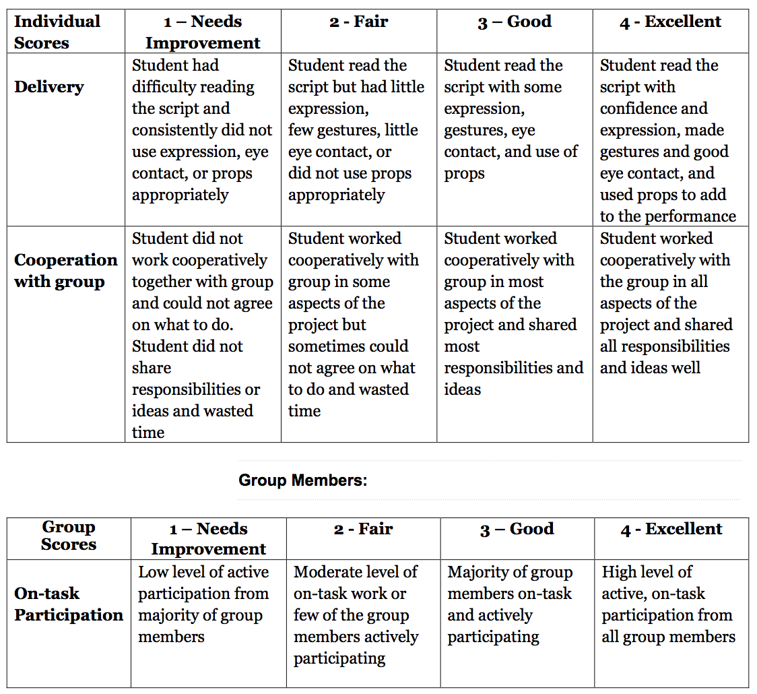
Main focus for today

Slide 18
I’m going to pass out sticky notes to each group so you can do the following:
Read through page 33 on your own
Put a sticky note to mark your individual lines of dialogue or narration
Work together to write one script using the line of text you identified.
Highlight your individual character lines

Slide 19
C. Performance and Feedback (15 mins)
“I can read my speaker’s lines with fluency”
“I can speak clearly and with appropriate emotion for my character.”
What does the second learning target mean?

Slide 20
Practice
Take a few minutes with your group to practice reading your scripts. Give each other feedback as you practice based on:
How clearly they are speaking
Use of facial expressions that match what the speaker says

Slide 21
Perform
You are now going to perform your scripts for another group. After a group performs, you will give feedback based on:
Speaking clearly
Using appropriate facial expressions

Slide 22
How did creating a Readers Theater script of page 33 in The Most Beautiful Roof in the World help us learn more about the rainforest?

Slide 23
Closing and Assessment
Debrief (5 mins)
Let’s look at our AQUA Biodiversity anchor chart.
What did you read about on page 33 about the rainforest that can be added to the U column of our AQUA chart?

Slide 24
Red light, Green light
Take out your red, yellow, and green sticks to use during the review of learning targets.

Slide 25
