Slide 1
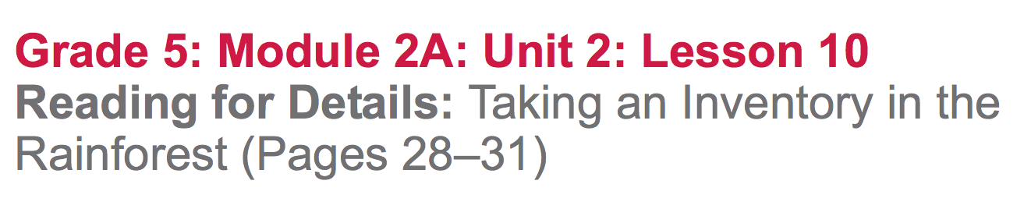

Slide 2
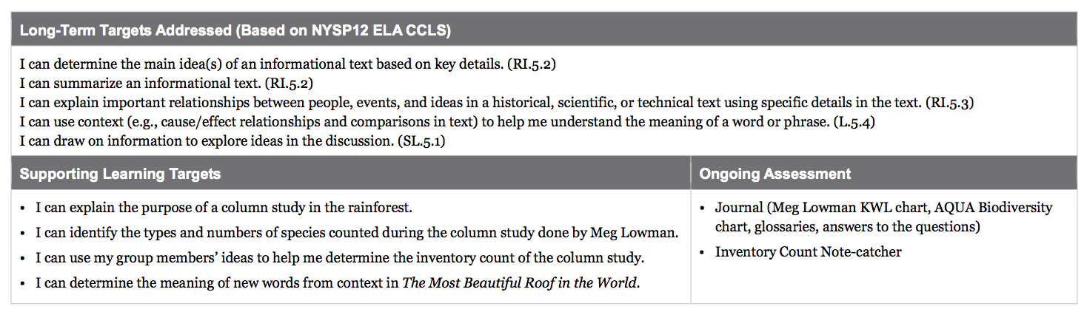

Slide 3
Opening
Reviewing Homework and Engaging the Reader (5 mins)

Slide 4
Take out your materials and join your reading groups.
Share out one new thing that you learned by rereading “The Wings of the Butterfly” that can be added to the AQUA Biodiversity anchor chart.

Slide 5
Choose one example of biodiversity from your charts to perform or act out silently for your group members to guess.

Slide 6
Work Time
Guided Practice and Discussion: What is a column study (15 mins)

Slide 7
Learning Target
“I can explain the purpose of a column study in the rainforest.”
What does the word purpose mean?

Slide 8
Turn to page 28 in The Most Beautiful Roof in the World with the sentence that begins: “Meg and her sons…”
Follow along as I read aloud.
(stop at “...starting from the ground up.”

Slide 9
What do you think it means to inventory something?
to count (verb); a list of things that have been counted (noun).
What is the gist of this page?

Slide 10
What do you think a column is?
Something that goes from bottom to top or top to bottom; like a post or a pillar
Look at the third (last) paragraph on page 28, beginning: “The boys help their mom…”. Read this paragraph independently to answer these questions:
What is a column study?
Why does Meg Lowman do column studies?

Slide 11
Journal
After sharing out…
On a new page, write a response to the two questions:
What is a column study?
Why does Meg Lowman do column studies?

Slide 12
B. Rereading and Taking Notes: Taking an Inventory (20 mins)
“I can identify the types and numbers of species counted during the column study done by Meg Lowman.”
What do you remember about the meaning of the word identify?

Slide 13
I’m going to reread page 31, paragraph 3 (“The sweeps, the beating trays…”. As you follow along, pay close attention to:
what Meg Lowman did during her column study and why.

Slide 14
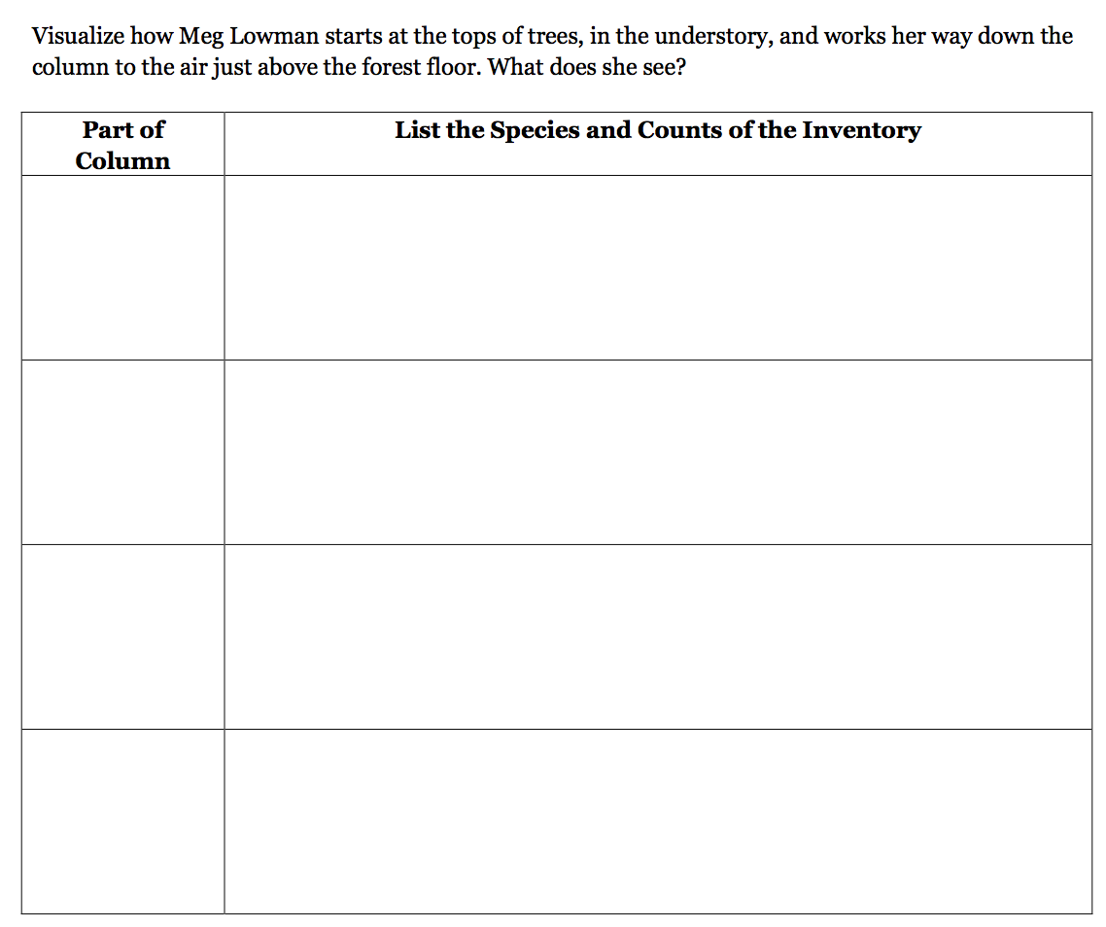
You will work with your groups to read page 29, starting with “There have been many methods…” through the end of the third paragraph on page 31(...snapshots of diverse rainforest life.”
You will work with your group to determine the inventory count of the column study.
Inventory is used as a noun here...what does it mean?

Slide 15
C. Key Vocabulary to Deepen Understanding (10 mins)
“I can determine the meaning of new words in context in The Most Beautiful Roof in the World
What does this target mean in YOUR own words?

Slide 16
Word Sort
Remember the word sort activity that we’ve done?
What do we do with the words during this activity?

Slide 17
WHAT Meg Lowman studies in the rainforest
HOW Meg Lowman studies in the rainforest
column, biological, biodiversity, situated, inventory, portion, emerge, estimates, sweeps
Make sure to justify your choice!
This means explaining to your group why you think a word belongs in a particular category.

Slide 18
column:
biodiversity:
situated:
to inventory(v):
inventory(n):
portion:
emerge:
estimates:
set of sweeps:
a post; pillar; pole; or a shape like a post, pillar, or pole.
various and different living things that are found in the same community
positioned; placed
to list; to count; to record
supply; account; record
piece; select area
appear; come out
close guesses; educated guesses
a technique for sampling insects; using a net to capture insects
in the air.

Slide 19
Closing and Assessment
Debrief (5 mins)
Let’s look back at the Meg Lowman Rainforest Scientist KWL anchor chart.
What have we learned about Meg Lowman that we can add to our KWL?

Slide 20
We’re going to participate in a new activity called Red Light, Green Light, to show how close they got to mastering today’s learning targets.
Red: Didn’t get it
Yellow: Got some of it
Green: I got it!

Slide 21
I can determine the main idea of an informational text based on key details.
I can summarize an informational text.
I can use context to help me understand the meaning of a word or phrase.

Slide 22
