Slide 1





Catch the Tooth Fairy
Catch a Leprechaun
OR

Slide 2
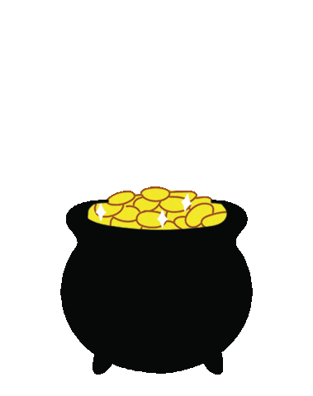

Find a Pot of Gold
Find $100
OR

Slide 3


Play in the Rain
Play in the Sun
OR

Slide 4
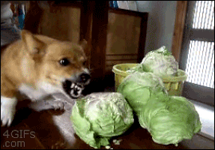
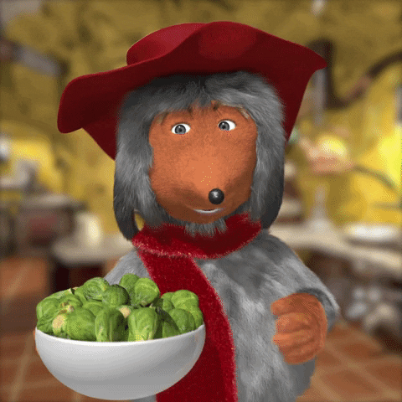
Eat Cabbage
Eat Brussle Sprouts
OR

Slide 5


Catch a Mermaid
Catch a Unicorn
OR

Slide 6

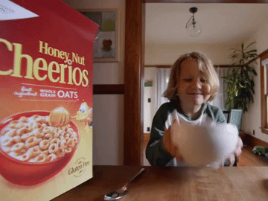
Eat Lucky Charms
Eat Cheerios
OR

Slide 7

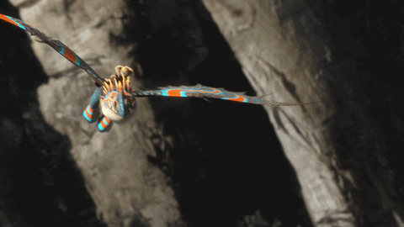
Ride a Unicorn
Ride a Dragon
OR

Slide 8

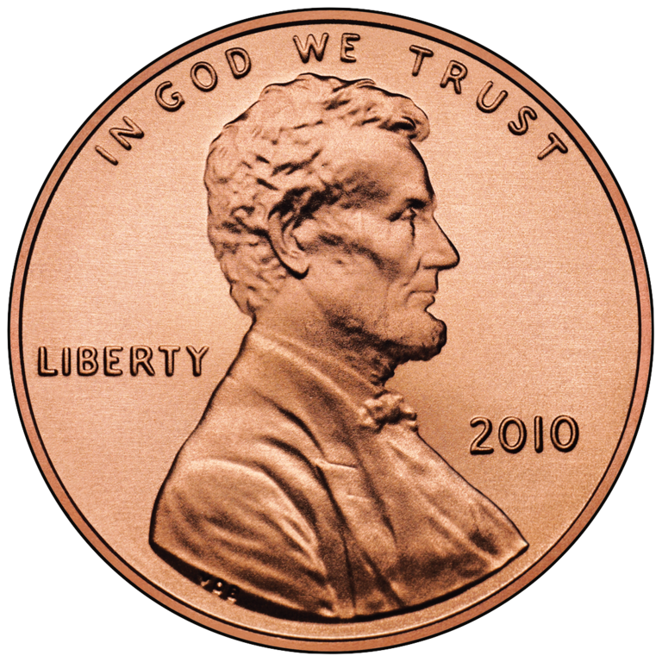
Find a 4 leaf clover
Find a lucky penny
OR

Slide 9

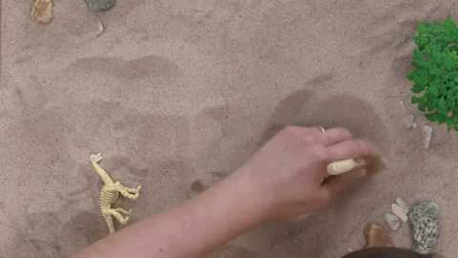
Be an Astronaut
Be a paleontologist
OR

Slide 10


Get candy from a leprechaun
Get a gold coin from a leprechaun
OR

Slide 11

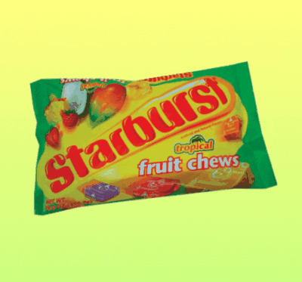
Eat Skittles
Eat Starbursts
OR

Slide 12


