Slide 1

Women’s History Month Daily
Inspiration

Slide 2
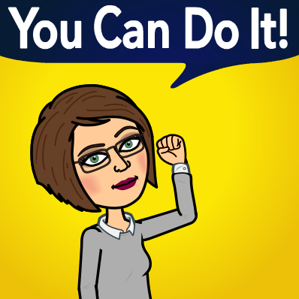
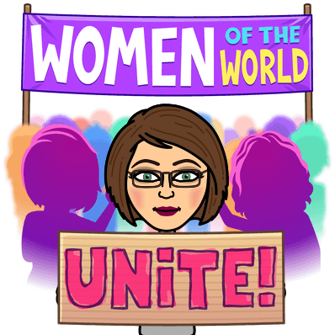
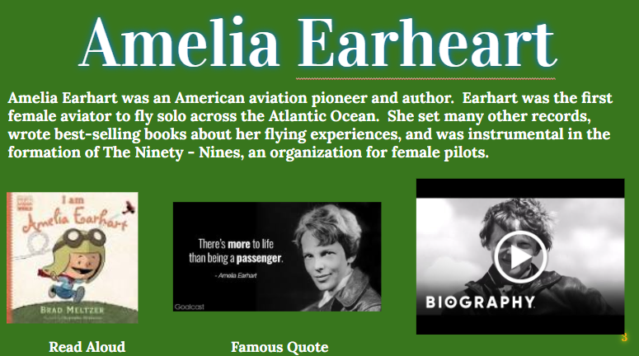
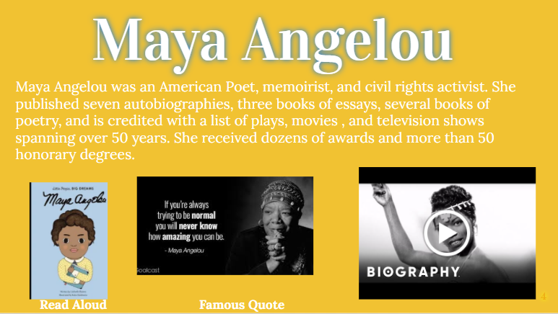
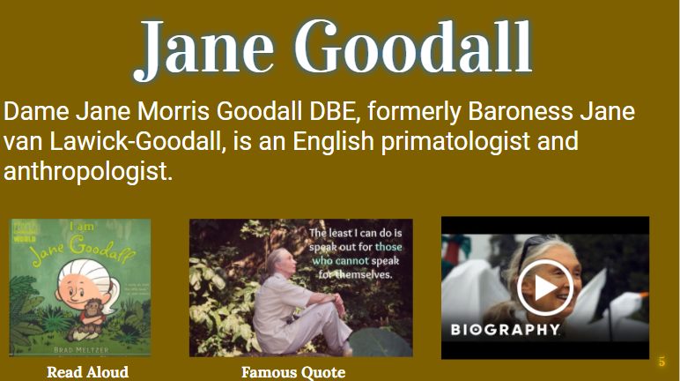
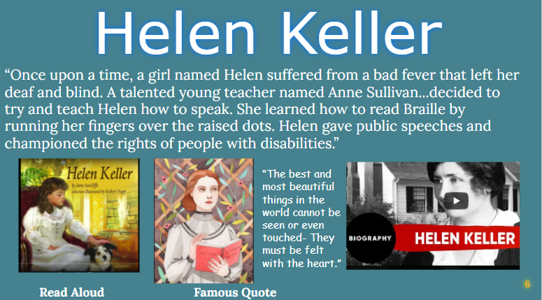
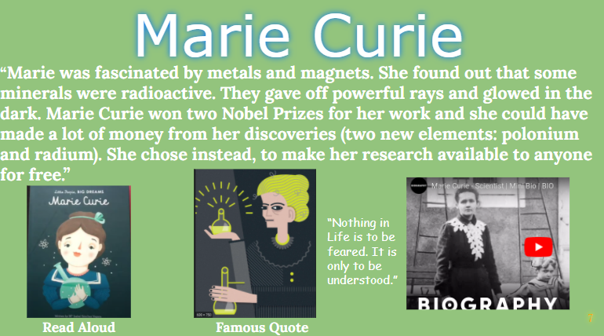
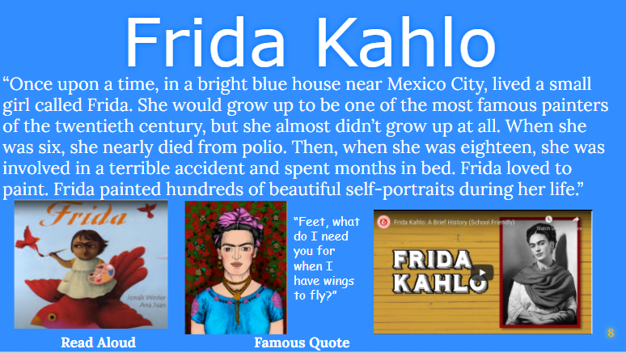
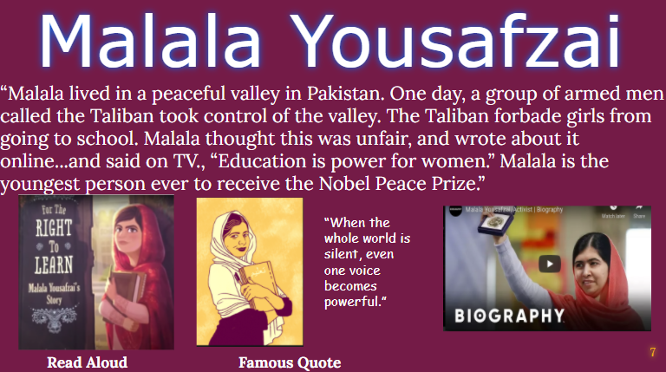
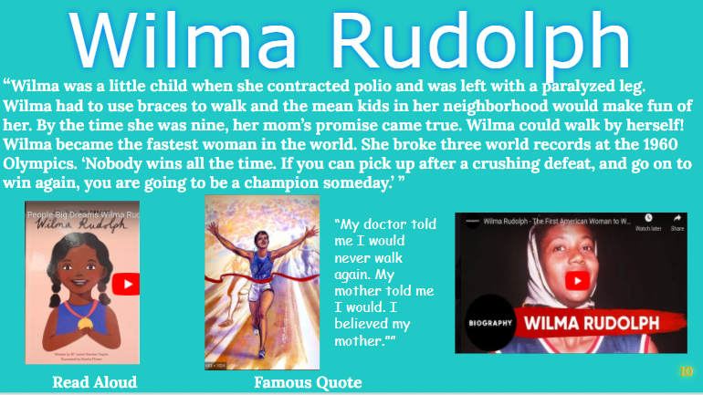
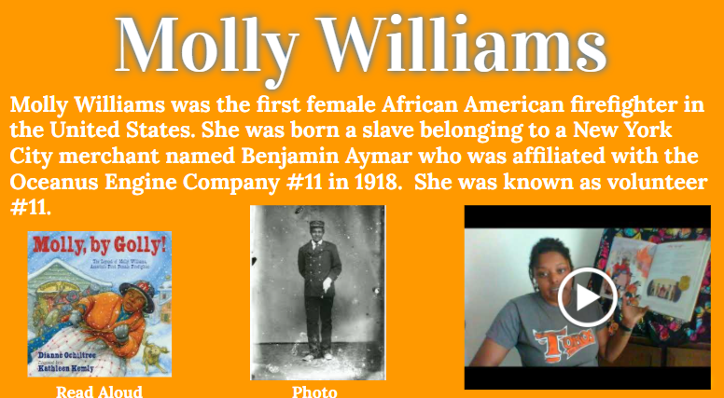
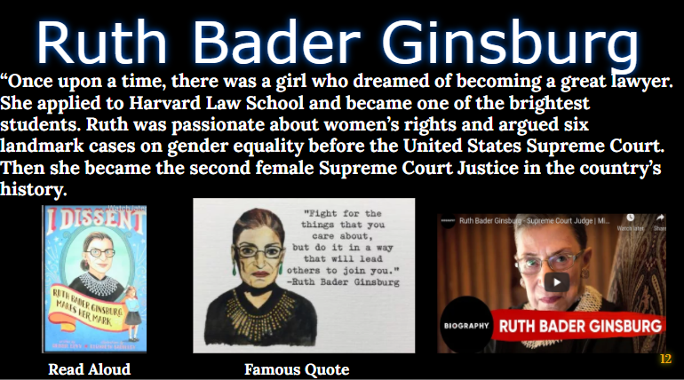
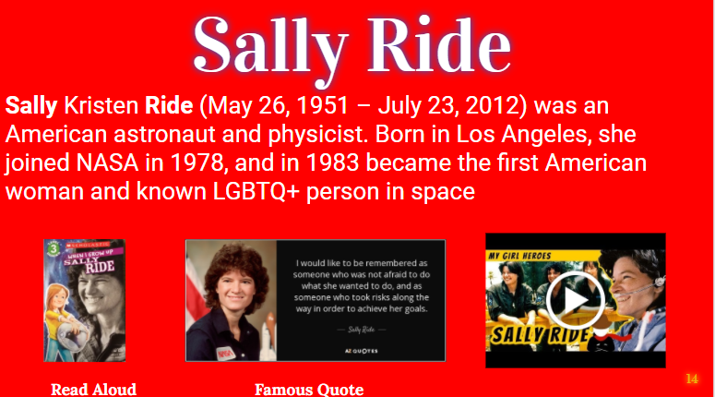
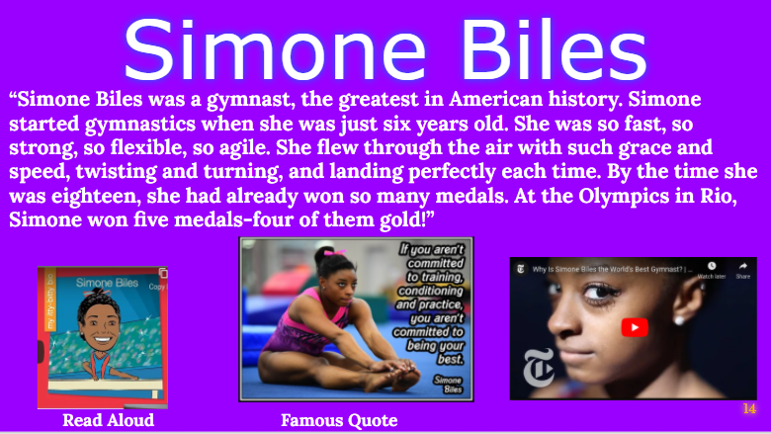
Women’s
History Month

Slide 3
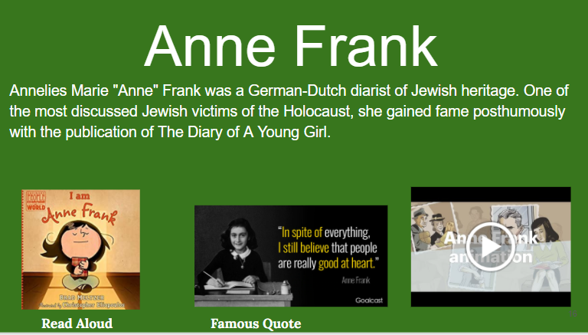
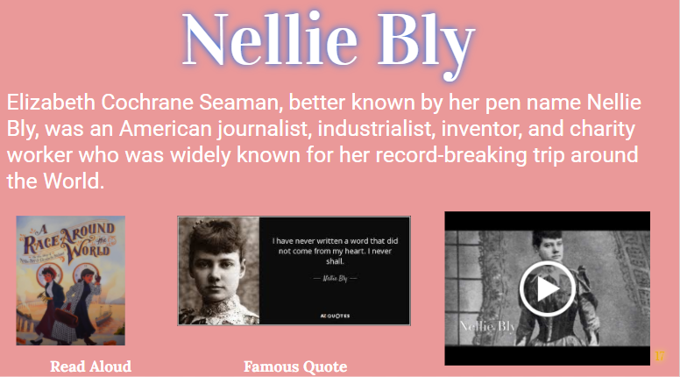
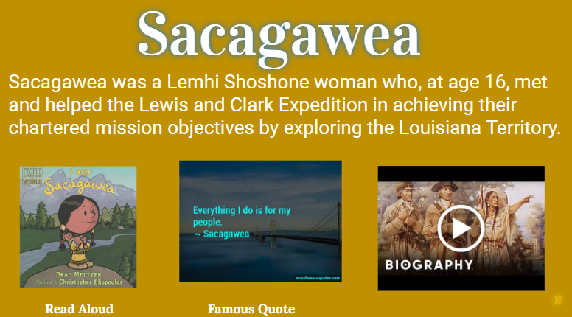
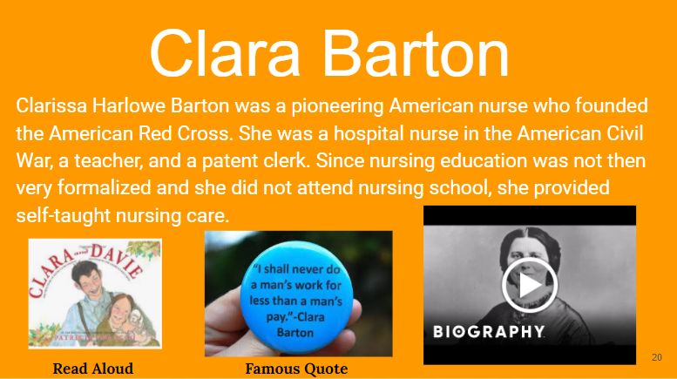
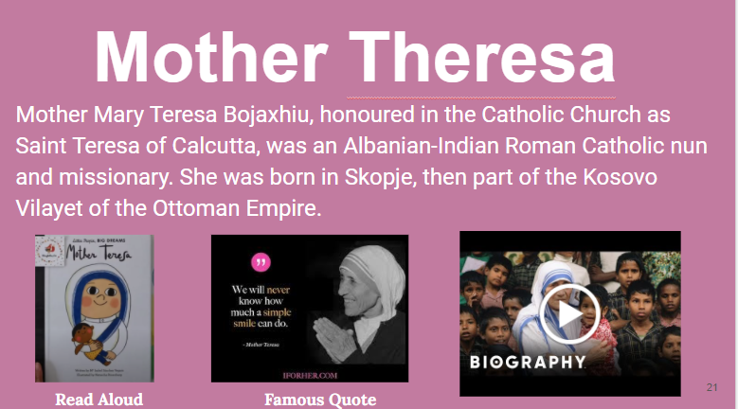
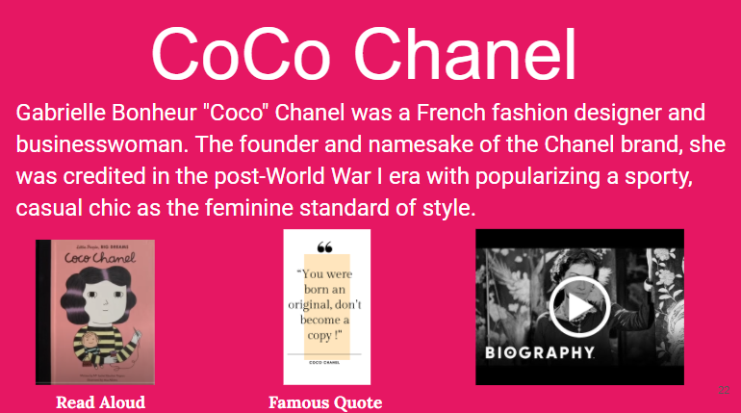
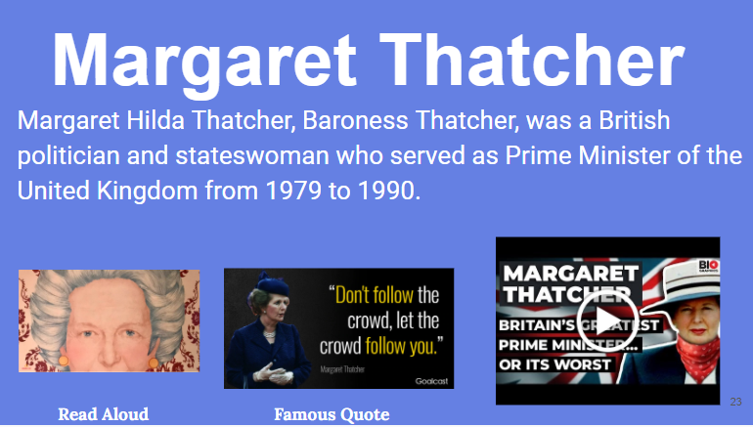
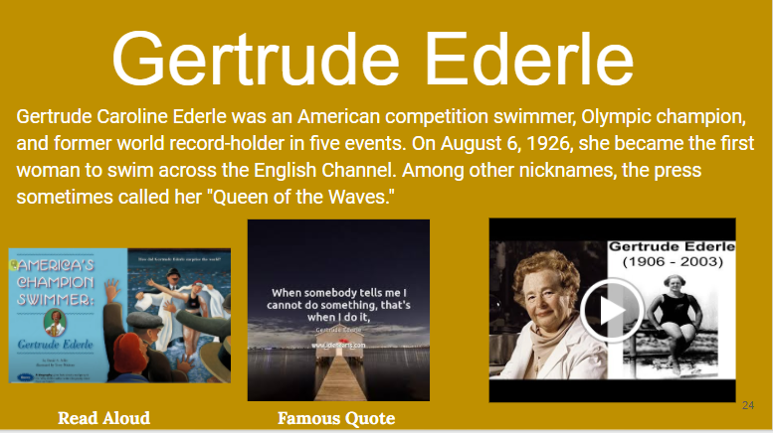
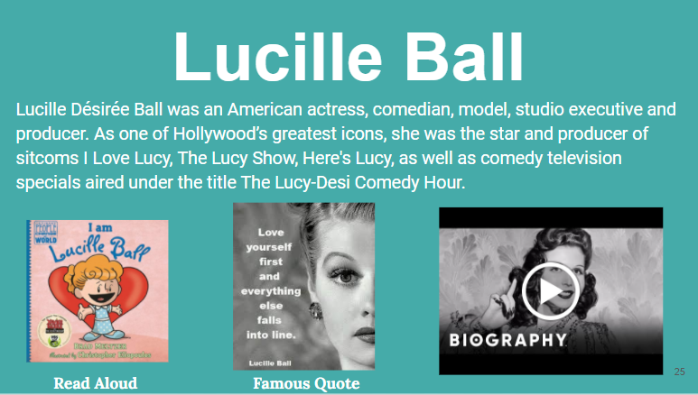
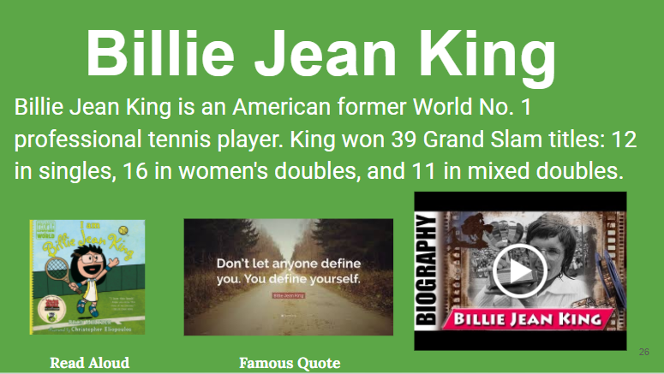
Women’s
History Month

Slide 4
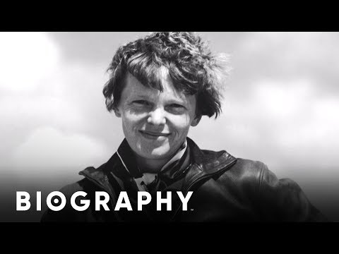

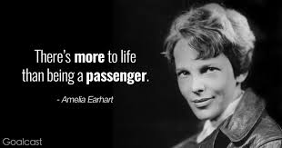
Amelia Earheart
Amelia Earhart was an American aviation pioneer and author. Earhart was the first female aviator to fly solo across the Atlantic Ocean. She set many other records, wrote best-selling books about her flying experiences, and was instrumental in the formation of The Ninety - Nines, an organization for female pilots.
Read Aloud Famous Quote

Slide 5
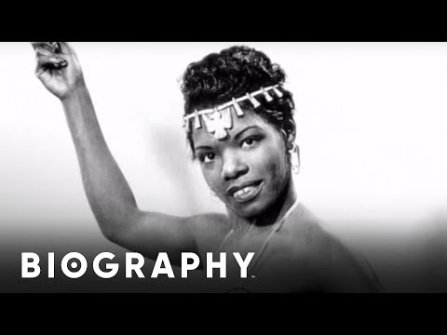

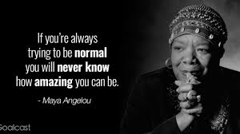
Maya Angelou
Maya Angelou was an American Poet, memoirist, and civil rights activist. She published seven autobiographies, three books of essays, several books of poetry, and is credited with a list of plays, movies , and television shows spanning over 50 years. She received dozens of awards and more than 50 honorary degrees.
Read Aloud Famous Quote

Slide 6

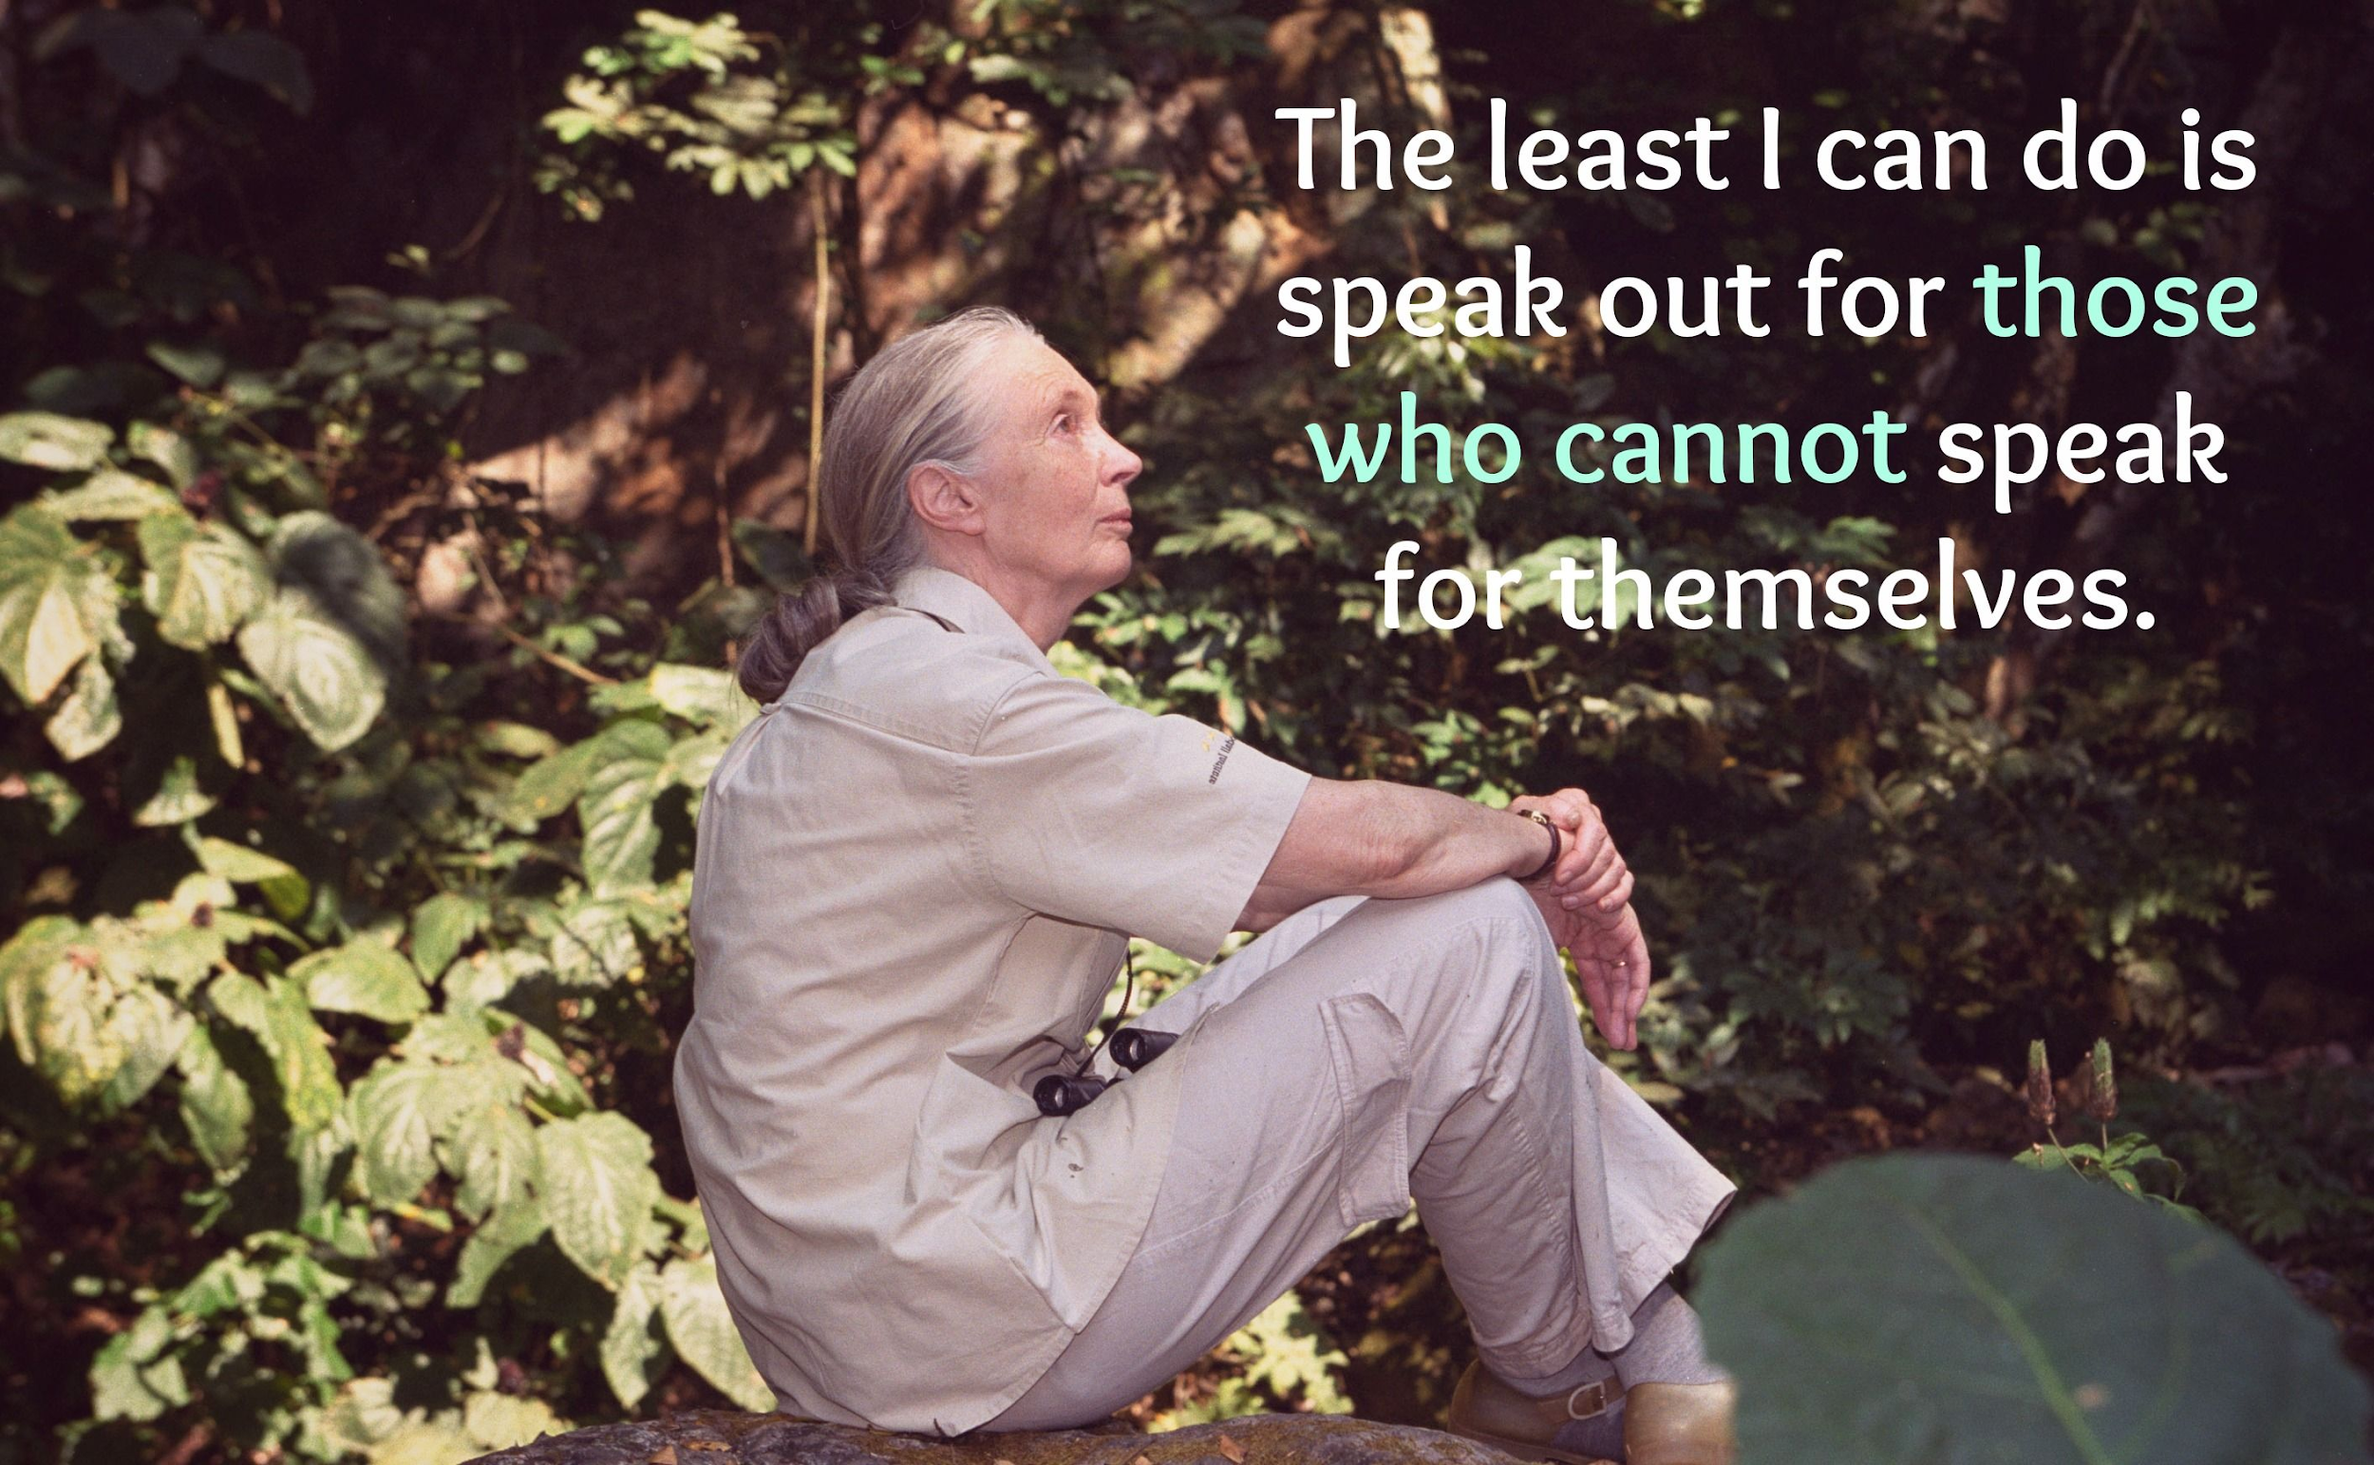
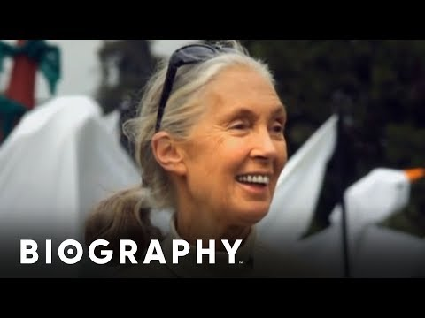
Jane Goodall
Dame Jane Morris Goodall DBE, formerly Baroness Jane van Lawick-Goodall, is an English primatologist and anthropologist.
Read Aloud Famous Quote

Slide 7
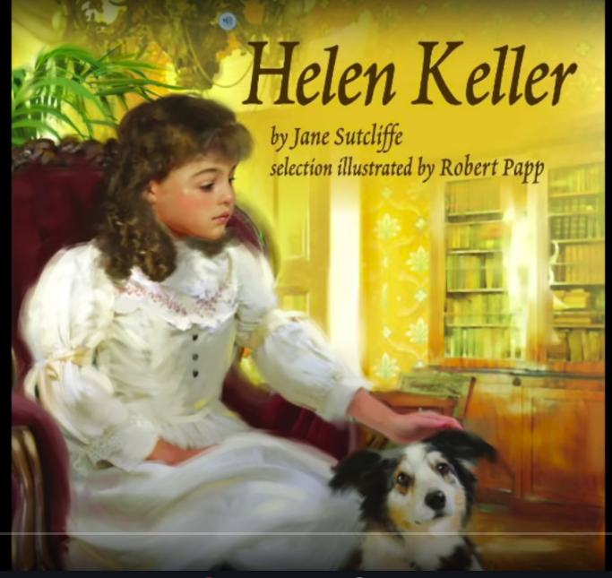
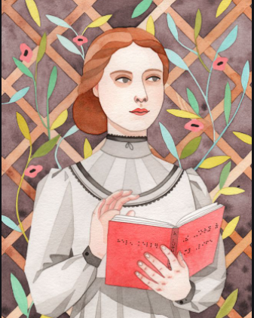
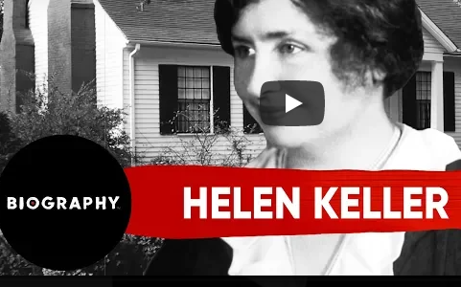
Helen Keller
“Once upon a time, a girl named Helen suffered from a bad fever that left her deaf and blind. A talented young teacher named Anne Sullivan...decided to try and teach Helen how to speak. She learned how to read Braille by running her fingers over the raised dots. Helen gave public speeches and championed the rights of people with disabilities.”
“The best and most beautiful things in the world cannot be seen or even touched- They must be felt with the heart.”
Read Aloud Famous Quote

Slide 8
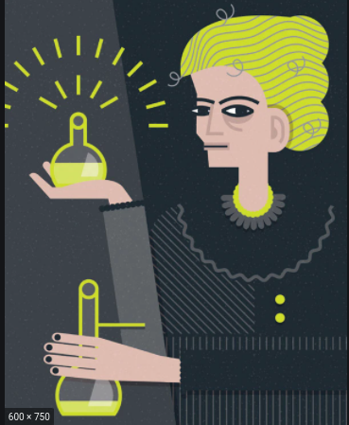
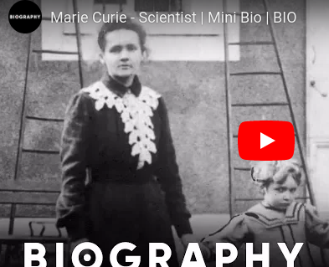
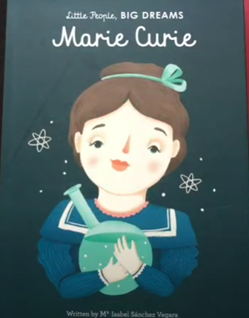
Marie Curie
“Marie was fascinated by metals and magnets. She found out that some minerals were radioactive. They gave off powerful rays and glowed in the dark. Marie Curie won two Nobel Prizes for her work and she could have made a lot of money from her discoveries (two new elements: polonium and radium). She chose instead, to make her research available to anyone for free.”
“Nothing in Life is to be feared. It is only to be understood.”
Read Aloud Famous Quote

Slide 9
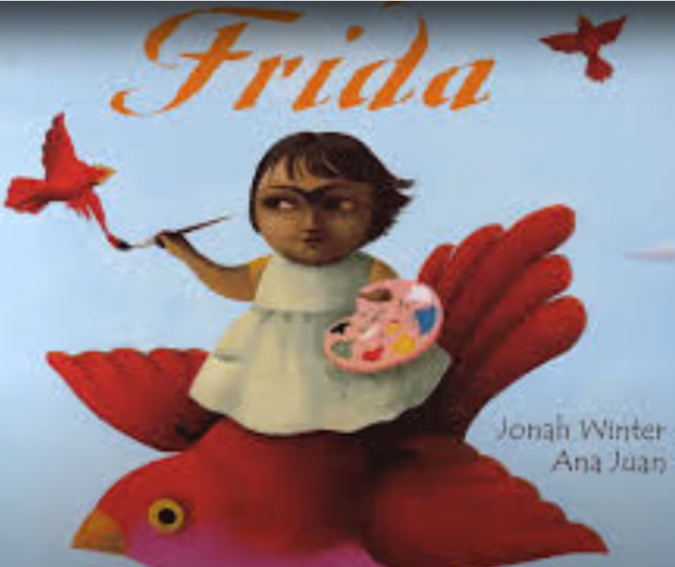
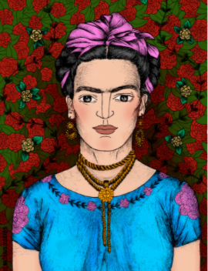
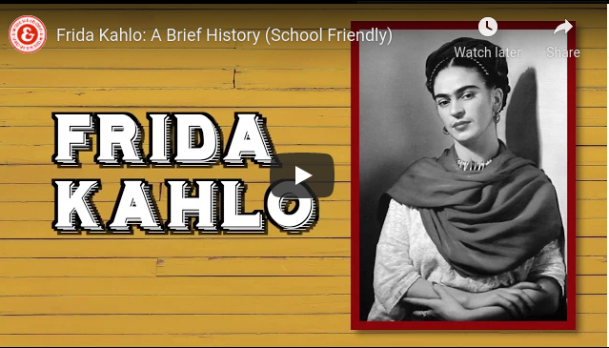
Frida Kahlo
“Once upon a time, in a bright blue house near Mexico City, lived a small girl called Frida. She would grow up to be one of the most famous painters of the twentieth century, but she almost didn’t grow up at all. When she was six, she nearly died from polio. Then, when she was eighteen, she was involved in a terrible accident and spent months in bed. Frida loved to paint. Frida painted hundreds of beautiful self-portraits during her life.”
“Feet, what do I need you for when I have wings to fly?”
Read Aloud Famous Quote

Slide 10
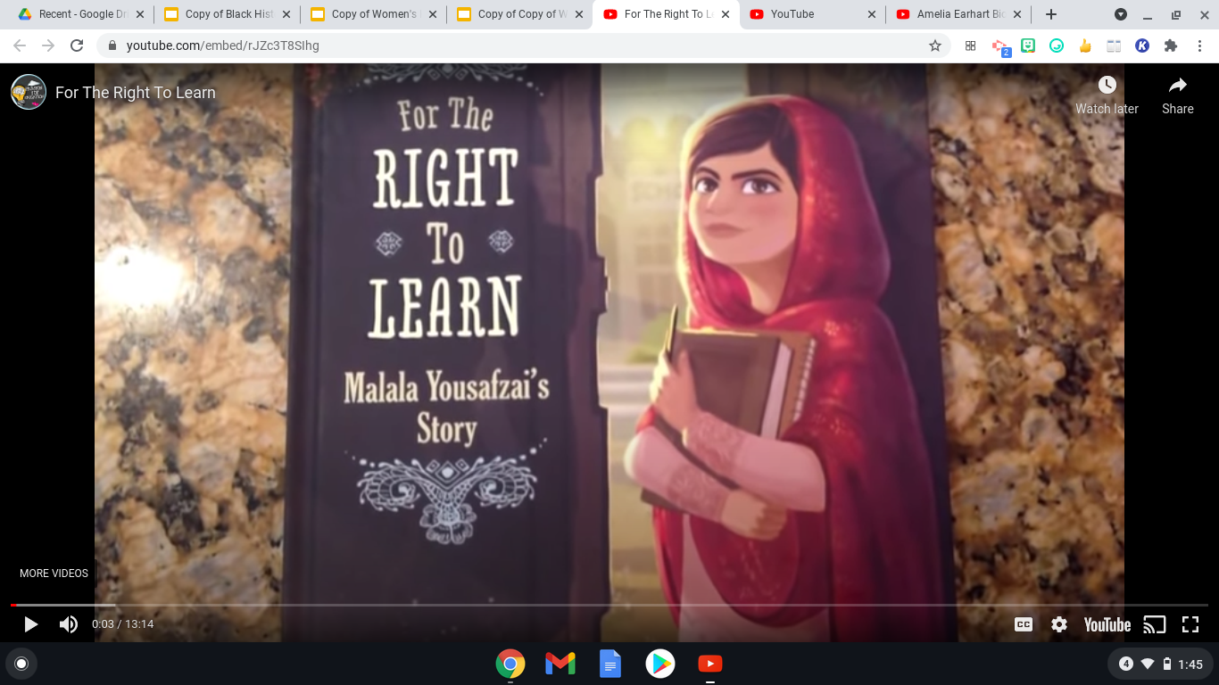
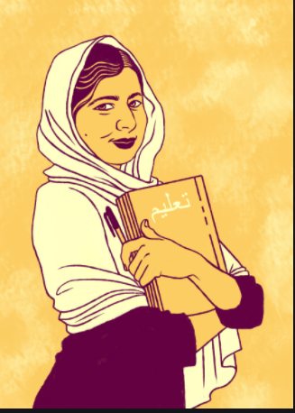
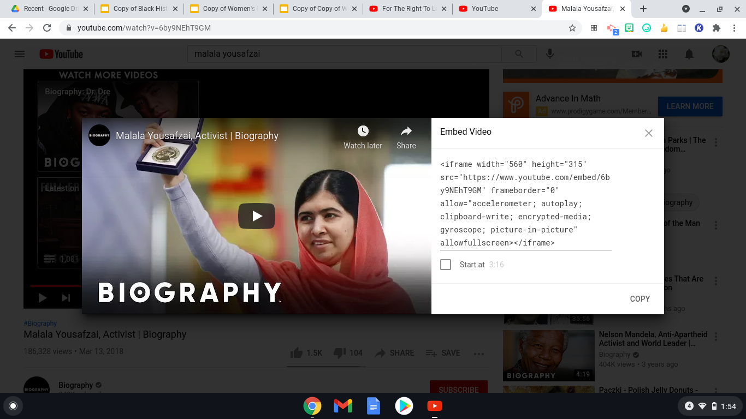
Malala Yousafzai
“Malala lived in a peaceful valley in Pakistan. One day, a group of armed men called the Taliban took control of the valley. The Taliban forbade girls from going to school. Malala thought this was unfair, and wrote about it online...and said on TV., “Education is power for women.” Malala is the youngest person ever to receive the Nobel Peace Prize.”
“When the whole world is silent, even one voice becomes powerful.”
Read Aloud Famous Quote

Slide 11
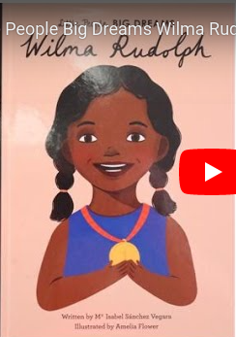
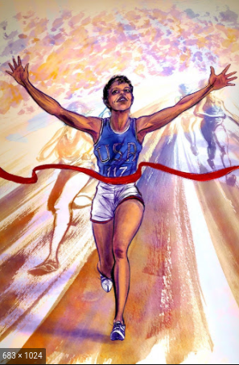
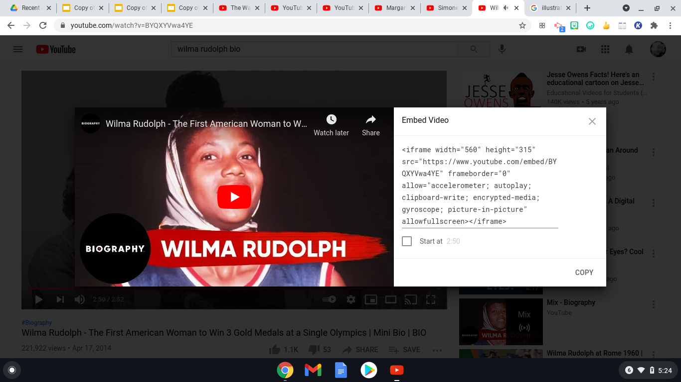
Wilma Rudolph
“Wilma was a little child when she contracted polio and was left with a paralyzed leg. Wilma had to use braces to walk and the mean kids in her neighborhood would make fun of her. By the time she was nine, her mom’s promise came true. Wilma could walk by herself! Wilma became the fastest woman in the world. She broke three world records at the 1960 Olympics. ‘Nobody wins all the time. If you can pick up after a crushing defeat, and go on to win again, you are going to be a champion someday.’ ”
“My doctor told me I would never walk again. My mother told me I would. I believed my mother.””
Read Aloud Famous Quote

Slide 12
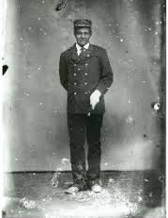
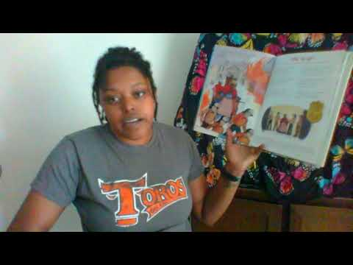
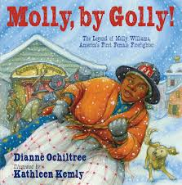
Molly Williams
Molly Williams was the first female African American firefighter in the United States. She was born a slave belonging to a New York City merchant named Benjamin Aymar who was affiliated with the Oceanus Engine Company #11 in 1918. She was known as volunteer #11.
Read Aloud Photo

Slide 13
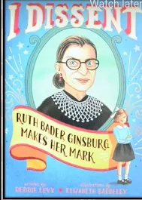
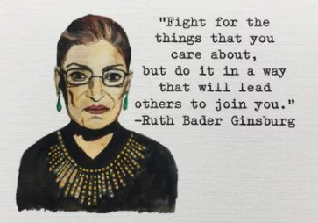

Ruth Bader Ginsburg
“Once upon a time, there was a girl who dreamed of becoming a great lawyer. She applied to Harvard Law School and became one of the brightest students. Ruth was passionate about women’s rights and argued six landmark cases on gender equality before the United States Supreme Court. Then she became the second female Supreme Court Justice in the country’s history.
Read Aloud Famous Quote

Slide 14



Simone Biles
“Simone Biles was a gymnast, the greatest in American history. Simone started gymnastics when she was just six years old. She was so fast, so strong, so flexible, so agile. She flew through the air with such grace and speed, twisting and turning, and landing perfectly each time. By the time she was eighteen, she had already won so many medals. At the Olympics in Rio, Simone won five medals-four of them gold!”
Read Aloud Famous Quote

Slide 15



Sally Ride
Sally Kristen Ride (May 26, 1951 – July 23, 2012) was an American astronaut and physicist. Born in Los Angeles, she joined NASA in 1978, and in 1983 became the first American woman and known LGBTQ+ person in space
Read Aloud Famous Quote

Slide 16



Anne Frank
Annelies Marie "Anne" Frank was a German-Dutch diarist of Jewish heritage. One of the most discussed Jewish victims of the Holocaust, she gained fame posthumously with the publication of The Diary of A Young Girl.
Read Aloud Famous Quote

Slide 17



Oprah Winfrey
Oprah Gail Winfrey is an American talk show host, television producer, actress, author, and philanthropist.
Read Aloud Famous Quote

Slide 18



Nellie Bly
Elizabeth Cochrane Seaman, better known by her pen name Nellie Bly, was an American journalist, industrialist, inventor, and charity worker who was widely known for her record-breaking trip around the World.
Read Aloud Famous Quote

Slide 19



Sacagawea
Sacagawea was a Lemhi Shoshone woman who, at age 16, met and helped the Lewis and Clark Expedition in achieving their chartered mission objectives by exploring the Louisiana Territory.
Read Aloud Famous Quote

Slide 20



Clara Barton
Clarissa Harlowe Barton was a pioneering American nurse who founded the American Red Cross. She was a hospital nurse in the American Civil War, a teacher, and a patent clerk. Since nursing education was not then very formalized and she did not attend nursing school, she provided self-taught nursing care.
Read Aloud Famous Quote

Slide 21



Mother Theresa
Mother Mary Teresa Bojaxhiu, honoured in the Catholic Church as Saint Teresa of Calcutta, was an Albanian-Indian Roman Catholic nun and missionary. She was born in Skopje, then part of the Kosovo Vilayet of the Ottoman Empire.
Read Aloud Famous Quote

Slide 22



CoCo Chanel
Gabrielle Bonheur "Coco" Chanel was a French fashion designer and businesswoman. The founder and namesake of the Chanel brand, she was credited in the post-World War I era with popularizing a sporty, casual chic as the feminine standard of style.
Read Aloud Famous Quote

Slide 23



Margaret Thatcher
Margaret Hilda Thatcher, Baroness Thatcher, was a British politician and stateswoman who served as Prime Minister of the United Kingdom from 1979 to 1990.
Read Aloud Famous Quote

Slide 24



Gertrude Ederle
Gertrude Caroline Ederle was an American competition swimmer, Olympic champion, and former world record-holder in five events. On August 6, 1926, she became the first woman to swim across the English Channel. Among other nicknames, the press sometimes called her "Queen of the Waves."
Read Aloud Famous Quote

Slide 25



Lucille Ball
Lucille Désirée Ball was an American actress, comedian, model, studio executive and producer. As one of Hollywood’s greatest icons, she was the star and producer of sitcoms I Love Lucy, The Lucy Show, Here's Lucy, as well as comedy television specials aired under the title The Lucy-Desi Comedy Hour.
Read Aloud Famous Quote

Slide 26



Billie Jean King
Billie Jean King is an American former World No. 1 professional tennis player. King won 39 Grand Slam titles: 12 in singles, 16 in women's doubles, and 11 in mixed doubles.
Read Aloud Famous Quote

