Slide 1

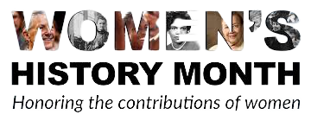
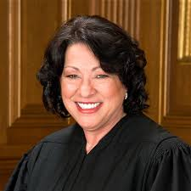
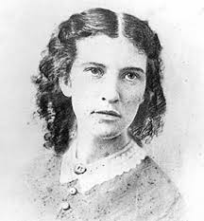
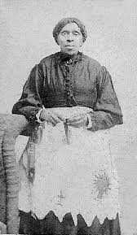
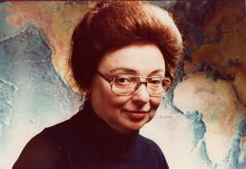
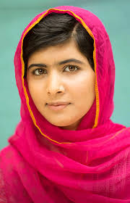
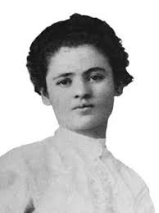
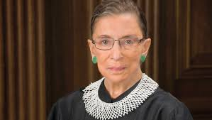
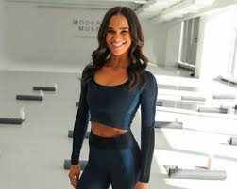
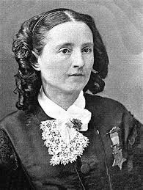
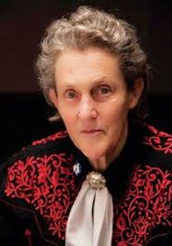
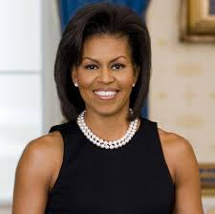
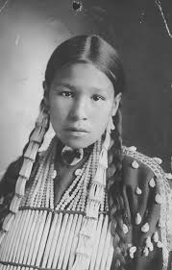
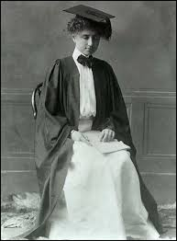
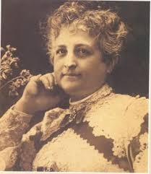
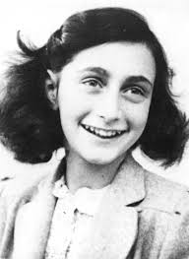
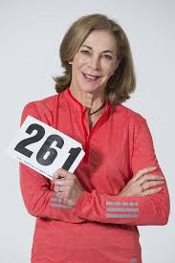
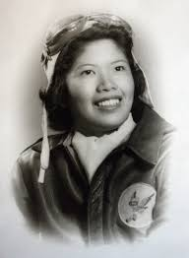
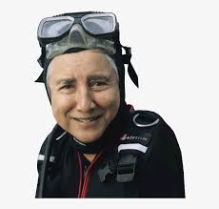
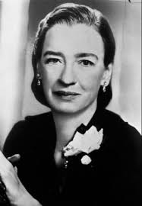
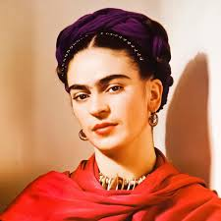
Sonia Elizabeth Harriet marie malala clara ruth misty Mary temple
Sotomayor Blackwell powers tharp yousafzai lemlich bader ginsburg copeland edwards walker Grandin
Michelle sacagawea helen teresa anne kathrine maggie eugenie grace frida
Obama keller carrena frank switzer gee clark hopper kahlo
NEXT GALLERY PAGE

Slide 2
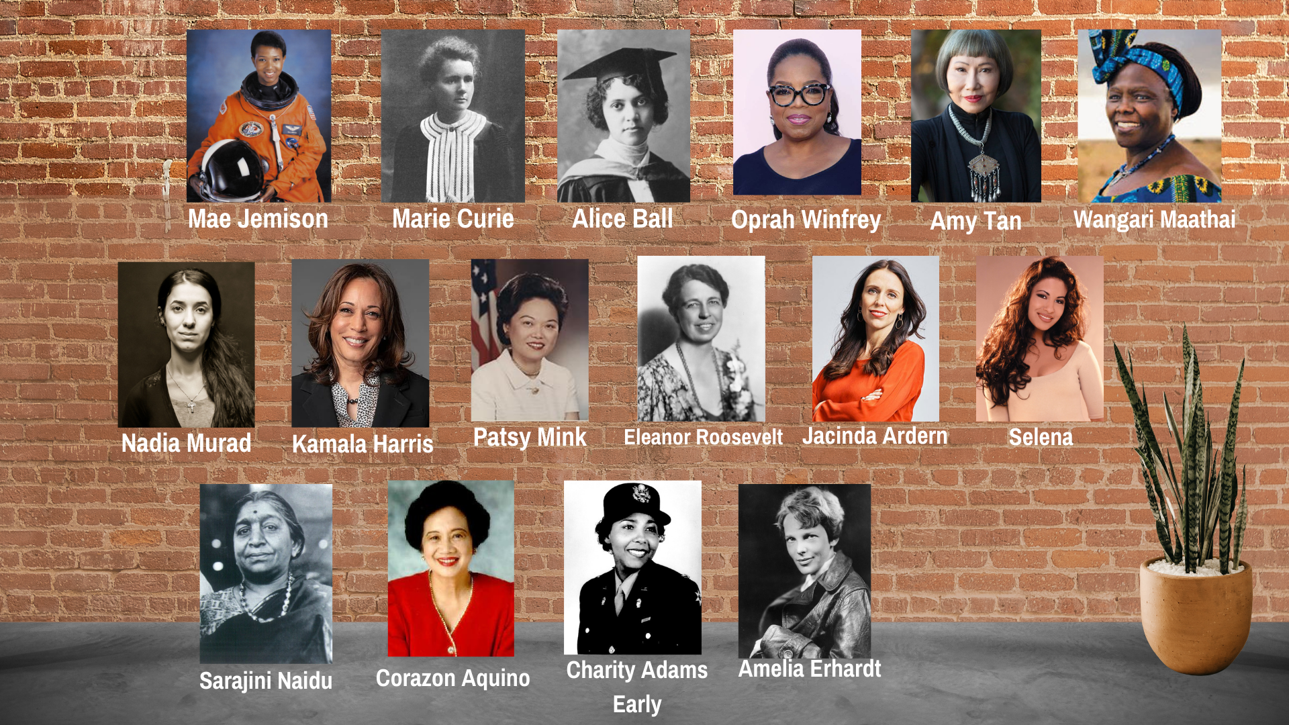
PREVIOUS GALLERY PAGE

Slide 3
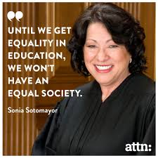
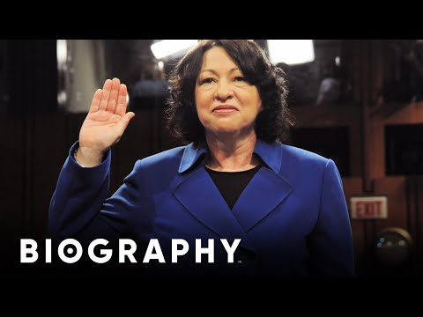


Sonia Sotomayor
Return to Gallery
Sonia Maria Sotomayor is an associate justice of the Supreme Court of the United States. She was nominated by President Barack Obama on May 26, 2009 and has served since August 8, 2009. Sotomayor is the first Hispanic and Latina member of the Court.

Slide 4

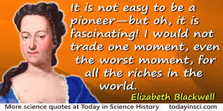
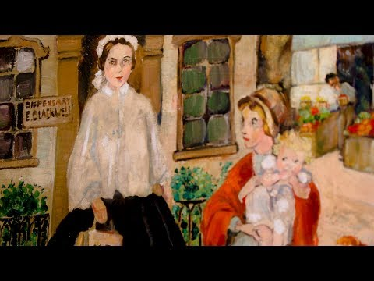
Elizabeth Blackwell
Return to Gallery
Elizabeth Blackwell was a British physician born in 1821, notable as the first woman to receive a medical degree in the United States, and the first woman on the Medical Register of the General Medical Council. Elizabeth Blackwell championed the participation of women in the medical profession and ultimately opened her own medical college for women.

Slide 5
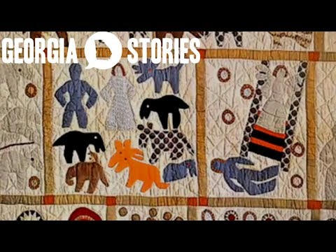
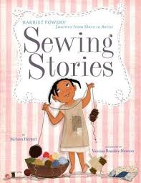
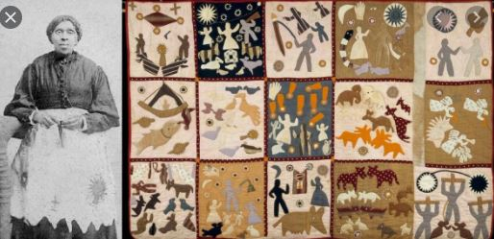
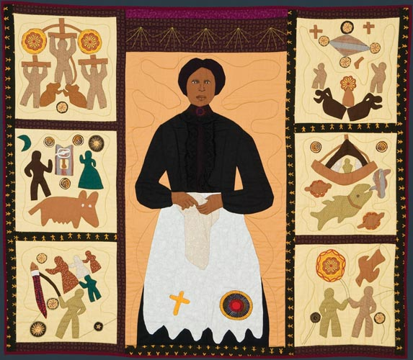
Harriet Powers
Return to Gallery
Harriet Powers was an African American folk artist and quilt maker. She was born into slavery in rural Georgia in 1837. She used traditional appliqué techniques to record local legends, Bible stories, and astronomical events on her quilts. Only two of her quilts are known to have survived: Bible Quilt 1886 and Pictorial Quilt 1898. Both of these quilts are now in museums.

Slide 6
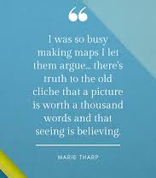
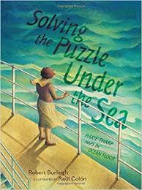
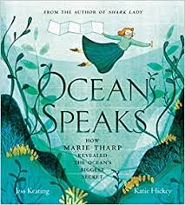
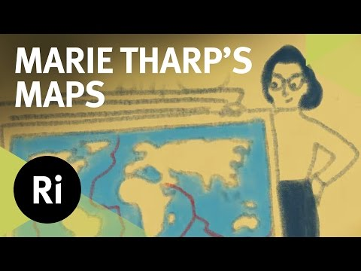
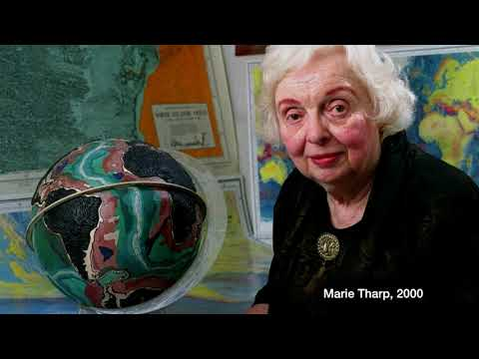
Marie Tharp
Return to Gallery
Marie Tharp, born in 1920, was an American geologist and oceanographic cartographer who, in partnership with Bruce Heezen, created the first scientific map of the Atlantic Ocean floor. Tharp's work revealed the detailed topography and multi-dimensional geographical landscape of the ocean bottom. She was one of a very few female scientists. Her scientific theories were often dismissed, but later found to be true.

Slide 7

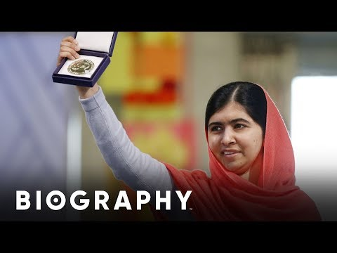

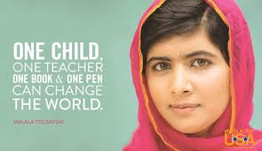
Malala Yousafzai
Return to Gallery
Malala Yousafzai, born in 1997, is a Pakistani activist for female education. When she was a teenager, Malala spoke out publicly against the prohibition on the education of girls that was imposed by the Tehrik-e-Taliban Pakistan and was shot by a member of the Taliban while on the school bus. Malala efforts resulted in her being the youngest Nobel Prize laureate.

Slide 8
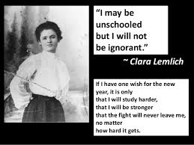

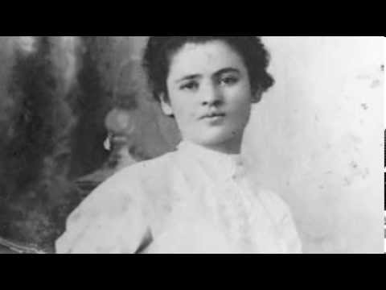
Clara Lemlich
Return to Gallery
Clara Lemlich, a 23-year-old Ukrainian immigrant, rose to a position of power in the women's labor movement, becoming the voice that incited the famous Uprising of the Twenty Thousand in 1909 in the shirtwaist garment district in New York. On November 22nd, 1909, Lemlich helped incite a strike that ultimately proved instrumental to industrial labor reform when she called her fellow seamstresses to strike until their work conditions improved.

Slide 9
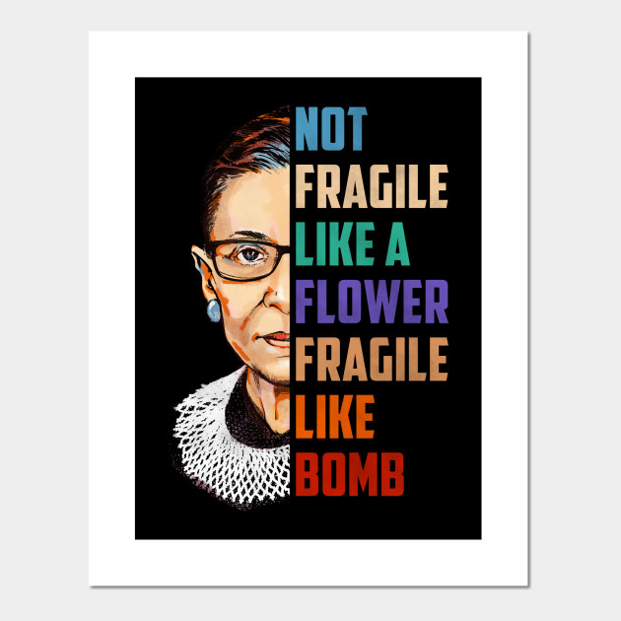
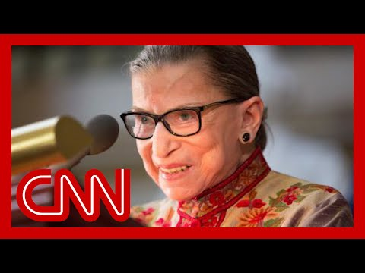
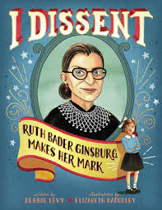
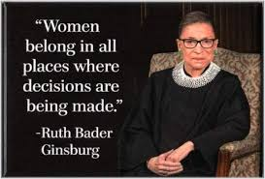

Ruth Bader Ginsburg
Return to Gallery
Joan Ruth Bader Ginsburg, born in 1933, was an American lawyer who served as an associate justice of the Supreme Court of the United States from 1993 until her death in September 2020. She was the second woman on the Supreme Court and the first Jewish woman. She was dedicated to using her job as a lawyer to fight for equity.

Slide 10

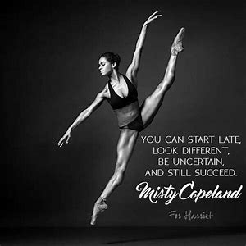
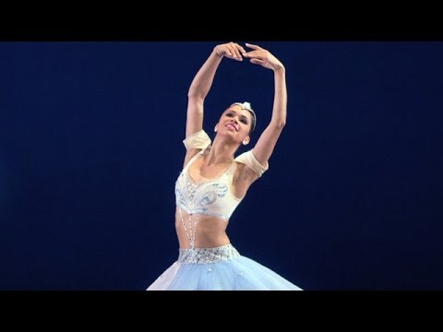
Misty Copeland
Return to Gallery
Misty Danielle Copeland, born in 1982, is an American ballet dancer for American Ballet Theatre, one of the three leading classical ballet companies in the United States. On June 30, 2015, Copeland became the first African American woman to be promoted to principal dancer in ABT's 75-year history.

Slide 11
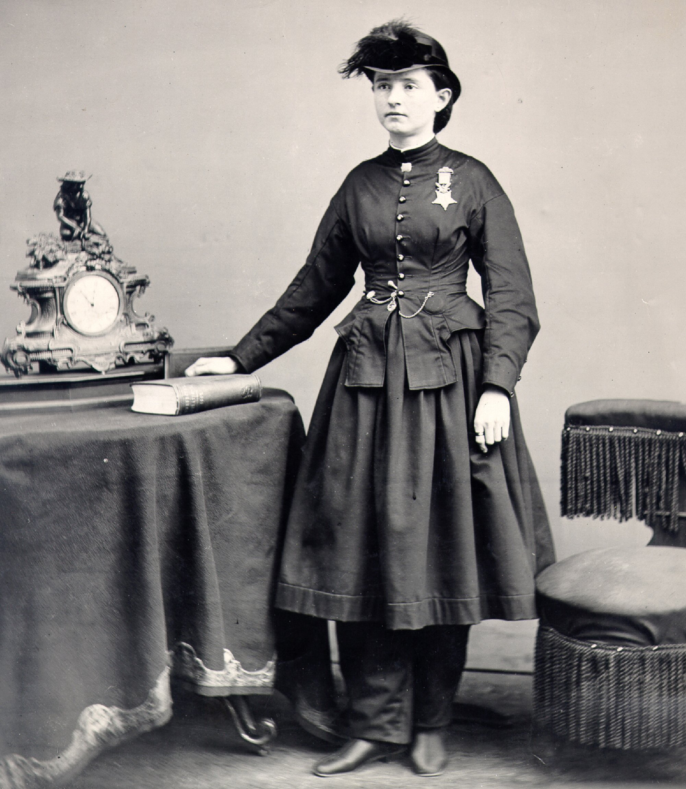
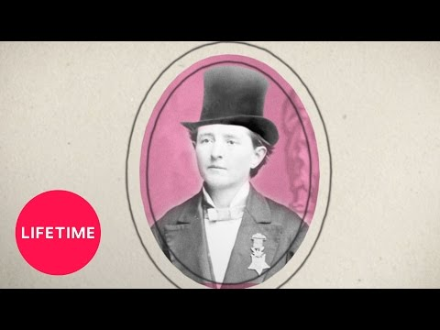
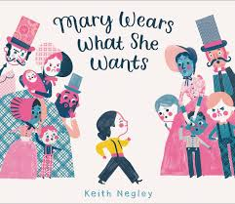

Mary Edwards Walker
Return to Gallery
Mary Edwards Walker, M.D., born in 1832, commonly referred to as Dr. Mary Walker, was an American abolitionist, prohibitionist, prisoner of war and surgeon. She is the only woman to ever receive the Congressional Medal of Honor. Mary was also revolutionary for refusing to wear dresses and was arrested multiple times for wearing boys’ clothes.

Slide 12
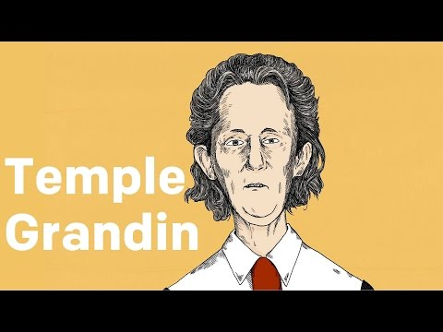
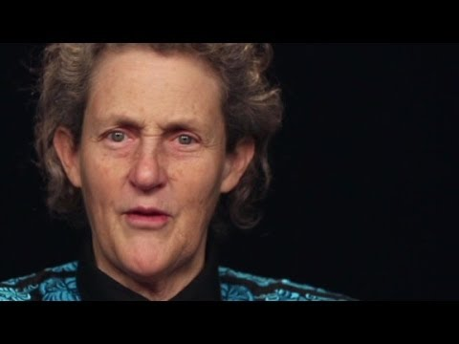


Temple Grandin
Return to Gallery
Mary Temple Grandin, born in 1947, was diagnosed with autism at an early age. Temple grew up to become an American scientist and activist. She is a prominent proponent for the humane treatment of livestock for slaughter and author of more than 60 scientific papers on animal behavior. She is a consultant to the livestock industry on animal behavior, and an autism spokesperson.

Slide 13




Michelle Obama
Return to Gallery
Michelle LaVaughn Obama, born in 1964, is an American attorney and author who was the first lady of the United States from 2009 to 2017. She is married to the 44th president of the United States, Barack Obama, and was the first African-American first lady.

Slide 14





Sacagawea
Return to Gallery
Sacagawea was a Lemhi Shoshone woman, born in 1788, who, at age 16, met and helped the Lewis and Clark Expedition in achieving their chartered mission objectives by exploring the Louisiana Territory and serving as their translator when they encountered Native Americans on their expedition.

Slide 15





Helen Keller
Return to Gallery
Helen Adams Keller, born in 1880, was an American author, disability rights advocate, political activist, educator and lecturer. Born in West Tuscumbia, Alabama, she lost her sight and hearing after a bout of illness at the age of nineteen months. Helen attended Radcliffe College and she was the first blind and deaf person to ever graduate from college in the United States.

Slide 16




Teresa Carreño
Return to Gallery
María Teresa Gertrudis de Jesús Carreño García, born in 1853, was a Venezuelan pianist, soprano, composer, and conductor. Over the course of her 54-year concert career, she became an internationally renowned virtuoso pianist and was often referred to as the "Valkyrie of the Piano". Over the course of her lifetime she played for two US. Presidents, Abraham Lincoln and Woodrow Wilson.

Slide 17




Anne Frank
Return to Gallery
Annelies Marie "Anne" Frank, born in 1929, was a German-Dutch diarist of Jewish heritage. One of the most discussed Jewish victims of the Holocaust, she gained fame posthumously with the publication of The Diary of a Young Girl. Anne and her family went into hiding during the Nazi invasion of the Netherlands. Her family was able to live in secret for two years before they were discovered. Once found, Anne was taken to a Nazi concerntration camp where she and her sister died in 1945.

Slide 18




Kathrine Switzer
Return to Gallery
Kathrine Virginia Switzer, born in 1947, is an American marathon runner, author, and television commentator. In 1967, she became the first woman to run the Boston Marathon as an officially registered competitor. Kathrine became an activist for women in running and was instrumental in getting the women’s marathon added into the Olympic games.

Slide 19



Maggie Gee
Return to Gallery
Margaret “Maggie” Gee, born in 1923, was an American aviator who served in the Women Airforce Service Pilots (WASP) in World War II. She was one of two Chinese-American women to serve in the organization, the other being Hazel Ying Lee. Gee co-piloted B-17 bombers through training missions to help bomber gunners perfect their skills for combat.

Slide 20



Eugenie Clark
Return to Gallery
Eugenie Clark, born in 1922, was a scientific pioneer who greatly contributed to people's knowledge of sharks and other fish. Eugenie was commonly known as the Shark Lady. She who worked tirelessly to improve the sharks' reputation in the public eye. She also revolutionized the field of scuba diving as an investigative vehicle for research purposes.

Slide 21




Grace Hopper
Return to Gallery
Grace Brewster Murray Hopper, born in 1906, was an American computer scientist and United States Navy rear admiral. One of the first programmers of the Harvard Mark I computer, she was a pioneer of computer programming who invented COBOL one of the first high level programming languages.

Slide 22





Frida Kahlo
Return to Gallery
Magdalena Carmen Frida Kahlo y Calderón, born in 1907, was a Mexican painter known for her many brilliantly colored portraits, self-portraits, and works inspired by the nature and artifacts of Mexico. Frida contracted polio at age 6, survived a tragic bus accident, and had her leg partially amputated due to gangrene, and used painting to pass the time as she was confined to her bed to heal.

Slide 23




Mae C. Jemison
Return to Gallery
Mae Jamison is recognized as the first female African American in space. Mae flew with 6 other astronauts in 1992 on the space voyage Endeavor. Mae was in the Peace Corps as a medical officer spending time in Sierra Leone and Liberia doing medical research.

Slide 24




Marie Curie
Return to Gallery
Marie Curie won the Nobel Prize in Physics in 1903 for discovering Radioactivity and she also won the Nobel Prize in Chemistry as she discovered the elements of polonium and radium. She is credited for much research in cancer treatment and spoke 5 languages fluently.

Slide 25



Alice Ball
Return to Gallery
The first person to development a successful treatment for the disease leprosy was African American chemist, Alice Ball. Tragically, Alice died very young, 24 years old, and was unable to see the full impact of her discovery.

Slide 26



Oprah Winfrey
Return to Gallery
Best known in her role as the host of her international talk show, Oprah Winfrey also launched her own television network, OWN. Winfrey overcame an abusive and troubled childhood to break into radio and television during the 1970s when opportunities for African American women on television were almost non-existent. Winfrey is a philanthropist and gives generously to many causes including the girls’ school she established in Africa.

Slide 27




Amy Tan
Return to Gallery
Amy tan is a well-known Chinese American writer whose works explore the cultural challenges of second generation immigrants. Her book, ‘The Joy Luck Club’ is a New York Times best selling novel.

Slide 28




Wangari Maathai
Return to Gallery
The first African to receive a Nobel Peace Prize, Wangari Maathai is a social, environmental, and political activist. As an advocate for real change in Africa, she presents legislation for green protection and keeping the Congo Basin forests protected.

Slide 29



Nadia Murad
Return to Gallery
An Iraqi human rights activist, Nadia Murad brought to light the brutal reality of sexual violence and trafficking. Nadia herself was held in captivity and subjected to repeated assault. Now working with women and children who are also victims of human trafficking, Nadia is a recipient of the Nobel Peace Prize.

Slide 30





Kamala Harris
Return to Gallery
Born to immigrant parents, Kamala Harris is the first female vice president of the United States. She is the daughter of an Indian mother and Jamaican father. Raised in a diverse environment, Kamala became California’s Attorney General overseeing one of the country’s largest justice system.

Slide 31




Patsy Mink
Return to Gallery
Patsy Mink was a politician and attorney from Hawaii. She was elected as the first woman of color into the United States Congress. Patsy was a third generation Japanese American who was born and raised in Hawaii. Patsy Mink was a fierce advocate for equality in education.

Slide 32





Eleanor Roosevelt
Return to Gallery
First lady, Eleanor Roosevelt, was a diplomat and humanitarian. A child of an extremely wealthy family, but lost her parents before the age of 10. Due to her husband’s polio diagnosis, Eleanor often sat in for her husband in meetings. She was an advocate for minimum wage, 40-hour work weeks, and the abolition of child labor.

Slide 33




Jacinda Ardern
Return to Gallery
Known for her ability to tackle a crisis and her exceptional leadership skills, Jacinda Ardern is the Prime Minister of New Zealand. Passionate about climate change and women’s rights, Ardern is the only leader to give birth during office in the last 30 years and is the world’s youngest female leader.

Slide 34





Selena Quintanilla
Return to Gallery
Mexican-American singer and songwriter who was tragically killed at the age of 24 by the president of her fan club. Selena was well loved in the Latin music world, becoming the first female Tejano artist to win a Grammy for Best Mexican-American Album. Her album was the first predominantly Spanish-language album to top the Billboard charts. Jennifer Lopez played Selena in the Selena movie.

Slide 35




Sarojini Naidu
Return to Gallery
An Indian writer and political leader, Sarojini goes down in history as the first Indian woman to be presidents of India’s National Congress and the first to be appointed as state governor. She is still known as the ‘Nightingale of India’. She created quite a scandal when she married the love of her life, ignoring India’s strict caste system. She is credited with the Great Awakening of women in India.

Slide 36




Corazon Aquino
Return to Gallery
A Filipino politician, Corazon Aquino, is the first female president of the Philippines. She and her family were imprisoned when the, then current, president abolished the country’s constitution. The family was released on medical exile. However, her husband, Benigno, a political leader himself, returned to the Philippines where he was assassinated.

Slide 37




Charity Adams Earley
Return to Gallery
Charity Adams was a pioneer in education, the military, and Psychology. She led the first overseas all female, all African American unit during WWII. Charity had a talent for learning languages, was a gifted speaker, and doctor. She continued in support of the military and education for veterans.

Slide 38





Amelia Earhart
Return to Gallery
The first female pilot to ever fly solo across the Atlantic Ocean, Amelia was a pioneer in aviation. She was pivotal in the create of the ‘Ninety-Nines’ for female pilots and was a best-selling author. She disappeared in 1937 (aged 39) en route to Howland Island in the Pacific Ocean. Her death is at the center of many conspiracy theories today.

