Slide 1
Women’s History Month

Slide 2
What’s it all about?
“Educators in Santa Rosa, California, first celebrated Women’s History Week in March 1978 to increase awareness of women’s contributions to society. Organizers selected a week in early March to correspond with International Women’s Day on March 8. Over the next several years, other cities across the country joined Santa Rosa in celebrating Women’s History Week.
In 1980, President Jimmy Carter declared the week of March 8 National Women’s History week, urging everyone in the United States to participate. According to Carter, “too often women were unsung and sometimes their contributions went unnoticed. But the achievements, leadership, courage, strength, and love of the women who built America was as vital as that of the men whose names we know so well.”
The week-long event officially became a month long one in 1987 when Congress passed a resolution designating March as Women’s History Month. [It] has been celebrated in the United States every March since.”
https://kids.nationalgeographic.com/explore/history/womens-history-month/

Slide 3
This month we will be learning about 22 female change-makers who made an impact in our society.
Notes:
Important note: There are 23 school days in March--- I only made 22 slides because my district has 1 day off during the month!

Slide 4
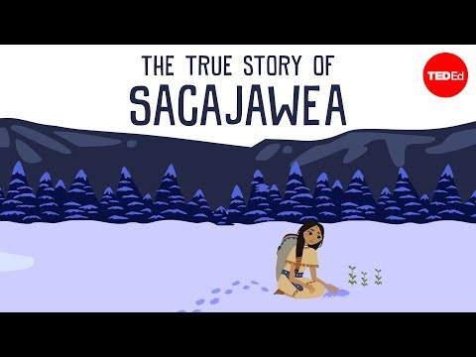
Sacagawea
Sacagawea, a Shoshone woman, is best known for helping Lewis and Clark with their expedition in 1804, which led them over thousands of miles to the Pacific Northwest. She acted as an interpreter and helped them keep the peace with the Indigenous people they met along the way, helped them survive by showing what wild foods were safe to eat, and consistently kept calm under pressure.

Slide 5
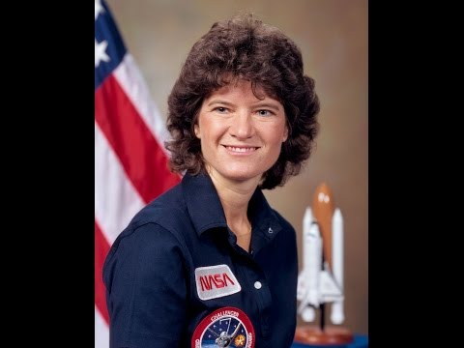
Sally Ride
Sally Ride was the first American woman to ever travel into space in 1983. In 2001 she co-founded Sally Ride Science which creates science programs for upper elementary and middle school students. She was inducted into the Astronaut Hall of Fame in 2003. She wrote 4 children’s books
about space, our planet, and
the solar system.

Slide 6
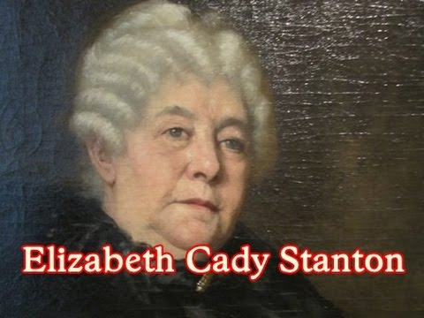
Elizabeth Cady Stanton
Elizabeth Cady Stanton was an author, lecturer, and advocate for the women's rights and suffrage movements. As a young adult she learned that only men could vote and that women had very few rights under the law. She knew this was not fair and fought to give women the same opportunities as men. In 1869, she and her friend Susan B. Anthony formed the National Woman Suffrage Association. Elizabeth fought hard but passed away in 1902 before the 19th amendment was ratified in 1920, which
gave women the right to vote.

Slide 7
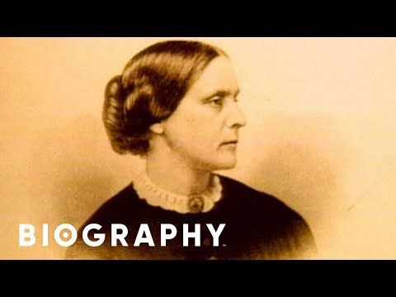
Susan B. Anthony
Susan B. Anthony was a women’s rights leader in the late 1800’s. She fought for equal rights for women and for women’s suffrage, or the right to vote. In November, 1872, Susan illegally voted in the election and was fined $100. She refused to pay her fine and spent time in jail as a consequence. She passed away in 1906 and was unable to see women gain the right to vote in 1920. The United States honored Susan
by minting a coin called the
Susan B. Anthony dollar.

Slide 8
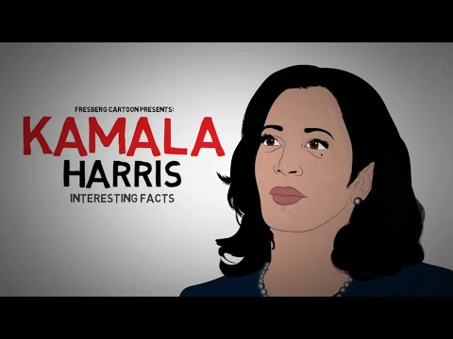
Kamala Harris
Kamala Harris is a lawyer and politician. In 2016, she was elected and served as the first Indian American senator in the United States. In 2020, she became the first black, Indian American, and woman to be elected as vice president of the United States.

Slide 9
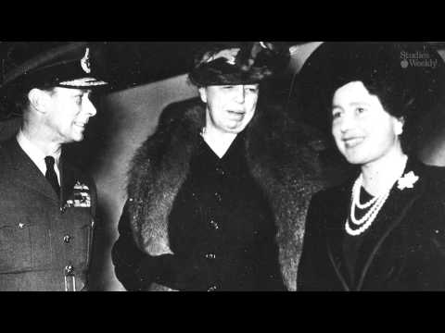
Eleanor Roosevelt
Eleanor Roosevelt was the wife of our 32nd president, Theodore Roosevelt. Eleanor was best known for helping others and raising awareness about human rights. She helped immigrants adjust to life in the United States, worked towards creating better working conditions in factories, visited injured soldiers during World War I and
helped others during the great depression.

Slide 10
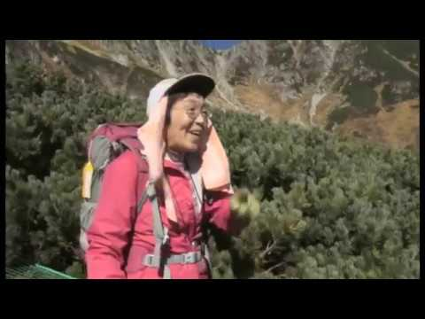
Junko Tabei
Junko Tabei was the first female ever to reach the peak of Mount Everest. During her accomplishment in 1975, Junko and her guides were buried under the snow when an avalanche struck their camp. She lost consciousness for about 6 minutes before her Sherpa guide dug her out. She didn’t give up and successfully reached the peak 12 days later.

Slide 11

Amelia Earhart
Amelia Earhart was the first female pilot to fly across the Atlantic Ocean in 1928. Before flying, she wasn’t sure what career she wanted to hold, so she nursed World War I soldiers, trained to be a mechanic, and studied medicine and medical research. In 1937, Amelia took her final flight around the world and traveled more than 22,000 miles. Her plane disappeared and she was never found.

Slide 12
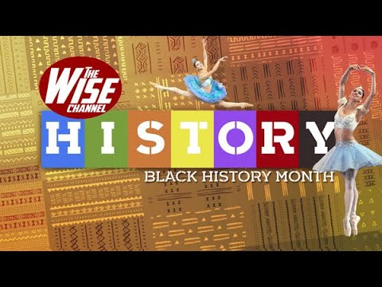
Misty Copeland
Misty Copeland became the first African American female principal dancer with the American Ballet Theatre in 2015. She is an author, and wrote a children’s book called, Firebird. Misty also works to provide youth with dance programs in developing countries.

Slide 13
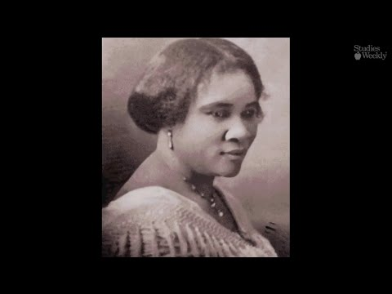
Sarah Breedlove
Sarah Breedlove was an American entrepreneur and philanthropist. She was said to be the first female self-made millionaire in America. She became famous by developing and marketing a successful line of beauty and hair products for black women after she suffered with
her own hair loss.

Slide 14

Malala Yousafzai
Malala Yousafzai is a female education activist who spoke out for equal education rights for young girls. As a young girl, Malala would sneak to school in order to receive an education. One day on her way home, the Taliban, a group of dangerous men, found her and shot her three times. Malala was rushed to a hospital where she was thankfully saved. Malala won the Nobel Peace Prize in 2014 and is
currently an author and shares her mission with others around the
world.
Notes:
NOTE: please preview this video to ensure appropriateness for your students

Slide 15
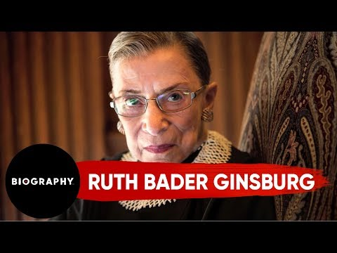
Ruth Bader Ginsburg
Ruth Bader Ginsburg was the second woman ever to serve as a justice on the U.S. Supreme Court. She fought fiercely for women’s rights, for herself, and others. Before serving, Ruth worked as an advocate for the advancement of gender equality. She worked as a volunteer attorney for the American Civil Liberties Union, which was established to defend the rights guaranteed to every person in the United States. Ruth served on the
Supreme court for 27 years before
she passed away in 2020.

Slide 16
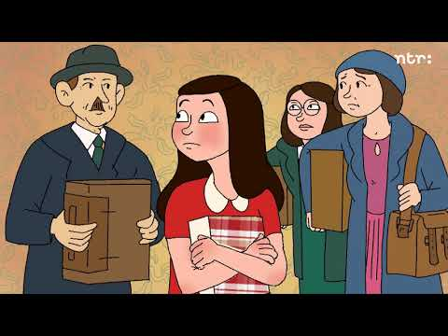
Anne Frank
Anne Frank was born in Germany in 1929 when the country was dealing with some changes. A man named Adolf Hilter, the leader of the Nazi Party, was blaming Jewish people for many of the problems happening in Germany. World War II made life hard for Anne’s family when the Nazi’s imposed strict rules and restricted places Jewish people could visit. They no longer could go to school, hold jobs, or shop at certain stores. Things quickly got worse for Anne’s family and they were forced to go into hiding. Anne kept a diary while hiding and shared what life was like for her and her family. For 761 days,
Anne and her family hid in an attic before
they were found and captured by Nazi soldiers.

Slide 17
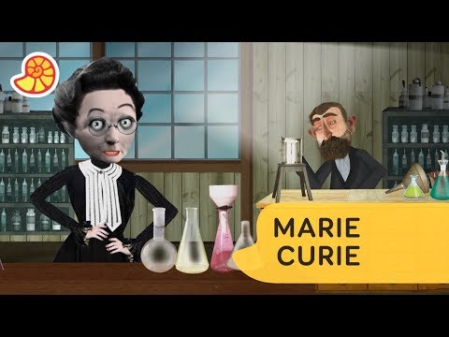
Marie Curie
Marie Curie was a physicist and chemist who helped research radioactivity and discover radium and polonium. She was the first woman to earn a Nobel Prize and the first and only woman to win the Nobel Prize twice. After becoming famous, doctors realized they could use radiation to treat cancer. Marie’s work on radiation allowed doctors to examine wounded soldiers using X-ray machines during World War I. In 1921, Marie
founded the Curie Institute in Paris,
which is still a major cancer
research facility today.

Slide 18
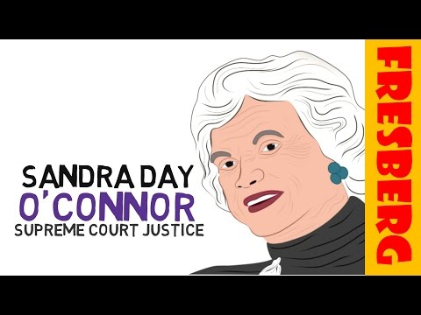
Sandra Day O’Connor
Sandra Day O’Connor was born in 1930 and
is best known for being the first woman to serve as a justice on the U.S. Supreme Court. After graduating from Stanford University, she was unable to find a job at a law firm because she was a woman. One firm finally offered her a job as a secretary, however she would not
stay in that position for long. She served as a civil attorney for the Army, Assistant Attorney General, a member of the Arizona Senate,
and the first female majority leader.
She was elected as a Supreme Court
Justice in 1981.

Slide 19
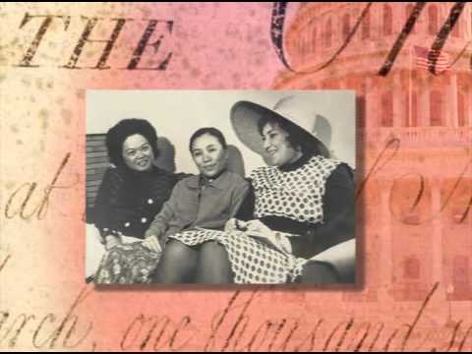
Patsy Mink
Patsy Mink was the first woman of color to be elected to the U.S. House of representatives, and the first Asian-American woman to serve in Congress. She played an important role in writing bills like Title IX, which makes it illegal to discriminate against a person based on their gender in a federally funded activity, like school. She also wrote the Early Childhood Education Act, and the Women’s Educational Equity Act. In 1972, she
became the first Asian-American to
run for President.

Slide 20
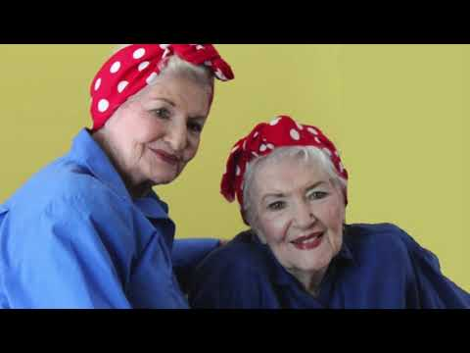
Naomi Parker
Naomi Parker was an American war worker who is considered to be the model for the well-known, “We Can Do It!” poster. During World War II, Naomi worked on an aircraft assembly at the Naval Air Station Alameda. The character in the iconic poster would be named Rosie the Riveter, which became a representation of women who worked in factories and shipyards during World War II. These women were paramount in creating munitions and war supplies.

Slide 21
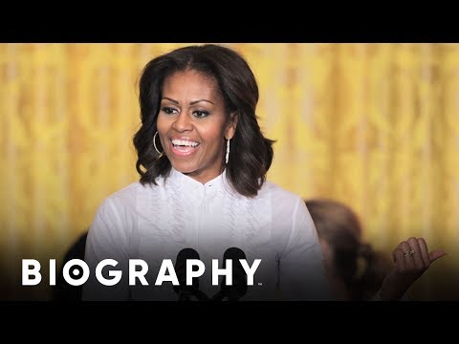
Michelle Obama
Michelle Obama is an attorney and author who is best known for being the first African American first lady of the United States. In 2010 she launched the “Let’s Move! Campaign, which worked towards fighting obesity in children. She continues to work as a spokesperson for ensuring children have good nutrition and exercise habits. On March 16, 2021 she will premiere a new culinary tv show for kids on Netflix called Waffles + Mochi, where she will cook, explore,
and eat food from around the world.

Slide 22
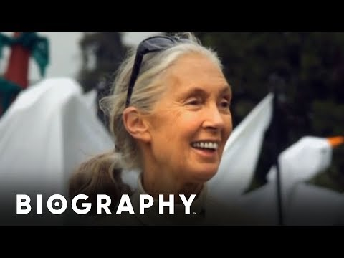
Jane Goodall
Dr. Jane Goodall is best known as an ethologist (someone who studies animal behavior) and a conservationist (someone who manages natural habitats). She is famous for her work with chimpanzees. Dr. Goodall studied them in the wild for over 60 years. Her research allowed us to understand more about their lives and what we now know about our nearest living relatives. During her research, Dr. Goodall discovered that chimps use
tools, are meat eaters, and show many personalities, like anger, joy
and sadness.

Slide 23

Greta Thunberg
Greta Thunberg is an environmental activist from Sweden. When she was 8 years old, Greta started learning about climate change. As she learned more, she was confused why so little was being done to make a difference. Greta has Asperger syndrome, which affects how she socializes with others. Greta uses, what she calls, her superpower to help her fight climate change. In 2018, Greta took action and went on strike from school. She sat down outside the Swedish parliament with a sign that said, “School Strike for Climate”, and waited for politicians to take notice and act to stop global warming. A year later, millions of protesters marched in their own climate strikes in 163 countries and over all 7 continents. Greta’s speeches were published in a
book called, No One is Too Small To Make a
Difference. In 2019 she was named Time
magazine's Person of the Year.

Slide 24
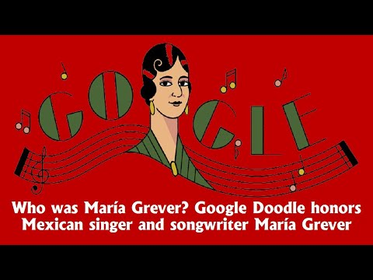
Maria Grever
Maria Grever, born in 1885, was the first female Mexican composed to achieve international fame. She is best known for her song, What a Difference a Day Makes. Numerous musicians have covered their own renditions of her song. Maria began composing music at the age of 4, and wrote her first song at age 18 which sold 3 million copies.

Slide 25
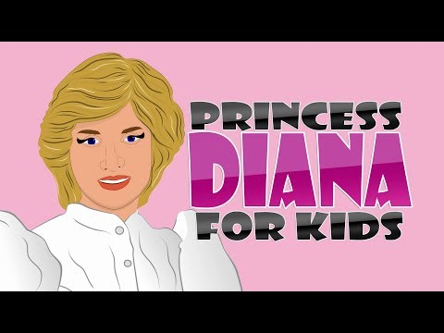
Princess Diana
Princess Diana, born in 1961, was a member of the British royal family and the first wife of Charles, Prince of Wales. As Princess of Wales, Diana worked in support of the International Campaign to Ban Landmines, London’s Great Ormond Street Hospital for children, and various charities like helping the homeless and the International
Red Cross.

