Slide 1

women’s History Month: Fact of the Day

Slide 2
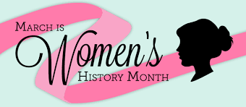
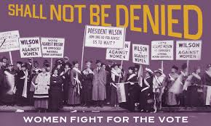
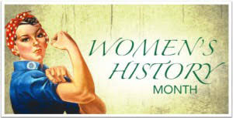

In honor of Women’s History Month we are going to learn an interesting fact of the day
Women’s History Month is a celebration of women’s contributions to history, culture and society and has been observed annually in the month of March in the United States since 1987.

Slide 3
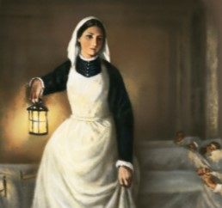
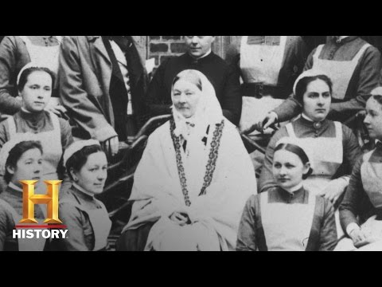
Fact of the Day
Florence Nightingale (1820-1910), known as “The Lady With the Lamp,” was a British nurse, social reformer and statistician best known as the founder of modern nursing.

Slide 4
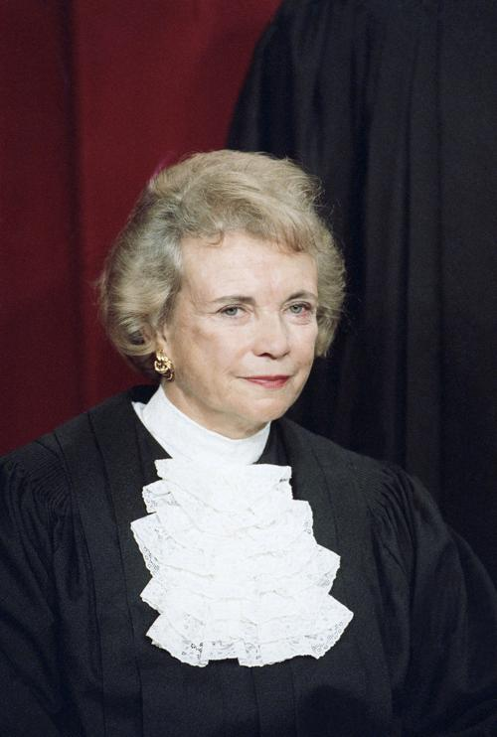

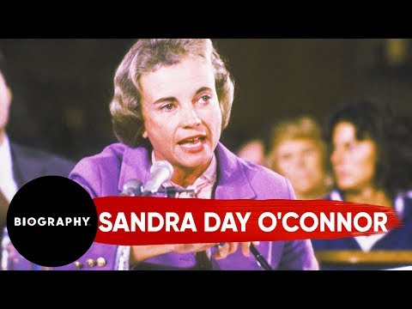
Fact of the Day
Sandra Day O’Connor was the first woman to serve on the Supreme Court of the United States.

Slide 5
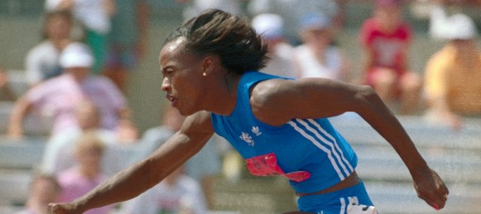

Fact of the Day
Jackie Joyner-Kersee (1962- ) is an American retired track and field athlete, ranked among the all-time greatest athletes in the heptathlon as well as long jump.

Slide 6
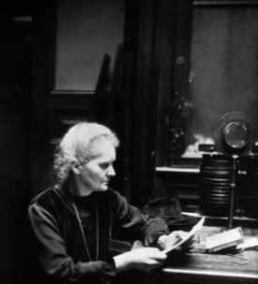


Fact of the Day
Marie Curie (1867 - 1923) worked with her husband and their
research was crucial in the development of x-rays in surgery. During World War One Curie helped to equip ambulances with x-ray equipment, which she herself drove to the front lines.

Slide 7
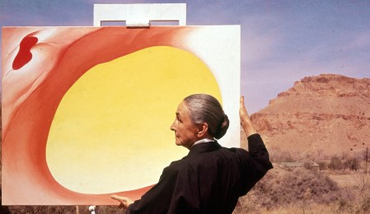

Fact of the Day
Georgia O’Keeffe (1187-1986)was an American painter who was an influential figure in Modernism, best known for her large-format paintings of natural forms, especially flowers and bones.

Slide 8
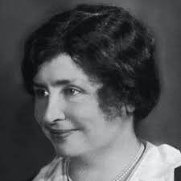

Fact of the Day
Helen Keller (1880-1968) was
American author and educator who was blind and deaf. Her education and training represent an extraordinary accomplishment in the education of persons with these disabilities.

Slide 9
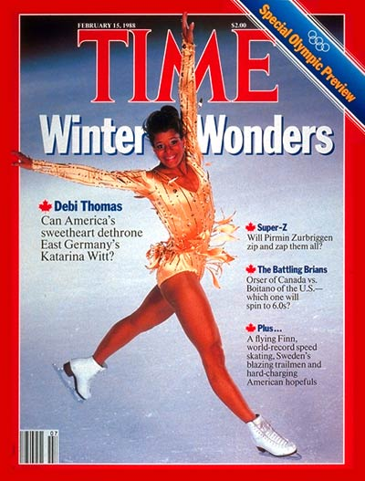

Fact of the Day
Debi Thomas , a talented figure-skater, is the first African American to win a medal (bronze) at the Winter Olympic games in 1988.

Slide 10
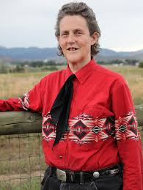

Fact of the Day
Temple Grandin is an American scientist and activist. She is an advocate for the humane treatment of livestock for slaughter and an autism spokesperson. She is one of the first individuals on the autism spectrum to document her personal experience of autism.

Slide 11
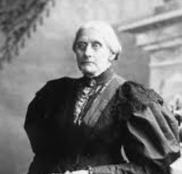
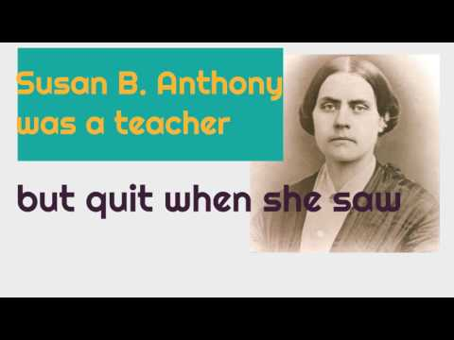
Fact of the Day
Susan B. Anthony was an American social reformer and women's rights activist who played a pivotal role in the women's suffrage movement.

Slide 12
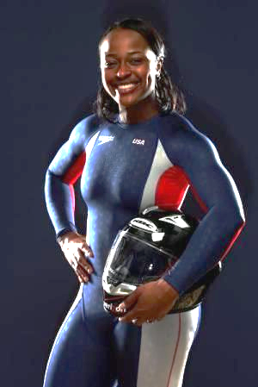
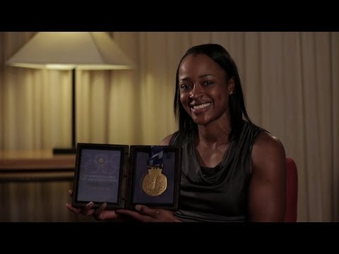
Fact of the Day
In 2002 Vonetta Flowers became the first African-American to win a gold medal at the Winter Olympic games in bobsledding

Slide 13
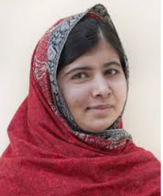

Fact of the Day
Malala Yousafzai ( 1997 - ) is a Pakistani activist who, while a teenager, spoke out publicly against the prohibition on the education of girls that was imposed by the Pakistani Taliban. She gained global attention when she survived an assassination attempt at age 15.

Slide 14
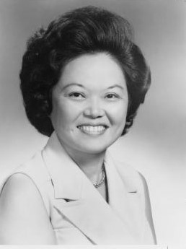
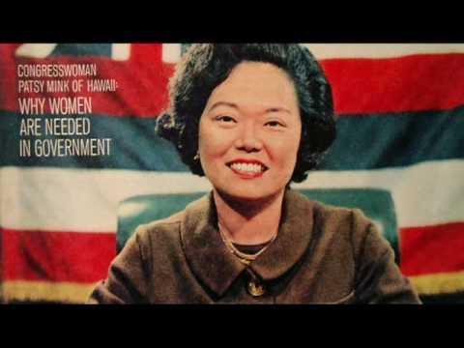
Fact of the Day
Patsy Mink (1927-2002) was the first woman of color elected to the U.S. House of Representatives and the first Asian-American woman to serve in Congress. She helped write bills like Title IX, the Early Childhood Education Act, and the Women's Educational Equity Act

Slide 15
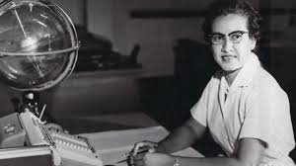
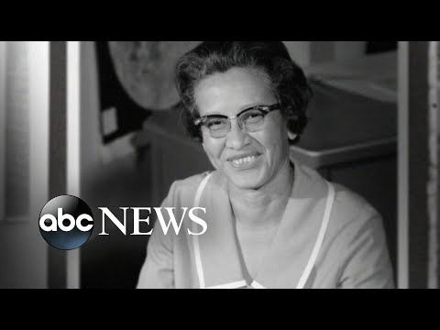

Fact of the Day
Katherine Johnson was an American mathematician whose calculations of orbital mechanics as a NASA employee were critical to the success of the first and subsequent U.S. crewed spaceflights.

Slide 16
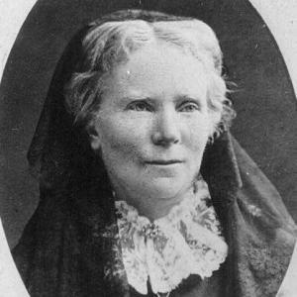
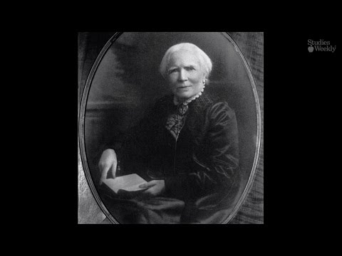
Fact of the Day
Elizabeth Blackwell (1821-1910) was the first woman in America to receive a medical degree, Elizabeth Blackwell championed the participation of women in the medical profession and ultimately opened her own medical college for women.

Slide 17
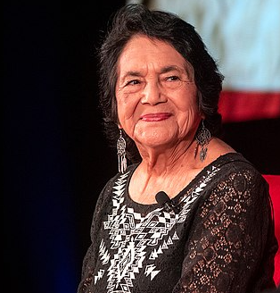

Fact of the Day
Dolores Huerta (1930- ) is an American labor leader and civil rights activist who, with Cesar Chavez, is a co-founder of the United Farm Workers. Huerta helped organize the Delano grape strike in 1965 in California.

Slide 18
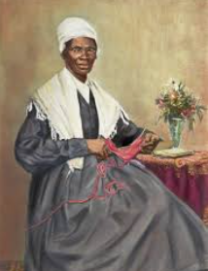
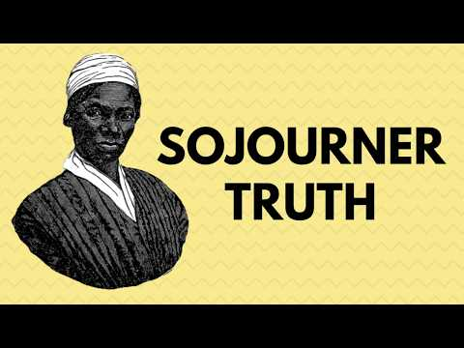
Fact of the Day
Sojourney Truth (1797 - 1883) was an American abolitionist and women's rights activist best-known for her speech on racial inequalities, "Ain't I a Woman?"

Slide 19
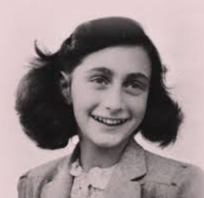


Fact of the Day
Anne Frank (1929- 1945) a Jewish teenager, wrote a diary of her family’s two years in hiding during World War II, and the book became a classic of war literature, personalizing the Holocaust.

Slide 20
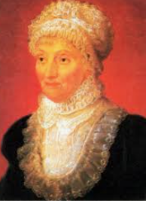
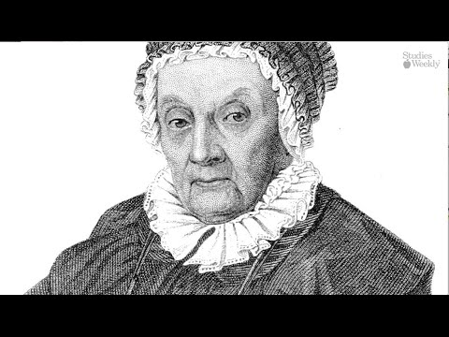

Fact of the Day
Caroline Herschel (1750-1848) was a German astronomer that discovered 8 comets. She was the younger sister of astronomer William Herschel, with whom she worked throughout her career. She was the first woman to receive a salary as a scientist

Slide 21
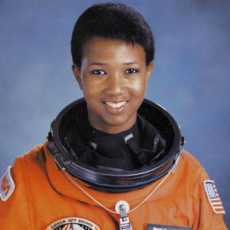


Fact of the Day
Mae C. Jemison is an American astronaut and physician who, on June 4, 1987, became the first African American woman to be admitted into NASA’s astronaut training program. On September 12, 1992, Jemison finally flew into space with six other astronauts aboard the Endeavour on mission STS47, becoming the first African American woman in space.

Slide 22
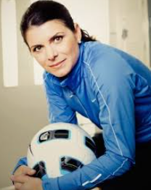


Fact of the Day
Mia Hamm (19 - ) is considered soccer’s first superstar, Hamm first put on the United States jersey when she was 15, and as a 19-year-old helped her country win the inaugural FIFA Women’s World Cup.

Slide 23
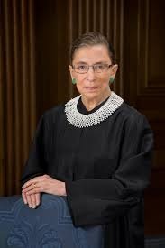
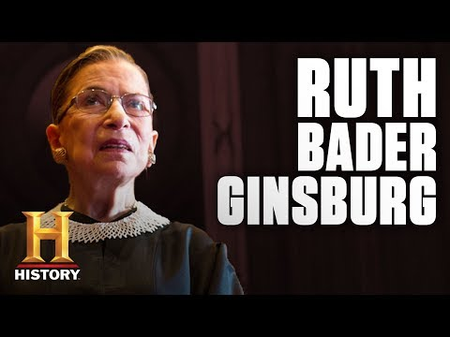
Fact of the Day
Ruth Bader Ginsburg (1933-2020) was the second female and the first Jewish female justice of the Supreme Court. She eventually became the longest-serving Jewish justice.

Slide 24
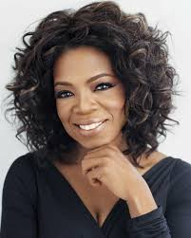
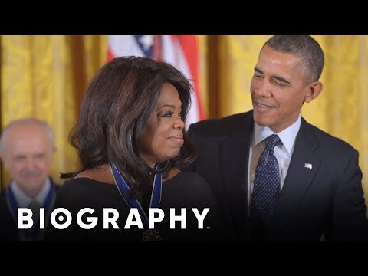
Fact of the Day
Oprah Winfrey is n American talk show host, television producer, actress, author, and philanthropist.

Slide 25



Fact of the Day
Serena Williams (1981- ) is an American tennis player who revolutionized women’s tennis with her powerful style of play and who won more Grand Slam singles titles (23) than any other woman or man, during the open era.

