Slide 1

Women’s History Month
Daily Inspiration

Slide 2
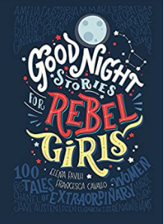
Most slides have quoted summaries and illustrations from:

Slide 3
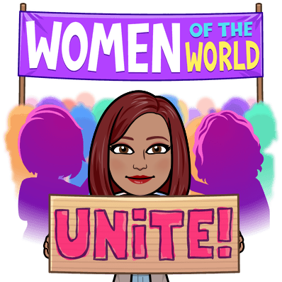
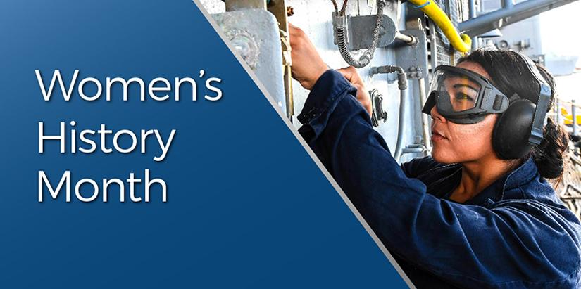

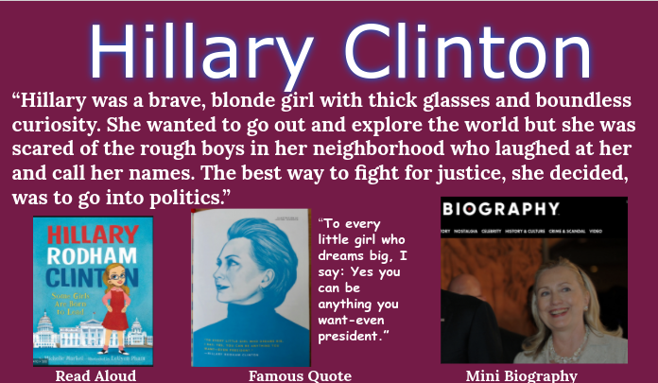
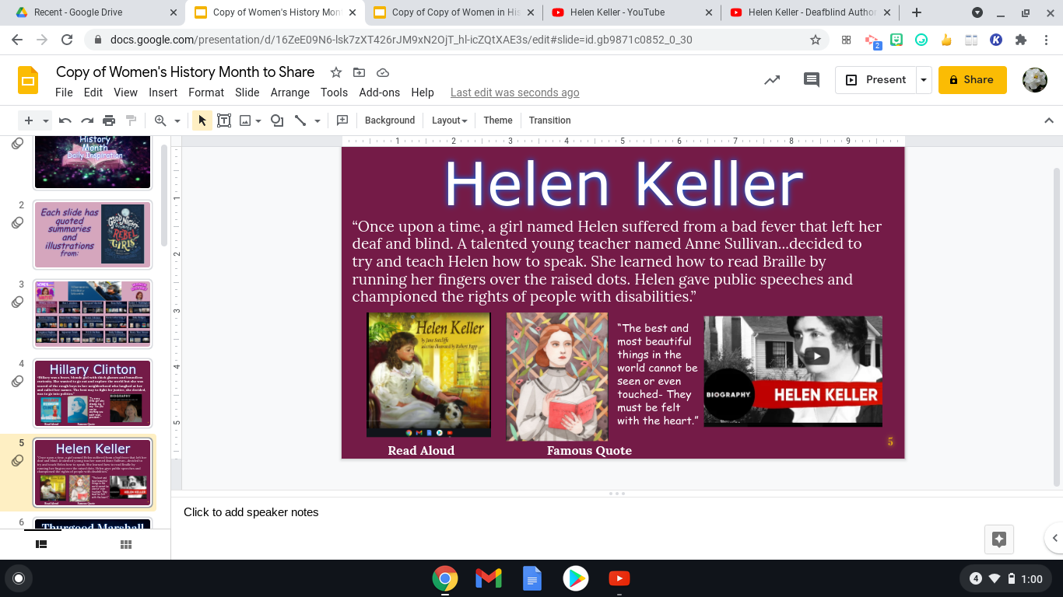
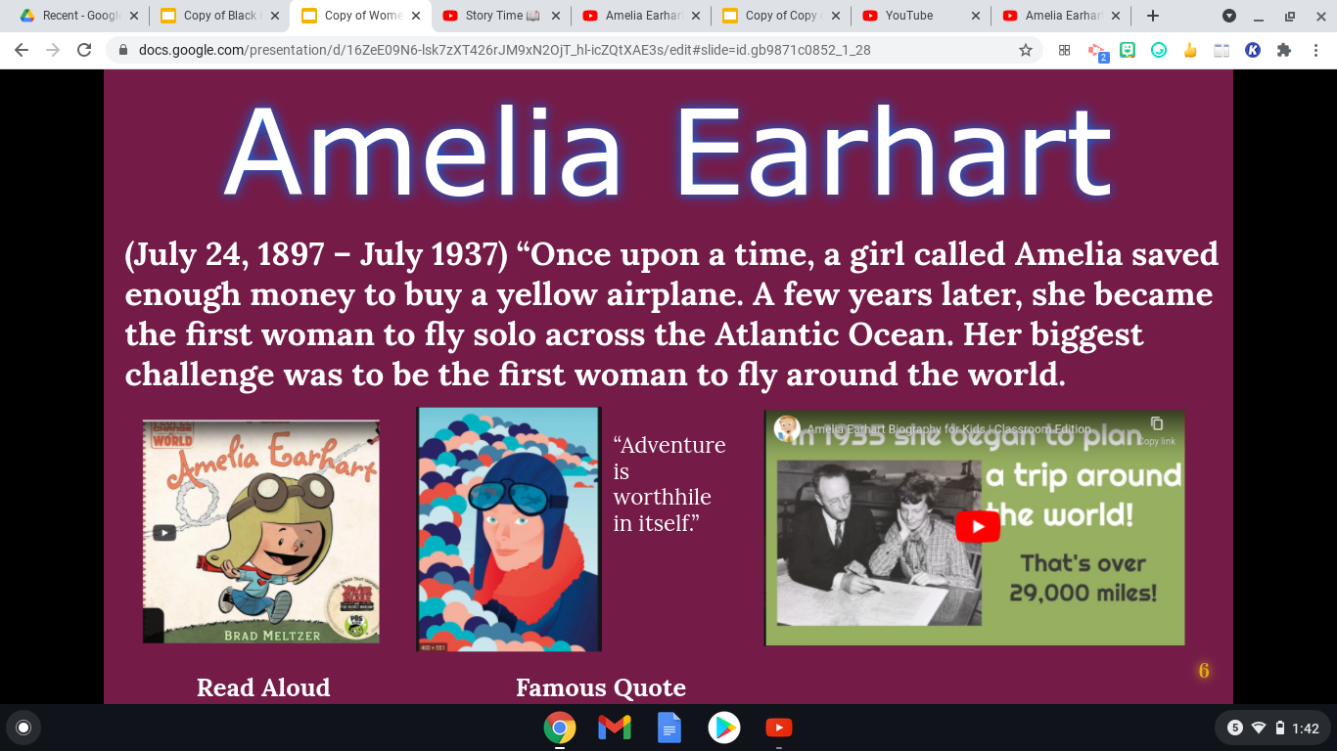
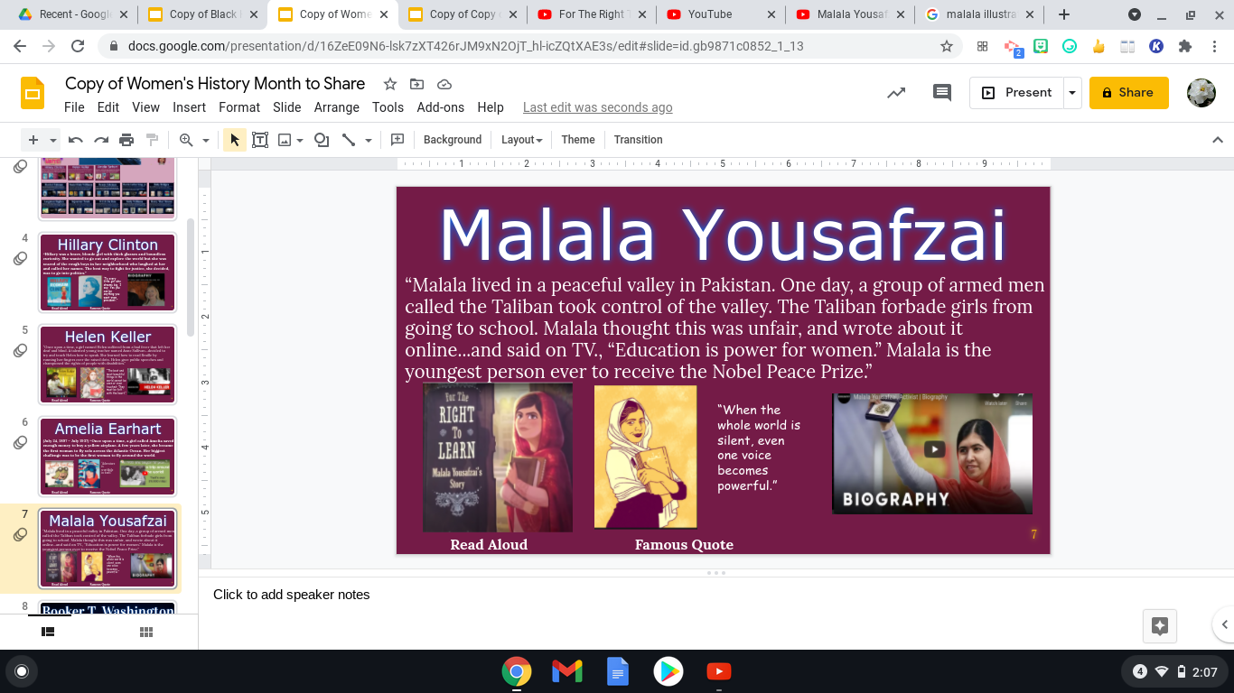
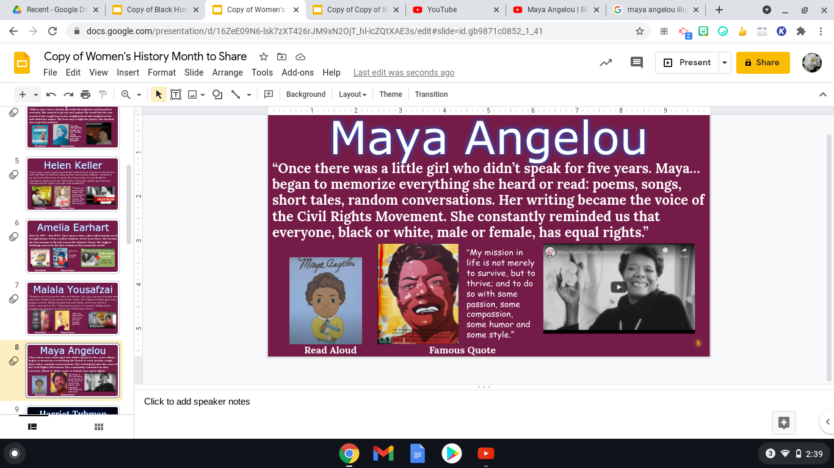
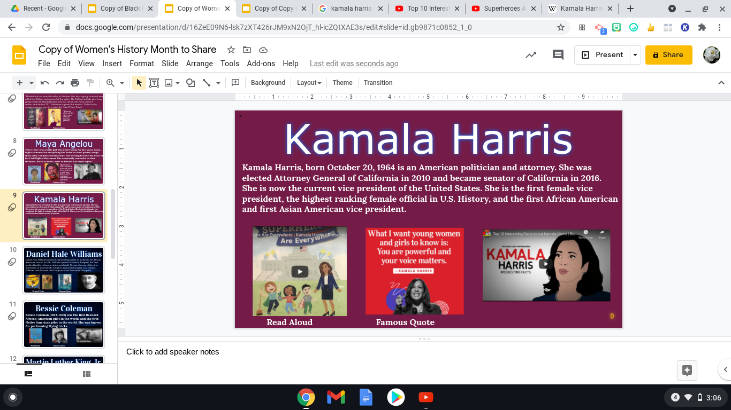
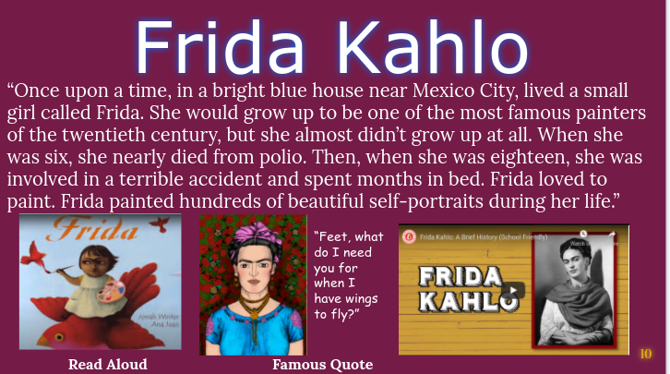
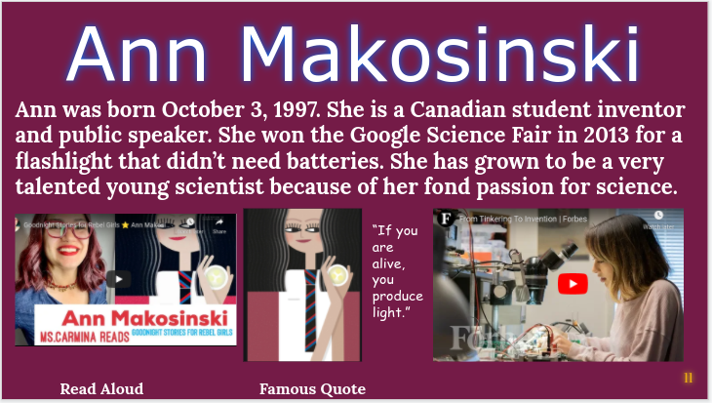
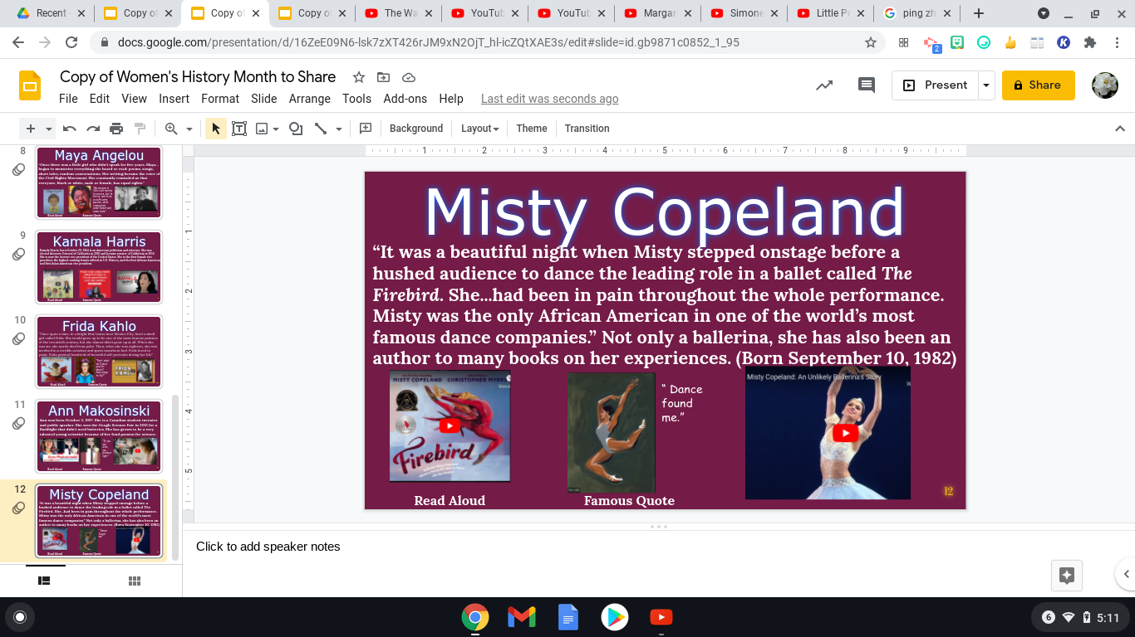
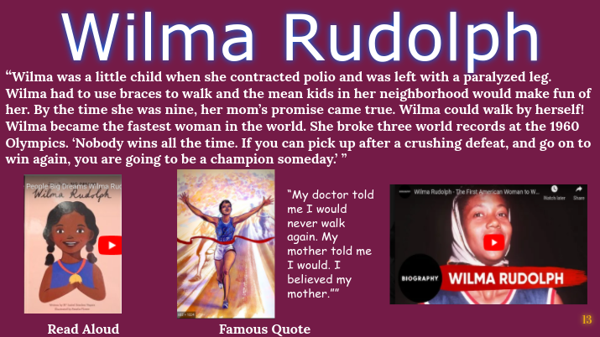
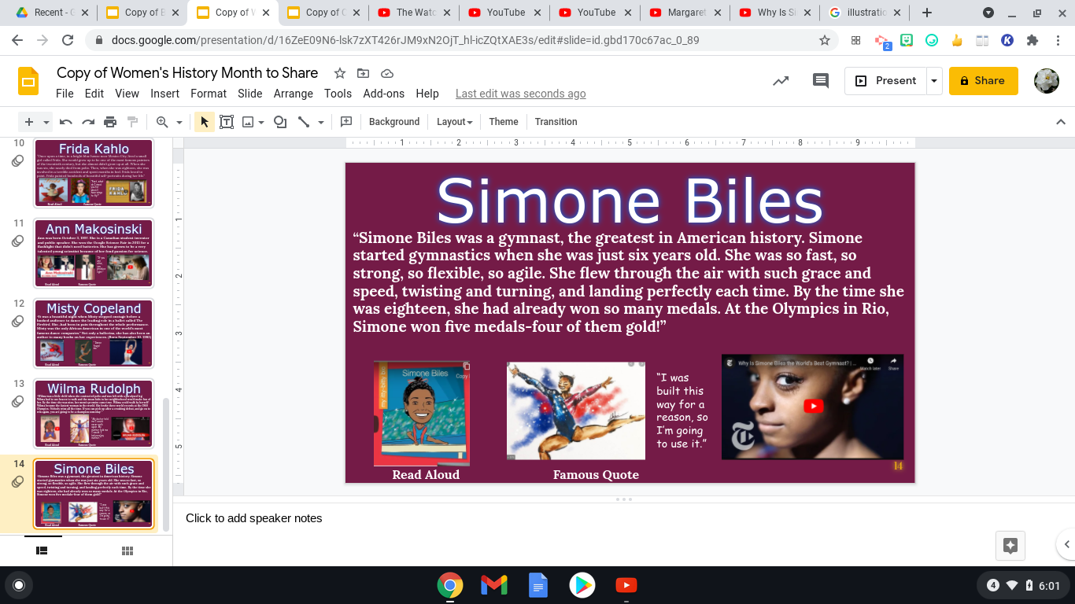
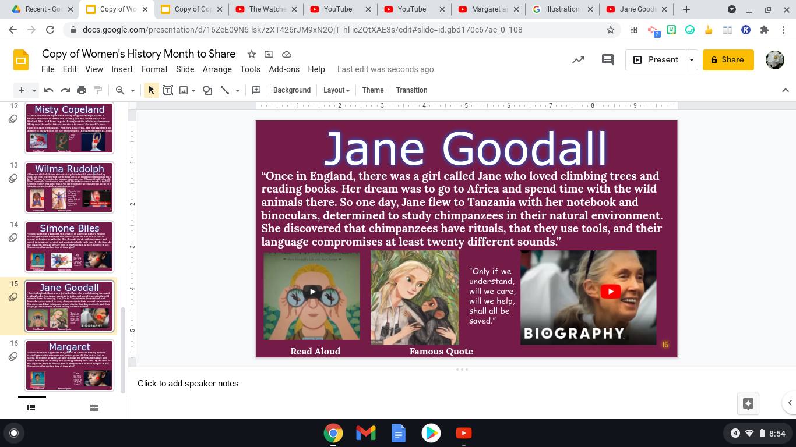
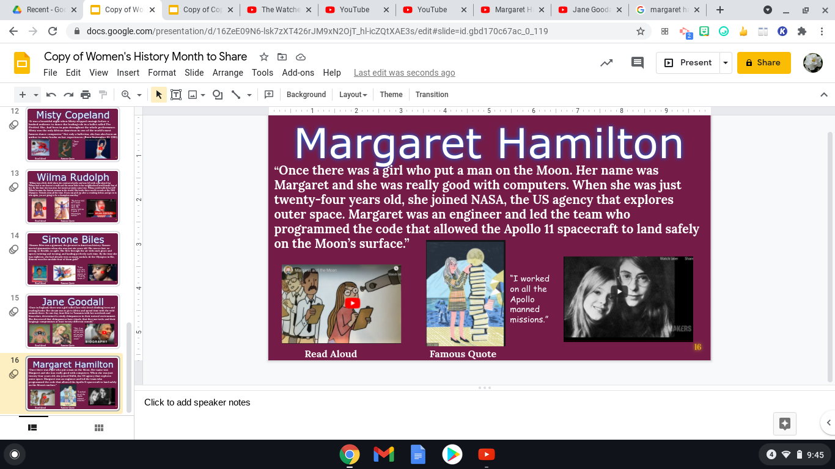
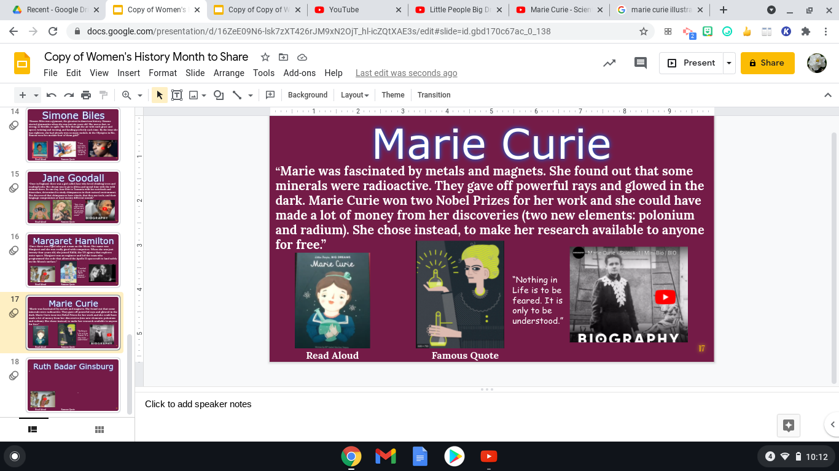
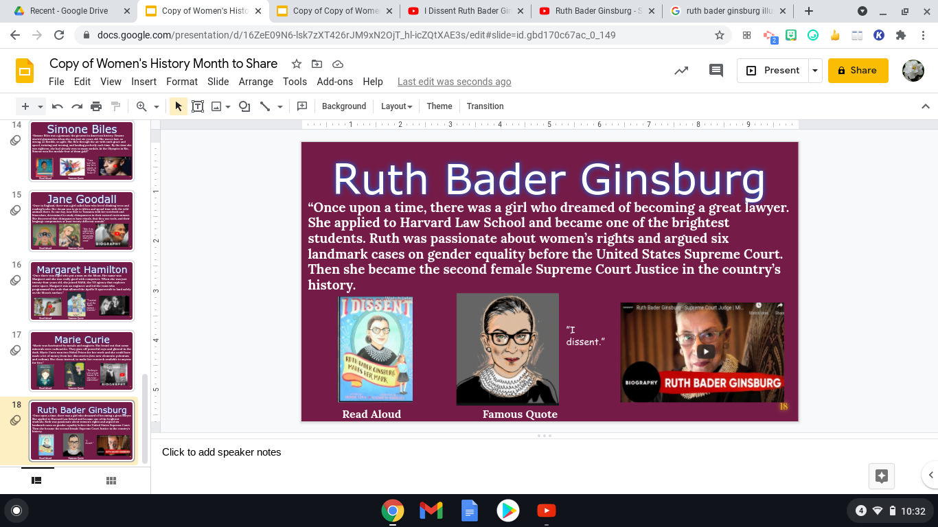

Slide 4
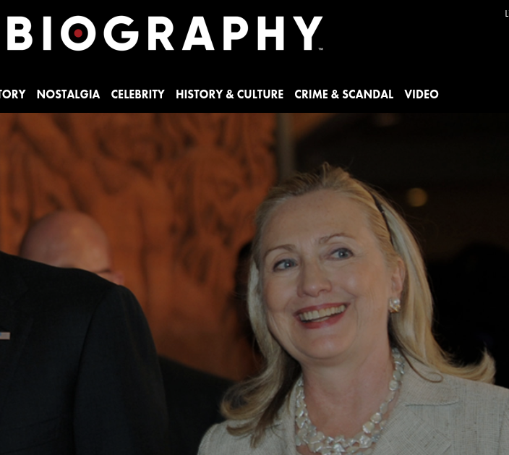
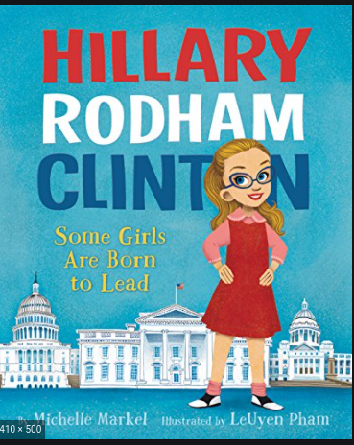
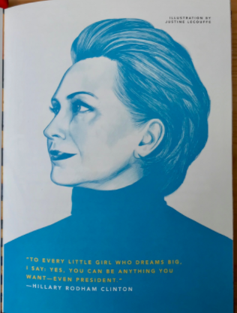
Hillary Clinton
“Hillary was a brave, blonde girl with thick glasses and boundless curiosity. She wanted to go out and explore the world but she was scared of the rough boys in her neighborhood who laughed at her and called her names. The best way to fight for justice, she decided, was to go into politics.”
“To every little girl who dreams big, I say: Yes you can be anything you want-even president.”
Read Aloud Famous Quote

Slide 5
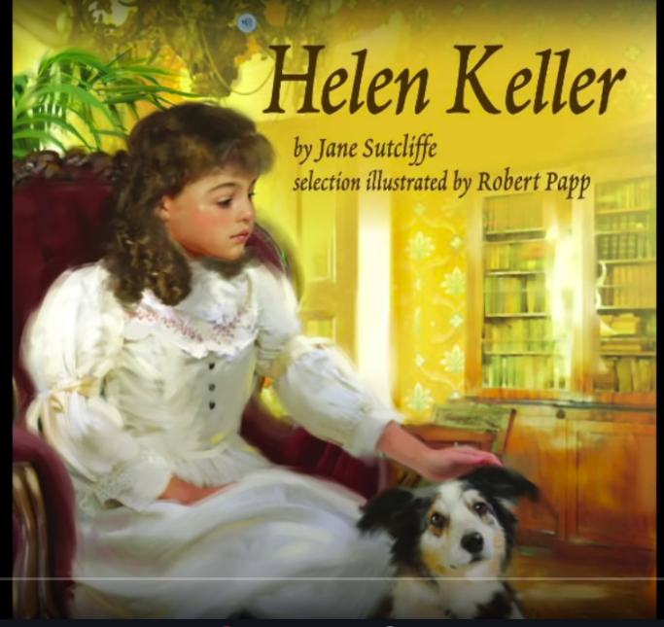
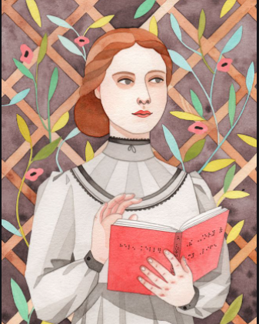
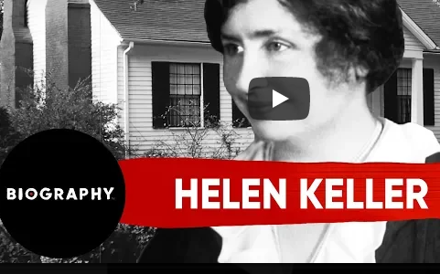
Helen Keller
“Once upon a time, a girl named Helen suffered from a bad fever that left her deaf and blind. A talented young teacher named Anne Sullivan...decided to try and teach Helen how to speak. She learned how to read Braille by running her fingers over the raised dots. Helen gave public speeches and championed the rights of people with disabilities.”
“The best and most beautiful things in the world cannot be seen or even touched- They must be felt with the heart.”
Read Aloud Famous Quote

Slide 6
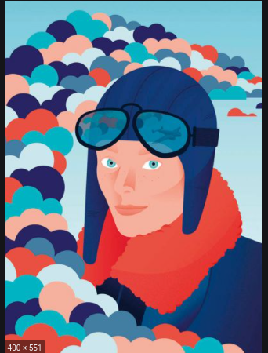
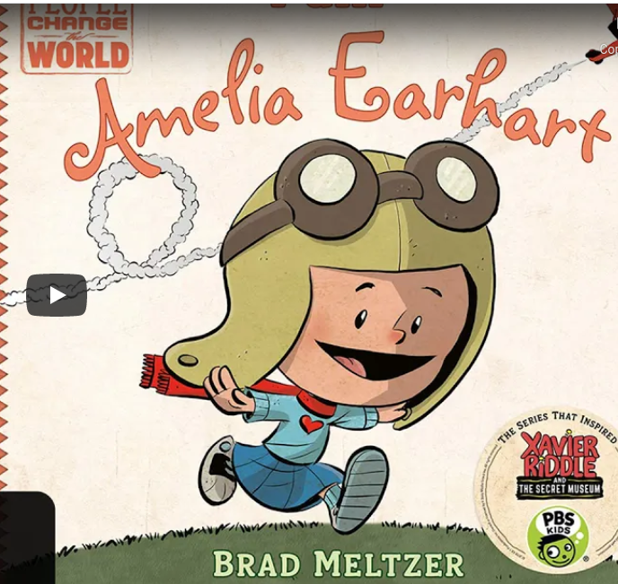
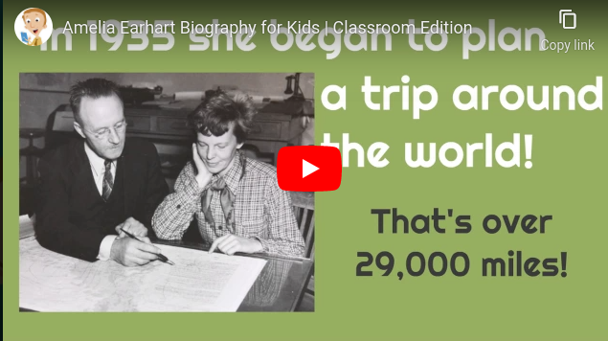
Amelia Earhart
(July 24, 1897 – July 1937) “Once upon a time, a girl called Amelia saved enough money to buy a yellow airplane. A few years later, she became the first woman to fly solo across the Atlantic Ocean. Her biggest challenge was to be the first woman to fly around the world.
“Adventure is worthhile in itself.”
Read Aloud Famous Quote

Slide 7
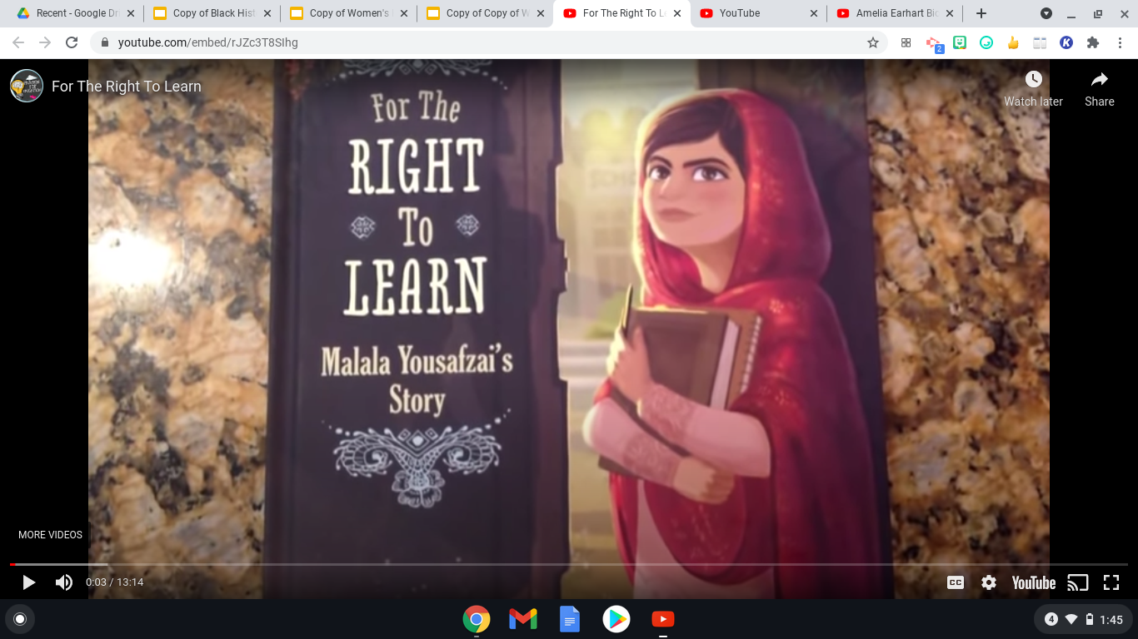
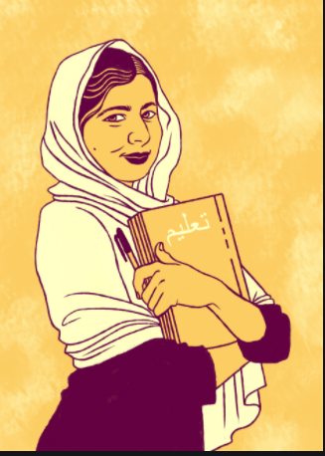
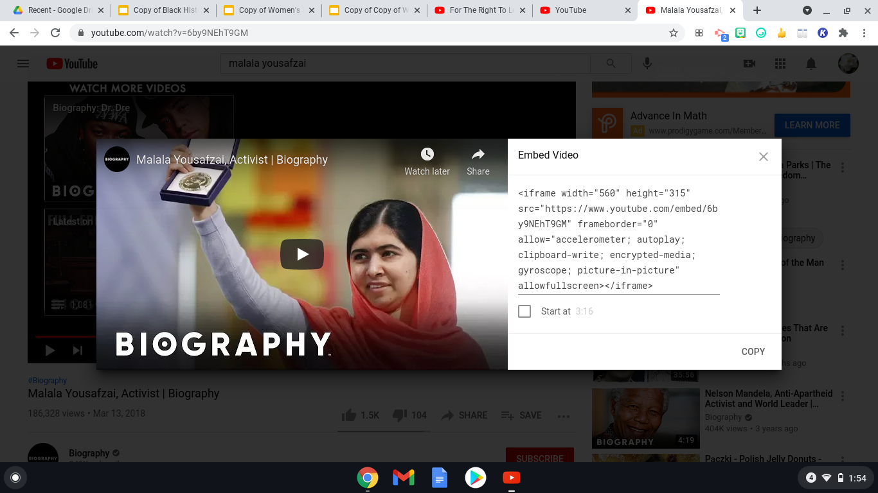
Malala Yousafzai
“Malala lived in a peaceful valley in Pakistan. One day, a group of armed men called the Taliban took control of the valley. The Taliban forbade girls from going to school. Malala thought this was unfair, and wrote about it online...and said on TV., “Education is power for women.” Malala is the youngest person ever to receive the Nobel Peace Prize.”
“When the whole world is silent, even one voice becomes powerful.”
Read Aloud Famous Quote

Slide 8
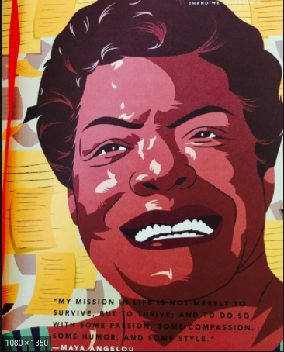
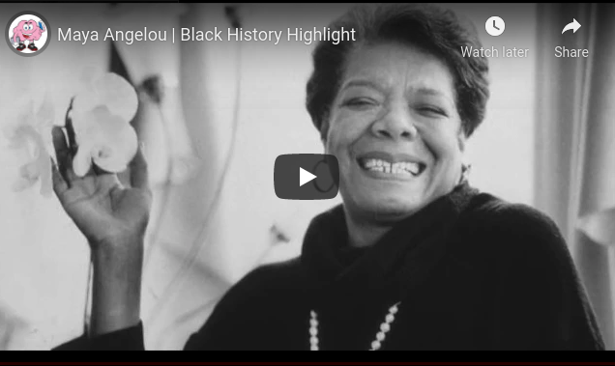
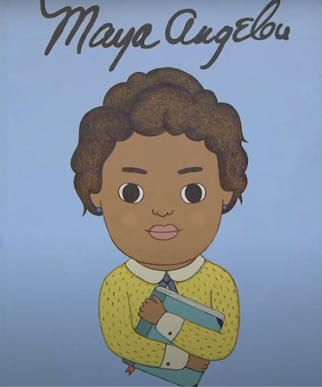
Maya Angelou
“Once there was a little girl who didn’t speak for five years. Maya… began to memorize everything she heard or read: poems, songs, short tales, random conversations. Her writing became the voice of the Civil Rights Movement. She constantly reminded us that everyone, black or white, male or female, has equal rights.”
“My mission in life is not merely to survive, but to thrive; and to do so with some passion, some compassion, some humor and some style.”
Read Aloud Famous Quote

Slide 9
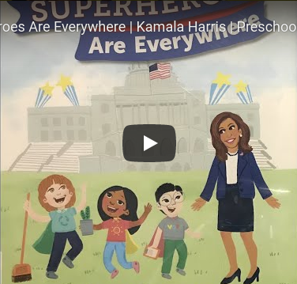
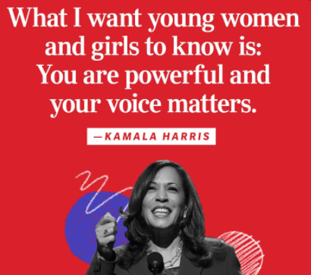
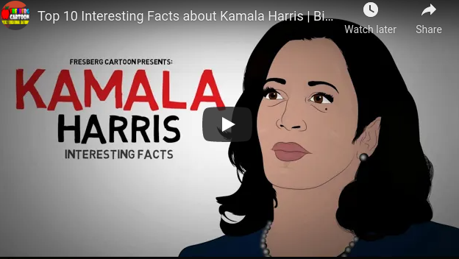
Kamala Harris
Kamala Harris, born October 20, 1964 is an American politician and attorney. She was elected Attorney General of California in 2010 and became senator of California in 2016. She is now the current vice president of the United States. She is the first female vice president, the highest ranking female official in U.S. History, and the first African American and first Asian American vice president.
Read Aloud Famous Quote

Slide 10
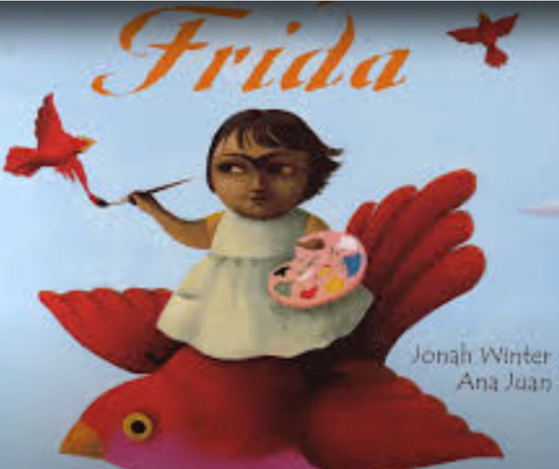
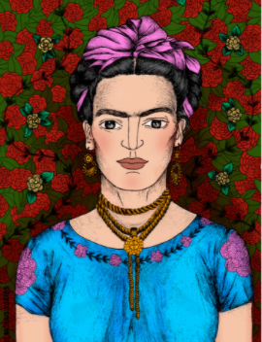
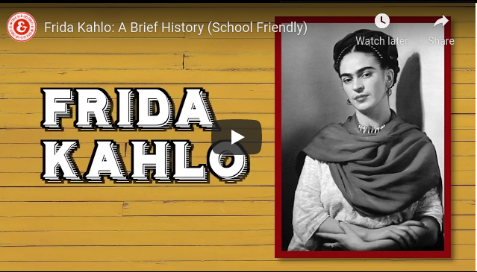
Frida Kahlo
“Once upon a time, in a bright blue house near Mexico City, lived a small girl called Frida. She would grow up to be one of the most famous painters of the twentieth century, but she almost didn’t grow up at all. When she was six, she nearly died from polio. Then, when she was eighteen, she was involved in a terrible accident and spent months in bed. Frida loved to paint. Frida painted hundreds of beautiful self-portraits during her life.”
“Feet, what do I need you for when I have wings to fly?”
Read Aloud Famous Quote

Slide 11
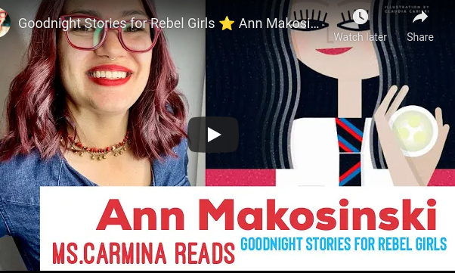
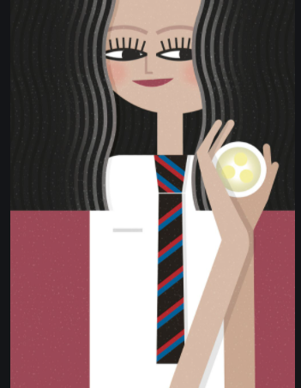
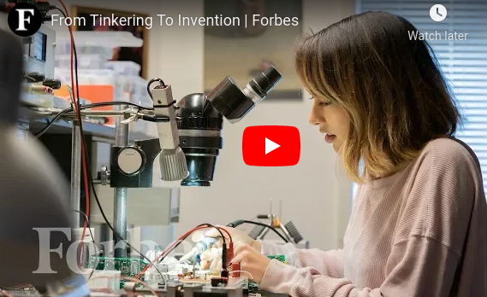
Ann Makosinski
Ann was born October 3, 1997. She is a Canadian student inventor and public speaker. She won the Google Science Fair in 2013 for a flashlight that didn’t need batteries. She has grown to be a very talented young scientist because of her fond passion for science.
“If you are alive, you produce light.”
Read Aloud Famous Quote

Slide 12
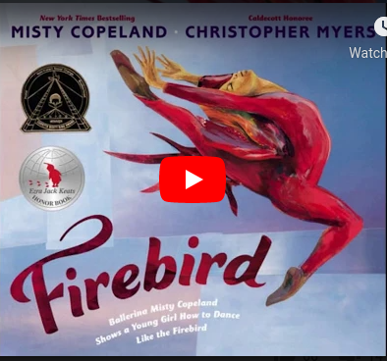
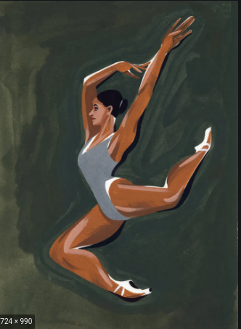
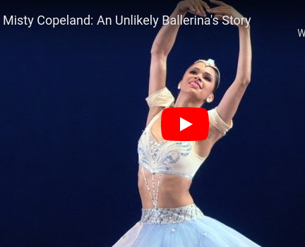
Misty Copeland
“It was a beautiful night when Misty stepped onstage before a hushed audience to dance the leading role in a ballet called The Firebird. She...had been in pain throughout the whole performance. Misty was the only African American in one of the world’s most famous dance companies.” Not only a ballerina, she has also been an author to many books on her experiences. (Born September 10, 1982)
“ Dance found me.”
Read Aloud Famous Quote

Slide 13
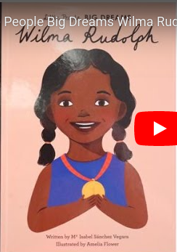
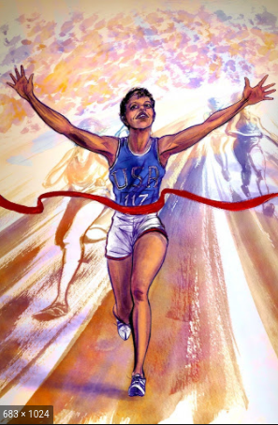
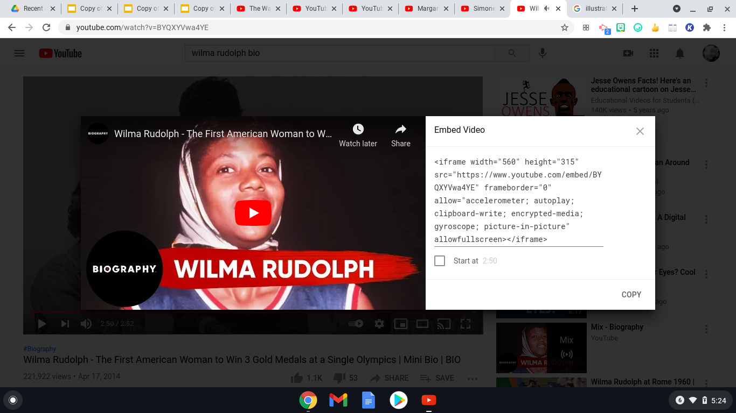
Wilma Rudolph
“Wilma was a little child when she contracted polio and was left with a paralyzed leg. Wilma had to use braces to walk and the mean kids in her neighborhood would make fun of her. By the time she was nine, her mom’s promise came true. Wilma could walk by herself! Wilma became the fastest woman in the world. She broke three world records at the 1960 Olympics. ‘Nobody wins all the time. If you can pick up after a crushing defeat, and go on to win again, you are going to be a champion someday.’ ”
“My doctor told me I would never walk again. My mother told me I would. I believed my mother.””
Read Aloud Famous Quote

Slide 14
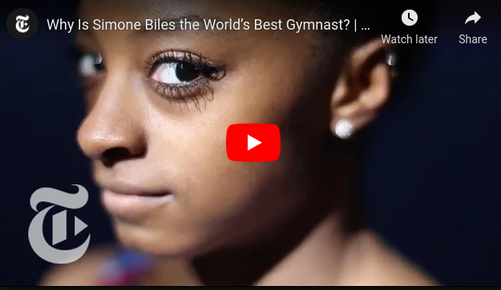
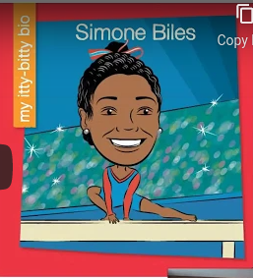

Simone Biles
“Simone Biles was a gymnast, the greatest in American history. Simone started gymnastics when she was just six years old. She was so fast, so strong, so flexible, so agile. She flew through the air with such grace and speed, twisting and turning, and landing perfectly each time. By the time she was eighteen, she had already won so many medals. At the Olympics in Rio, Simone won five medals-four of them gold!”
“I was built this way for a reason, so I’m going to use it.”
Read Aloud Famous Quote

Slide 15



Jane Goodall
“Once in England, there was a girl called Jane who loved climbing trees and reading books. Her dream was to go to Africa and spend time with the wild animals there. So one day, Jane flew to Tanzania with her notebook and binoculars, determined to study chimpanzees in their natural environment. She discovered that chimpanzees have rituals, that they use tools, and their language compromises at least twenty different sounds.”
“Only if we understand, will we care, will we help, shall all be saved.”
Read Aloud Famous Quote

Slide 16



Margaret Hamilton
“Once there was a girl who put a man on the Moon. Her name was Margaret and she was really good with computers. When she was just twenty-four years old, she joined NASA, the US agency that explores outer space. Margaret was an engineer and led the team who programmed the code that allowed the Apollo 11 spacecraft to land safely on the Moon’s surface.”
“I worked on all the Apollo manned missions.”
Read Aloud Famous Quote

Slide 17



Marie Curie
“Marie was fascinated by metals and magnets. She found out that some minerals were radioactive. They gave off powerful rays and glowed in the dark. Marie Curie won two Nobel Prizes for her work and she could have made a lot of money from her discoveries (two new elements: polonium and radium). She chose instead, to make her research available to anyone for free.”
“Nothing in Life is to be feared. It is only to be understood.”
Read Aloud Famous Quote

Slide 18



Ruth Bader Ginsburg
“Once upon a time, there was a girl who dreamed of becoming a great lawyer. She applied to Harvard Law School and became one of the brightest students. Ruth was passionate about women’s rights and argued six landmark cases on gender equality before the United States Supreme Court. Then she became the second female Supreme Court Justice in the country’s history.
”I dissent.”
Read Aloud Famous Quote

