Slide 1
Daily
Inspiration
Women’s History
Month

Slide 2

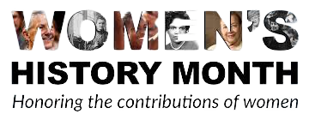
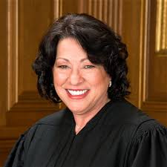
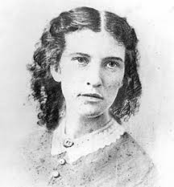
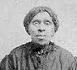
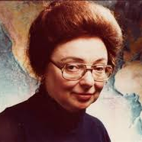
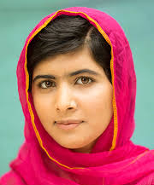
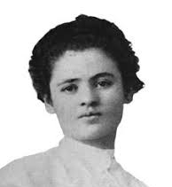
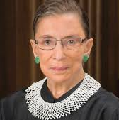
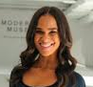
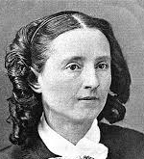
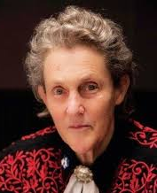
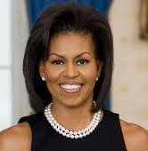
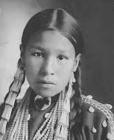
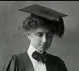
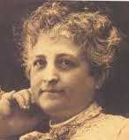
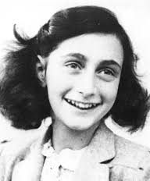
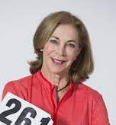
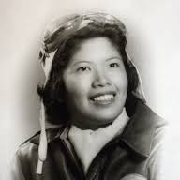
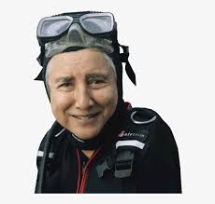
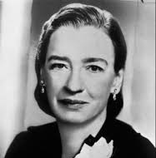
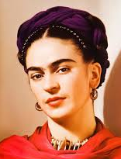
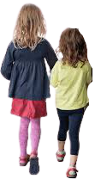
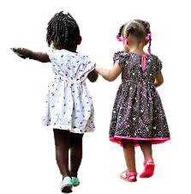
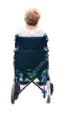
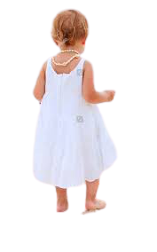
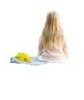
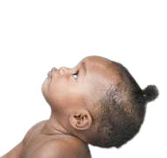
Sonia Elizabeth Harriet marie malala clara ruth misty Mary temple
Sotomayor Blackwell powers tharp yousafzai lemlich bader ginsburg copeland edwards walker Grandin
Michelle sacagawea helen teresa anne kathrine maggie eugenie grace frida
Obama keller carrena frank switzer gee clark hopper kahlo

Slide 3
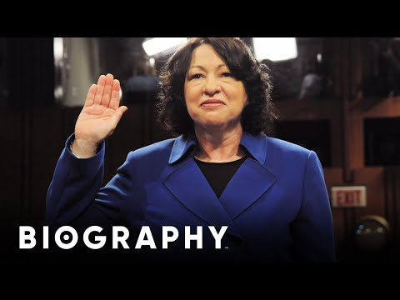
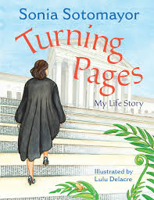
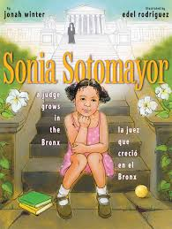
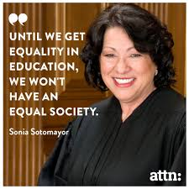
Sonia Sotomayor
Sonia Maria Sotomayor is an associate justice of the Supreme Court of the United States. She was nominated by President Barack Obama on May 26, 2009 and has served since August 8, 2009. Sotomayor is the first Hispanic and Latina member of the Court.
Read Alouds Famous Quote

Slide 4
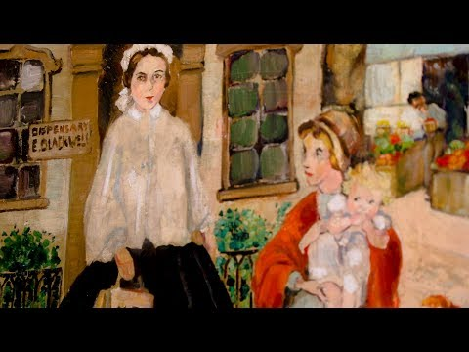
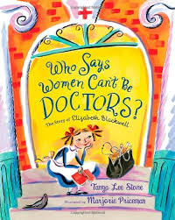
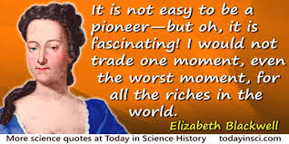
Elizabeth Blackwell
Elizabeth Blackwell was a British physician born in 1821, notable as the first woman to receive a medical degree in the United States, and the first woman on the Medical Register of the General Medical Council. Elizabeth Blackwell championed the participation of women in the medical profession and ultimately opened her own medical college for women.
Read Aloud Famous Quote

Slide 5
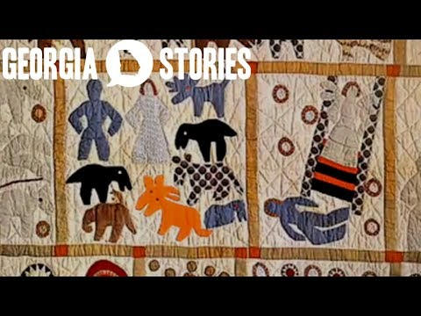
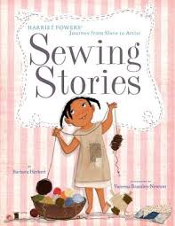
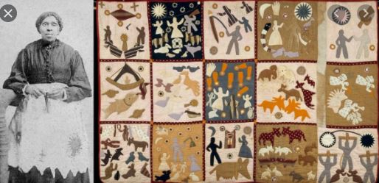
Harriet Powers
Harriet Powers was an African American folk artist and quilt maker. She was born into slavery in rural Georgia in 1837. She used traditional appliqué techniques to record local legends, Bible stories, and astronomical events on her quilts. Only two of her quilts are known to have survived: Bible Quilt 1886 and Pictorial Quilt 1898. Both of these quilts are now in museums.
Read Aloud Harriet’s Quilts Spoke for Her

Slide 6
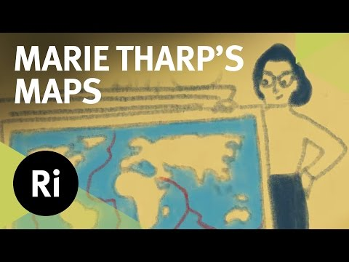
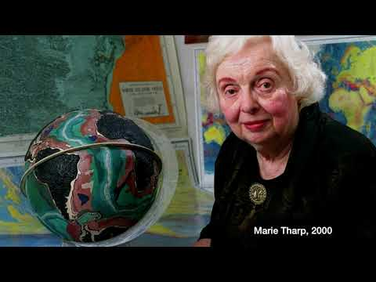
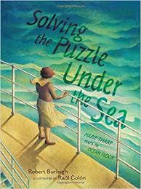
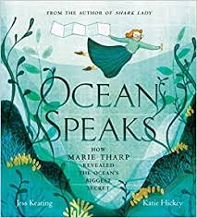
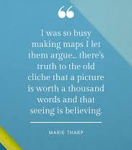
Marie Tharp
Marie Tharp, born in 1920, was an American geologist and oceanographic cartographer who, in partnership with Bruce Heezen, created the first scientific map of the Atlantic Ocean floor. Tharp's work revealed the detailed topography and multi-dimensional geographical landscape of the ocean bottom. She was one of a very few female scientists. Her scientific theories were often dismissed, but later found to be true.
Read Alouds Famous Quote

Slide 7
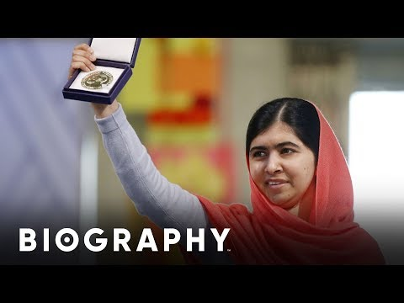
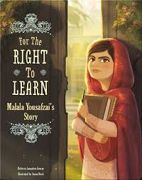

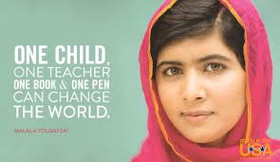
Malala Yousafzai
Malala Yousafzai, born in 1997, is a Pakistani activist for female education. When she was a teenager, Malala spoke out publicly against the prohibition on the education of girls that was imposed by the Tehrik-e-Taliban Pakistan and was shot by a member of the Taliban while on the school bus. Malala efforts resulted in her being the youngest Nobel Prize laureate.
Read Alouds Famous Quote

Slide 8
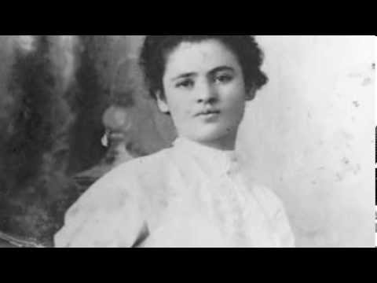
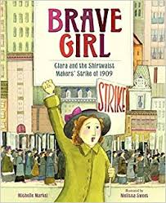
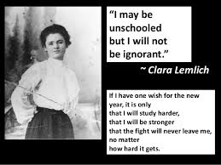
Clara Lemlich
Clara Lemlich, a 23-year-old Ukrainian immigrant, rose to a position of power in the women's labor movement, becoming the voice that incited the famous Uprising of the Twenty Thousand in 1909 in the shirtwaist garment district in New York. On November 22nd, 1909, Lemlich helped incite a strike that ultimately proved instrumental to industrial labor reform when she called her fellow seamstresses to strike until their work conditions improved.
Read Aloud Famous Quote

Slide 9
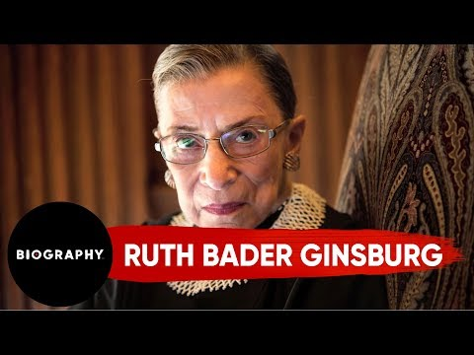
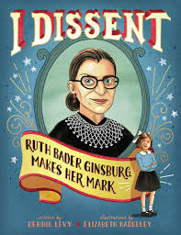

Ruth Bader Ginsburg
Joan Ruth Bader Ginsburg, born in 1933, was an American lawyer who served as an associate justice of the Supreme Court of the United States from 1993 until her death in September 2020. She was the second woman on the Supreme Court and the first Jewish woman. She was dedicated to using her job as a lawyer to fight for equity.
Read Aloud Famous Quote

Slide 10



Misty Copeland
Misty Danielle Copeland, born in 1982, is an American ballet dancer for American Ballet Theatre, one of the three leading classical ballet companies in the United States. On June 30, 2015, Copeland became the first African American woman to be promoted to principal dancer in ABT's 75-year history.
Read Aloud Famous Quote

Slide 11



Mary Edwards Walker
Mary Edwards Walker, M.D., born in 1832, commonly referred to as Dr. Mary Walker, was an American abolitionist, prohibitionist, prisoner of war and surgeon. She is the only woman to ever receive the Congressional Medal of Honor. Mary was also revolutionary for refusing to wear dresses and was arrested multiple times for wearing boys’ clothes.
Read Aloud Famous Quote

Slide 12



Temple Grandin
Mary Temple Grandin, born in 1947, was diagnosed with autism at an early age. Temple grew up to become an American scientist and activist. She is a prominent proponent for the humane treatment of livestock for slaughter and author of more than 60 scientific papers on animal behavior. She is a consultant to the livestock industry on animal behavior, and an autism spokesperson.
Read Aloud Famous Quote

Slide 13




Michelle Obama
Michelle LaVaughn Obama, born in 1964, is an American attorney and author who was the first lady of the United States from 2009 to 2017. She is married to the 44th president of the United States, Barack Obama, and was the first African-American first lady.
Read Alouds Famous Quote

Slide 14




Sacagawea
Sacagawea was a Lemhi Shoshone woman, born in 1788, who, at age 16, met and helped the Lewis and Clark Expedition in achieving their chartered mission objectives by exploring the Louisiana Territory and serving as their translator when they encountered Native Americans on their expedition.
Read Aloud Famous Quote

Slide 15




Helen Keller
Helen Adams Keller, born in 1880, was an American author, disability rights advocate, political activist, educator and lecturer. Born in West Tuscumbia, Alabama, she lost her sight and hearing after a bout of illness at the age of nineteen months. Helen attended Radcliffe College and she was the first blind and deaf person to ever graduate from college in the United States.
Read Alouds Famous Quote

Slide 16



Teresa Carreño
María Teresa Gertrudis de Jesús Carreño García, born in 1853, was a Venezuelan pianist, soprano, composer, and conductor. Over the course of her 54-year concert career, she became an internationally renowned virtuoso pianist and was often referred to as the "Valkyrie of the Piano". Over the course of her lifetime she played for two US. Presidents, Abraham Lincoln and Woodrow Wilson.
Read Aloud Teresa was Known for Signing Music

Slide 17



Anne Frank
Annelies Marie "Anne" Frank, born in 1929, was a German-Dutch diarist of Jewish heritage. One of the most discussed Jewish victims of the Holocaust, she gained fame posthumously with the publication of The Diary of a Young Girl. Anne and her family went into hiding during the Nazi invasion of the Netherlands. Her family was able to live in secret for two years before they were discovered. Once found, Anne was taken to a Nazi concerntration camp where she and her sister died in 1945.
Read Aloud Famous Quote

Slide 18



Kathrine Switzer
Kathrine Virginia Switzer, born in 1947, is an American marathon runner, author, and television commentator. In 1967, she became the first woman to run the Boston Marathon as an officially registered competitor. Kathrine became an activist for women in running and was instrumental in getting the women’s marathon added into the Olympic games.
Read Aloud Famous Quote

Slide 19



Maggie Gee
Margaret “Maggie” Gee, born in 1923, was an American aviator who served in the Women Airforce Service Pilots (WASP) in World War II. She was one of two Chinese-American women to serve in the organization, the other being Hazel Ying Lee. Gee co-piloted B-17 bombers through training missions to help bomber gunners perfect their skills for combat.
Read Aloud Famous Quote

Slide 20



Eugenie Clark
Eugenie Clark, born in 1922, was a scientific pioneer who greatly contributed to people's knowledge of sharks and other fish. Eugenie was commonly known as the Shark Lady. She who worked tirelessly to improve the sharks' reputation in the public eye. She also revolutionized the field of scuba diving as an investigative vehicle for research purposes.
Read Aloud Famous Quote

Slide 21



Grace Hopper
Grace Brewster Murray Hopper, born in 1906, was an American computer scientist and United States Navy rear admiral. One of the first programmers of the Harvard Mark I computer, she was a pioneer of computer programming who invented COBOL one of the first high level programming languages.
Read Aloud Famous Quote

Slide 22




Frida Kahlo
Magdalena Carmen Frida Kahlo y Calderón, born in 1907, was a Mexican painter known for her many brilliantly colored portraits, self-portraits, and works inspired by the nature and artifacts of Mexico. Frida contracted polio at age 6, survived a tragic bus accident, and had her leg partially amputated due to gangrene, and used painting to pass the time as she was confined to her bed to heal.
Read Alouds Famous Quote

Slide 23








Sonia Elizabeth Harriet marie malala clara ruth misty Mary temple
Sotomayor Blackwell powers tharp yousafzai lemlich bader ginsburg copeland edwards walker Grandin
Michelle sacagawea helen teresa anne kathrine maggie eugenie grace frida
Obama keller carrena frank switzer gee clark hopper kahlo

