Slide 1

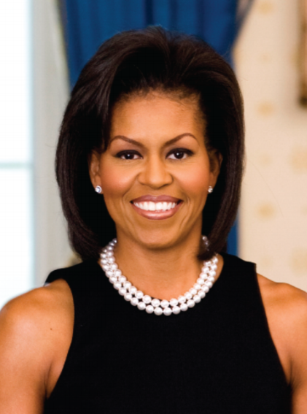

Women’s History Month: Michelle Obama

Slide 2
Michelle was born as Michelle Robinson. She changed her name to Michelle Obama when she got married.
Full Name:
Michelle was born in Chicago, Illinois.
Birth Location:
Michelle was born on January 17th, 1964.
Birthdate:

Slide 3
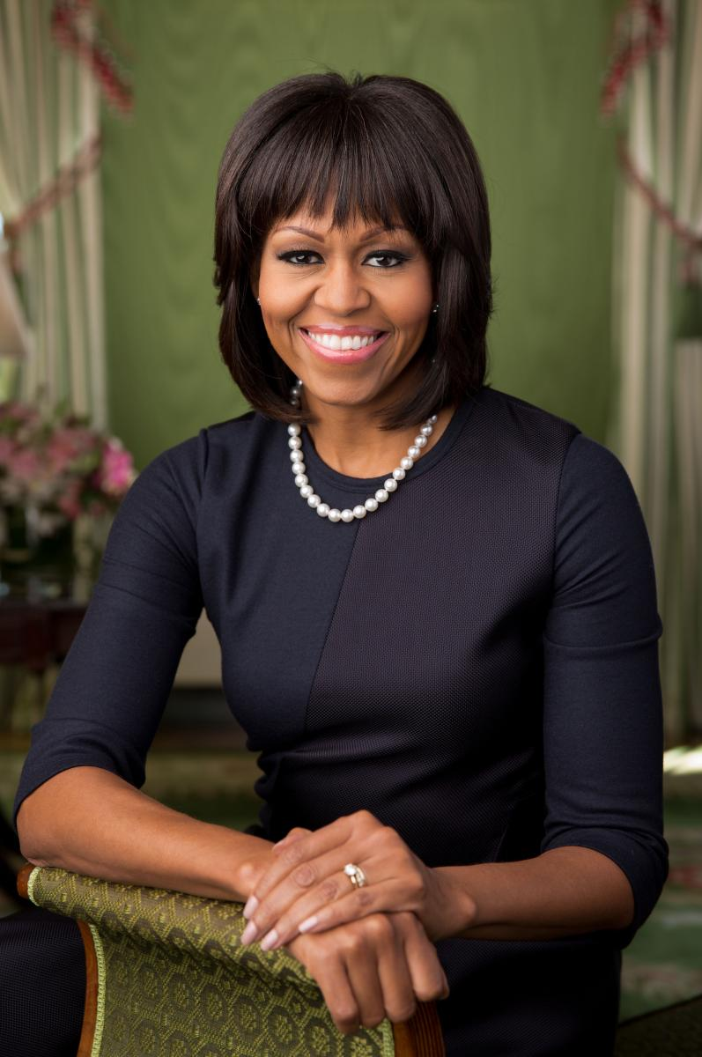
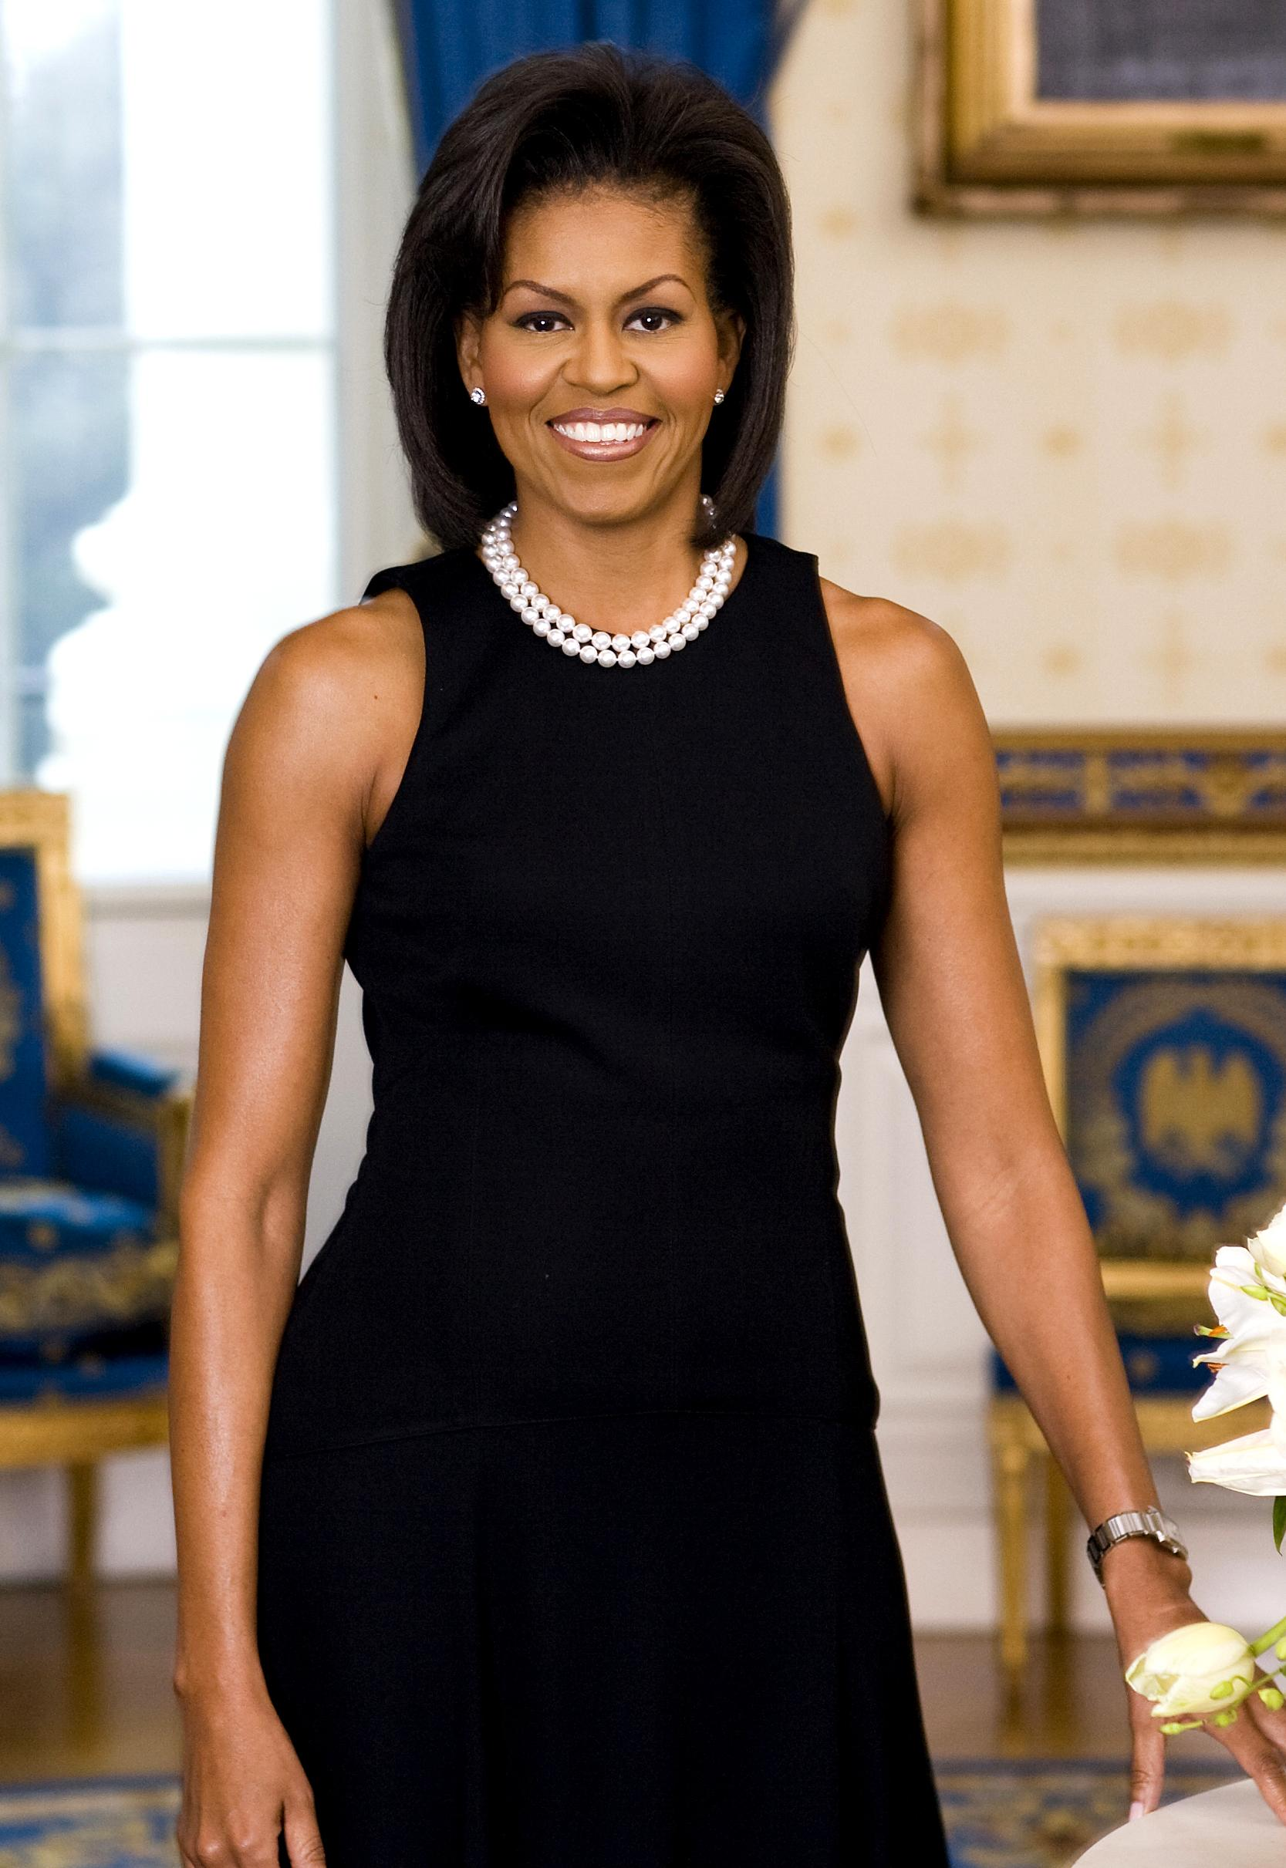
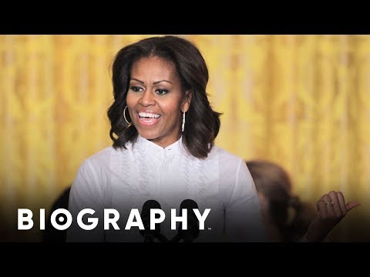
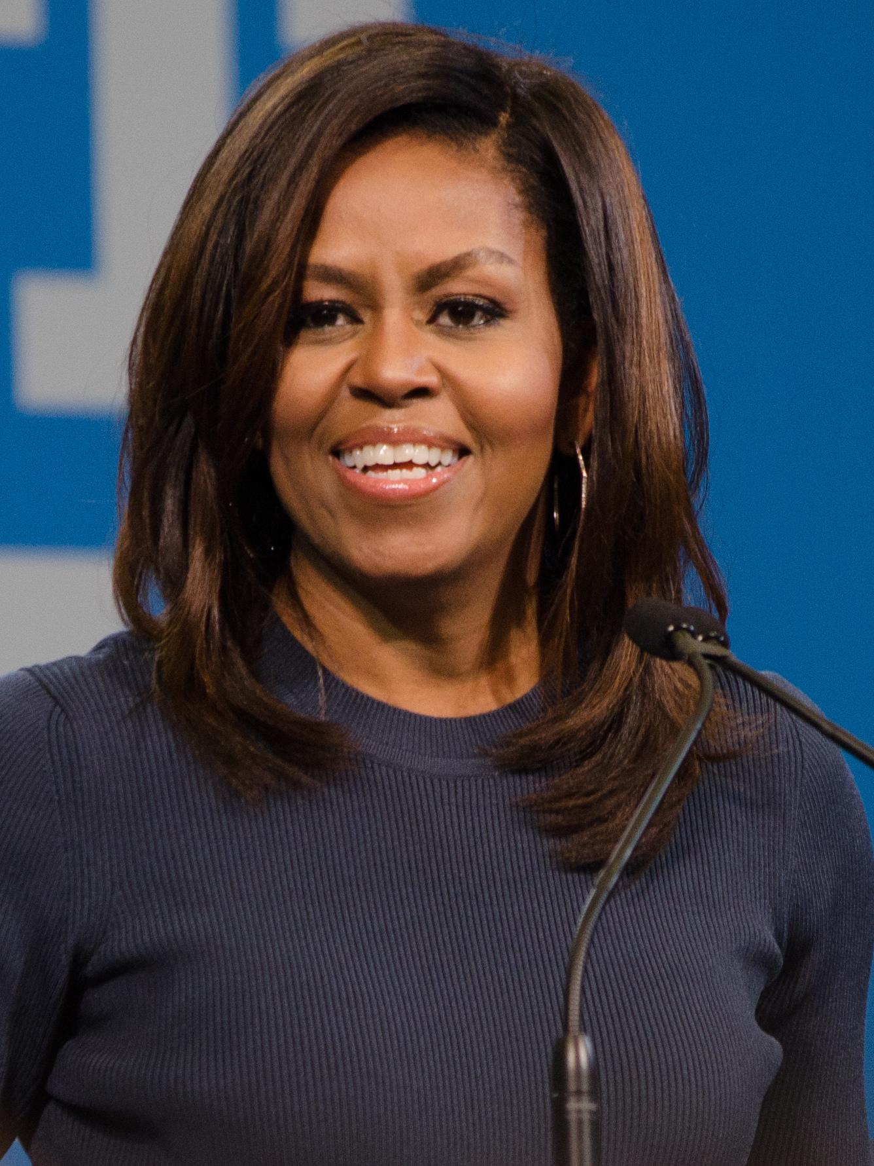

Slide 4
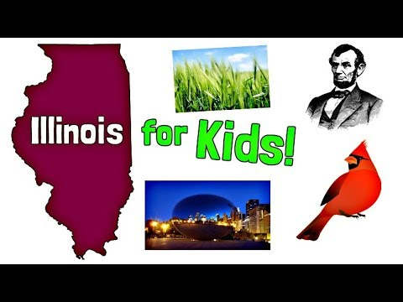
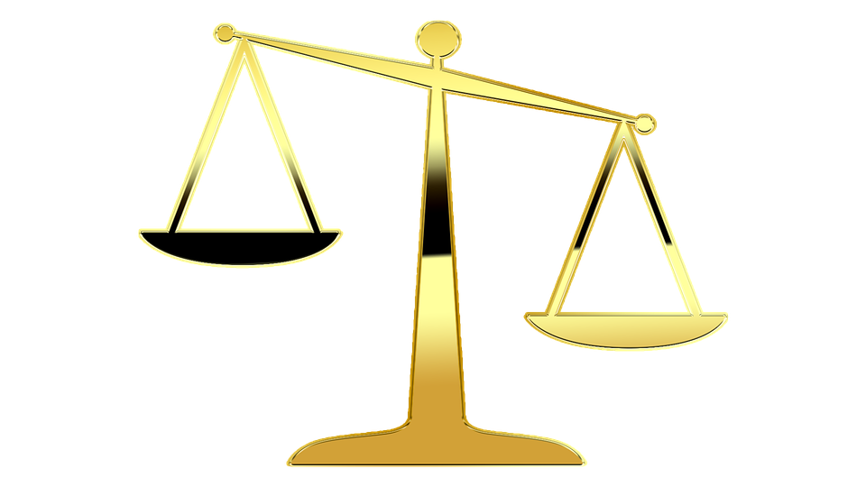
Michelle is from Illinois. Here is a video all about Illinois.

Slide 5
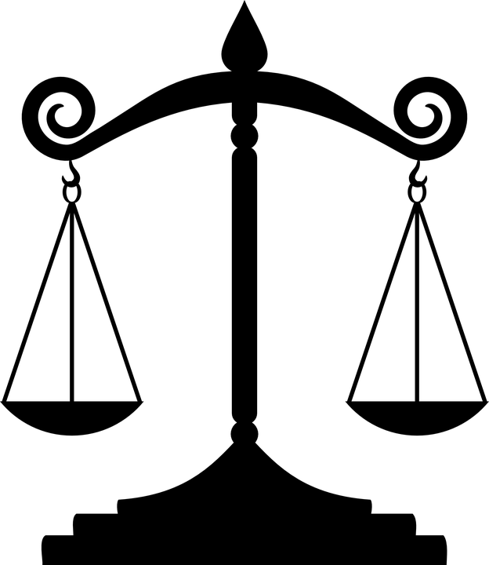
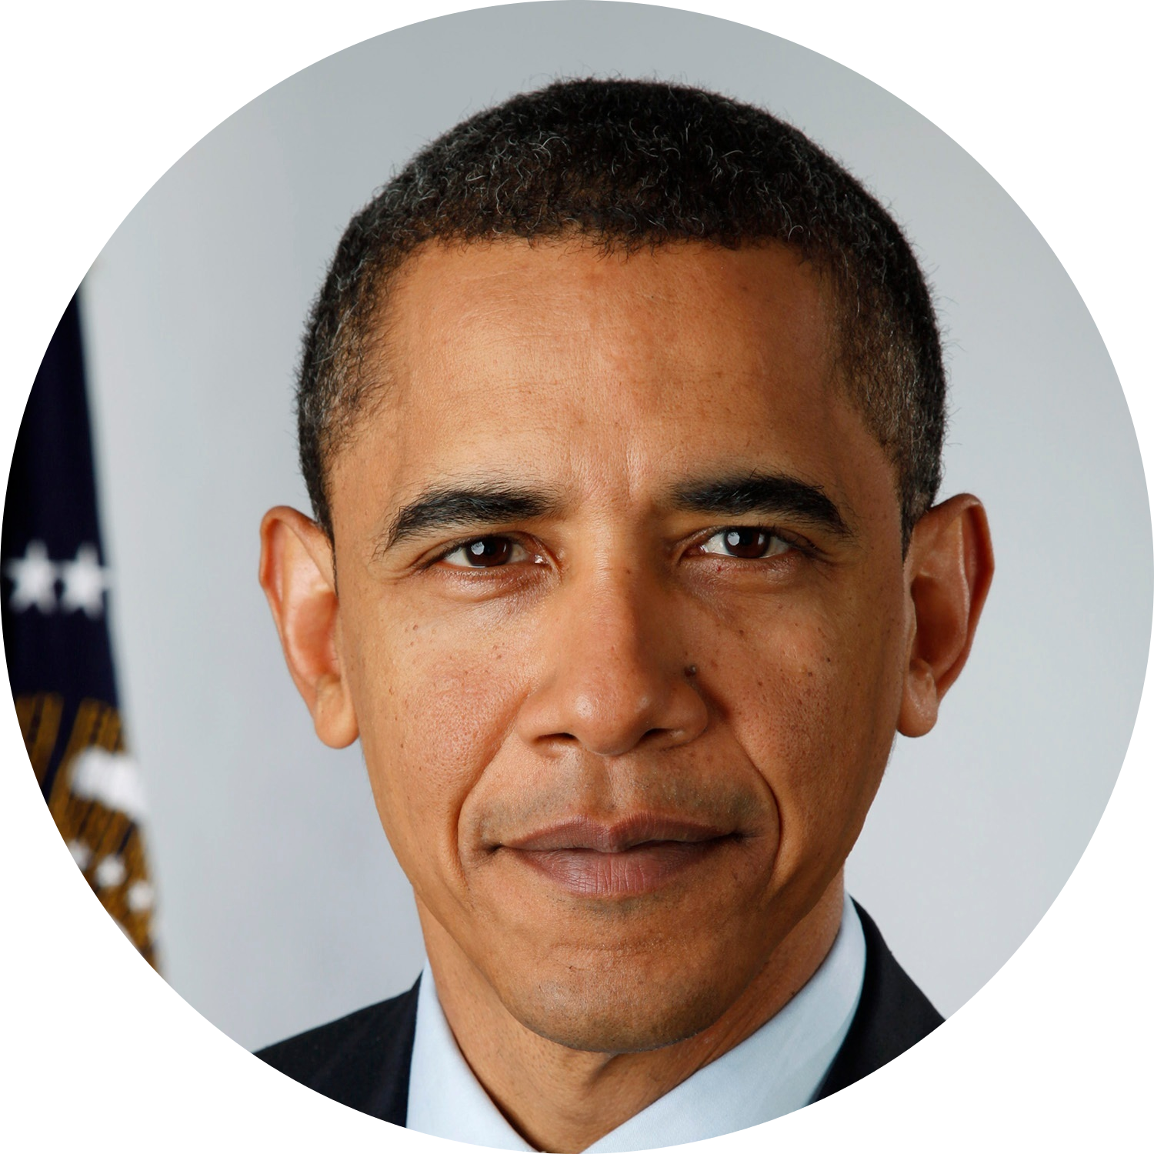
Where did she go to college?
Michelle went to Princeton and Harvard. Michelle studied law.
After graduating from college Michelle went on to become an attorney.
Occupation(s):
Michelle met a man named Barack Obama in 1989. They dated for three years and then got married.
Was she married?

Slide 6
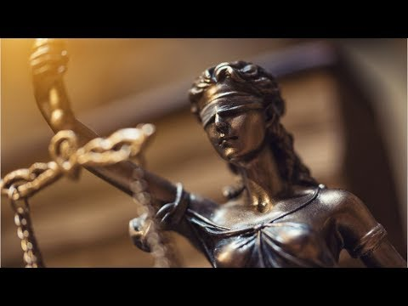

Michelle was an attorney. Here is a video about being an attorney.

Slide 7
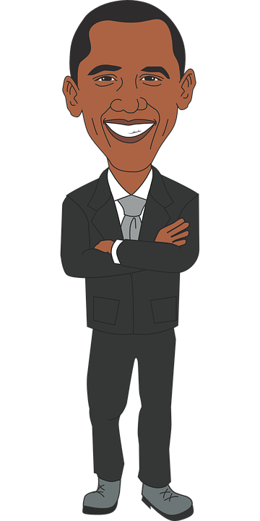
Did she has any children?
Michelle and Barack Obama have two daughters. Their names are Sasha and Malia.
Michelle’s husband Barack was an attorney and a law professor. He also served 3 terms in the Illinois Senate. In 2008, Barack become President of the United States of America. Michelle became the first lady of the Unites States. AS the 1st lady, she helped to start the Let’s Move! Program and MyPlate program.
Who was Michelle’’s husband Barack?

Slide 8
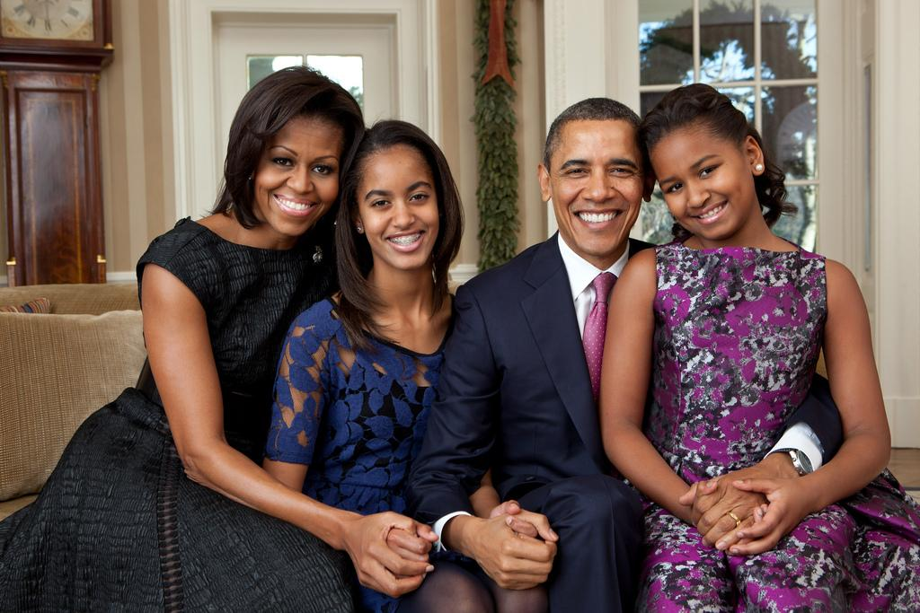
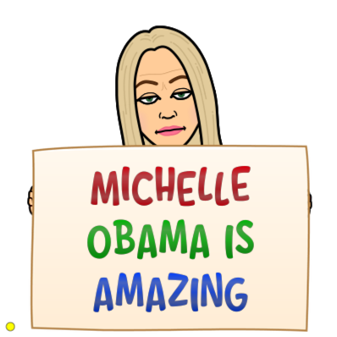

Slide 9


Fun Facts:
Michelle’s mother was a homemaker and her father worked at a water plant.
She planted a vegetable garden at the White House.
She has a podcast called The Michelle Obama Podcast.
She was the first African-American first lady of the U.S.

Slide 10
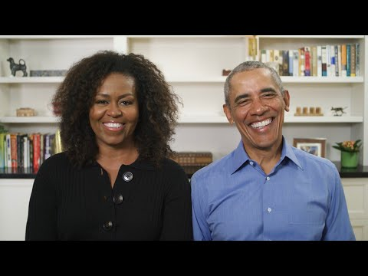
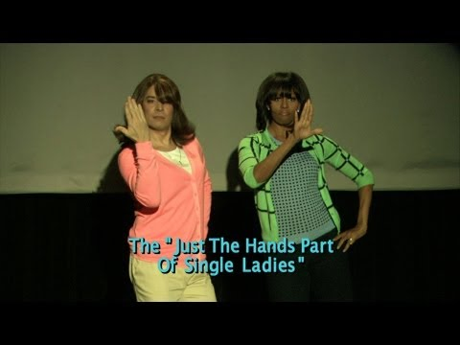
Other Videos:

Slide 11
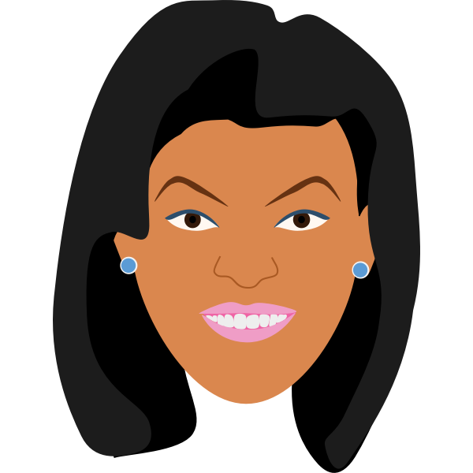
Review Time
Type your answer here.
Where was Michelle born?:
Type your answer here.
Where did Michelle go to school?:

Slide 12
Review Time
Type your answer here.
Who is Michelle’s husband?
Type your answer here.
What are the names of her daughters?

Slide 13
References:
Unique Learning System
https://www.britannica.com/biography/Michelle-Obama

