Slide 1
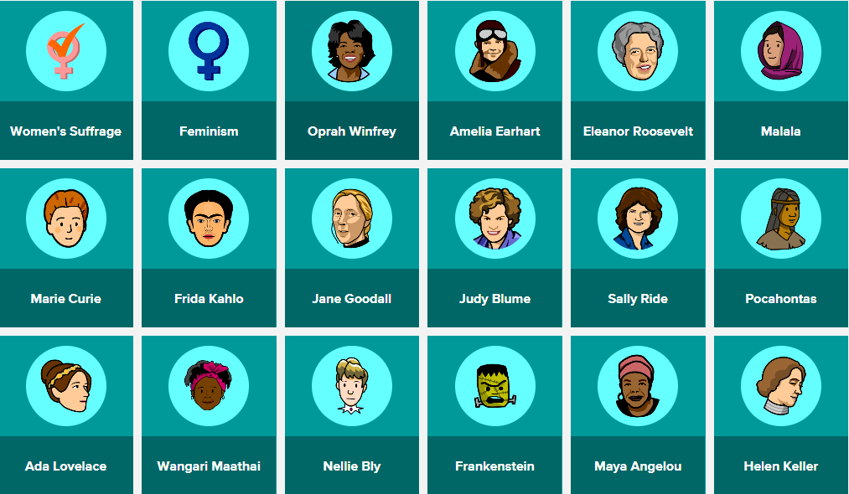
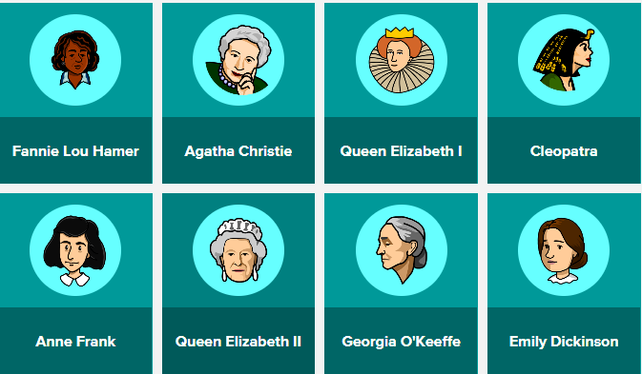
Women’s History Month
Notes:
Need a school brainpop subscription

