Slide 1


March Morning Board

Slide 2
March Morning Board
Give to students in present mode. I copy the share link and erase everything after the /. Next, I add the letters preview?rm=minimum to the end of the link. Once, I have my new link, I share to Google Classroom by adding it to the instruction section.
Students can use this however you see fit. I have my students get on in the morning while they are waiting for class to begin. They work on an independent activity to get their brain juices flowing. I also allow them to go back to it throughout the day if they have any extra time before the next subject/task.
This is the slide deck without links, feel free to change, delete, add whatever you need to fit your classroom needs.
Notes:
Delete after reading :)

Slide 3

March
Click on today’s date.
Sunday | Monday | Tuesday | Wednesday | Thursday | Friday | Saturday
 | 1 | 2 | 3 | 4 | 5 | 6
7 | 8 | 9 | 10 | 11 | 12 | 13
14 | 15 | 16 | 17 | 18 | 19 | 20
21 | 22 | 23 | 24 | 25 | 26 | 27
28 | 29 | 30 | 31
No School
No School
St. Patrick’s Day
Notes:
Move the clover to cover the days as you complete them to better help the students see which day is next. Or just keep them in the corner to look cute.

Slide 4

March
Click on today’s date.
Morning Photo Prompt
Click here
Sunday | Monday | Tuesday | Wednesday | Thursday | Friday | Saturday
 | 1 | 2 | 3 | 4 | 5 | 6
7 | 8 | 9 | 10 | 11 | 12 | 13
14 | 15 | 16 | 17 | 18 | 19 | 20
21 | 22 | 23 | 24 | 25 | 26 | 27
28 | 29 | 30 | 31
No School
No School
St. Patrick’s Day
Notes:
March 1

Slide 5

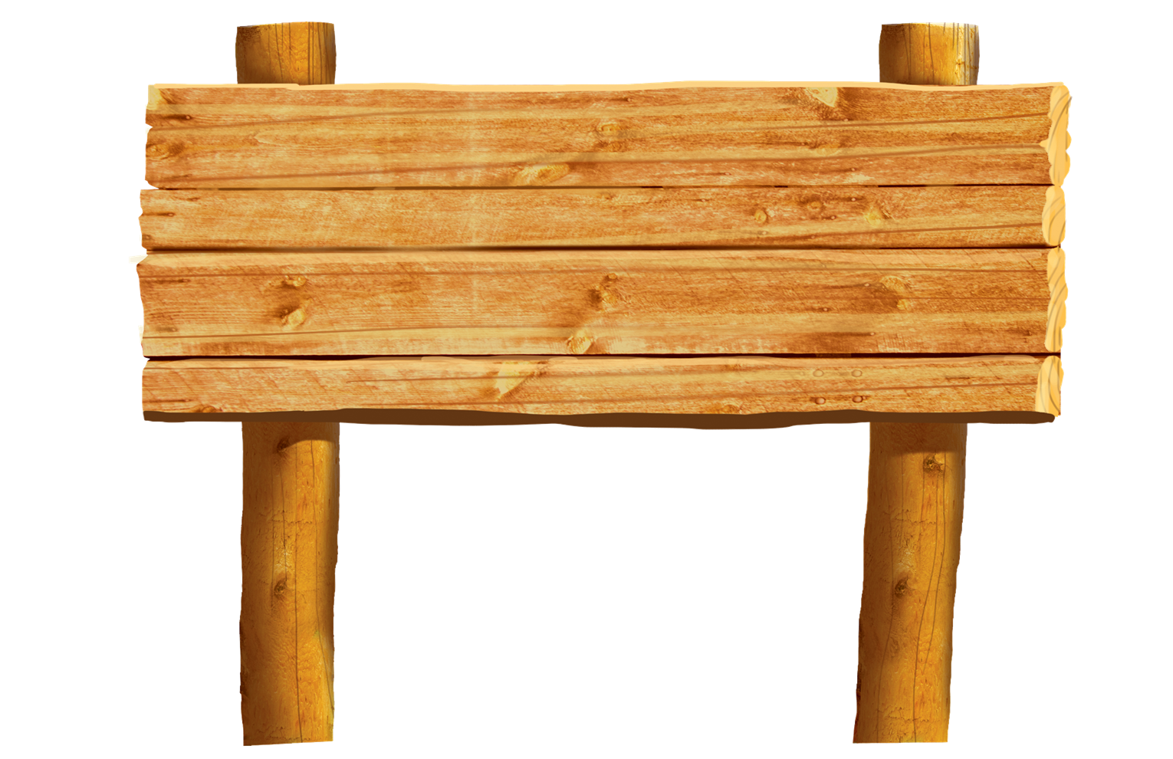

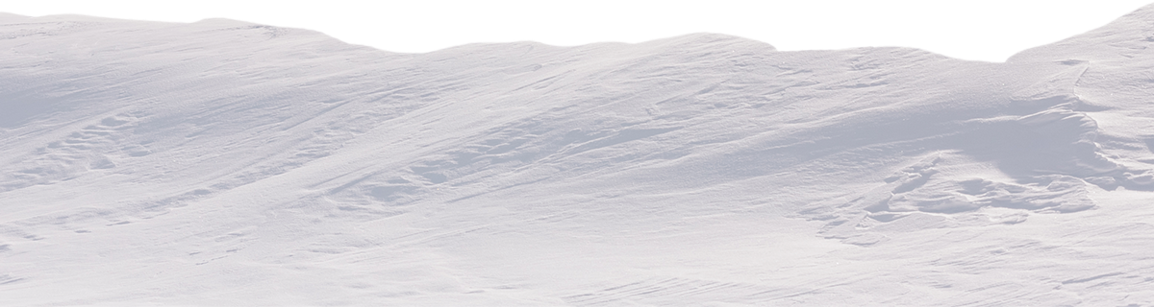

Idea Starters!
-How did this happen?
-How is she feeling?
-Describe the setting.
-Why is this happening?
-What will happen next?
Morning Photo
Prompt
Notes:
Inspired by Kristen May’s wonderful work

Slide 6

March
Click on today’s date.
“How to” Drawing
Get out a piece of paper and pencil before you start.
Sunday | Monday | Tuesday | Wednesday | Thursday | Friday | Saturday
 | 1 | 2 | 3 | 4 | 5 | 6
7 | 8 | 9 | 10 | 11 | 12 | 13
14 | 15 | 16 | 17 | 18 | 19 | 20
21 | 22 | 23 | 24 | 25 | 26 | 27
28 | 29 | 30 | 31
No School
No School
St. Patrick’s Day
Notes:
March 2nd

Slide 7
March
Click on today’s date.
Get out a piece of notebook paper to help you do today’s activity.
Sunday | Monday | Tuesday | Wednesday | Thursday | Friday | Saturday
 | 1 | 2 | 3 | 4 | 5 | 6
7 | 8 | 9 | 10 | 11 | 12 | 13
14 | 15 | 16 | 17 | 18 | 19 | 20
21 | 22 | 23 | 24 | 25 | 26 | 27
28 | 29 | 30 | 31
No School
No School
St. Patrick’s Day
Notes:
March 3

Slide 8
March
Click on today’s date.
Get some headphones and click here
to complete today’s activity.
Sunday | Monday | Tuesday | Wednesday | Thursday | Friday | Saturday
 | 1 | 2 | 3 | 4 | 5 | 6
7 | 8 | 9 | 10 | 11 | 12 | 13
14 | 15 | 16 | 17 | 18 | 19 | 20
21 | 22 | 23 | 24 | 25 | 26 | 27
28 | 29 | 30 | 31
No School
No School
St. Patrick’s Day
Notes:
March 4

Slide 9
March
Click on today’s date.
Get some headphones before completing today’s activity.
Sunday | Monday | Tuesday | Wednesday | Thursday | Friday | Saturday
 | 1 | 2 | 3 | 4 | 5 | 6
7 | 8 | 9 | 10 | 11 | 12 | 13
14 | 15 | 16 | 17 | 18 | 19 | 20
21 | 22 | 23 | 24 | 25 | 26 | 27
28 | 29 | 30 | 31
No School
No School
St. Patrick’s Day
Notes:
March 5

Slide 10
March
Click on today’s date.
Morning Photo Prompt
Click here
Sunday | Monday | Tuesday | Wednesday | Thursday | Friday | Saturday
 | 1 | 2 | 3 | 4 | 5 | 6
7 | 8 | 9 | 10 | 11 | 12 | 13
14 | 15 | 16 | 17 | 18 | 19 | 20
21 | 22 | 23 | 24 | 25 | 26 | 27
28 | 29 | 30 | 31
No School
No School
St. Patrick’s Day
Notes:
March 8

Slide 11
Idea Starters!
-How did this happen?
-How is she feeling?
-Describe the setting.
-Why is this happening?
-What will happen next?
Morning Photo
Prompt
Notes:
Inspired by Kristen May’s wonderful work

Slide 12
March
Click on today’s date.
“How to” Drawing
Get out a piece of paper and pencil before you start.
Sunday | Monday | Tuesday | Wednesday | Thursday | Friday | Saturday
 | 1 | 2 | 3 | 4 | 5 | 6
7 | 8 | 9 | 10 | 11 | 12 | 13
14 | 15 | 16 | 17 | 18 | 19 | 20
21 | 22 | 23 | 24 | 25 | 26 | 27
28 | 29 | 30 | 31
No School
No School
St. Patrick’s Day
Notes:
March 9

Slide 13
March
Click on today’s date.
Get some headphones before completing today’s activity.
Sunday | Monday | Tuesday | Wednesday | Thursday | Friday | Saturday
 | 1 | 2 | 3 | 4 | 5 | 6
7 | 8 | 9 | 10 | 11 | 12 | 13
14 | 15 | 16 | 17 | 18 | 19 | 20
21 | 22 | 23 | 24 | 25 | 26 | 27
28 | 29 | 30 | 31
No School
No School
St. Patrick’s Day
Notes:
March 10

Slide 14
March
Click on today’s date.
Morning Photo Prompt
Click here
Sunday | Monday | Tuesday | Wednesday | Thursday | Friday | Saturday
 | 1 | 2 | 3 | 4 | 5 | 6
7 | 8 | 9 | 10 | 11 | 12 | 13
14 | 15 | 16 | 17 | 18 | 19 | 20
21 | 22 | 23 | 24 | 25 | 26 | 27
28 | 29 | 30 | 31
No School
No School
St. Patrick’s Day
Notes:
March 15

Slide 15
Idea Starters!
-How did this happen?
-How is she feeling?
-Describe the setting.
-Why is this happening?
-What will happen next?
Morning Photo
Prompt
Notes:
Inspired by Kristen May’s wonderful work

Slide 16
March
Click on today’s date.
“How to” Drawing
Get out a piece of paper and pencil before you start.
Sunday | Monday | Tuesday | Wednesday | Thursday | Friday | Saturday
 | 1 | 2 | 3 | 4 | 5 | 6
7 | 8 | 9 | 10 | 11 | 12 | 13
14 | 15 | 16 | 17 | 18 | 19 | 20
21 | 22 | 23 | 24 | 25 | 26 | 27
28 | 29 | 30 | 31
No School
No School
St. Patrick’s Day
Notes:
March 16

Slide 17
March
Click on today’s date.
Get out a piece of notebook paper to help you do today’s activity.
Sunday | Monday | Tuesday | Wednesday | Thursday | Friday | Saturday
 | 1 | 2 | 3 | 4 | 5 | 6
7 | 8 | 9 | 10 | 11 | 12 | 13
14 | 15 | 16 | 17 | 18 | 19 | 20
21 | 22 | 23 | 24 | 25 | 26 | 27
28 | 29 | 30 | 31
No School
No School
St. Patrick’s Day
Notes:
March 17

Slide 18
March
Click on today’s date.
Get some headphones and click here
to complete today’s activity.
Sunday | Monday | Tuesday | Wednesday | Thursday | Friday | Saturday
 | 1 | 2 | 3 | 4 | 5 | 6
7 | 8 | 9 | 10 | 11 | 12 | 13
14 | 15 | 16 | 17 | 18 | 19 | 20
21 | 22 | 23 | 24 | 25 | 26 | 27
28 | 29 | 30 | 31
No School
No School
St. Patrick’s Day
Notes:
March 18

Slide 19
March
Click on today’s date.
Get some headphones before completing today’s activity.
Sunday | Monday | Tuesday | Wednesday | Thursday | Friday | Saturday
 | 1 | 2 | 3 | 4 | 5 | 6
7 | 8 | 9 | 10 | 11 | 12 | 13
14 | 15 | 16 | 17 | 18 | 19 | 20
21 | 22 | 23 | 24 | 25 | 26 | 27
28 | 29 | 30 | 31
No School
No School
St. Patrick’s Day
Notes:
March 19

Slide 20
March
Click on today’s date.
Morning Photo Prompt
Click here
Sunday | Monday | Tuesday | Wednesday | Thursday | Friday | Saturday
 | 1 | 2 | 3 | 4 | 5 | 6
7 | 8 | 9 | 10 | 11 | 12 | 13
14 | 15 | 16 | 17 | 18 | 19 | 20
21 | 22 | 23 | 24 | 25 | 26 | 27
28 | 29 | 30 | 31
No School
No School
St. Patrick’s Day
Notes:
March 22

Slide 21
Idea Starters!
-How did this happen?
-How is she feeling?
-Describe the setting.
-Why is this happening?
-What will happen next?
Morning Photo
Prompt
Notes:
Inspired by Kristen May’s wonderful work

Slide 22
March
Click on today’s date.
“How to” Drawing
Get out a piece of paper and pencil before you start.
Sunday | Monday | Tuesday | Wednesday | Thursday | Friday | Saturday
 | 1 | 2 | 3 | 4 | 5 | 6
7 | 8 | 9 | 10 | 11 | 12 | 13
14 | 15 | 16 | 17 | 18 | 19 | 20
21 | 22 | 23 | 24 | 25 | 26 | 27
28 | 29 | 30 | 31
No School
No School
St. Patrick’s Day
Notes:
March 23

Slide 23
March
Click on today’s date.
Get out a piece of notebook paper to help you do today’s activity.
Sunday | Monday | Tuesday | Wednesday | Thursday | Friday | Saturday
 | 1 | 2 | 3 | 4 | 5 | 6
7 | 8 | 9 | 10 | 11 | 12 | 13
14 | 15 | 16 | 17 | 18 | 19 | 20
21 | 22 | 23 | 24 | 25 | 26 | 27
28 | 29 | 30 | 31
No School
No School
St. Patrick’s Day
Notes:
March 24

Slide 24
March
Click on today’s date.
Get some headphones and click here
to complete today’s activity.
Sunday | Monday | Tuesday | Wednesday | Thursday | Friday | Saturday
 | 1 | 2 | 3 | 4 | 5 | 6
7 | 8 | 9 | 10 | 11 | 12 | 13
14 | 15 | 16 | 17 | 18 | 19 | 20
21 | 22 | 23 | 24 | 25 | 26 | 27
28 | 29 | 30 | 31
No School
No School
St. Patrick’s Day
Notes:
March 25

Slide 25
March
Click on today’s date.
Get some headphones before completing today’s activity.
Sunday | Monday | Tuesday | Wednesday | Thursday | Friday | Saturday
 | 1 | 2 | 3 | 4 | 5 | 6
7 | 8 | 9 | 10 | 11 | 12 | 13
14 | 15 | 16 | 17 | 18 | 19 | 20
21 | 22 | 23 | 24 | 25 | 26 | 27
28 | 29 | 30 | 31
No School
No School
St. Patrick’s Day
Notes:
March 26

Slide 26
March
Click on today’s date.
Morning Photo Prompt
Click here
Sunday | Monday | Tuesday | Wednesday | Thursday | Friday | Saturday
 | 1 | 2 | 3 | 4 | 5 | 6
7 | 8 | 9 | 10 | 11 | 12 | 13
14 | 15 | 16 | 17 | 18 | 19 | 20
21 | 22 | 23 | 24 | 25 | 26 | 27
28 | 29 | 30 | 31
No School
No School
St. Patrick’s Day
Notes:
March 29

Slide 27
Idea Starters!
-How did this happen?
-How is she feeling?
-Describe the setting.
-Why is this happening?
-What will happen next?
Morning Photo
Prompt
Notes:
Inspired by Kristen May’s wonderful work

Slide 28
March
Click on today’s date.
“How to” Drawing
Get out a piece of paper and pencil before you start.
Sunday | Monday | Tuesday | Wednesday | Thursday | Friday | Saturday
 | 1 | 2 | 3 | 4 | 5 | 6
7 | 8 | 9 | 10 | 11 | 12 | 13
14 | 15 | 16 | 17 | 18 | 19 | 20
21 | 22 | 23 | 24 | 25 | 26 | 27
28 | 29 | 30 | 31
No School
No School
St. Patrick’s Day
Notes:
March 30

Slide 29
March
Click on today’s date.
Get some headphones before completing today’s activity.
Sunday | Monday | Tuesday | Wednesday | Thursday | Friday | Saturday
 | 1 | 2 | 3 | 4 | 5 | 6
7 | 8 | 9 | 10 | 11 | 12 | 13
14 | 15 | 16 | 17 | 18 | 19 | 20
21 | 22 | 23 | 24 | 25 | 26 | 27
28 | 29 | 30 | 31
No School
No School
St. Patrick’s Day
Notes:
March 31

