Slide 1


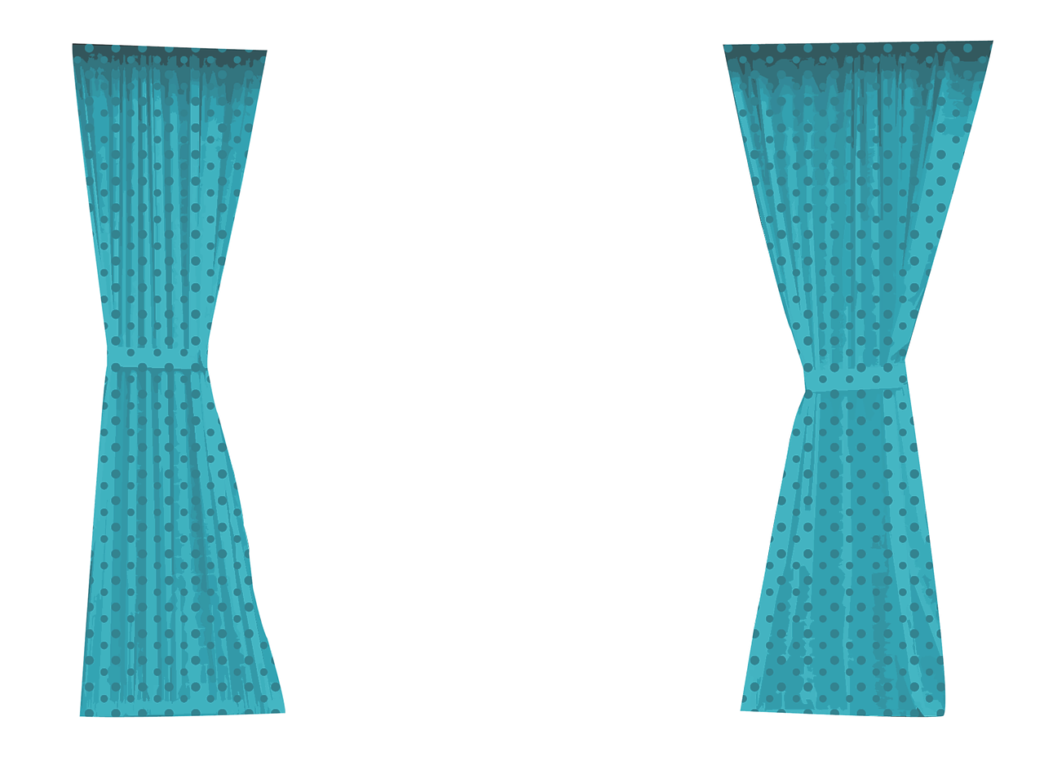


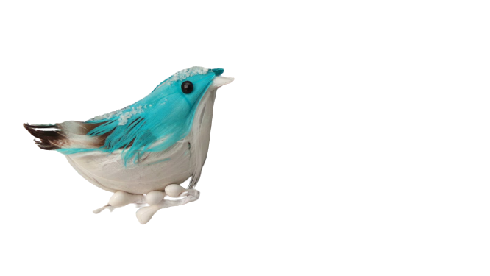
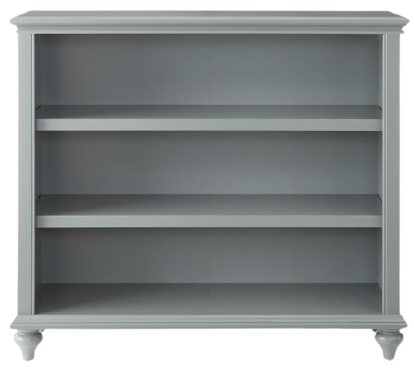








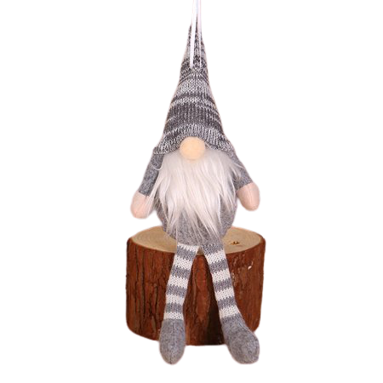

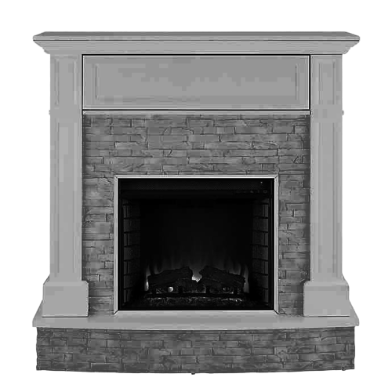










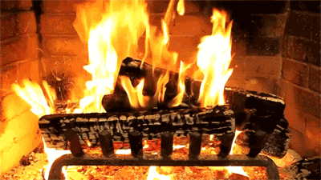









Let’s Learn About
Winter

Slide 2

Return
To
Menu

Slide 3

Return
To
Menu

Slide 4

Return
To
Menu

Slide 5

Return
To
Menu

Slide 6

Return
To
Menu

Slide 7
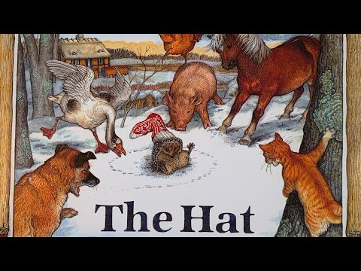
Return
To
Menu

Slide 8
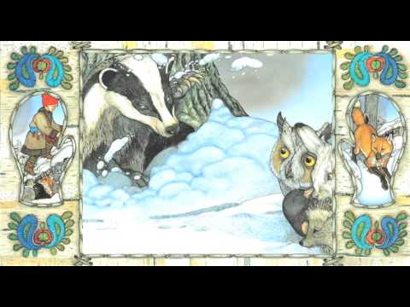
Return
To
Menu

Slide 9

Return
To
Menu

Slide 10

Return
To
Menu

Slide 11

Return
To
Menu

Slide 12
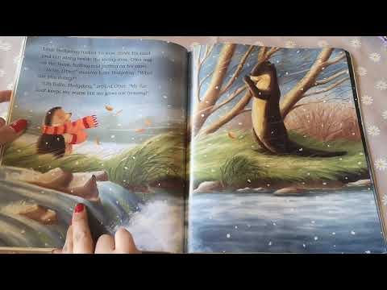
Return
To
Menu

Slide 13

Return
To
Menu

Slide 14

Return
To
Menu

Slide 15

Return
To
Menu

Slide 16

Return
To
Menu

Slide 17

Return
To
Menu

Slide 18

Return
To
Menu

Slide 19

Return
To
Menu

Slide 20
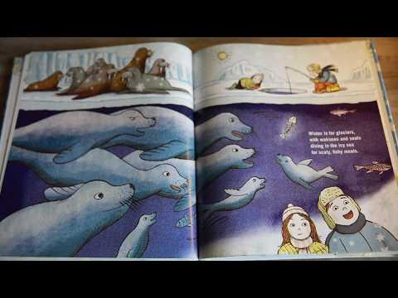
Return
To
Menu

Slide 21

Return
To
Menu

Slide 22

Return
To
Menu

Slide 23

Return
To
Menu

