Slide 1
Notes:
Introductory question

Slide 2
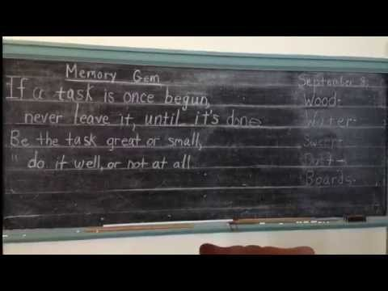
Notes:
Short video of one-room schoolhouses.

Slide 3
Teacher’s Desk
Chalkboard
Piano
Wood Stove
School Bell
American Flag
Students’ Desks
Inkwells
Kerosene Lamp
Notes:
Identify objects in the one room schoolhouse

Slide 4
Notes:
Short video of man who remembers attending class in a one-room schoolhouse

Slide 5
Notes:
Introductory slide to more one-room schoolhouse images (on following slides)

Slide 6
Notes:
Questions to prompt discussion

Slide 7
Notes:
Questions to prompt discussion

Slide 8
Notes:
Questions to prompt discussion

Slide 9
Notes:
Prompt to encourage discussion and comparison of one-room schoolhouses and learning environments today

Slide 10
Notes:
Prompt to encourage discussion and comparison of one-room schoolhouses and learning environments today

Slide 11
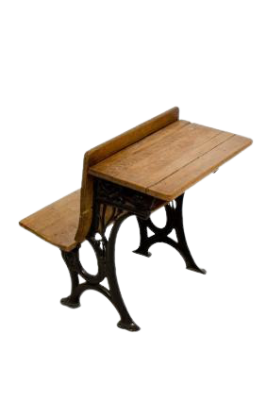

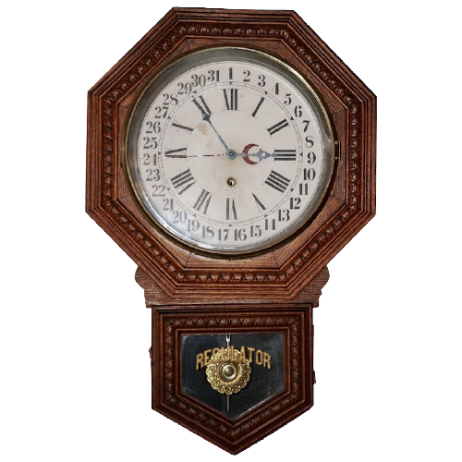
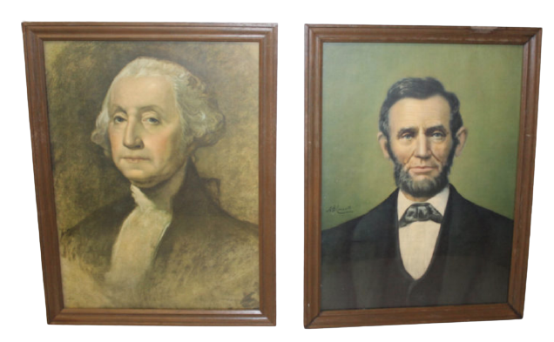
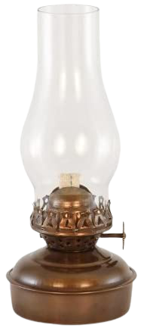
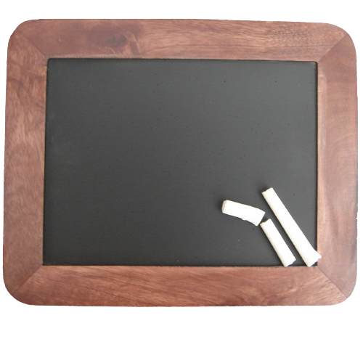
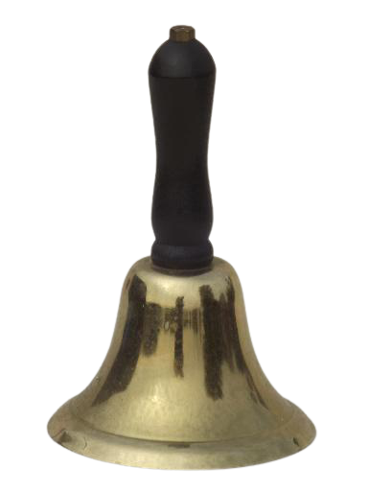

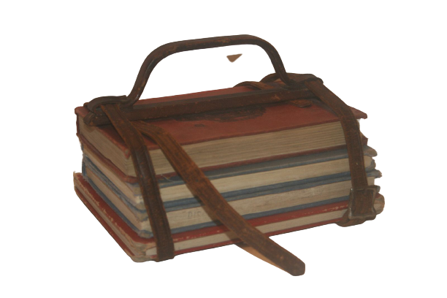
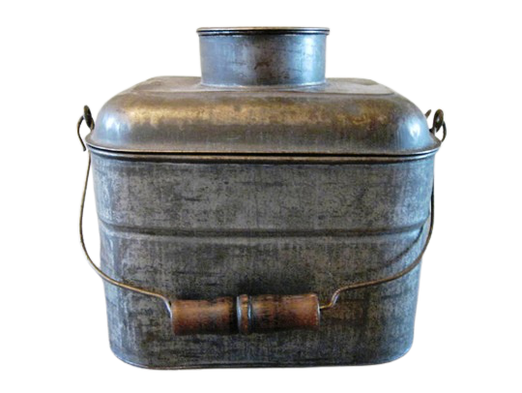
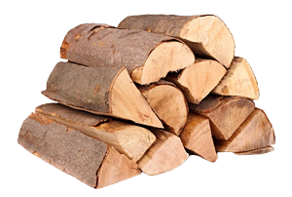
Notes:
Oil lamp, firewood, school bell, tablet and chalk, quill and ink, student desk, clock, lunch pail, book strap, globe, presidential portraits are all moveable and re-sizeable.

