Slide 1
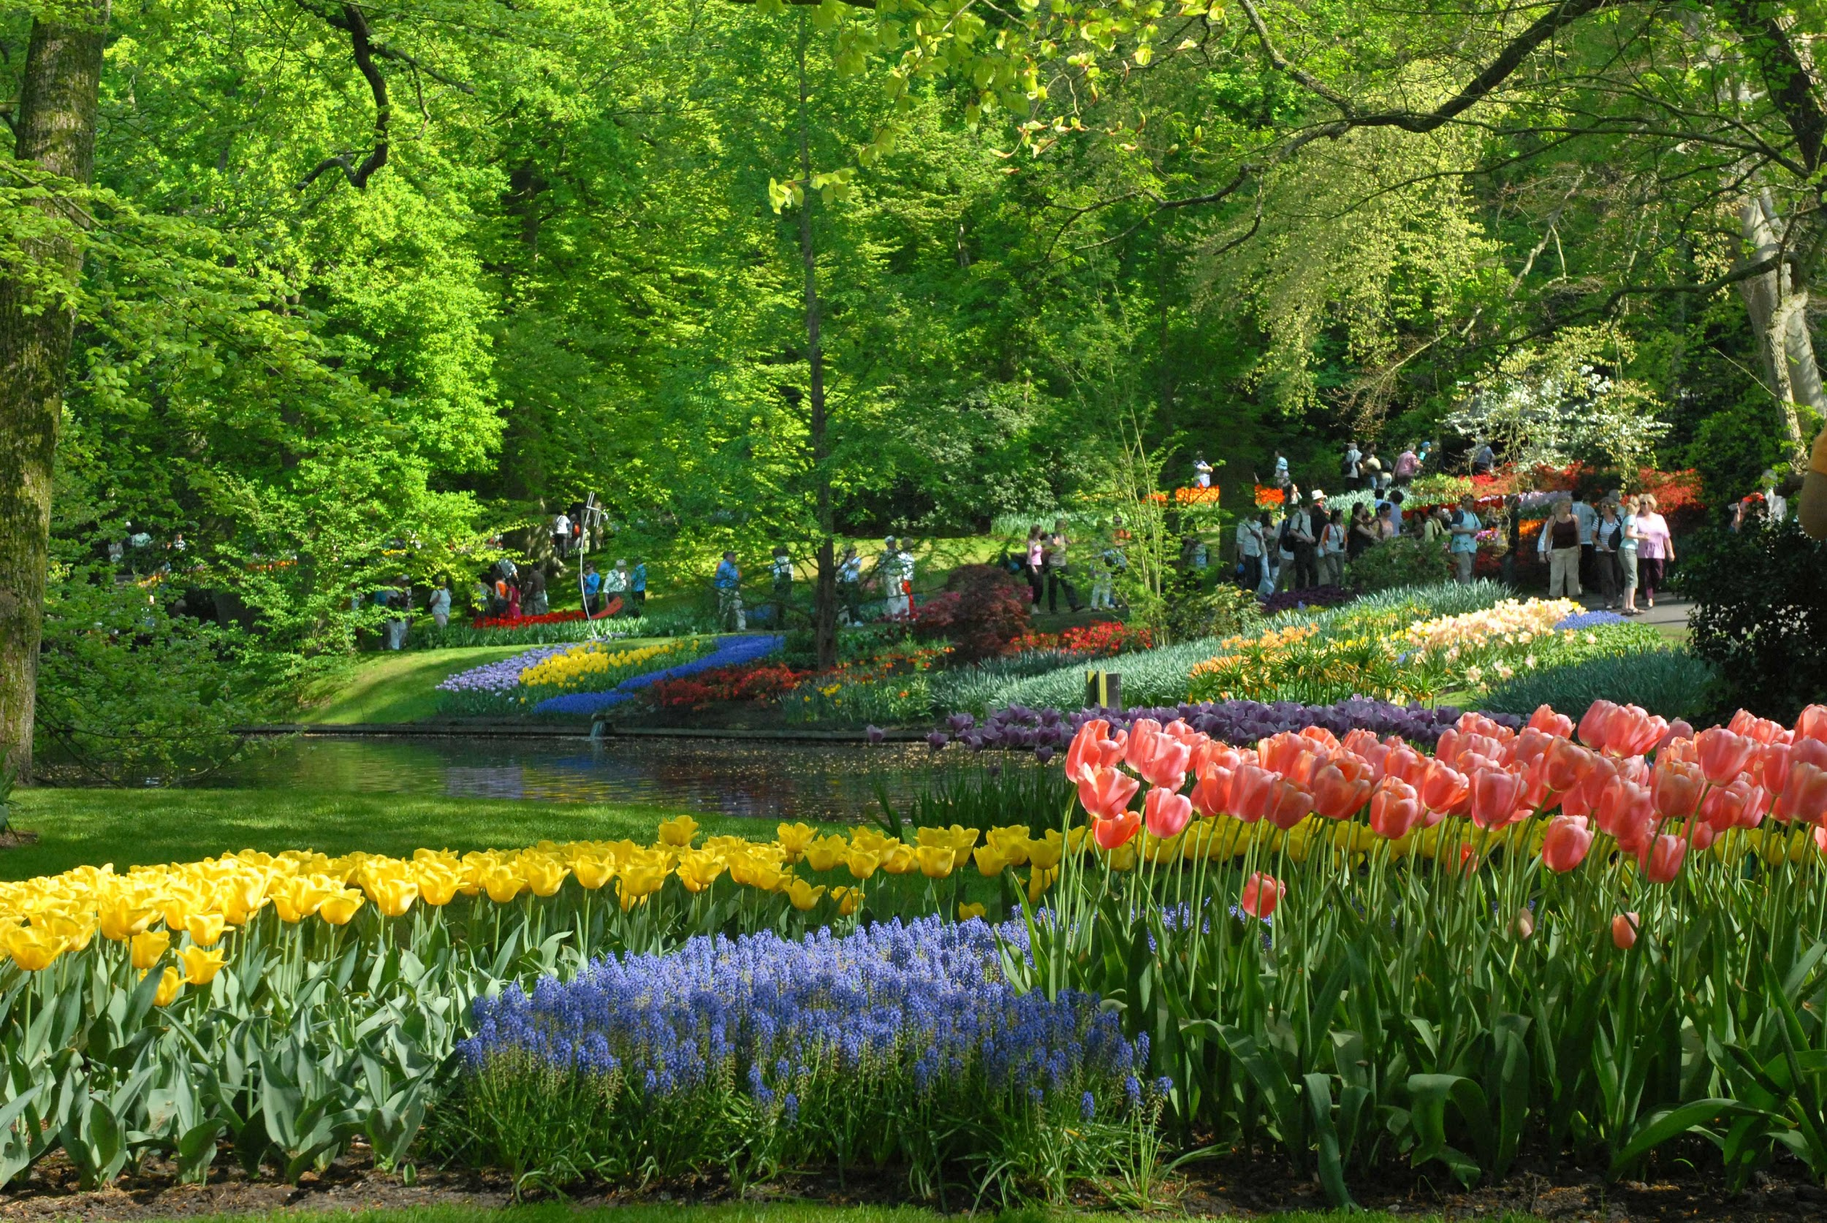







Monday 3/31
Good Morning!
I’m looking forward to another great day with you!
Ms. Kent
Spring in the Netherlands

Slide 2
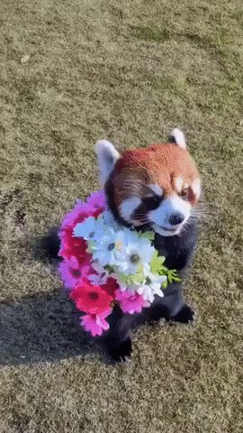


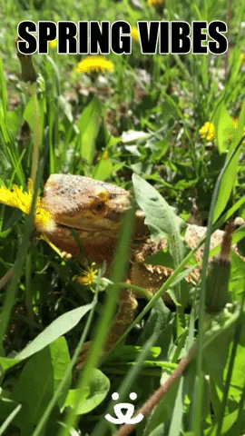
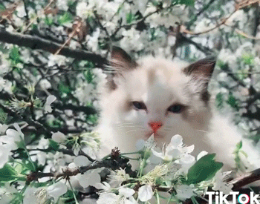

How do you feel on a scale of (Netherlands) Spring?
1 2 3 4
5 6

Slide 3
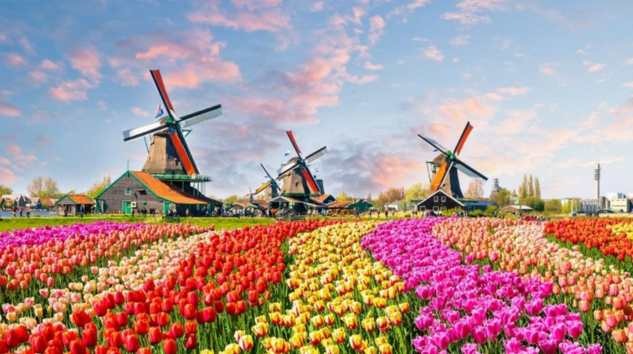
Spring in the Netherlands
Notes:
Click the title to see some amazing photos of flower fields in the Netherlands.

Slide 4



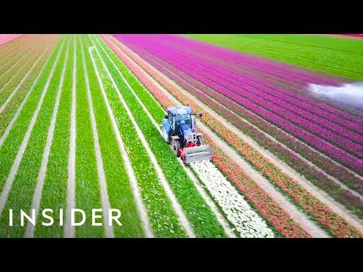









That's a Wrap!
Monday
March 31
QUOTE OF THE DAY
THINK ABOUT IT
SHARE OUT
“Tulip Capital of the World”
Why do you think the harvester in the video is cutting the flowers that way?
What are your feelings as you watch this video?
Share your thoughts!
DAILY GREETING
POLL OF THE DAY
Greet each other in class.
Notes:
Poll of the day: Which flower do you like better: Tulip or Rose?

Slide 5








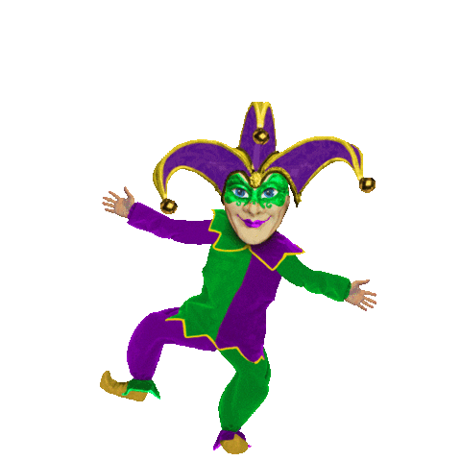



Friday 4/1
Good Morning! I will
not be staying here today. Ms. Kim
will be down at 10.
Ms. Kent
Notes:
(This is a JOKE...The teacher IS here today.)

Slide 6
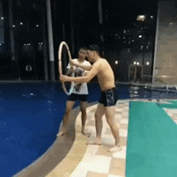

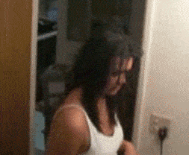
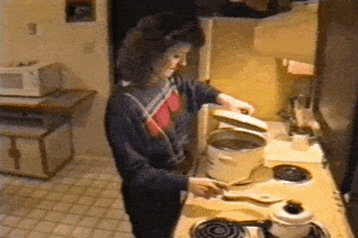
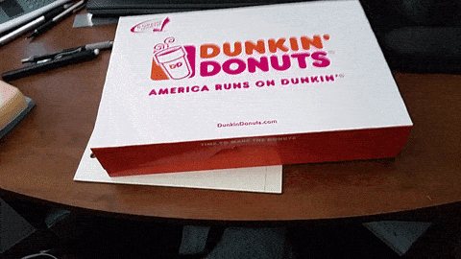


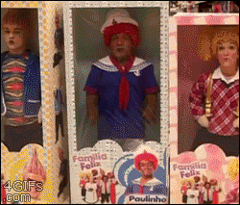
How are you feeling on a scale of April Fools?
1 2 3 4
5 6 7 8

Slide 7


Slide 8


That's a Wrap!
Tuesday
April 1
QUOTE OF THE DAY
THINK ABOUT IT
SHARE OUT
“April Fool’s Day”
Could you handle being pranked as long as it didn’t hurt? What prank ideas do you have? Who would
you prank?
Share your thoughts!
DAILY GREETING
POLL OF THE DAY
Greet each other in class.
I like I don’t like
April Fool’s April Fool’s
pranks. pranks.
Notes:
Poll of the day: Do you like April Fool’s pranks?

Slide 9






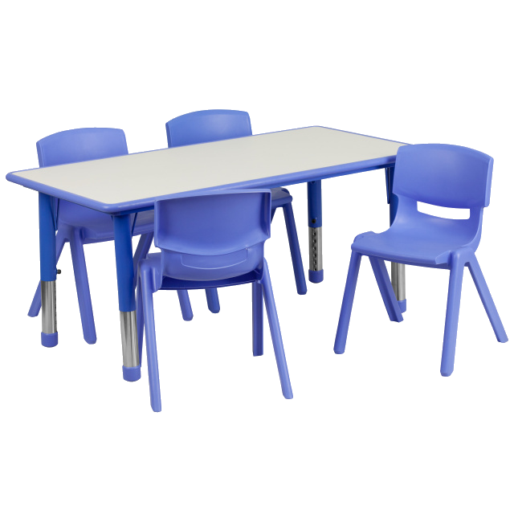




Wednesday 4/2
Good Morning!
I am looking forward to appreciating differences with you!
Ms. Kent
Notes:
April is Autism Awareness Month

Slide 10
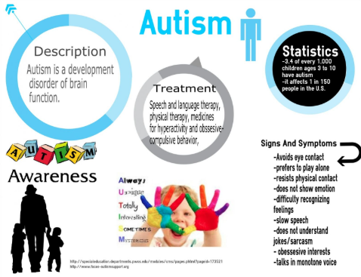



Slide 11


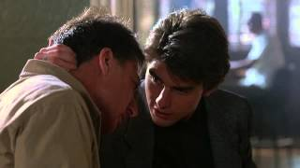
That's a Wrap!
Wednesday
April 2
QUOTE OF THE DAY
THINK ABOUT IT
SHARE OUT
“All About Autism”
Play this clip from 4:13-4:54 ONLY
It illustrates the concept of how an autistic brain may work.
(toothpick scene from Rain Man)
Share your thoughts!
DAILY GREETING
POLL OF THE DAY
Greet each other in class.
yes no
Notes:
Poll of the day: Have you ever met or do you know someone with autism?

Slide 12


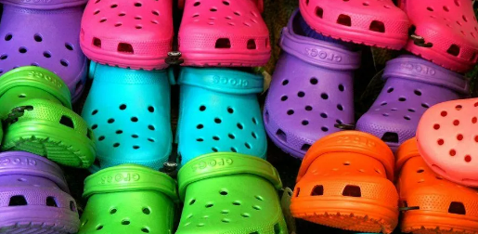





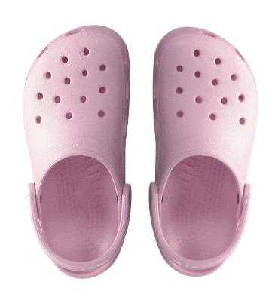
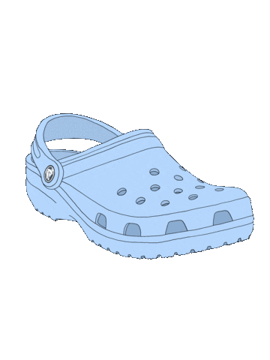



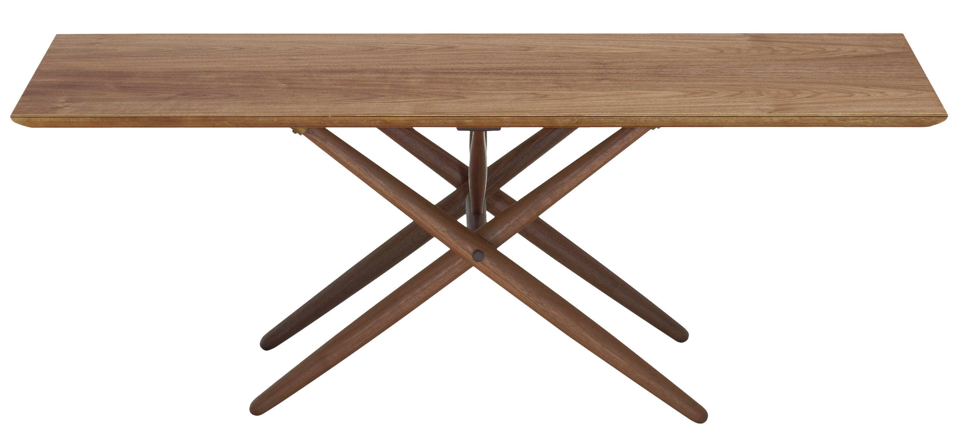
THURSDAY 4/3
GOOD MORNING!
I’M LOOKING FORWARD TO ANOTHER GREAT DAY WITH YOU!
MS. KENT

Slide 13




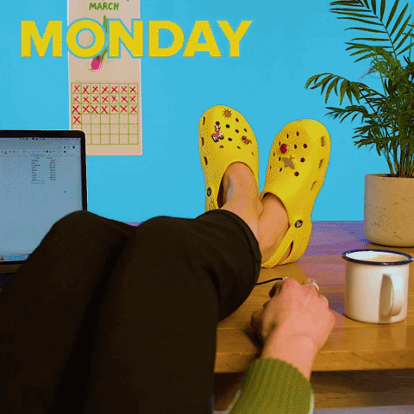
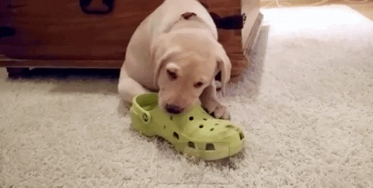
How are you feeling on a scale of Crocs?
1 2 3
4 5 6

Slide 14


That's a Wrap!
Thursday
April 3
QUOTE OF THE DAY
THINK ABOUT IT
SHARE OUT
“Fashion Statement?”
Real crocs live on land and in water. The material in the shoes are waterproof. What should the company do next?
Share your thoughts!
DAILY GREETING
POLL OF THE DAY
Greet each other in class.
ugly fashion
Notes:
Poll of the day: Do you think Crocs are ugly or do you think they are a great fashion statement?

Slide 15

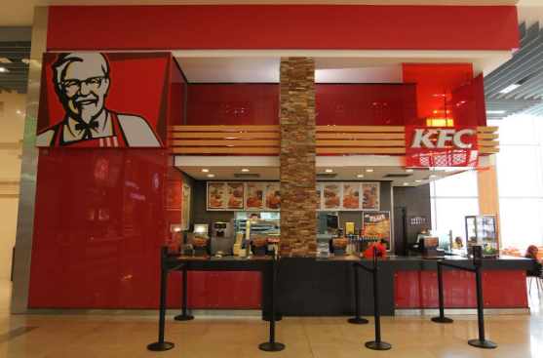
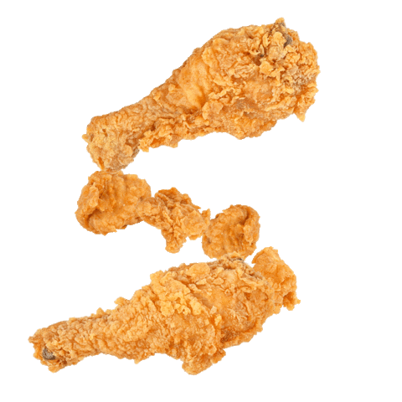
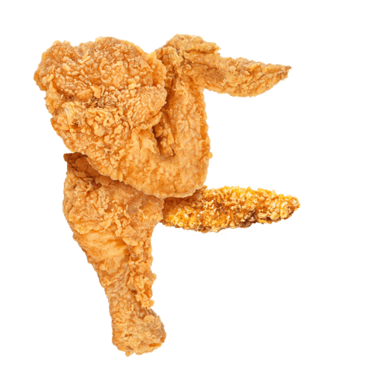
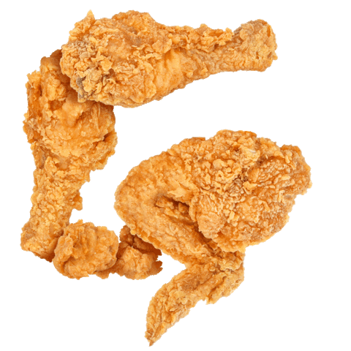
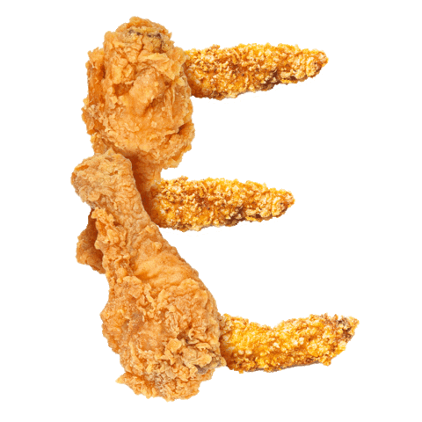

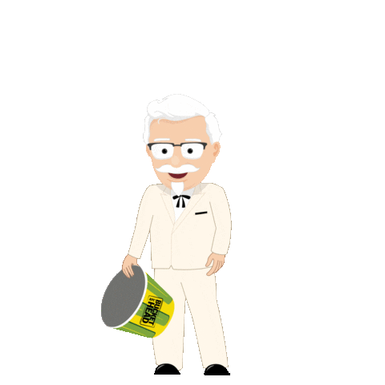



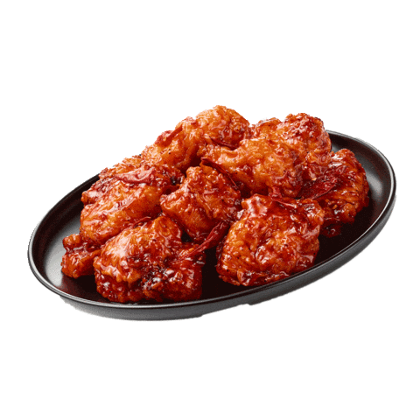
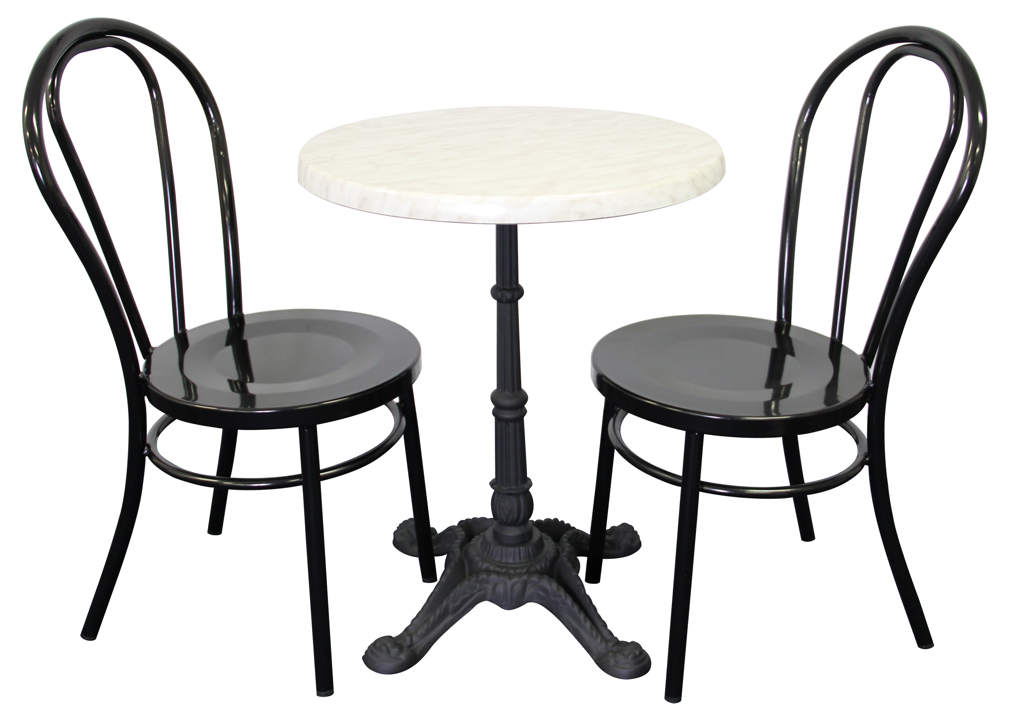
Friday, 4/4
Good Morning!
I am looking forward to another great day with you!
Ms. Kent
Notes:
GSFE are the initials of my school. Click on them to remove them. The Giphy App has all of the letters if you wanted to put in yours. :)

Slide 16
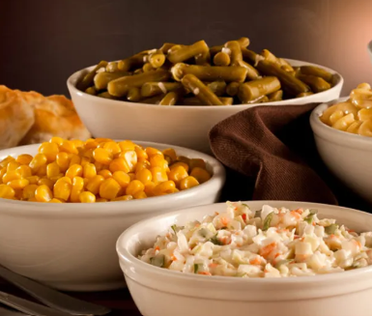
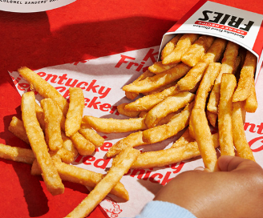
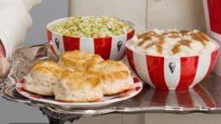
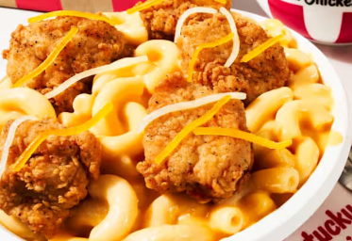
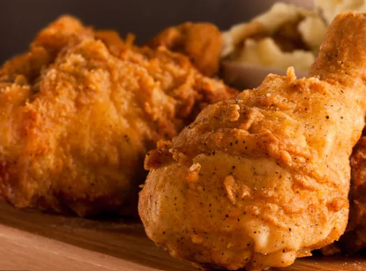
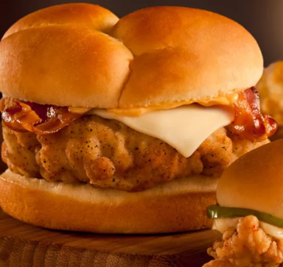
How are you feeling on a scale of KFC?
1 2 3
4 5 6

Slide 17


That's a Wrap!
Friday
April 4
QUOTE OF THE DAY
THINK ABOUT IT
SHARE OUT
“Rejected 1009 Times!”
How can remembering Colonel Sanders’ story help you when you are struggling?
Share your thoughts!
DAILY GREETING
POLL OF THE DAY
Greet each other in class.
grilled fried
Notes:
Poll of the day: Which type of chicken do you prefer?

