Slide 1




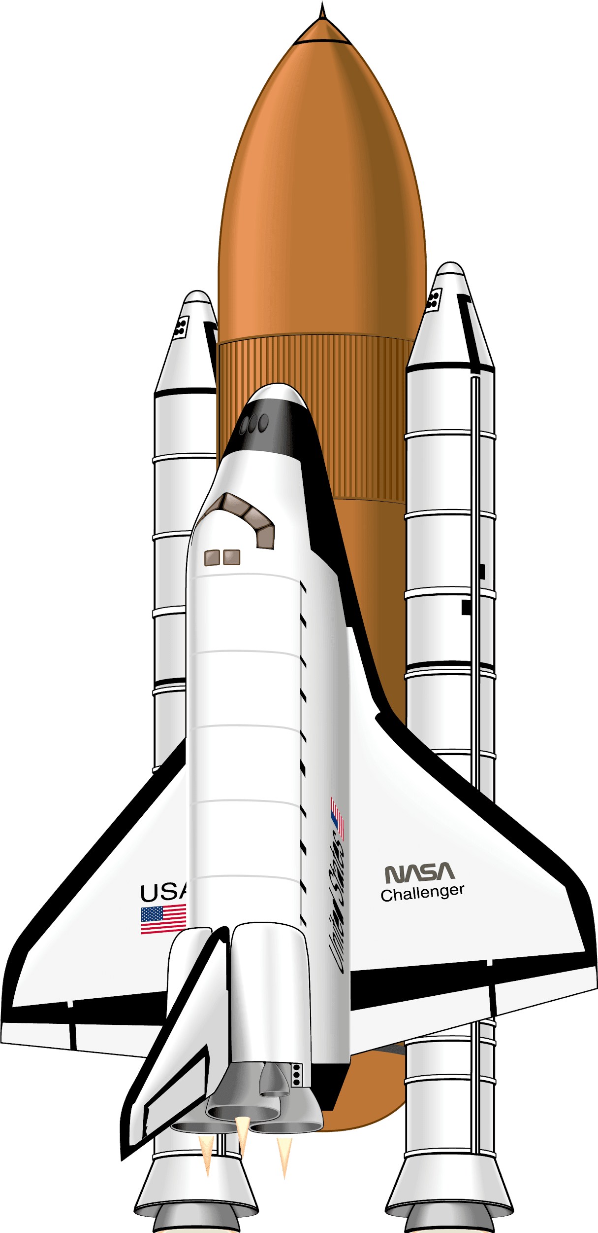


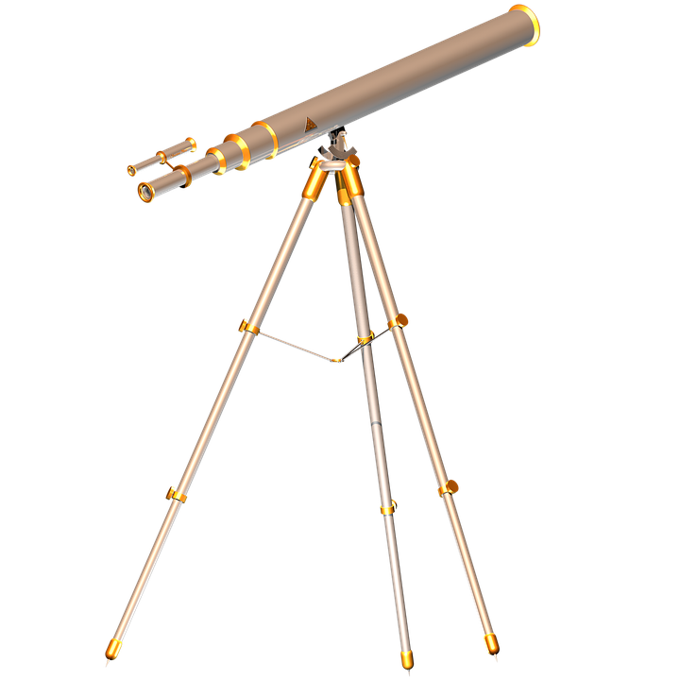
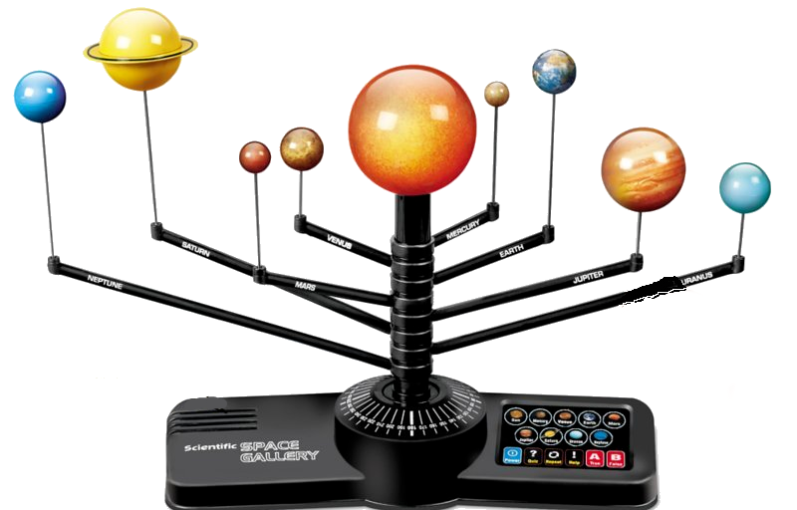
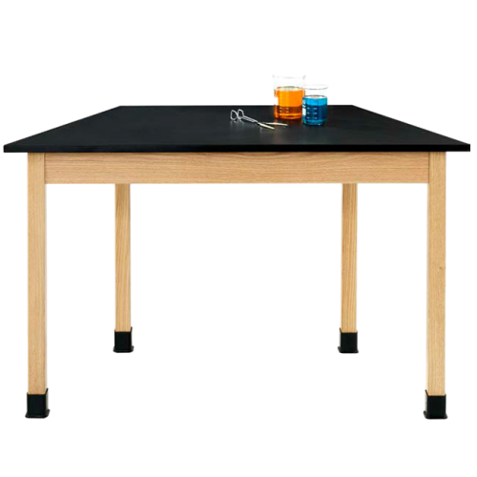

Monday 3/15
Good Morning!
I am looking forward to another great day with you!
Ms. Porter

Slide 2
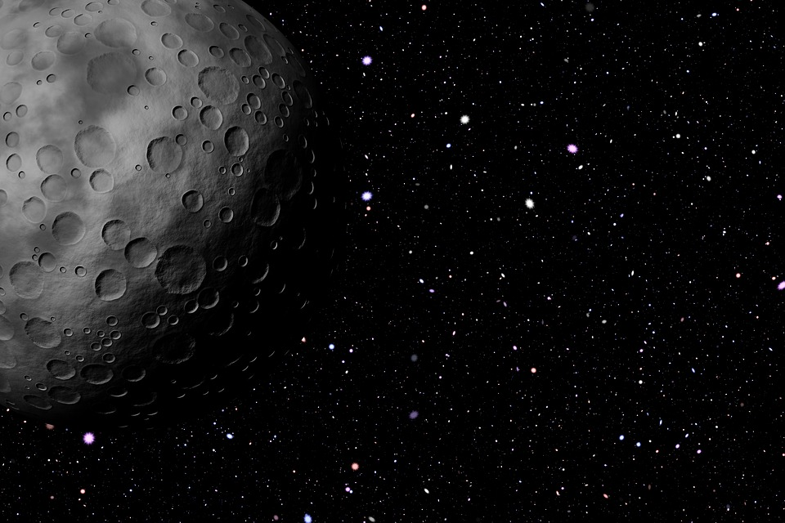








How are you feeling on a scale of outer space?
1 2 3 4
5 6 7 8

Slide 3

Monday 3/15
Please stand
for the
Pledge of
Allegiance.

Slide 4

Ms. Porter
Third Grade
March 2021
Notes
Let’s get stars on each day we have perfect attendance! If we get 5 stars, WE GET FUN FRIDAY!!
M | T | W | T | F | S | S
1 | 2 | 3 | 4 | 5 INTERIMS | 6 | 7
8 | 9 | 10 no school Parent conferences | 11 | 12 | 13 | 14
15 | 16 | 17 | 18 | 19 | 20 | 21
22 | 23 | 24 | 25 | 26 | 27 | 28

Slide 5
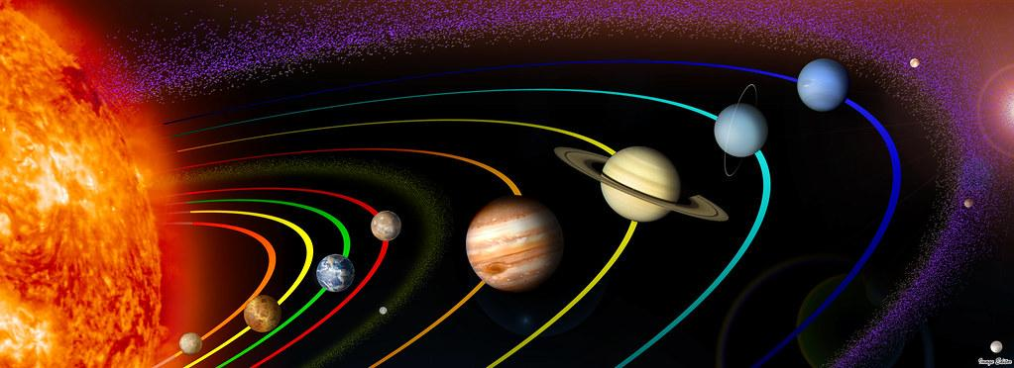

Monday 3/15
Who is “out of this world” today?

Slide 6



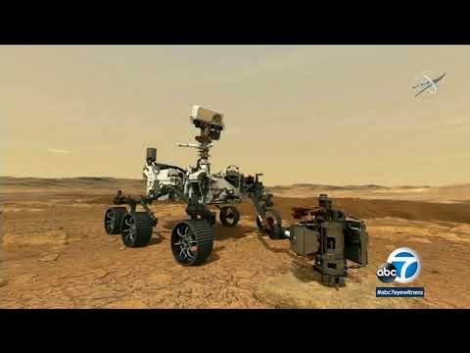







MORNING MEETING
Monday
March 15
QUOTE OF THE DAY
THINK ABOUT IT
SHARE OUT
“7 Minutes of Terror”
Why do you think the NASA workers were so excited about the landing of the Mars Rover “Perseverance”?
Do you think this is a good name for this spaceship?
Share your thoughts!
MORNING GREETING
POLL OF THE DAY
Greet each other in class.
go into space stay home
myself and watch it
on TV
Notes:
Poll of the Day: Would you rather travel into outer space yourself or just watch it on TV?
Quote is from Mae Jemison, the first African American woman to go into space on September 12, 1992. She traveled
on the space shuttle “Endeavor”. The Endeavor went around the Earth 126 times.

Slide 7
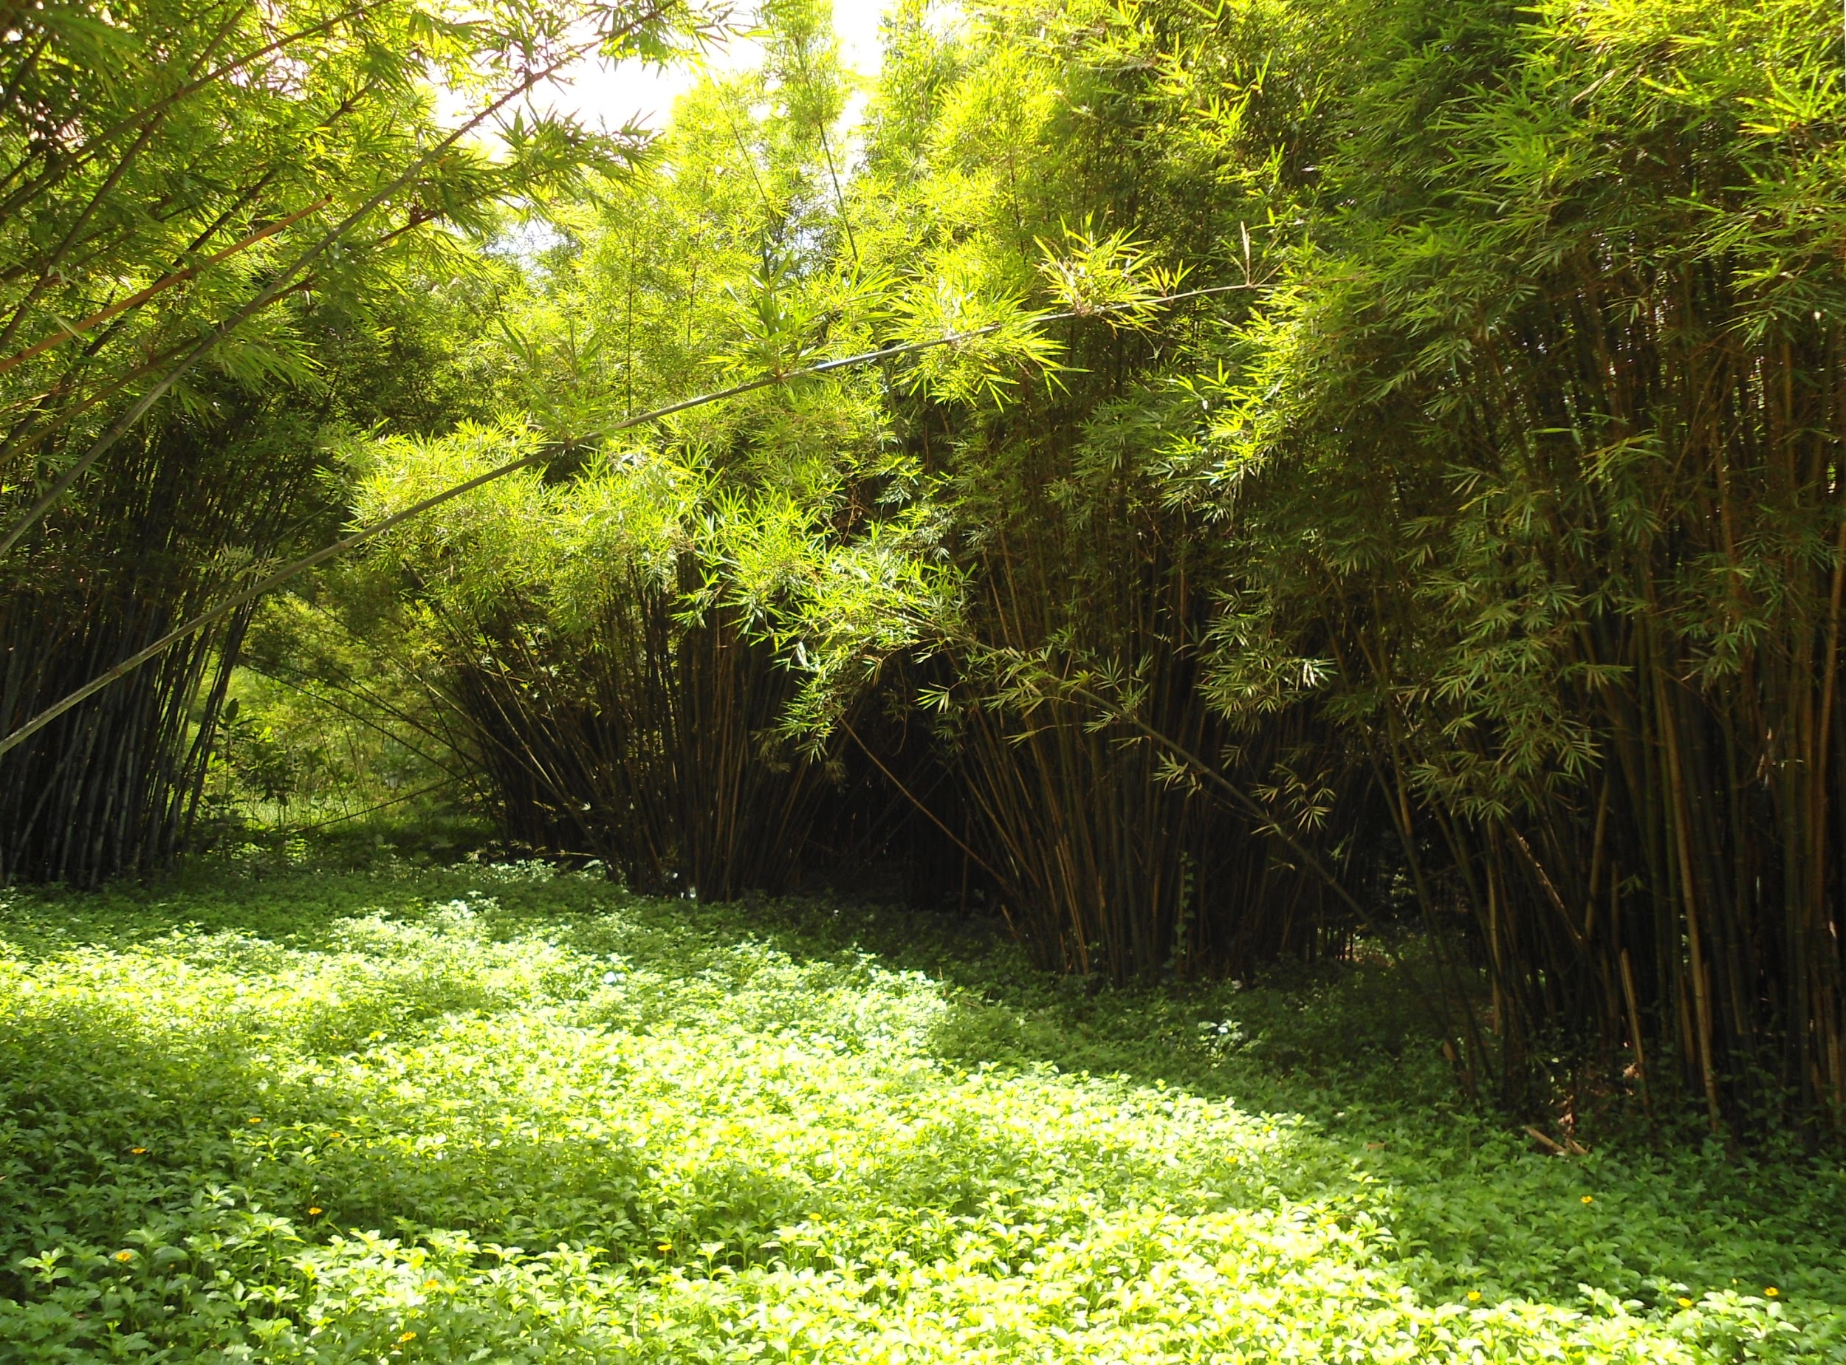










Tuesday 3/16
Good Morning!
I am looking forward to another great day with you!
Ms. Porter
Notes:
Thank you to our classmate Ryleigh for the great room idea!
To learn about endangered pandas, click on the link in the panda speaking. To learn how to draw a panda, click the link on the panda eating bamboo.

Slide 8
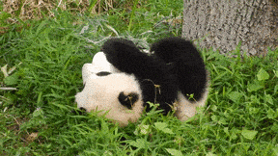
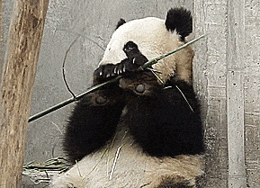
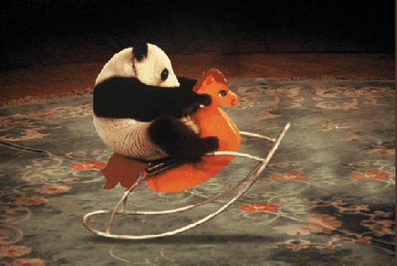
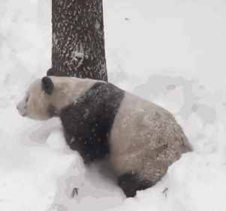
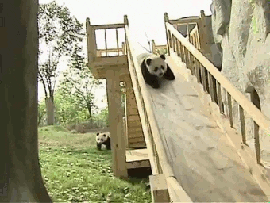
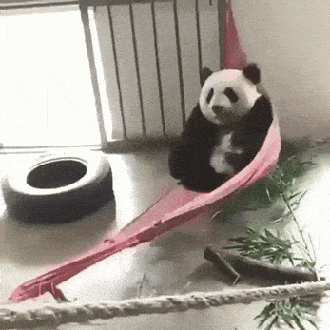
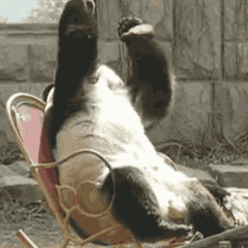
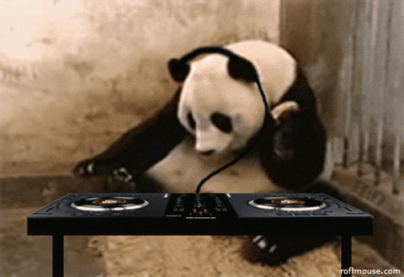
How are you feeling on a scale of panda?
1 2 3 4
5 6 7 8

Slide 9
Tuesday 3/16
Please stand
For the
Pledge of
Allegiance.

Slide 10
Ms. Porter
Third Grade
March 2021
Notes
Let’s get stars on each day we have perfect attendance! If we get 5 stars, WE GET FUN FRIDAY!!
M | T | W | T | F | S | S
1 | 2 | 3 | 4 | 5 INTERIMS | 6 | 7
8 | 9 | 10 no school Parent conferences | 11 | 12 | 13 | 14
15 | 16 National Panda Day! | 17 | 18 | 19 | 20 | 21
22 | 23 | 24 | 25 | 26 | 27 | 28

Slide 11
Tuesday 3/16
Who is gathering all the bamboo in the forest?

Slide 12
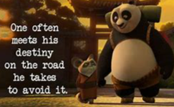
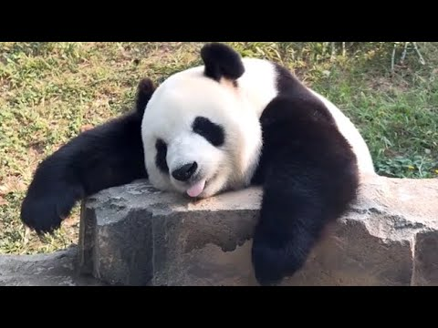
MORNING MEETING
Tuesday
March 16
QUOTE OF THE DAY
THINK ABOUT IT
SHARE OUT
“Funny Pandas”
What makes pandas so fun to watch?
How are pandas like kids?
Share your thoughts!
MORNING GREETING
POLL OF THE DAY
Greet each other in class.
live panda a video
cams put together
before
Notes:
Poll of the Day: Would you rather watch a live panda cam, where you might not see anything,
or would you rather watch a video put together beforehand? Link to live cam:
https://youtu.be/D0eqnda8dOk

Slide 13

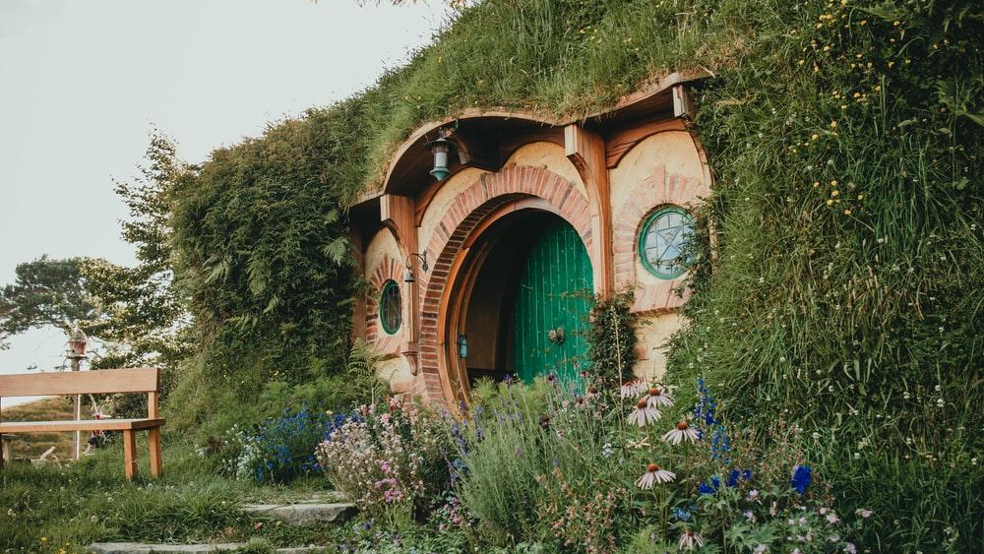





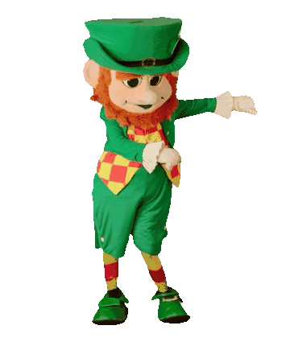



Good Morning!
I am looking
forward to another
great day with you!
Ms. Porter
https://unsplash.com/photos/6ajf6BAyYt4
Notes:
Click the link on the pot of gold to learn about some facts concerning St. Patrick's day that we bet you didn't know!
Going to date to learn about the history of Saint Patrick's Day. Click on the leprechaun to play a game find some gold!

Slide 14
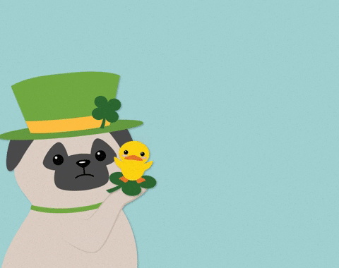
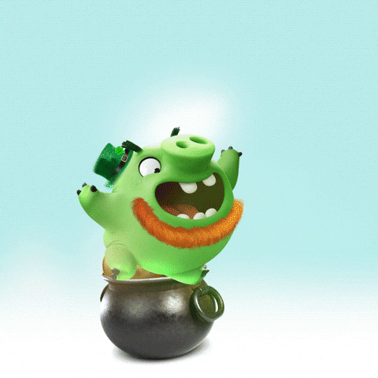
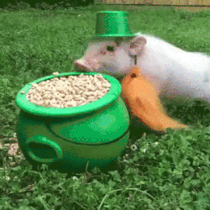
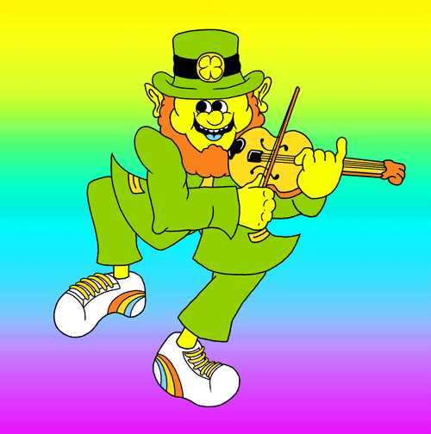
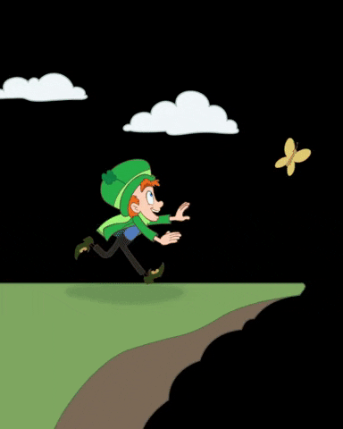

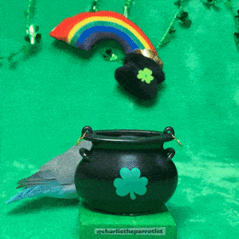
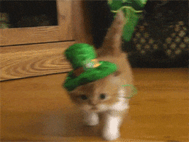
How are you feeling on a scale of St. Patrick’s Day?
1 2 3 4
5 6 7 8

Slide 15
Please stand
for the
Pledge of
Allegiance.
https://unsplash.com/photos/6ajf6BAyYt4

Slide 16
Ms. Porter
Third Grade
March 2021
Notes
Let’s get stars on each day we have perfect attendance! If we get 5 stars, WE GET FUN FRIDAY!!
M | T | W | T | F | S | S
1 | 2 | 3 | 4 | 5 INTERIMS | 6 | 7
8 | 9 | 10 no school Parent conferences | 11 | 12 | 13 | 14
15 | 16 | 17 | 18 | 19 | 20 | 21
22 | 23 | 24 | 25 | 26 | 27 | 28

Slide 17
Who are the
Luckiest Learners
today?
https://unsplash.com/photos/6ajf6BAyYt4

Slide 18


Morning Meeting
Wednesday
March 17
QUOTE OF THE DAY
THINK ABOUT IT
SHARE OUT
“History of Leprechauns”
If you were lucky enough to find a leprechaun and get 3 wishes, what would they be? Be careful to not get tricked!
Share your thoughts!
MORNING GREETING
POLL OF THE DAY
Greet each other in class.
eat potatoes not eat
every day for potatoes at
a year all for a year
Notes:
Poll of the Day: Ireland is known for potatoes. Would you rather eat potatoes everyday for a year or not eat them at all for a year?
https://youtu.be/oyI7ei_jyz8 This video would be better for younger learners (K-1)

Slide 19
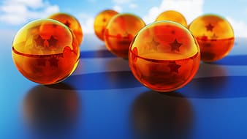







Thursday 3/18
Good Morning!
I am looking forward to another great day with you! Ms. Porter

Slide 20
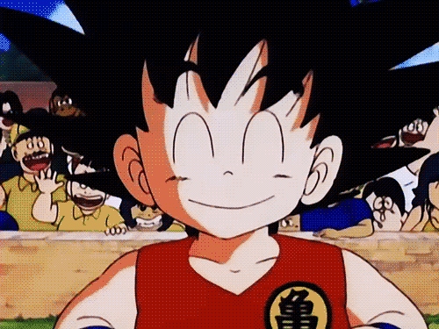
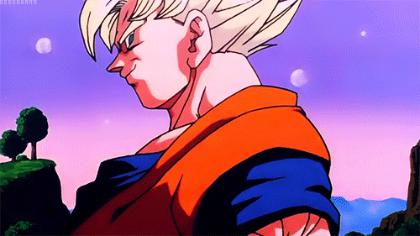
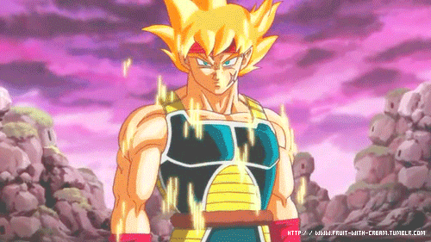


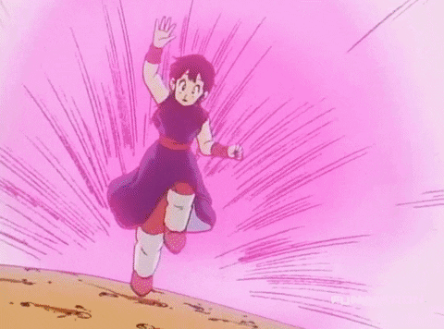

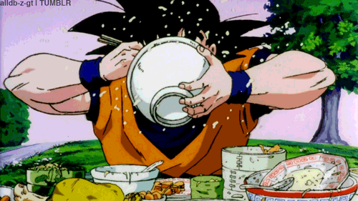
How are you feeling on a scale of Dragon Ball Z?
1 2 3 4
5 6 7 8

Slide 21
Thursday 3/18
Please stand
for the
Pledge of
Allegiance.

Slide 22
Ms. Porter
Third Grade
March 2021
Notes
Let’s get stars on each day we have perfect attendance! If we get 5 stars, WE GET FUN FRIDAY!!
M | T | W | T | F | S | S
1 | 2 | 3 | 4 | 5 INTERIMS | 6 | 7
8 | 9 | 10 no school Parent conferences | 11 | 12 | 13 | 14
15 | 16 | 17 | 18 | 19 | 20 | 21
22 | 23 | 24 | 25 | 26 | 27 | 28

Slide 23
Thursday 3/18
Who has caught the Dragon Ball today?

Slide 24
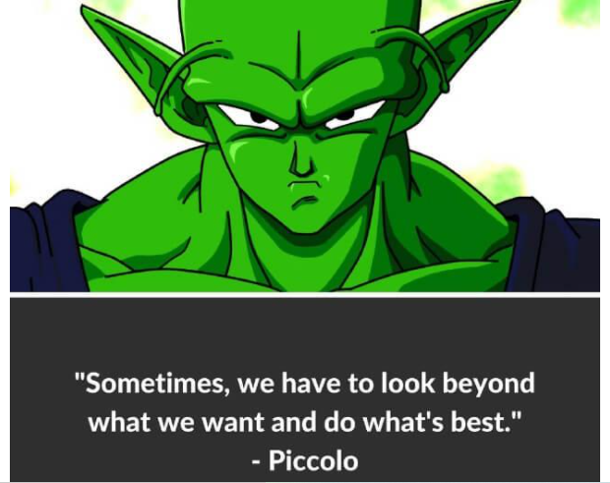
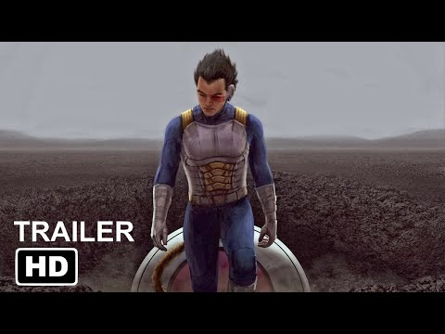
MORNING MEETING
Thursday
March 18
QUOTE OF THE DAY
THINK ABOUT IT
SHARE OUT
“Z Movie Trailer”
Based on this trailer, do you think this will be a good movie? Why or why not?
Share your thoughts!
MORNING GREETING
POLL OF THE DAY
Greet each other in class.
Animated Realistic
Notes:
Poll of the day: Do you prefer animated Dragon Ball Z or realistic?

Slide 25
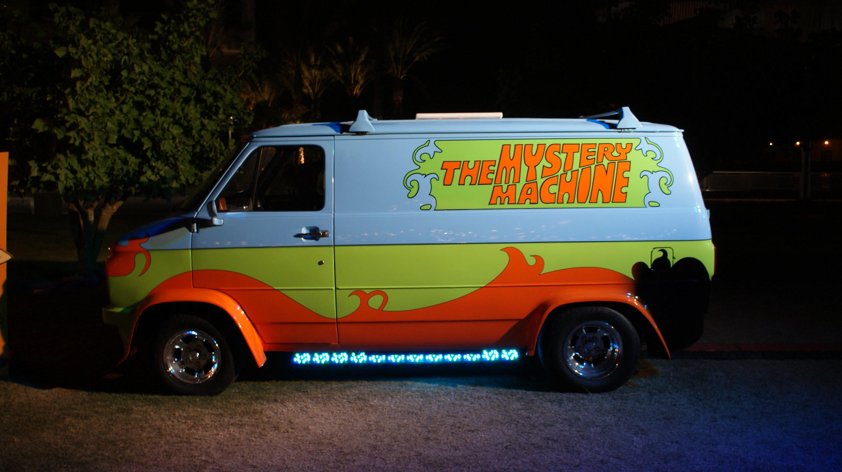











Friday 3/19
Good Morning!
I am looking forward to another great day with you!
Ms. Porter

Slide 26


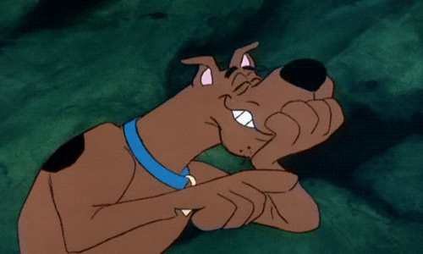

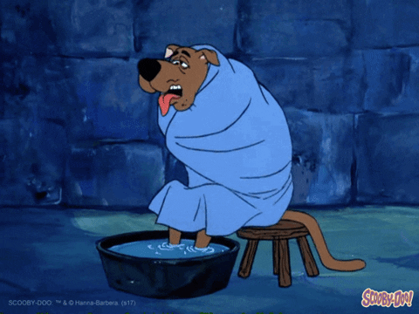

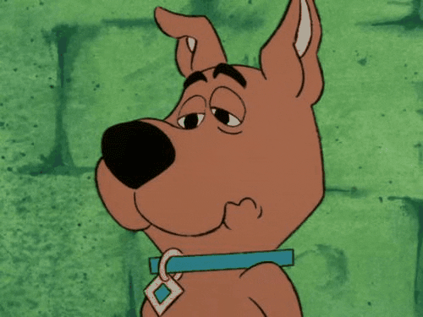
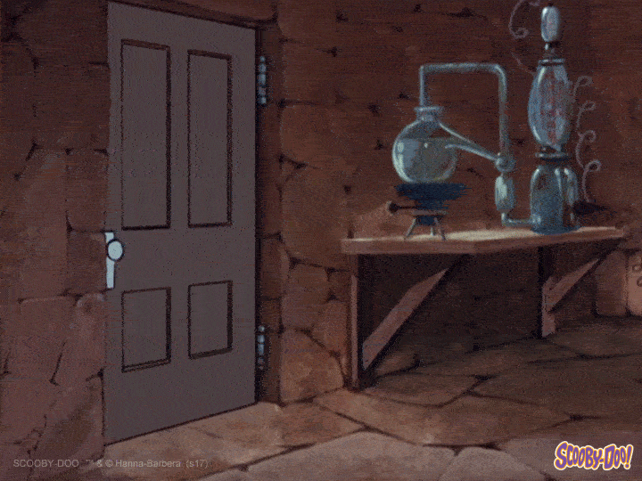
How are you feeling on a scale of Scooby Doo?
1 2 3 4
5 6 7 8

Slide 27
Friday 3/19
Please stand
for the
Pledge of
Allegiance.

Slide 28

Ms. Porter
Third Grade
March 2021
Notes
Let’s get stars on each day we have perfect attendance! If we get 5 stars, WE GET FUN FRIDAY!!
M | T | W | T | F | S | S
1 | 2 | 3 | 4 | 5 INTERIMS | 6 | 7
8 | 9 | 10 no school Parent conferences | 11 | 12 | 13 | 14
15 | 16 | 17 | 18 | 19 | 20 | 21
22 | 23 | 24 | 25 | 26 | 27 | 28

Slide 29
Friday 3/19
Who is driving the Mystery Machine today?

Slide 30

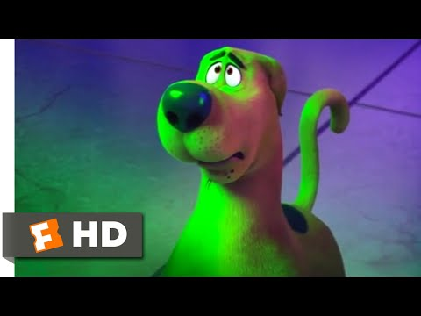
MORNING MEETING
Friday
March 19
QUOTE OF THE DAY
THINK ABOUT IT
SHARE OUT
“Friend Sacrifice”
Do you have a friend or special person in your life for whom you would sacrifice anything?
Share your thoughts!
MORNING GREETING
POLL OF THE DAY
Greet each other in class.
a few close a whole
close friends bunch but
not that close
Notes:
Poll of the day: Do you prefer a few really close friends of a bunch of friends but none that close?

