Slide 1
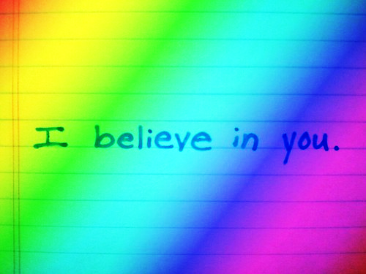
water and outdoor fun!
Adapted PE - Mrs. Hopson

Slide 2
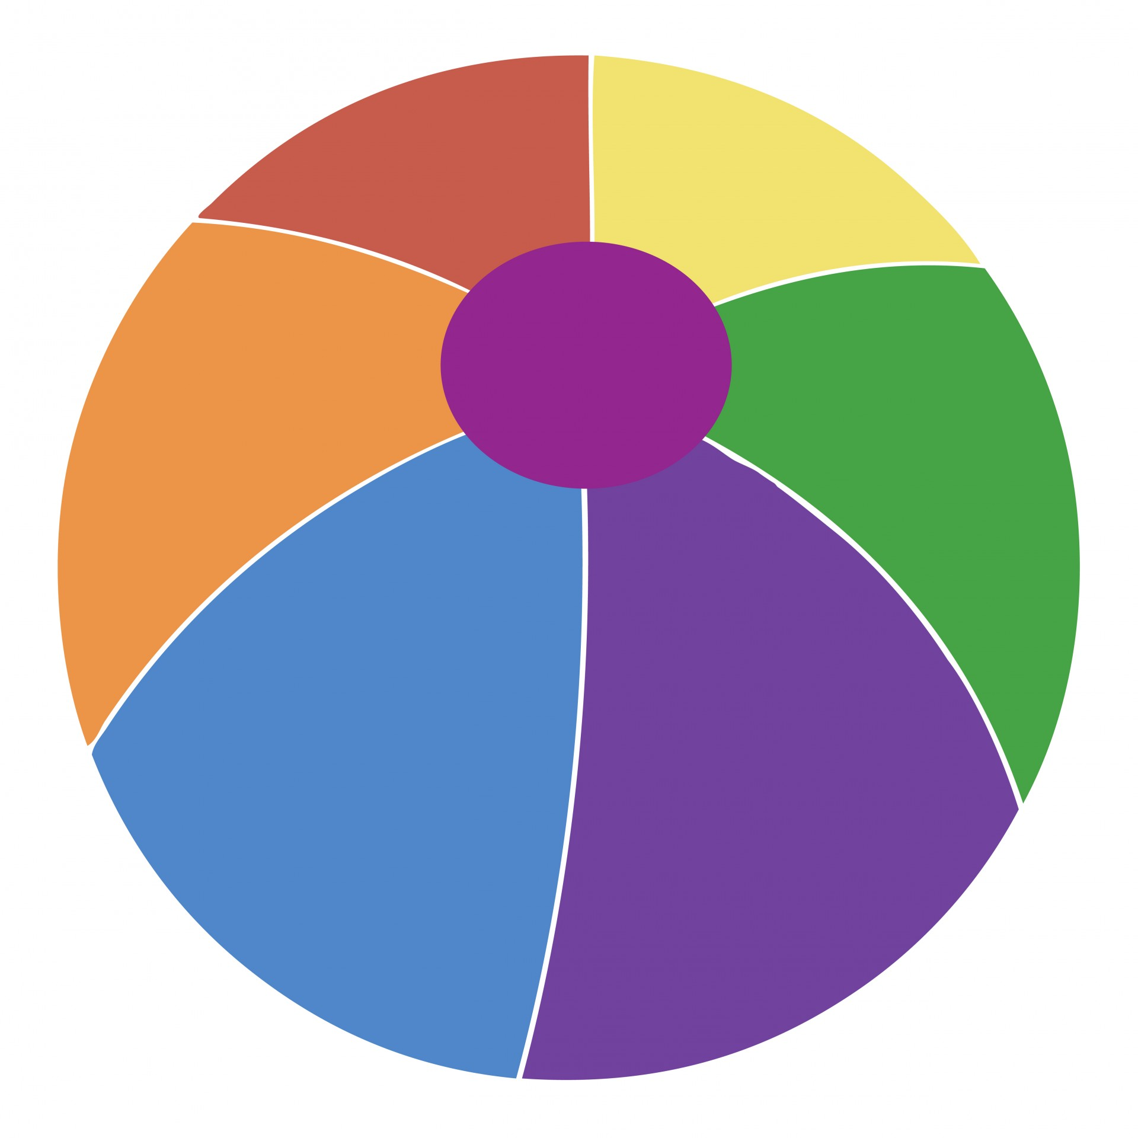
Water and outdoor fun
Hello Adapted PE families! Throughout these slides you will find a variety of water and non-water APE activities along with videos as demonstrations. Feel free to modify any or all of the activities to fit the needs of your family and equipment you have. If you need help modifying something - please reach out and let me know, I’m always happy to help :)
Please take pictures of your kids in action and send them to me - I love receiving photos of my kiddos :)
HAVE a BLAST!!!

Slide 3
Sponge relay (water)
Instructions to play:
Fill 1 bucket/bowl with water and place in open space
Place 1 empty bucket/bowl about 10 feet away from water bucket (put a fill line on the empty bucket with tape)
Person going first fills a sponge with water in the water bucket and run/walk/roll to the empty bucket and squeeze the water out of the sponge
Keep going until the empty bucket is full of water up to the “fill line”
Equipment: 2 buckets or bowls, 1 sponge
Modifications: Make the distance longer or shorter, hand over hand assistance

Slide 4
Cup relay (Water)
Instructions to play:
Fill 1 bucket/bowl with water and place in an open space
Place 1 empty bucket/bowl about 10 feet away from water bucket (put a fill line on the empty bucket with tape)
Person going first fills a plastic cup with water and run/walk/roll to the empty bucket and pour the cup of water out
Keep going until the empty bucket is full of water up to the “fill line”
Equipment: 2 buckets or bowls, 1 plastic cup (holes or no holes)
Modifications: Make the distance longer or shorter

Slide 5
Ready, set, aim (water)
Instructions to play:
Place objects (empty water bottles, plastic cups, etc.)as targets in a line on the ground or on a table
Fill 1 bucket or bowl with water
Using a water soaker or hose aim for the targets and knock them down
Equipment: Objects as targets(empty water bottles, plastic cups, plastic toy figures, etc.), 1 bucket or hose
Modifications: You can use a ball to roll or throw instead of water.

Slide 6
Egg spoon relay
Instructions to play:
Place an egg on a spoon at a starting line
Place an object about 10 feet away to travel around
Object of the relay is to balance the egg on the spoon while traveling around a cone and hand it off to a partner who will repeat the task.
Equipment: 1 egg (or golf ball, plastic egg, water balloon, puff ball, etc.) 1 spoon (or measuring cup, sand shovel, hand, etc.), 1 object to travel around (cone, can, rock, shoe, etc.)
Modifications: You can balance an object (scarf, wash cloth) on your head, hand, etc.

Slide 7
Marble pick up (water)
Instructions to play:
Fill large bucket/bowl or baby pool with water
Place objects that sink in the bottom of the pool
Using your toes (or fingers) pick up the objects and place them on a plate/frisbee placed outside of the pool
Try to pick up as many objects as you can
Equipment: baby pool (large bucket, bowl or pot), marbles (rocks, toy figures, etc. - objects that are safe for your child)
Modifications: You may use your hands to pick up objects, sort objects

Slide 8
Parachute
Instructions to play:
Participants will hold on to the edge of a bed sheet at waist level (need at least 3 or more people)
  Little waves - shake fast and small
  Big slow waves - shake above your head and slowly
  Parachute up - bring parachute up above your head
  Parachute down - bring parachute down to the ground
  Parachute clockwise - everyone walks clockwise with the parachute
  Parachute counter-clockwise - everyone walks counterclockwise with the parachute
  Popcorn - place stuffed animals on top of the parachute and shake as fast as you can to knock off the animals
  Under parachute - participants may lay or sit under the parachute and other participants will shake the parachute over them

Slide 9
Parachute cont.
Instructions to play cont.
Activities cont.
  Tent - bring the parachute up above your head and then at the same time everyone jumps inside the parachute while holding and sitting on the edge of the parachute
  Hokey pokey - everyone holds on to the parachute and play the song “Hokey pokey”. When the body parts are called you place that body part towards the center of the parachute. When you hear shake it all about, you may shake the parachute. Move in a circle clockwise or counter-clockwise when you hear “turn yourself around”
Equipment: Flat bed sheet, light blanket
Modifications: May be done sitting or standing

Slide 10
Seated Bowling
Instructions to play:
Set up targets (6 or 10) in a triangle formation. Using a ball, roll it down a ramp to knock down targets.
Equipment: Lid to storage container (box, anything large and flat), ball, targets (water bottles, plastic cups, etc.)
Modifications: Push ball across a table

Slide 11
Knock it off
Instructions to play:
Place objects on top of a slightly elevated surface and using the right hand knock objects off the surface and into a basket or cookie sheet. Do the same thing with the left hand.
Equipment: objects (plastic egg, toy, ball, etc.) elevated surface (measuring cups, tupperware container upside-down, etc.) and basket or cookie sheet
Modifications: Move objects away from body for participant to reach. Pick up objects and drop them onto the tray. Throw objects toward a target or basket.

