Slide 1
Valentine kitten with a ❤️ Art Gallery Template (2)❤️
Delete this slide before you make a copy for your students
The purpose of this “gallery” is for students to upload their art for their classmates to view and admire. I plan to put together an ART ROOM later of all my students’ artwork for OPEN HOUSE.
Only the first 2 slides are editable -(slide #1 & #2 after deleting this slide) You can always make a copy of the slides you want. Slide #4 and on are just copies of slide #4 (set as background). You can copy and paste (slide 4) as many pages you need for your class.
Don’t forget to input your students’ names in slide #2 after you delete this page, so they know which slide they should upload their drawings or art pieces to.
Drawing tutorials are linked in slide #2

Slide 2




Slide 2 | Jody, Chris | Slide 9
Slide 3 |  | Slide 10
Slide 4 |  | Slide 11
Slide 5 |  | Slide 12
Slide 6 |  | Slide 13
Slide 7 |  | Slide 14
Slide 8 |  | Slide 15
Students, please find your name on the screen to locate your slide and insert your Valentines kitten drawing.
Click HERE or HERE to see the tutorial on How to draw a Valentine kitten with a cute little heart.
Instructions:
Click on insert, image, camera, and take a picture of your Art.
Arrange it to fit in your box with your name. (The slide you are assigned to)

Slide 3





情人節快樂
Jody
Chris

Slide 4
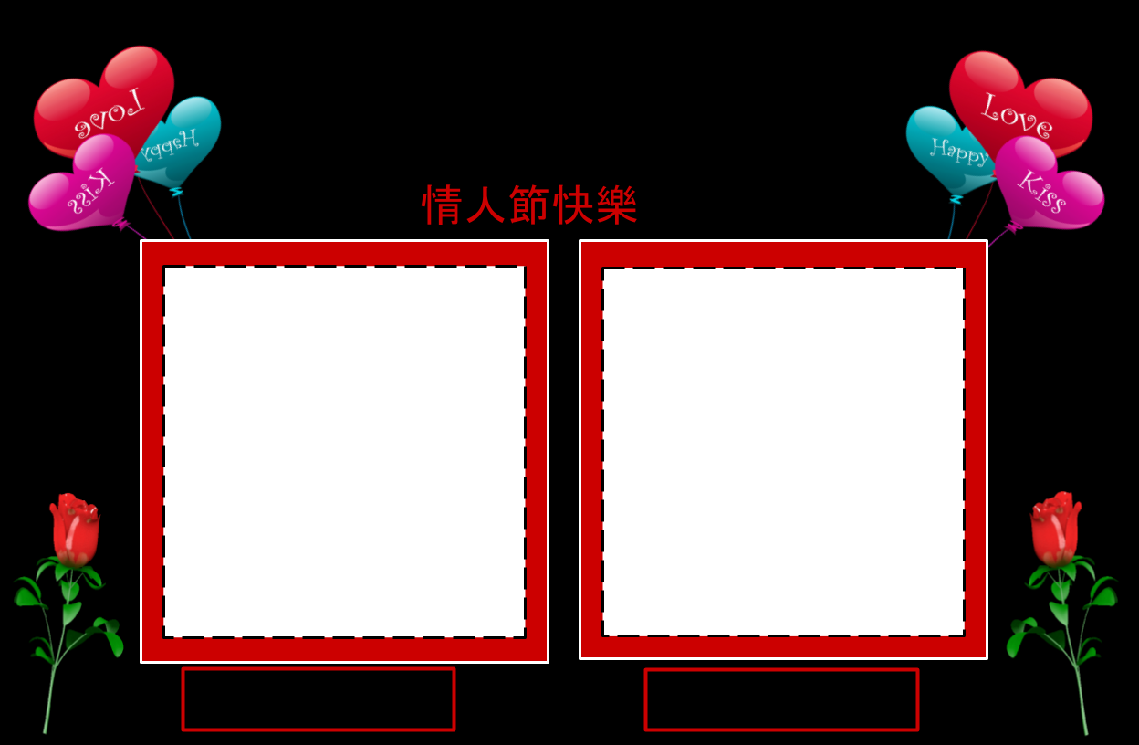
情人節快樂

Slide 5
情人節快樂

Slide 6
情人節快樂

Slide 7
情人節快樂

Slide 8
情人節快樂

Slide 9
情人節快樂

Slide 10
情人節快樂

Slide 11
情人節快樂

Slide 12
情人節快樂

Slide 13
情人節快樂

Slide 14
情人節快樂

Slide 15
情人節快樂

Slide 16
情人節快樂

Slide 17
情人節快樂

