Slide 1
Valentines Teddy Bear with a ❤️ Art Gallery Template （2）
Delete this slide before you make a copy for your students
The purpose of this “gallery” is for students to upload their art for their classmates to view and admire. I plan to put together an ART ROOM later of all my students’ artwork for OPEN HOUSE.
Only the first 2 slides are editable -(slide #1 & #2 after deleting this slide) You can always make a copy of the slides you want. Slide #4 and on are just copies of slide #4 (set as background). You can copy and paste (slide 4) as many pages you need for your class.
Don’t forget to input your students’ names in slide #2 after you delete this page, so they know which slide they should upload their drawings or art pieces to.
Drawing tutorials are linked in slide #2
Jody Dowell

Slide 2
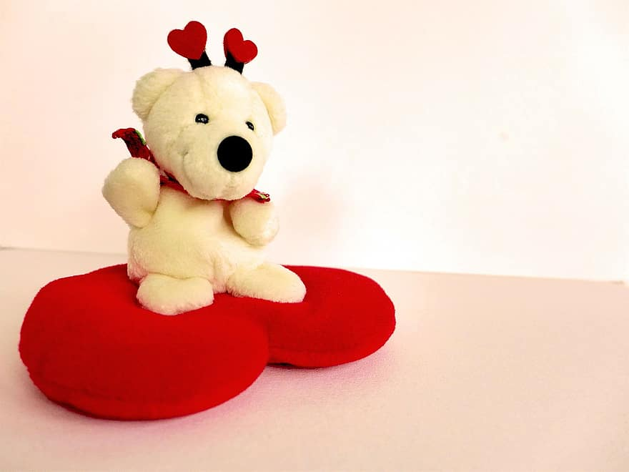







Slide 2 | Jody, Chris | Slide 9
Slide 3 |  | Slide 10
Slide 4 |  | Slide 11
Slide 5 |  | Slide 12
Slide 6 |  | Slide 13
Slide 7 |  | Slide 14
Slide 8 |  | Slide 15
Find your name on the screen to locate your slide and insert your Teddy Bear with a cute little heart drawing.
Click HERE or HERE to see the tutorial on How to draw Teddy Bear with a cute little heart.
Instructions:
Click on insert, image, camera, and take a picture of your Art.
Arrange it to fit in your box with your name. (The slide you are assigned to)

Slide 3









Slide 4
