Slide 3
About these Texts
Printing
I’ve added a blank page after any one-page texts so that you can print all of them double-sided and have each one be one sheet each.
Printing
I’ve added a blank page after any one-page texts so that you can print all of them double-sided and have each one be one sheet each.
Fonts
Font for student texts:
Report Regular
Font for headings and lesson plans:
Neue Montreal

Slide 4
Why Fluency
“Though fluency does not guarantee comprehension, lack of fluency guarantees students will not be able to comprehend text.”
Student Achievement Partners
“It may be helpful to think of reading fluency as a ‘bridge’ between the two major components of reading – word decoding and comprehension. At one end of this bridge, fluency connects to accuracy and automaticity in decoding. At the other end, fluency connects to comprehension though prosody, or expressive interpretation.”
Flash Fluency by The Positive Engagement Project
http://pepnonprofit.org/flash-fluency.html
“
About Fluency
At this stage, attention to fluency is not on reading rate; rather it is on building a bank of words recognized automatically and developing the ability to read with expression. Beginning readers may continue to demonstrate some word-by-word reading as phrasal reading develops. As automaticity with word recognition increases, cognitive resources needed for decoding are freed up for comprehension, allowing for fluid and expressive oral reading.
Quoted from Grade 1 Unit 2 Assessment and Remediation Guide, p. 102
”
This is the second-grade Common Core standard related to fluency.
As stated in the quote above, the first step is accuracy and automaticity.
This is fluency practice’s great benefit to struggling readers – the more they read and reread, the more quickly they can correctly identify words. As second graders progress through the year, you can help them develop their ability to phrase (group words into chunks) and add expression. The ultimate goal, of course, is not smooth reading on its own, but smooth reading that frees up mental space for understanding.
RF.2.4 Read with sufficient accuracy and fluency to support comprehension. Read grade-level text with purpose and understanding. Read grade-level text orally with accuracy, appropriate rate, and expression. Use context to confirm or self-correct word recognition and understanding, rereading as necessary.

Slide 5

How to Use These Texts
In the CKLA Skills Assessment & Remediation Guides for grade 1, the fluency texts are located in a section called Fluency and Comprehension, and the program suggests that fluency be used as a warm-up to a comprehension-strategy lesson.
If you use these texts as a warm-up to other activities, two directions from CKLA:
Simple directions on how to use two-voice texts are below. They are also printed vertically along the side of each text.
Silly Voices as a warm-up is copied to the next two slides (these directions are from CKLA and I did not write them).
Image (and a nice little article) found at www.weareteachers.com/what-is-fluency/
Directions for Two-Voice Texts
Objective: Foster automatic recognition of words and promote expressive reading.
Materials:
copies of familiar story in the Two Voices format
Preparation: Select and copy a familiar story in the Two Voices format.
Instructions:
Provide student partner pairs with a copy of the selected story in the Two Voices format.
One student reads down column 1 while the other student reads down column 2, together completing the story. The lines read chorally (voices together) are in bold.
Grade 1 Unit 2 Assessment and Remediation Guide, p. 103
If you want to use these texts as the basis of their own fluency lesson:
Sample lesson outline for a 45-minute block is below.
Some of my favorite tried-and-true activities are listed after the Silly Voices warm-up. The activities are separated into accuracy and smoothness, phrasing, pacing, and expression and volume.
Warm-up: Tricky Words flash cards or choral reading of

Slide 6
Warm-Up: Silly Voices
Objective: Foster automatic recognition of words and promote expressive reading.
Materials:
Silly Voices Cards
copies of familiar story
Preparation: Copy and cut a set of Silly Voices cards and select and copy a familiar story from [these texts].
Instructions:
Provide each student with a copy of the selected text.
Have students choose or draw a Silly Voices card to determine the voice they will use for reading aloud.
Students read aloud independently, with a partner, or to the teacher.
Partner reading options may include:
If students are using the silly voices for the first time, model how to use the voices and gestures to read like the characters on the cards.
Take turns reading the entire story;
Have one student be the leader, reading a line at a time for the partner to echo.
Read chorally, keeping voices together to read the story.
Cowboy: Sit in your chair like you are riding a horse and use a country accent.
Scuba Diver: Vibrate your pointer finger on your lips as you read.
Sick Person: Hold your nose to sound all stuffed up.
Opera Singer: Use big arm motions and a grand singing voice.
Rock Star: Play your guitar while you read.
Robot: Move your arms like a robot and use a monotone voice.
Ghost: Use a spooky voice.
Teacher: Point to the words and use a teacher voice.
Feel free to add others you or your students think of!
from Grade 1 Unit 2 Assessment and Remediation Guide, p. 102-3

Slide 7
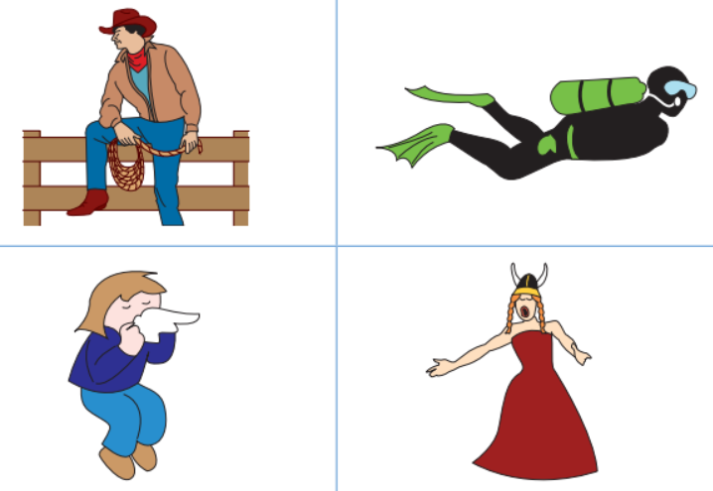
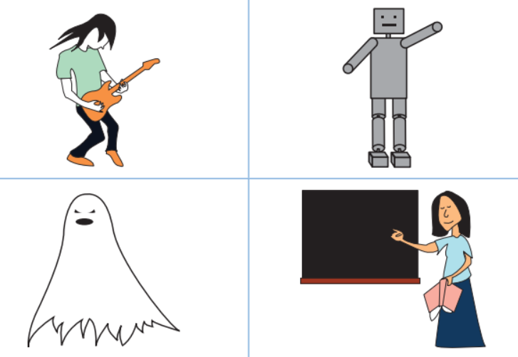
Fluency: Silly Voices Cards
Directions: Print and cut out the character cards to pull out of a bag when rereading stories with silly voices.
from Grade 1 Unit 2 Assessment and Remediation Guide, p. 138

Slide 8
Name: _________________________________________________
Fluency: Two Voices
Directions: One student reads down column 1 while the other student reads down column 2, together completing the story.
The lines that should be read chorally (voices together) are in bold.
The Hot Dog
1 | 2
Mom had a hot dog. | Mom had a hot dog.
She left the hot dog on a shelf in the den.
 | The hot dog sent up a smell. The smell
drifted and drifted. | drifted and drifted.
The cat bandit sat on the deck,
 | wishing he had a snack.
Then the hot dog smell hit him.
 | Such a smell!
Sniff, sniff, sniff! | Sniff, sniff, sniff!
The cat bandit ran in the den.
 | He spotted the hot dog up on the shelf.
He got up on a bench.
 | Then he sprang up on the TV set.
Then,
 | with a big jump,
he sprang up and
 | landed on the shelf.
Then—
munch, munch, munch— | munch, munch, munch—
the cat bandit
 | had himself a picnic lunch.
CKLA Skills Grade 2
Unit 1 Fluency Texts

Slide 10
Name: _________________________________________________
Fluency: Two Voices
Directions: One student reads down column 1 while the other student reads down column 2, together completing the story.
The lines that should be read chorally (voices together) are in bold.
The Chicken Nugget
1 | 2
Hank set his dish in the sink.
 | He left a big chicken nugget on the dish.
The nugget was still hot.
 | The smell of
chicken | chicken
drifted up from the sink.
 | It drifted into the den.
The cat bandit was napping in the den.
 | But he was sniffing as he slept.
Sniff, sniff, sniff! | Sniff, sniff, sniff!
The cat bandit sprang up.
 | He ran in and spotted the nugget in the sink.
He sat a bit,
 | thinking up a plan.
Then he went to the closet and got a bunch of boxes.
 | He set up a box.
Then he set a big box
next to that box. | next to that box.
 | Then he set the biggest box
next to the sink. | next to the sink.
CKLA Skills Grade 2
Unit 1 Fluency Texts

Slide 11
Fluency: Two Voices (“The Chicken Nugget” continued)
The Chicken Nugget
1 | 2
The cat bandit set off running.
 | He ran up the boxes,
hopping from box to box.
 | Then—
munch, munch, munch— | munch, munch, munch—
that was the end
of the chicken nugget. | of the chicken nugget.
CKLA Skills Grade 2
Unit 1 Fluency Texts

Slide 12
Name: _________________________________________________
Fluency: Two Voices
Directions: One student reads down column 1 while the other student reads down column 2, together completing the story.
The lines that should be read chorally (voices together) are in bold.
The Snack Mix
1 | 2
Beth left a basket of snack mix on a shelf.
 | The cat bandit spotted the snack mix.
He felt he had to get it.
But how? | But how?
 | He sat thinking.
Then he got up and ran off to the deck.
 | The cat bandit got the grilling tongs Dad kept next to the gas grill.
He set the tongs up on the rug.
 | Then he went and got a bunch of rocks.
He set the rocks on the rug.
 | He got a rock and set it down on the top tong.
He set his leg on the top tong to press it down.
 | Then he let the tong spring up. Swish!
The rock went zipping off. Bing!
 | The rock hit the shelf.
But it did not hit the basket with the snack mix.
CKLA Skills Grade 2
Unit 1 Fluency Texts

Slide 13
Fluency: Two Voices (“The Snack Mix” continued)
The Snack Mix
1 | 2
 | The bandit set a rock on the tongs and shot it.
Swish, bing!
 | Swish, bing!
Swish, bing! | Swish, bing!
The bandit shot six rocks.
 | But the rocks did not hit the basket of snack mix.
At last—
swish, smack! | swish, smack!
 | The seventh rock hit the basket.
The basket fell down.
 | It landed on the rug.
The rug was dotted with snack mix. Then—
chomp, chomp, chomp— | chomp, chomp, chomp—
 | that was the end of the snack mix.
CKLA Skills Grade 2
Unit 1 Fluency Texts

Slide 14
Name: _________________________________________________
Fluency: Two Voices
Directions: One student reads down column 1 while the other student reads down column 2, together completing the story.
The lines that should be read chorally (voices together) are in bold.
The Ham
1 | 2
Mom left a pink ham sitting in a big black pan.
 | The cat bandit was resting on a quilt
when he got a whiff of the ham.
 | What was that smell?
It was ham! | It was ham!
Where was the ham?
 | The cat bandit set off,
sniffing as he went.
 | He went on sniffing until he spotted the ham.
But the ham was up on top.
 | How was he to get it down?
That was the problem. | That was the problem.
The cat bandit ran to the closet and got a belt.
 | Then he ran to the shed and got a strong magnet.
He stuck the magnet on the end of the belt.
 | The magnet stuck to the belt.
Then the cat bandit swung the belt.
Clang! | Clang!
 | The magnet on the end of the belt hit the pan.
It stuck to the pan.
CKLA Skills Grade 2
Unit 1 Fluency Texts

Slide 15
Fluency: Two Voices (“The Ham” continued)
The Ham
1 | 2
 | In a flash, the cat bandit was tugging on the belt.
Tug,
 | tug,
tug! | tug!
Yank,
 | yank,
yank! | yank!
At last, the pan slid off.
 | It fell down and landed with a clang.
Then—
munch, munch, munch— | munch, munch, munch—
 | that was the end of the ham.
CKLA Skills Grade 2
Unit 1 Fluency Texts

Slide 16
Name: _________________________________________________
Fluency: Two Voices
Directions: One student reads down column 1 while the other student reads down column 2, together completing the story.
The lines that should be read chorally (voices together) are in bold.
The Fish
1 | 2
 | Once Mom hung a fish up on a string.
The cat bandit was scratching himself
 | when he got a whiff of the fish.
Quick as a flash | Quick as a flash
he ran into the kitchen.
 | The bandit spotted the fish hanging on the string.
He sat down to think up a plan to get the fish.
 | The cat bandit ran and got Mom’s glasses.
He set the glasses on a bench that was in the sun.
The sun shone on the two lenses of the glasses. | The sun shone on the two lenses of the glasses.
 | The lenses glinted in the sun.
The bandit slid the glasses a bit to the left.
 | He slid the glasses until one of the lenses sent hot sun flashing onto the string.
Then he sat. | Then he sat.
The sun from the glasses shone on the string.
CKLA Skills Grade 2
Unit 1 Fluency Texts

Slide 17
Fluency: Two Voices (“The Fish” continued)
The Fish
1 | 2
 | The string got hot.
The wax on the string melted.
 | Then,
rip! | rip!
The fish fell. Then—
munch, munch, munch— | munch, munch, munch—
 | that was the end of the fish.
CKLA Skills Grade 2
Unit 1 Fluency Texts

Slide 18
Name: _________________________________________________
Fluency: Two Voices
Directions: One student reads down column 1 while the other student reads down column 2, together completing the story.
The lines that should be read chorally (voices together) are in bold.
The Milk
1 | 2
Once Beth left a glass of milk on the deck.
 | The cat bandit spotted it.
It was up where he could not get it.
The bandit was sad. | The bandit was sad.
But then he spotted a string
 | that ran from the shed to the deck.
Mom had hung wet socks,
 | wet pants,
and a wet jacket on the string.
The bandit grinned. | The bandit grinned.
 | The cat bandit went and got Dad’s belt.
Then he got up on top of the shed.
 | He swung the belt on top of the string.
Then he held on to the belt
and jumped off the shed. Whiz! | and jumped off the shed. Whiz!
 | The bandit went zipping off on the string.
Pop, pop, pop! | Pop, pop, pop!
He knocked the socks off the string.
CKLA Skills Grade 2
Unit 1 Fluency Texts

Slide 19
Fluency: Two Voices (“The Milk” continued)
The Milk
1 | 2
Pop, pop, pop! | Pop, pop, pop!
 | He knocked the pants off the string.
Thwack! | Thwack!
He knocked the jacket off the string.
 | At last the bandit went zipping past the milk.
As he went past, he kicked the cup with his leg.
 | The cup fell on the deck with a crash.
The bandit landed on the deck.
 | Then—
lap, lap, lap— | lap, lap, lap—
that was the end of the milk.
CKLA Skills Grade 2
Unit 1 Fluency Texts

Slide 20
Name: _________________________________________________
Fluency: Two Voices
Directions: One student reads down column 1 while the other student reads down column 2, together completing the story.
The lines that should be read chorally (voices together) are in bold.
The Chips
1 | 2
Once Mom left a big bag of chips on the top shelf in the kitchen.
“The cat will not get them up there,” | “The cat will not get them up there,”
 | she said.
But it was not long until the cat bandit was up to his tricks.
 | He got a log,
a plank,
 | and a big rock.
He set the rock on the bench.
 | He set the log on the rug next to the bench.
He set the plank on top of the log.
 | Then the bandit sat on one end of the plank.
He slid the rock off the bench.
 | The rock fell and landed on one end of the plank.
Smack! | Smack!
The end of the plank where the rock fell went down fast.
 | But the end of the plank the cat bandit was sitting on popped up,
and the cat bandit popped up with it.
CKLA Skills Grade 2
Unit 1 Fluency Texts

Slide 21
Fluency: Two Voices (“The Chips” continued)
The Chips
1 | 2
Whiz! | Whiz!
The cat bandit did a flip and landed on top of the shelf.
Slash! | Slash!
 | The bandit cut a big gash in the bag.
Then—
crunch, crunch, crunch— | crunch, crunch, crunch—
 | that was the end of the chips.
CKLA Skills Grade 2
Unit 1 Fluency Texts

Slide 22
Name: _________________________________________________
Fluency: Two Voices
Directions: One student reads down column 1 while the other student reads down column 2, together completing the story.
The lines that should be read chorally (voices together) are in bold.
The Catfish
1 | 2
Dad went fishing and got a big catfish.
 | He left the catfish in a bucket.
Then he locked the bucket in the shed.
“There!” | “There!”
 | he said as he clicked the lock shut.
“This lock will stop the cat!” | “This lock will stop the cat!”
The tempting smell of fish drifted in the wind.
 | The cat bandit sensed that there was a fish in the shed.
He went to visit. | He went to visit.
The shed was locked up.
 | But that did not stop him!
He went and got a belt.
 | He hitched the end of the belt to the lock and tugged on it.
But the lock held
and the shed just sat there. | and the shed just sat there.
 | The cat bandit went and got a dog.
The cat and the dog tugged on the belt.
But still the shed just sat there. | But still the shed just sat there.
CKLA Skills Grade 2
Unit 1 Fluency Texts

Slide 23
Fluency: Two Voices (“The Catfish” continued)
The Catfish
1 | 2
 | The cat bandit went and got a pig.
The cat, the dog, and the pig tugged on the belt.
That did it. | That did it.
 | The shed tilted to the left.
Wham! | Wham!
The shed fell with a crash.
 | Then—
munch, munch, munch— | munch, munch, munch—
that was the end of the catfish.
CKLA Skills Grade 2
Unit 1 Fluency Texts

Slide 24
