Slide 1


Slide 2


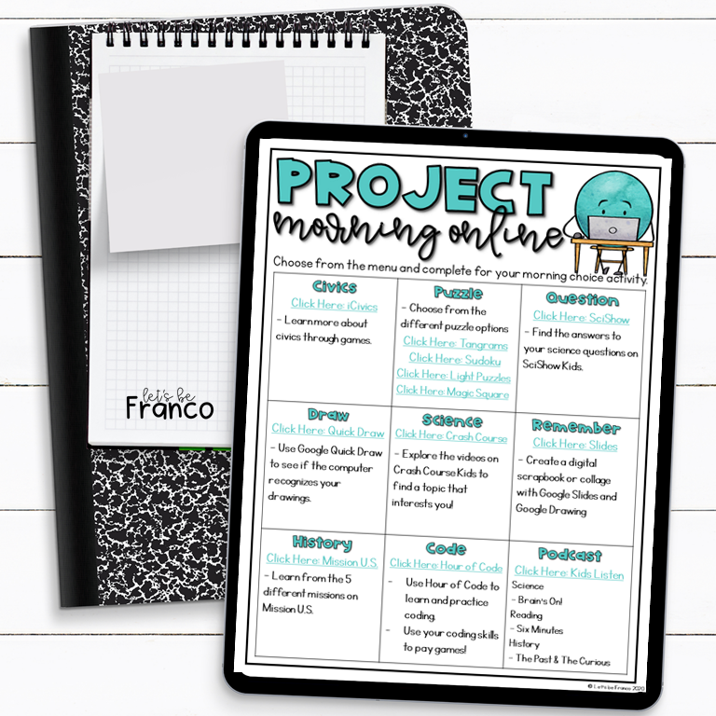

Yes Please!

Slide 3

Click HERE for the Google Slides Version

Slide 4
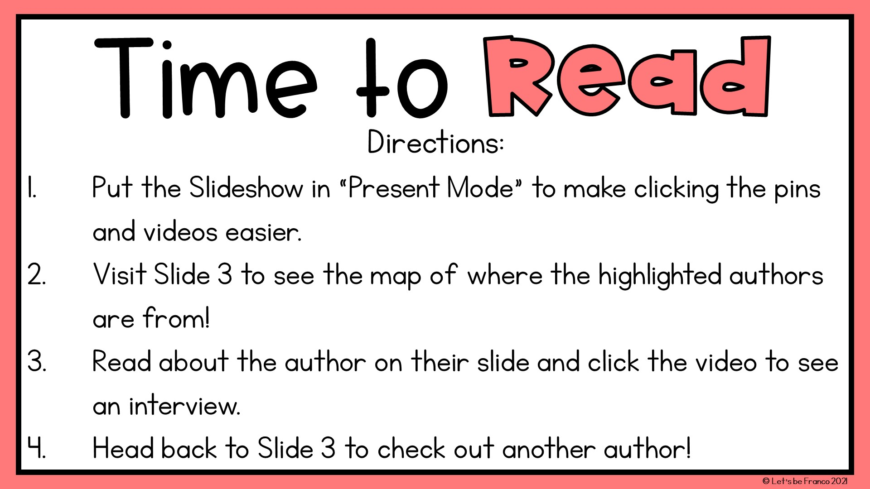

Slide 5
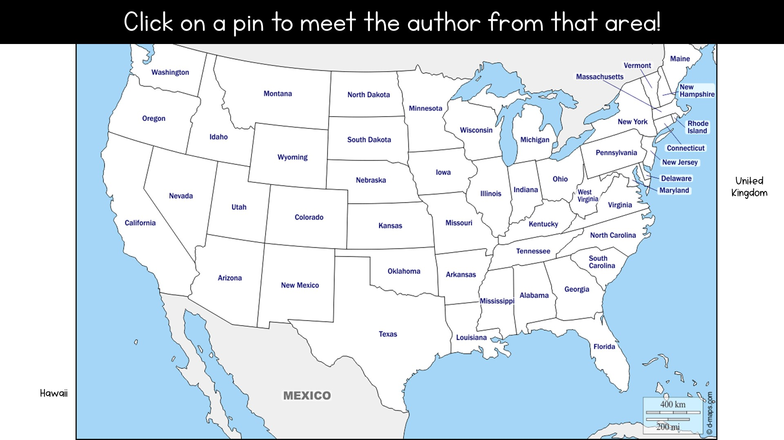













Slide 6

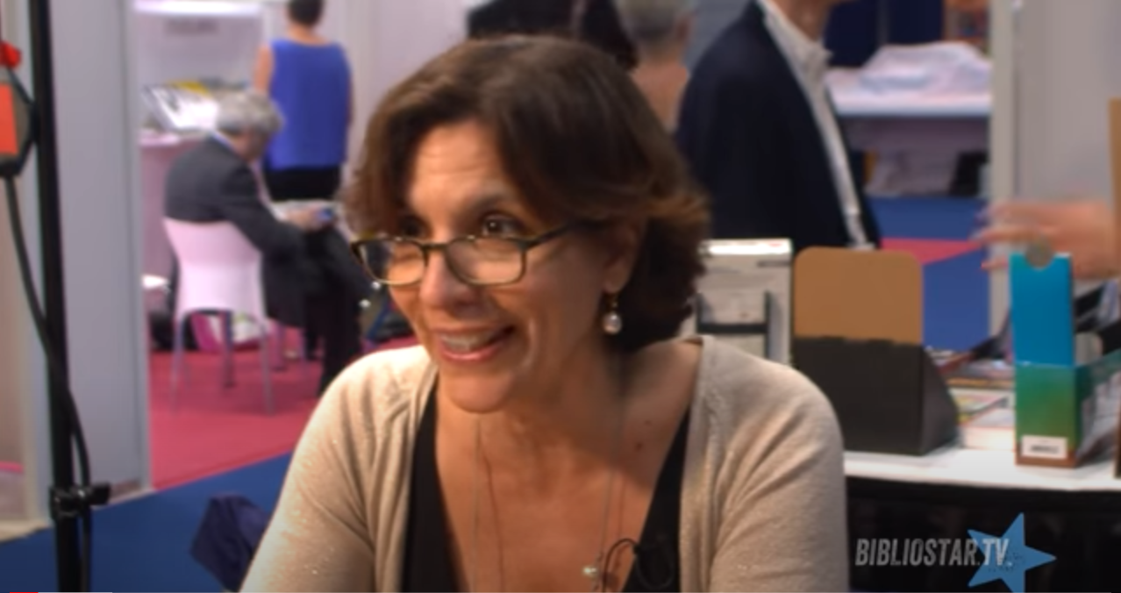

Slide 7

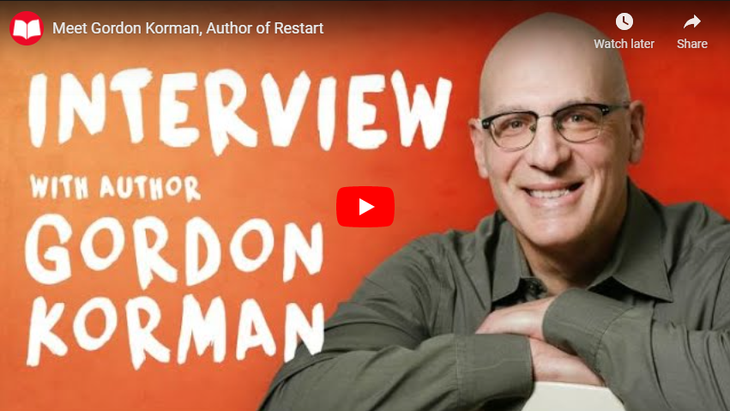

Slide 8

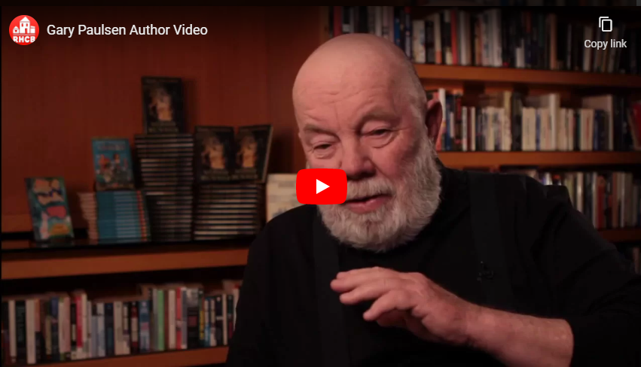

Slide 9

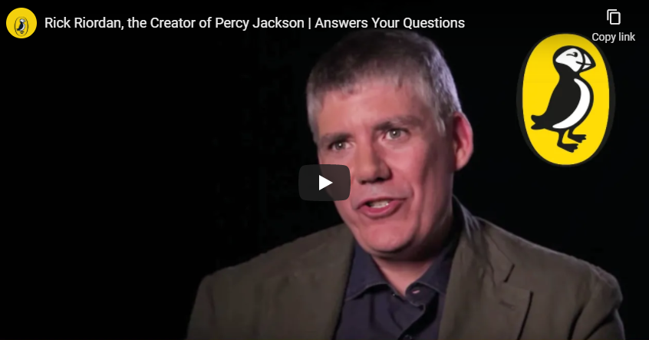

Slide 10



Slide 11

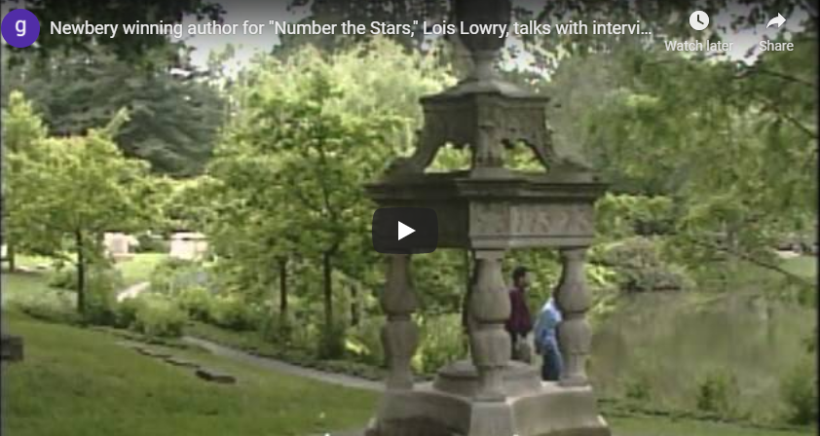

Slide 12

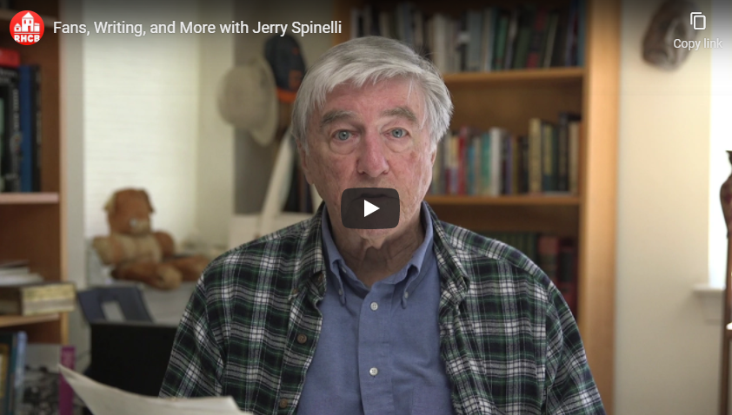

Slide 13

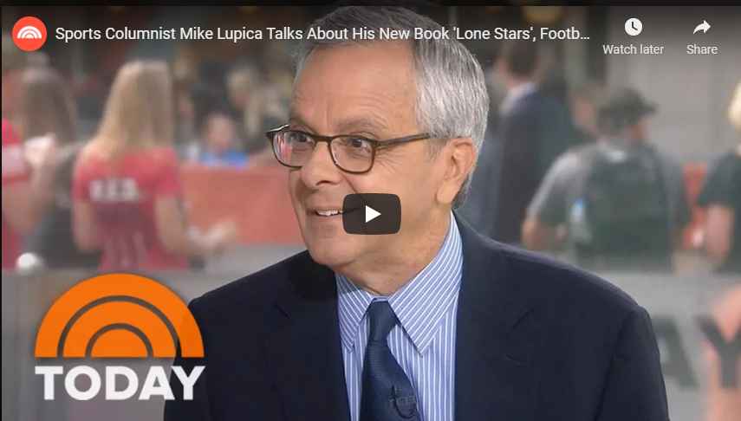

Slide 14



Slide 15

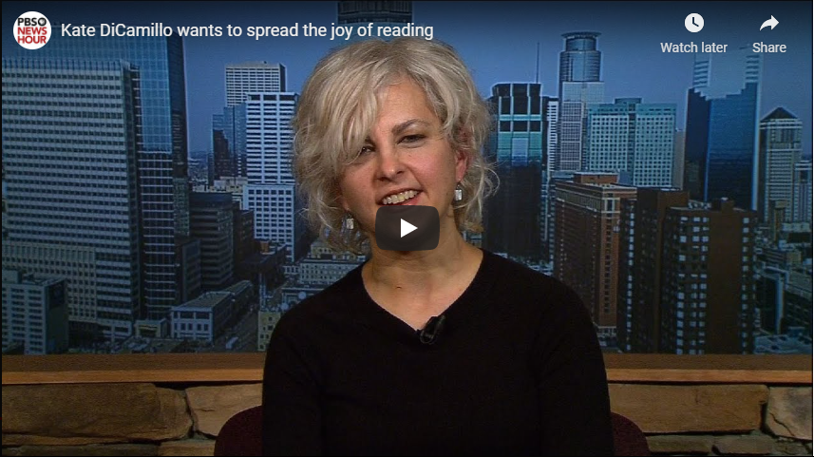

Slide 16

Thank you VERY much for downloading the file! I hope you enjoy it.
Please consider looking for other products on my Teachers Pay Teachers store.
Follow me on TpT for updates! Click Here
When you try out the product, leave feedback to let me know how you like it on my TpT store. You can also earn TpT credits!
Check out my blog Let’s be Franco or follow me on Instagram to see how my products are used in my classroom.
Terms of Use
This file comes with a limited use license for the original download.
Please respect the time and effort that goes into each
project by not giving it away to others.
Copyright
© Let’s be Franco
Fonts and Graphics thanks to

