Slide 1





Tic-Tac-Toe
(for every month)
Notes:
I did not include all the holidays. Feel free to change as needed.

Slide 2



Notes:
January - New Year's Day

Slide 3
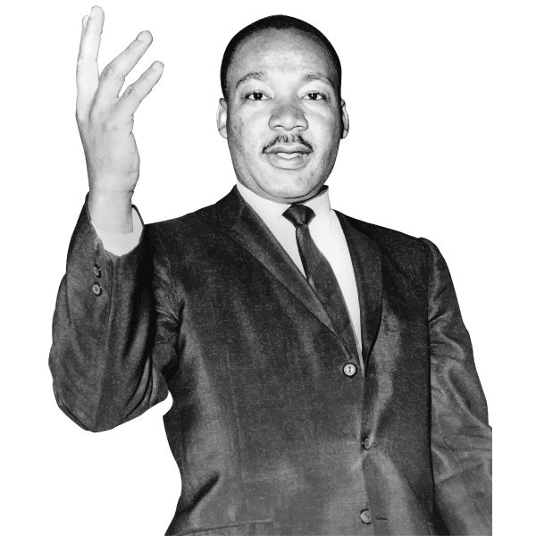

Notes:
February - Black History Month

Slide 4


Notes:
February- Groundhog’s Day

Slide 5


Notes:
February- Valentine’s Day

Slide 6
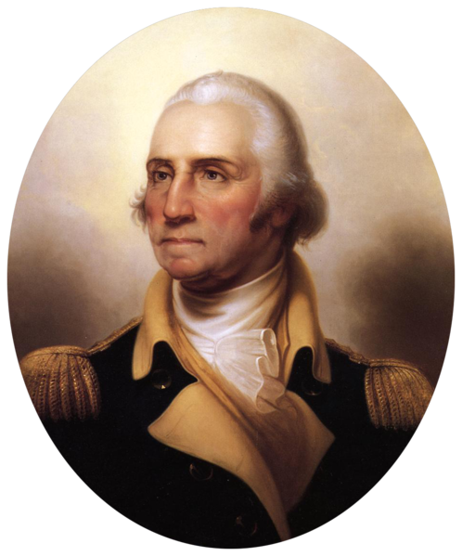
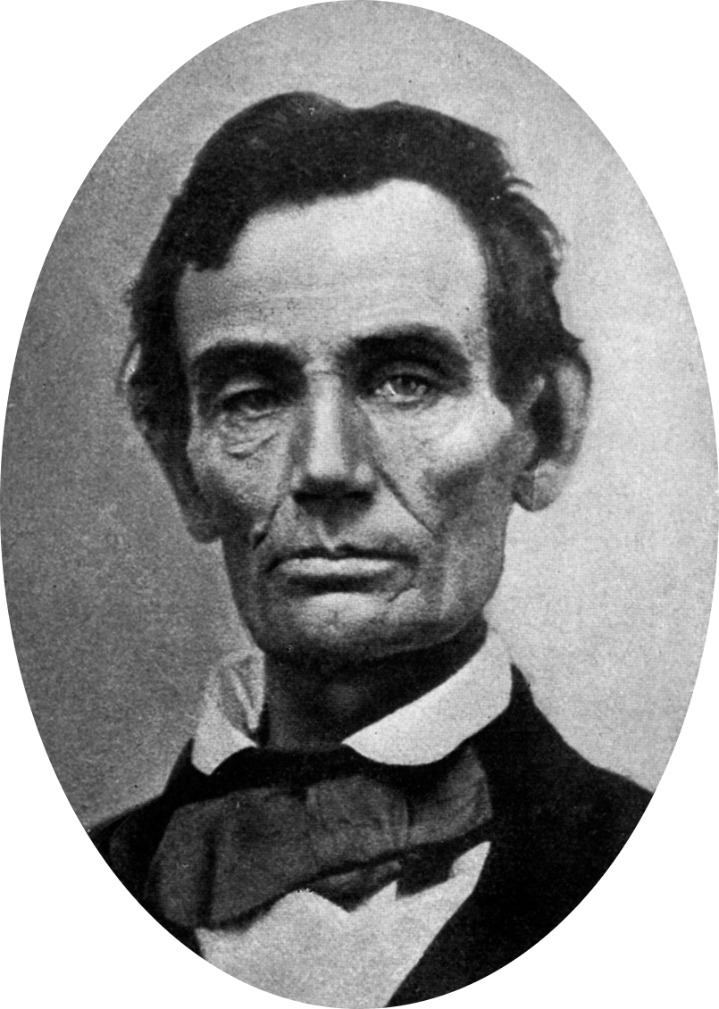
Notes:
February - President’s Day

Slide 7


Notes:
March- St. Patrick’s Day

Slide 8


Notes:
March- St. Patrick’s Day, Spring

Slide 9
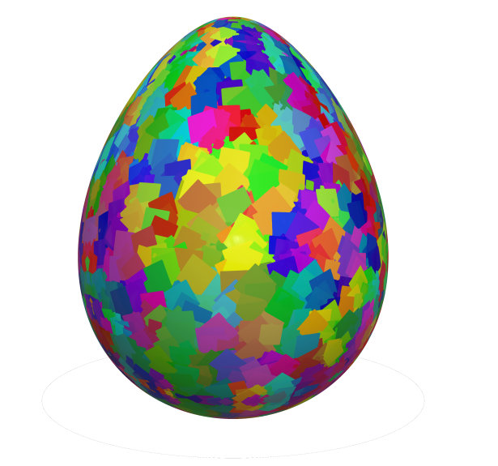
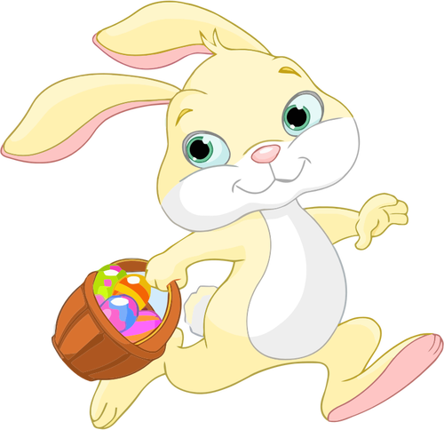
Notes:
April- Easter, World Autism Awareness Month

Slide 10
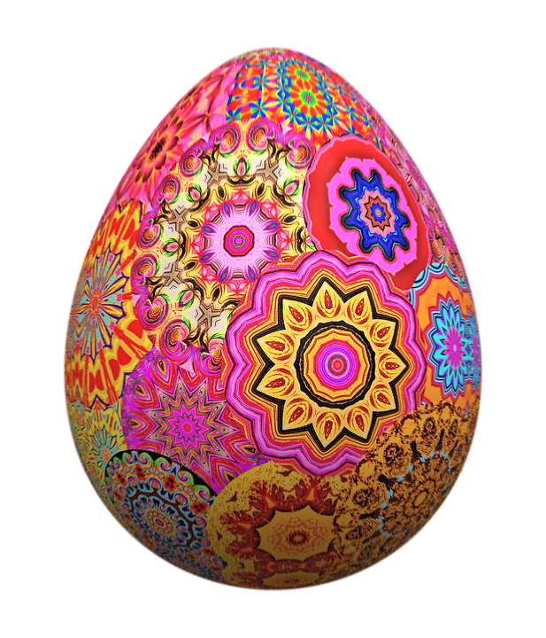

Notes:
April- Easter, World Autism Awareness Month

Slide 11


Notes:
April- Easter, World Autism Awareness Month

Slide 12


Notes:
May- Memorial Day, Mother’s Day

Slide 13


Notes:
May- Memorial Day, Mother’s Day

Slide 14


Notes:
June- Juneteenth, Father’s Day

Slide 15


Notes:
June- Juneteenth, Father’s Day

Slide 16

Notes:
July- 4th of July

Slide 17


Notes:
July- 4th of July

Slide 18

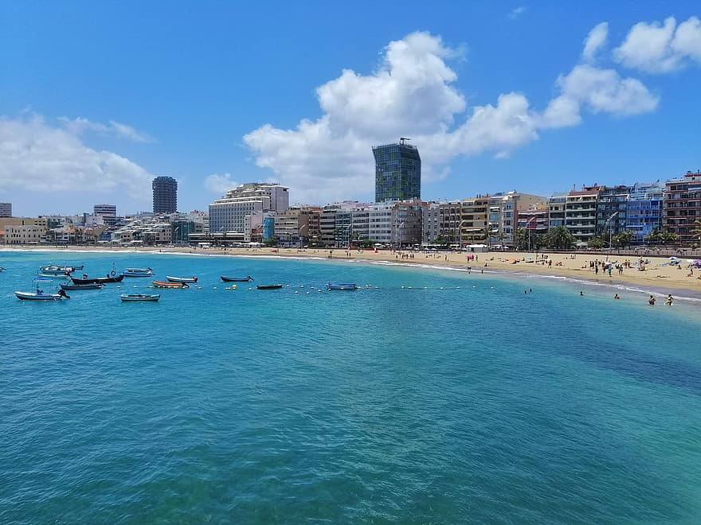
Notes:
August- Summer

Slide 19


Notes:
August- Summer

Slide 20


Notes:
September- Labor Day

Slide 21
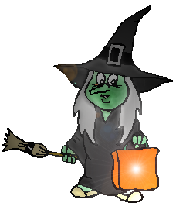

Notes:
October- Halloween

Slide 22


Notes:
October- Halloween

Slide 23
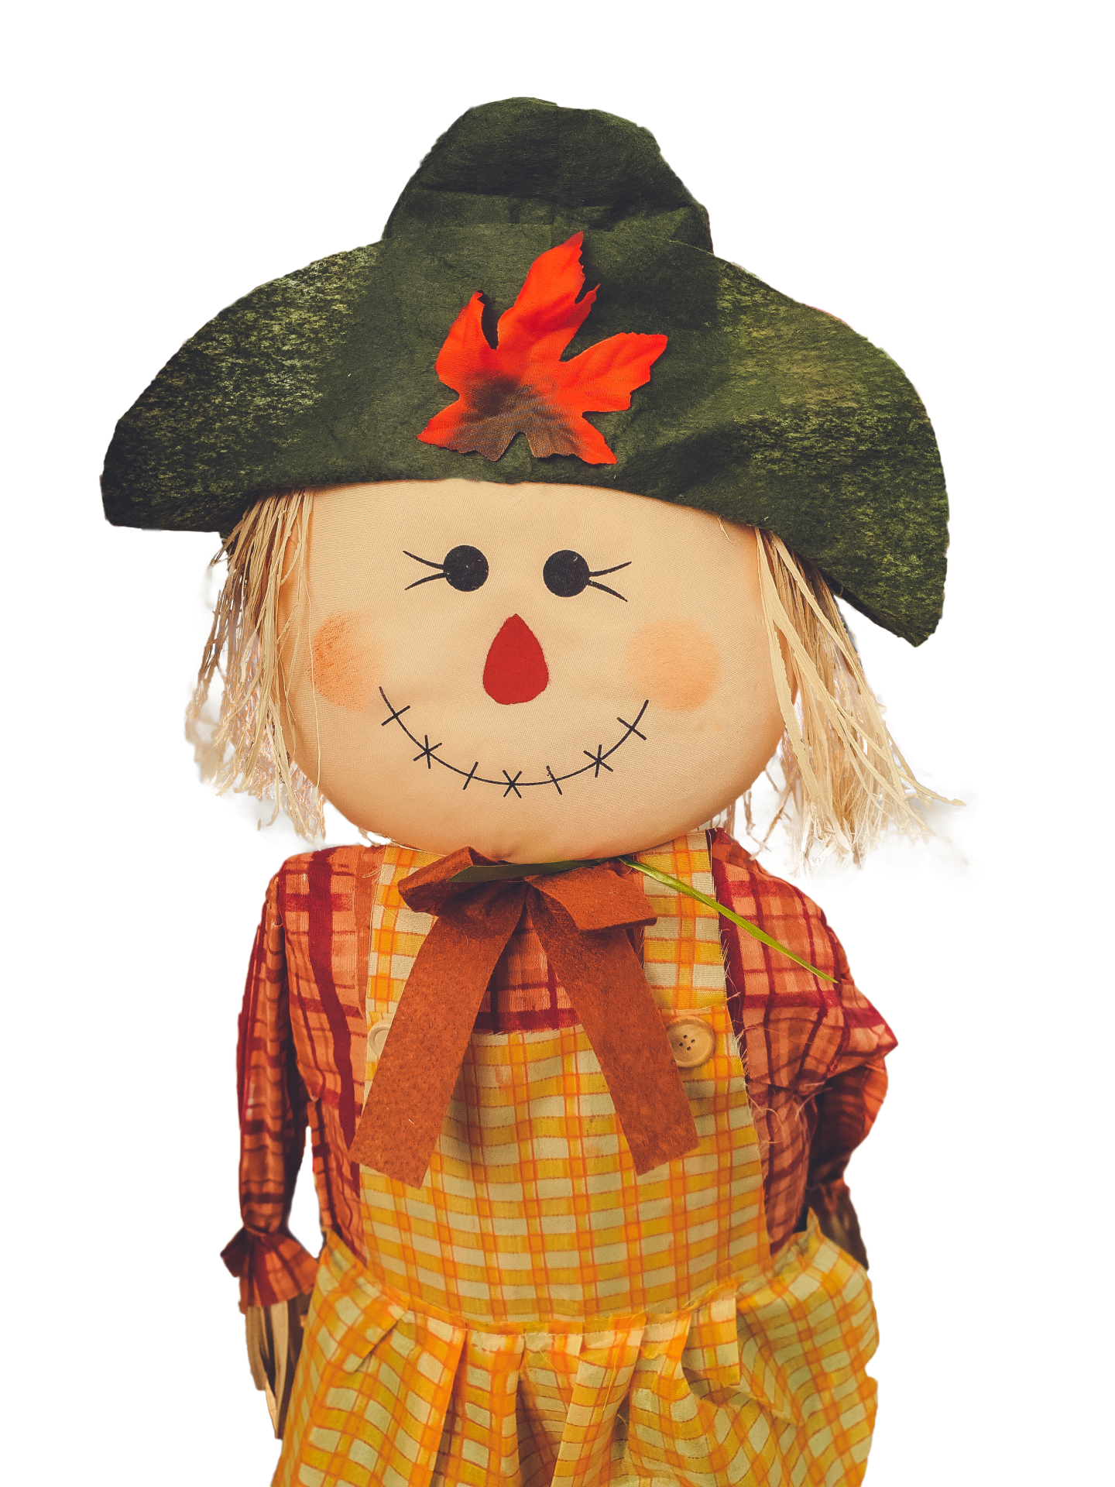
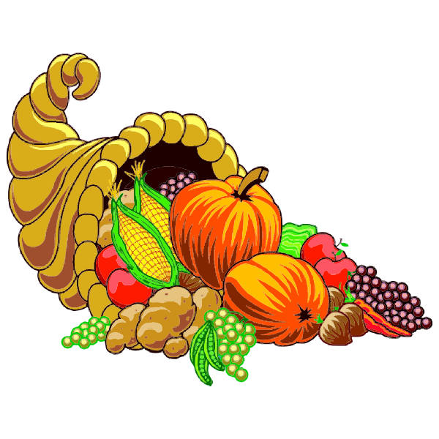
Notes:
November- Fall, Thanksgiving, Diwali

Slide 24
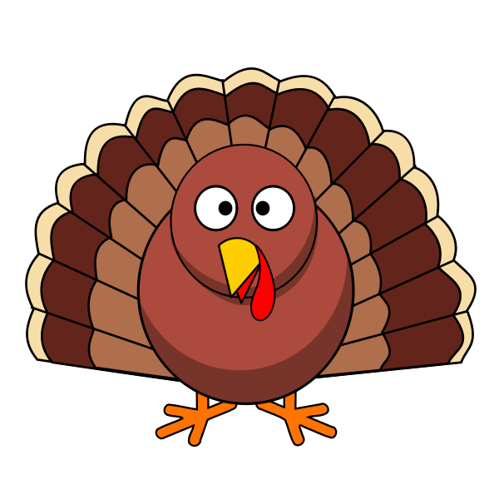

Notes:
November- Fall, Thanksgiving, Diwali

Slide 25


Notes:
November- Fall, Thanksgiving, Diwali

Slide 26


Notes:
December- Winter Solstice, Kwanzaa, Christmas, Hanukkah

Slide 27


Notes:
December- Winter Solstice, Kwanzaa, Christmas, Hanukkah

Slide 28

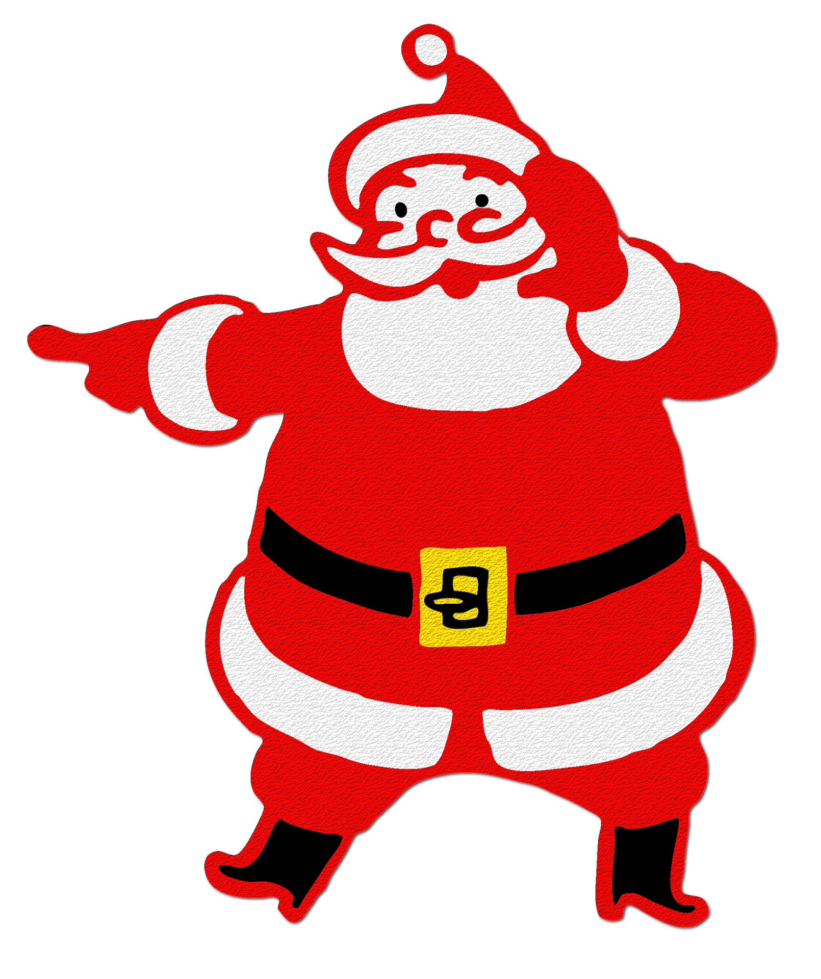
Notes:
December- Winter Solstice, Kwanzaa, Christmas, Hanukkah

Slide 29
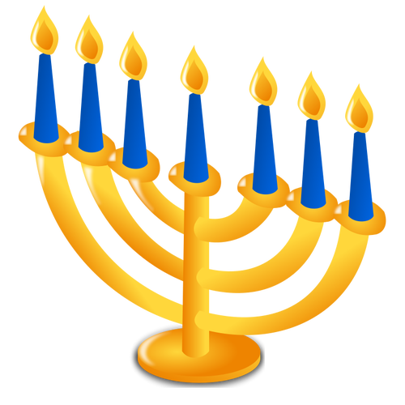

Notes:
December- Winter Solstice, Kwanzaa, Christmas, Hanukkah

