Slide 1
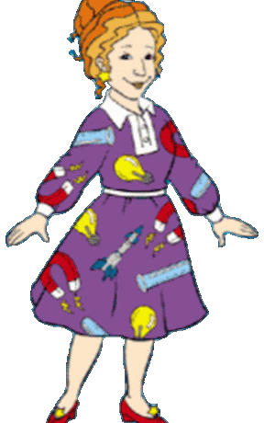
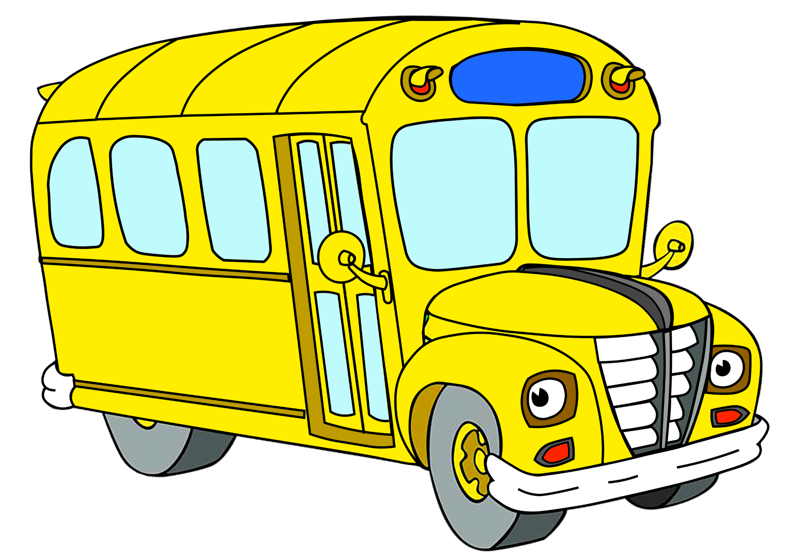
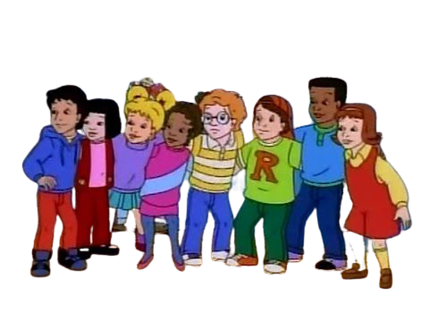
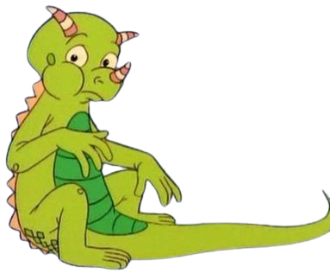
Magic School Bus
In the Haunted House: Sound | Gets Ready, Set, Dough: Kitchen Chemistry | Plays Ball: Forces | Hops Home: Habitats | Taking Flight: Flight | Getting Energized: Energy | Ups and Downs: Floating and Sinking | In the Arctic: Heat
Gets a Bright Idea: Light | Makes a Rainbow: Color | Meets Molly Cule: Molecules | Goes on Air: Air Pressure | Gains Weight: Gravity | Makes a Stink: Smells | Gets Charged: Electricity | Physical Science

Slide 2
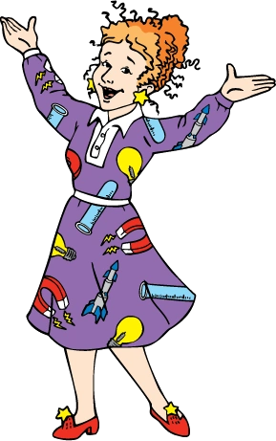
Magic School Bus
For Lunch: Human Digestion | Inside Ralphie: Human Health | Gets Eaten: Food Chains | Hops Home: Habitats | Meets the Rot Squad: Decomposition | All Dried Up: Desert Adaptation | Goes to Seed: Seeds/ How Living Things Grow | Gets Ants in Its Pants: Ants | Flexes Its Muscles: Body Mechanics
The Busasaurus: Dinosaurs | Going Batty: Bats | Butterfly and the Bog Beast: Butterflies | In a Pickle: Microbes | Cold Feet: Warm/Cold-Blooded Animals | In a Beehive: Bees | Spins a Web: Spiders | Goes Upstream: Migration | Works Out: Circulation
Gets Planted: Photosynthesis | In the Rainforest: Rainforest Ecology | Cracks a Yolk: Eggs: Eggs | Goes to Mussel Beach: Tidal Zones | Gets Swamped: Wetlands | Goes Cellular: Cells | Takes a Dive: Coral Reefs and Symbiosis | Biology

Slide 3
Magic School Bus
Kicks Up a Storm: Weather | Blows Its Top: Volcanoes | Wet All Over: Water | Rocks and Rolls: Erosion | Holiday Special: Recycling | Earth Science
Gets Lost in Space: Solar System | Out of This World: Space Rocks | Sees Stars: Stars | Outer Space
Revving Up: Engines | Under Construction: Structures | Shows and Tells: Archaeology | Gets Programmed:Computers | Applied Science

