Slide 1

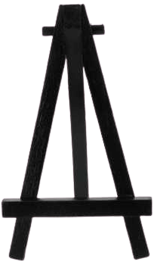


Ch. 1 | Ch. 2 | Ch. 3 | Ch. 4
Ch. 5 | Ch. 6 | Ch. 7 | Ch. 8
Ch. 9 | Ch. 10 | Ch. 11 | Ch. 12
Ch. 13 | Ch. 14 | Ch. 15 | Ch. 16
Ch. 17 | Ch. 18 | Ch. 19 | Ch. 20
Ch. 21 | Ch. 22 | Ch. 23
Notes:
The Giver

