Slide 1





Slide 2
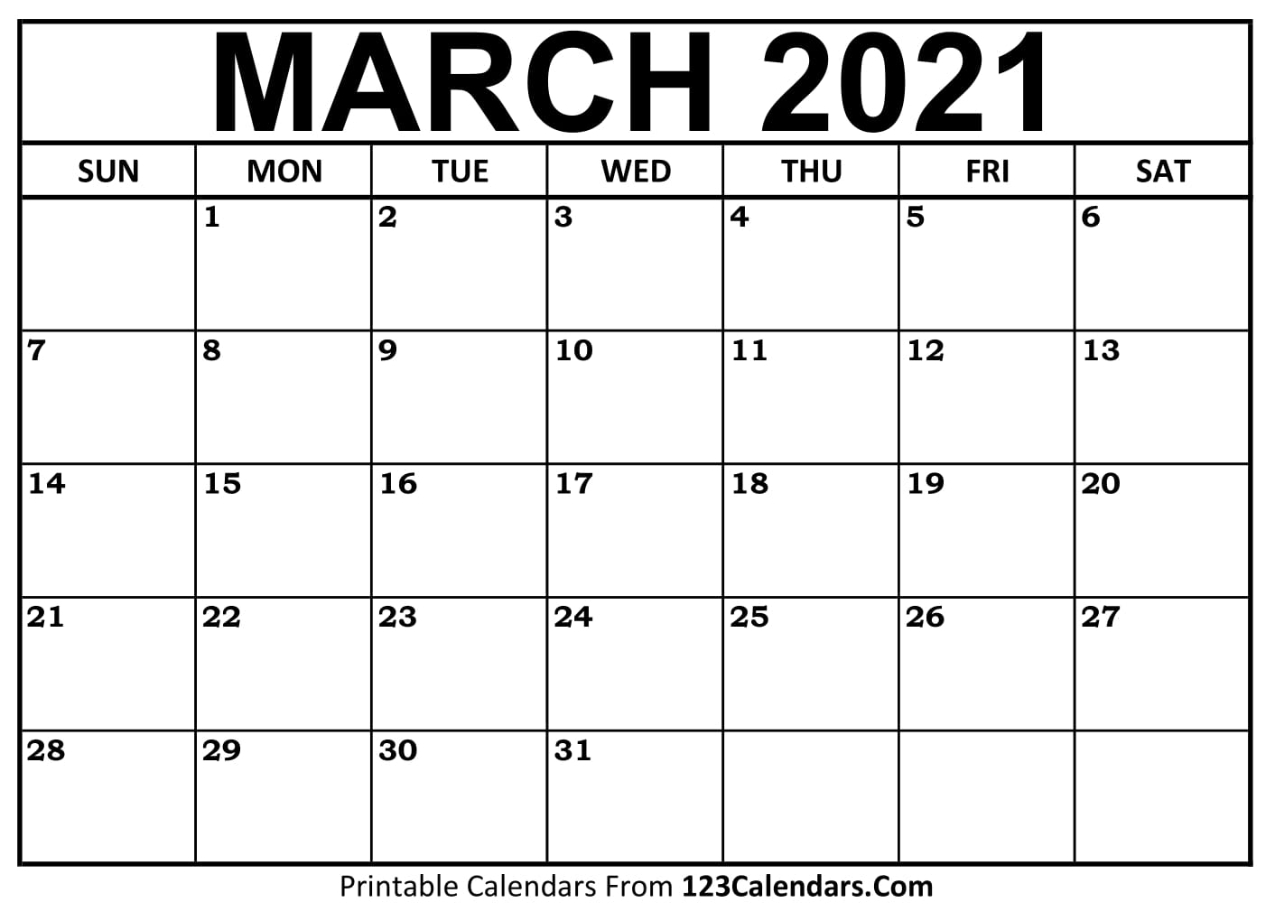



Slide 3
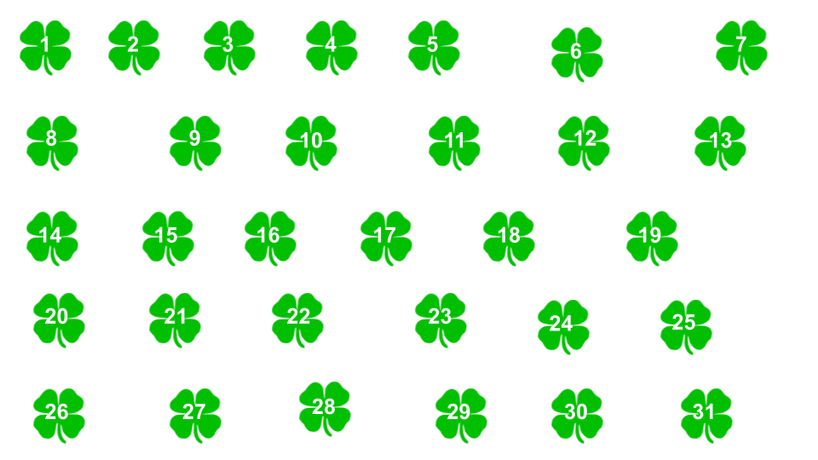




Brainy Bunch
Math:
English:
Science:
Social Studies:
Dream Team
Math:
English:
Science:
Social Studies:
Reminders
Brainy Bunch
Dream Team

Slide 4
Brainy Bunch
Math:
English:
Science:
Social Studies:
Dream Team
Math:
English:
Science:
Social Studies:
Reminders
Brainy Bunch
Dream Team

Slide 5
Brainy Bunch
Math:
English:
Science:
Social Studies:
Dream Team
Math:
English:
Science:
Social Studies:
Reminders
Brainy Bunch
Dream Team

Slide 6
Brainy Bunch
Math:
English:
Science:
Social Studies:
Dream Team
Math:
English:
Science:
Social Studies:
Reminders
Brainy Bunch
Dream Team

Slide 7
Brainy Bunch
Math:
English:
Science:
Social Studies:
Dream Team
Math:
English:
Science:
Social Studies:
Reminders
Brainy Bunch
Dream Team

Slide 8
Brainy Bunch
Math:
English:
Science:
Social Studies:
Dream Team
Math:
English:
Science:
Social Studies:
Reminders
Brainy Bunch
Dream Team

Slide 9
Brainy Bunch
Math:
English:
Science:
Social Studies:
Dream Team
Math:
English:
Science:
Social Studies:
Reminders
Brainy Bunch
Dream Team

Slide 10
Brainy Bunch
Math:
English:
Science:
Social Studies:
Dream Team
Math:
English:
Science:
Social Studies:
Reminders
Brainy Bunch
Dream Team

Slide 11
Brainy Bunch
Math:
English:
Science:
Social Studies:
Dream Team
Math:
English:
Science:
Social Studies:
Reminders
Brainy Bunch
Dream Team

Slide 12
Brainy Bunch
Math:
English:
Science:
Social Studies:
Dream Team
Math:
English:
Science:
Social Studies:
Reminders
Brainy Bunch
Dream Team

Slide 13
Brainy Bunch
Math:
English:
Science:
Social Studies:
Dream Team
Math:
English:
Science:
Social Studies:
Reminders
Brainy Bunch
Dream Team

Slide 14
Brainy Bunch
Math:
English:
Science:
Social Studies:
Dream Team
Math:
English:
Science:
Social Studies:
Reminders
Brainy Bunch
Dream Team

Slide 15
Brainy Bunch
Math:
English:
Science:
Social Studies:
Dream Team
Math:
English:
Science:
Social Studies:
Reminders
Brainy Bunch
Dream Team

Slide 16
Brainy Bunch
Math:
English:
Science:
Social Studies:
Dream Team
Math:
English:
Science:
Social Studies:
Reminders
Brainy Bunch
Dream Team

Slide 17
Brainy Bunch
Math:
English:
Science:
Social Studies:
Dream Team
Math:
English:
Science:
Social Studies:
Reminders
Brainy Bunch
Dream Team

Slide 18
Brainy Bunch
Math:
English:
Science:
Social Studies:
Dream Team
Math:
English:
Science:
Social Studies:
Reminders
Brainy Bunch
Dream Team

Slide 19
Brainy Bunch
Math:
English:
Science:
Social Studies:
Dream Team
Math:
English:
Science:
Social Studies:
Reminders
Brainy Bunch
Dream Team

Slide 20
Brainy Bunch
Math:
English:
Science:
Social Studies:
Dream Team
Math:
English:
Science:
Social Studies:
Reminders
Brainy Bunch
Dream Team

Slide 21
Brainy Bunch
Math:
English:
Science:
Social Studies:
Dream Team
Math:
English:
Science:
Social Studies:
Reminders
Brainy Bunch
Dream Team

Slide 22
Brainy Bunch
Math:
English:
Science:
Social Studies:
Dream Team
Math:
English:
Science:
Social Studies:
Reminders
Brainy Bunch
Dream Team

Slide 23
Brainy Bunch
Math:
English:
Science:
Social Studies:
Dream Team
Math:
English:
Science:
Social Studies:
Reminders
Brainy Bunch
Dream Team

Slide 24
Brainy Bunch
Math:
English:
Science:
Social Studies:
Dream Team
Math:
English:
Science:
Social Studies:
Reminders
Brainy Bunch
Dream Team

Slide 25
Brainy Bunch
Math:
English:
Science:
Social Studies:
Dream Team
Math:
English:
Science:
Social Studies:
Reminders
Brainy Bunch
Dream Team

