Slide 1

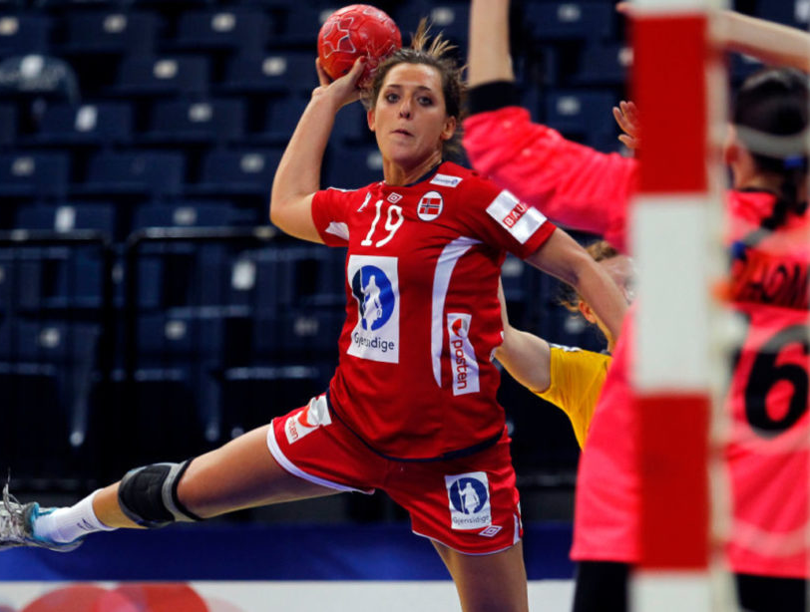
Team Handball
Rules
Game play
Communication

Slide 2
How -I can communicate with my teammates while playing a game of Handball.
What – I am learning about the necessary skills to play
a game of a Handball.
Why - Handball teaches us teamwork, collaboration, fair play
and healthy competition. Teamwork Improves
communication skills and can lead to better relationships
with peers.
Standards for Physical Education - 6.4.SW1. 7.4.SW1 8.4.SW1
Accept differences among classmates in physical development,
maturation and varying skill levels by providing encouragement and positive feedback

Slide 3
The objective of team handball is to score a goal by passing the ball quickly and throwing the ball past the defense and goalie and into the goal.

Slide 4
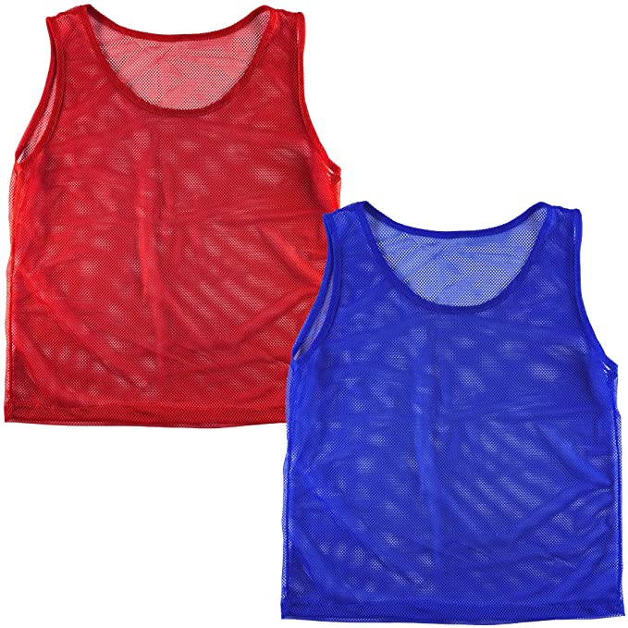

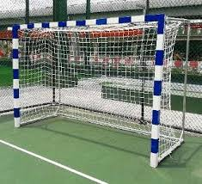
Players & Equipment
The standard handball games features 7 players on each side, six outfield players and one goalkeeper.
A team will also have up to 7 substitutes. Players can sub in after a point has been scored.
To win in handball you must score more than your opponent.
Two 12-minute quarters – team with the most points at the end of the game wins.

Slide 5

Rules:
Flip a coin or Rock, Paper, scissors to determine who gets the ball first
3 steps (travel: if you take more than 3 steps)
3 second holding rule (can only stand stationary for 3 seconds)
If ball hits the ground, then possession changes
If the ball goes out of bounds, then it's a throw-in
Play begins with a throw-in after a goal is scored. The throw-in is a free pass – cannot guard a throw-in after a goal has been scored.
Can’t pass back to the goalkeeper
Only goalkeeper allowed in goal area; can’t come out of crease; can switch with fielders anytime
Scoring- shoot from outside the crease; goals can be scored through the air, off ground, or off goalie
After goal is scored, goalie starts with the ball
The ball can be intercepted, knocked down in the air
CANNOT knock the ball out of a player’s hand

Slide 6

Tips for success
communicate with teammates
call for the ball and let teammates
know where you are
Offense: student moves without the ball to give his or her teammate an option to pass to; student has hands in ready position
(hand up and in front of them) to catch the ball; student is constantly moving around; student passes, shoots
Defense: student tries to stop attackers from approaching goal; guarding one person from the other team;
hands are up to guard, block, and intercept the ball
Sportsmanship: student is a team player by sharing the ball, passing to all teammates,
being kind and respectful to all teams and teammates.

