Slide 1



SuperBowl
A battle of the math minds!
Length vs. Width

Slide 2
Rules of Play
Teams
Divide into your teams and pick a side of the classroom.
Once you are in your area each person will need their notebook.
L
W
1
2
Length
Width
Student Names here
Student Names here
Student Names here
Student Names here
Using your equations for perimeter and area you will solve problems
When you get the question correct- your team will draw a card and follow the instructions.
4
3
  You score a touchdown after each question your team gets correct! This is worth 7 points! To earn the point after your team has to answer correctly first!
  The team with the most points correct after wins the game!

Slide 3
Rules of Play
Teams
Divide into your teams and pick a side of the classroom.
Once you are in your area each person will need their notebook.
L
W
1
2
Length
Width
Student Names here
Student Names here
Student Names here
Student Names here
Using your equations for perimeter and area you will solve problems
When you get the question correct- your team will draw a card and follow the instructions.
4
3
  You score a touchdown after each question your team gets correct! This is worth 7 points! To earn the point after your team has to answer correctly first!
  The team with the most points correct after wins the game!

Slide 4
Rules of Play
Teams
Divide into your teams and pick a side of the classroom.
Once you are in your area each person will need their notebook.
L
W
1
2
Length
Width
Student Names here
Student Names here
Student Names here
Student Names here
Using your equations for perimeter and area you will solve problems
When you get the question correct- your team will draw a card and follow the instructions.
4
3
  You score a touchdown after each question your team gets correct! This is worth 7 points! To earn the point after your team has to answer correctly first!
  The team with the most points correct after wins the game!

Slide 5

Length vs. Width
0
0
0
0

Slide 6
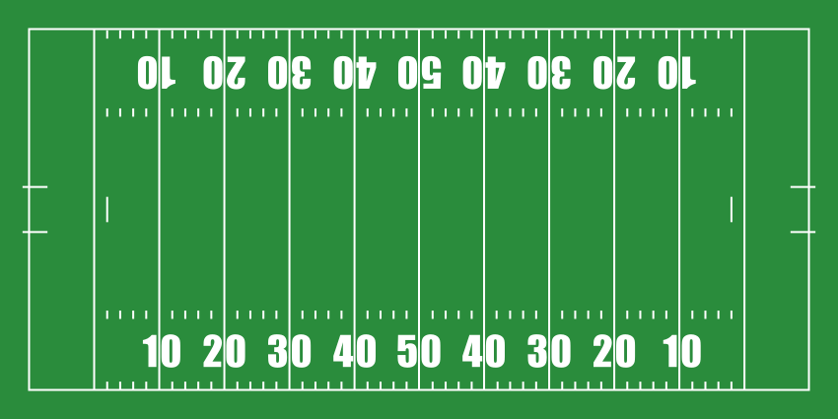


L
E
N
G
T
H
W
I
D
T
H

Slide 7
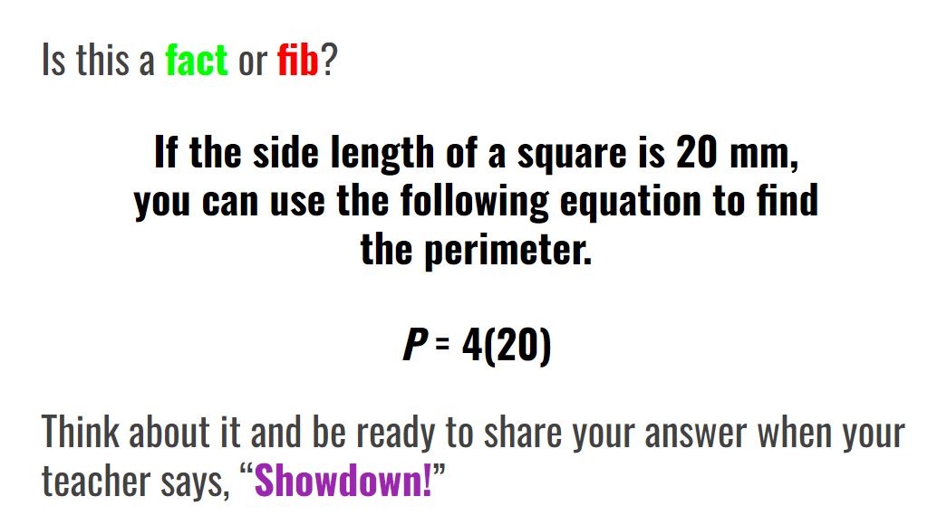

Slide 8
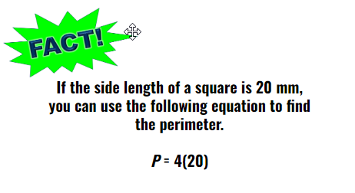

Slide 9
Length vs. Width
0
0
0
0

Slide 10
L
E
N
G
T
H
W
I
D
T
H

Slide 11
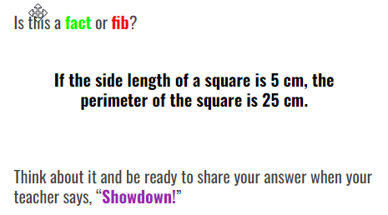

Slide 12
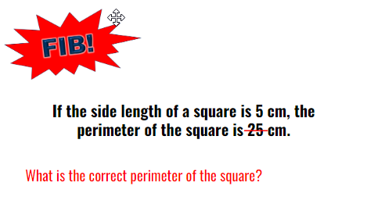

Slide 13
Length vs. Width
0
0
0
0

Slide 14
L
E
N
G
T
H
W
I
D
T
H

Slide 15
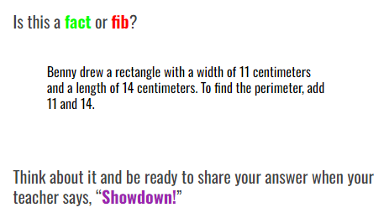

Slide 16
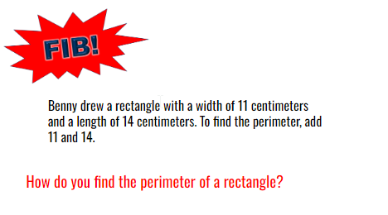

Slide 17
Length vs. Width
0
0
0
0

Slide 18
L
E
N
G
T
H
W
I
D
T
H

Slide 19
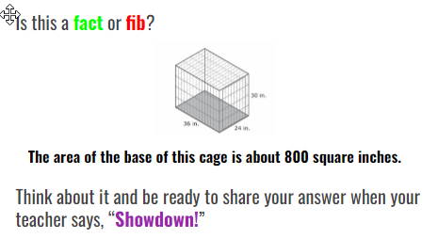

Slide 20
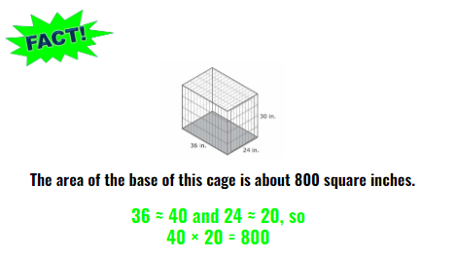

Slide 21
Length vs. Width
0
0
0
0

Slide 22
L
E
N
G
T
H
W
I
D
T
H

Slide 23
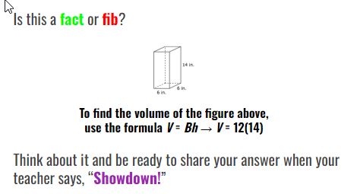

Slide 24
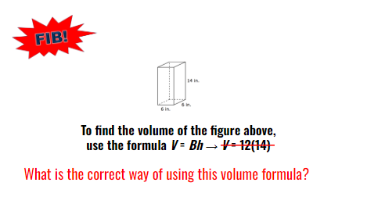

Slide 25
Length vs. Width
0
0
0
0

Slide 26
L
E
N
G
T
H
W
I
D
T
H

Slide 27

Gain 10 yards
Fumble
Field Goal
Touchdown
Lose 15 yards
Gain 30 yards
Gain 30 yards
2 point conversion

Slide 28
Gain 10 yards
Fumble
Field Goal
Touchdown
Lose 15 yards
Gain 30 yards
Gain 30 yards
2 point conversion

Slide 29

Gain 10 yards
Fumble
Field Goal
Touchdown
Lose 15 yards
Gain 30 yards
Gain 30 yards
2 point conversion

Slide 30
Gain 10 yards
Fumble
Field Goal
Touchdown
Lose 15 yards
Gain 30 yards
Gain 30 yards
2 point conversion

