Slide 1

What People See!

Slide 3
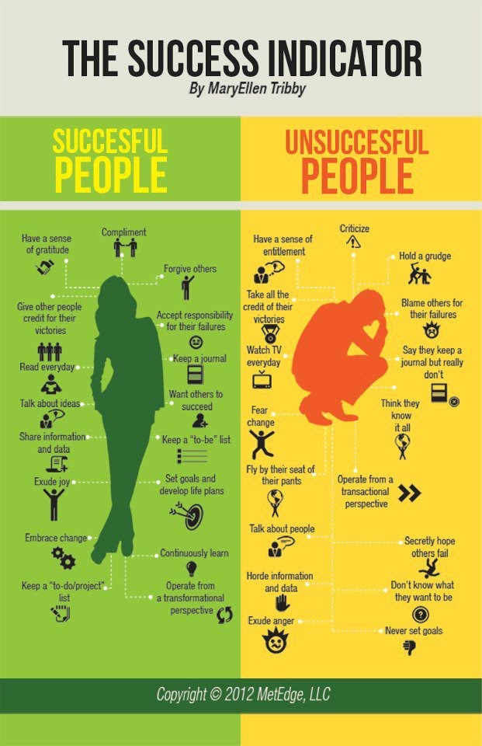

Slide 4
