Slide 1
Static Balance VS Dynamic Balance
Static
Dynamic Balance
Balancing while standing still
Example:
  Holding a yoga pose
  Standing on your toes
Balancing while moving
Example:
  Hopping on one foot
  Walking across a balance beam

Slide 2
Static balance practices

Slide 3
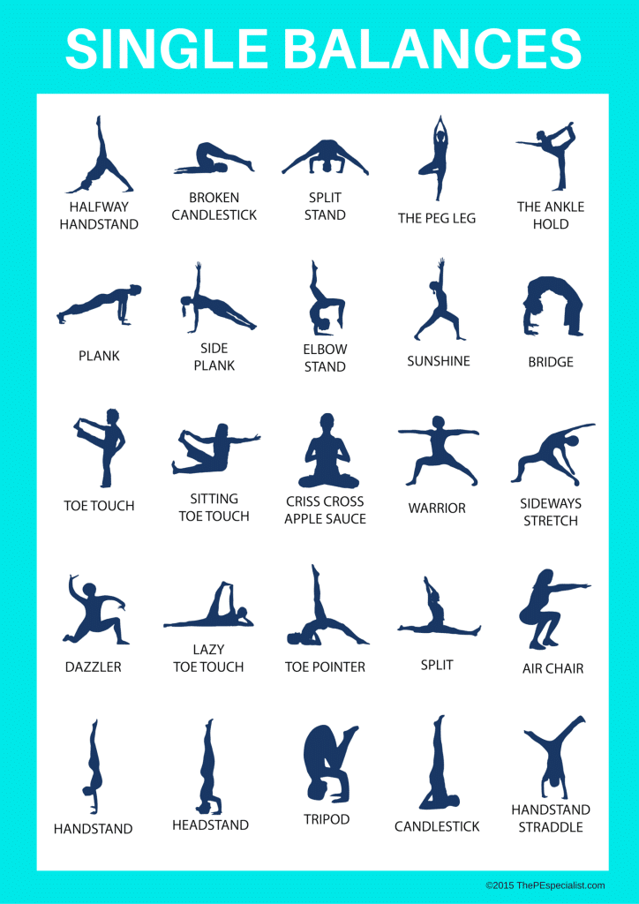

Slide 10
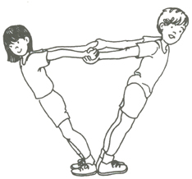

Slide 11
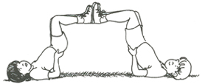

Slide 12
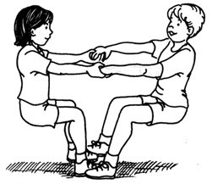

Slide 13
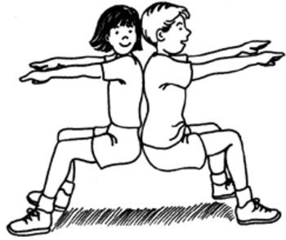

Slide 14
