Slide 1
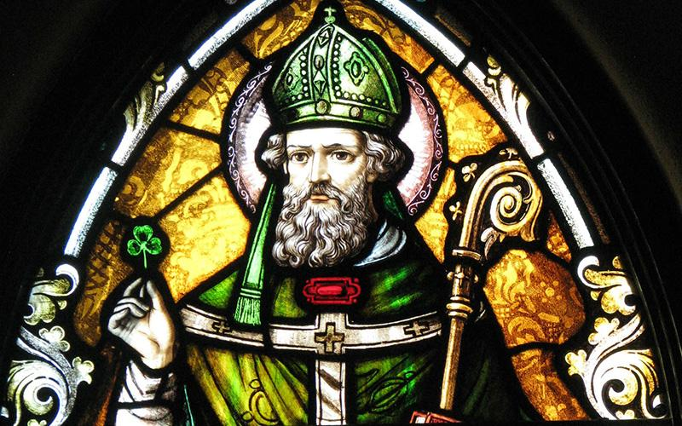



HOW MANY COINS?
ON 17TH MARCH
WE CELEBRATE
SAINT PATRICK’S DAY.

Slide 2
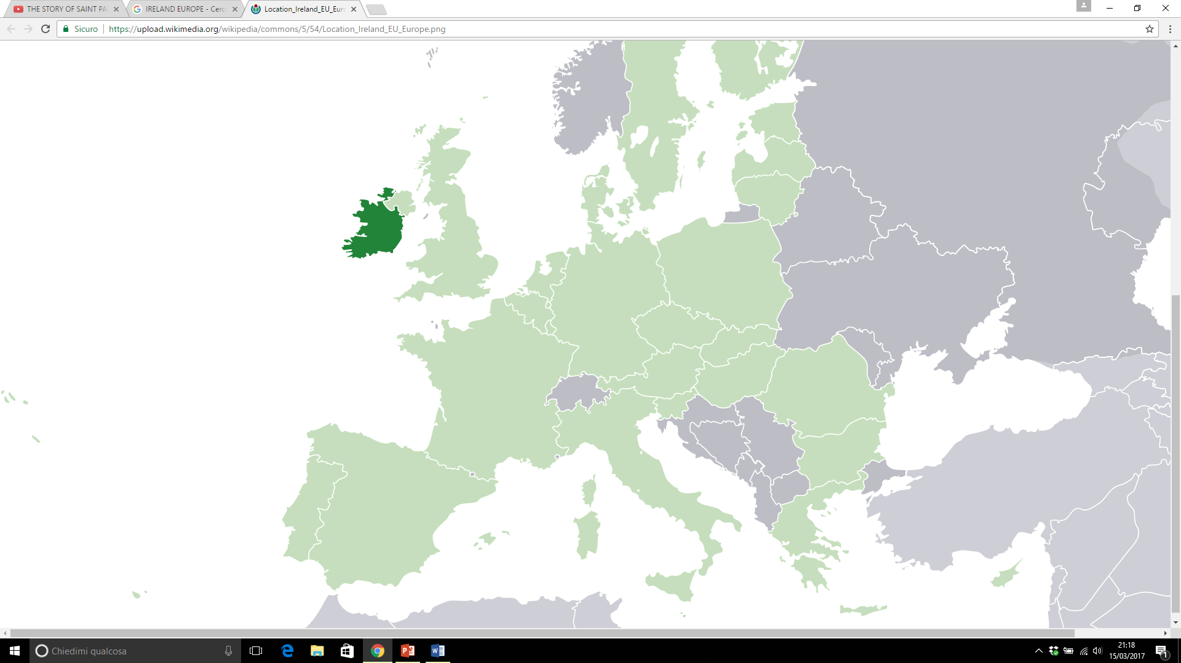
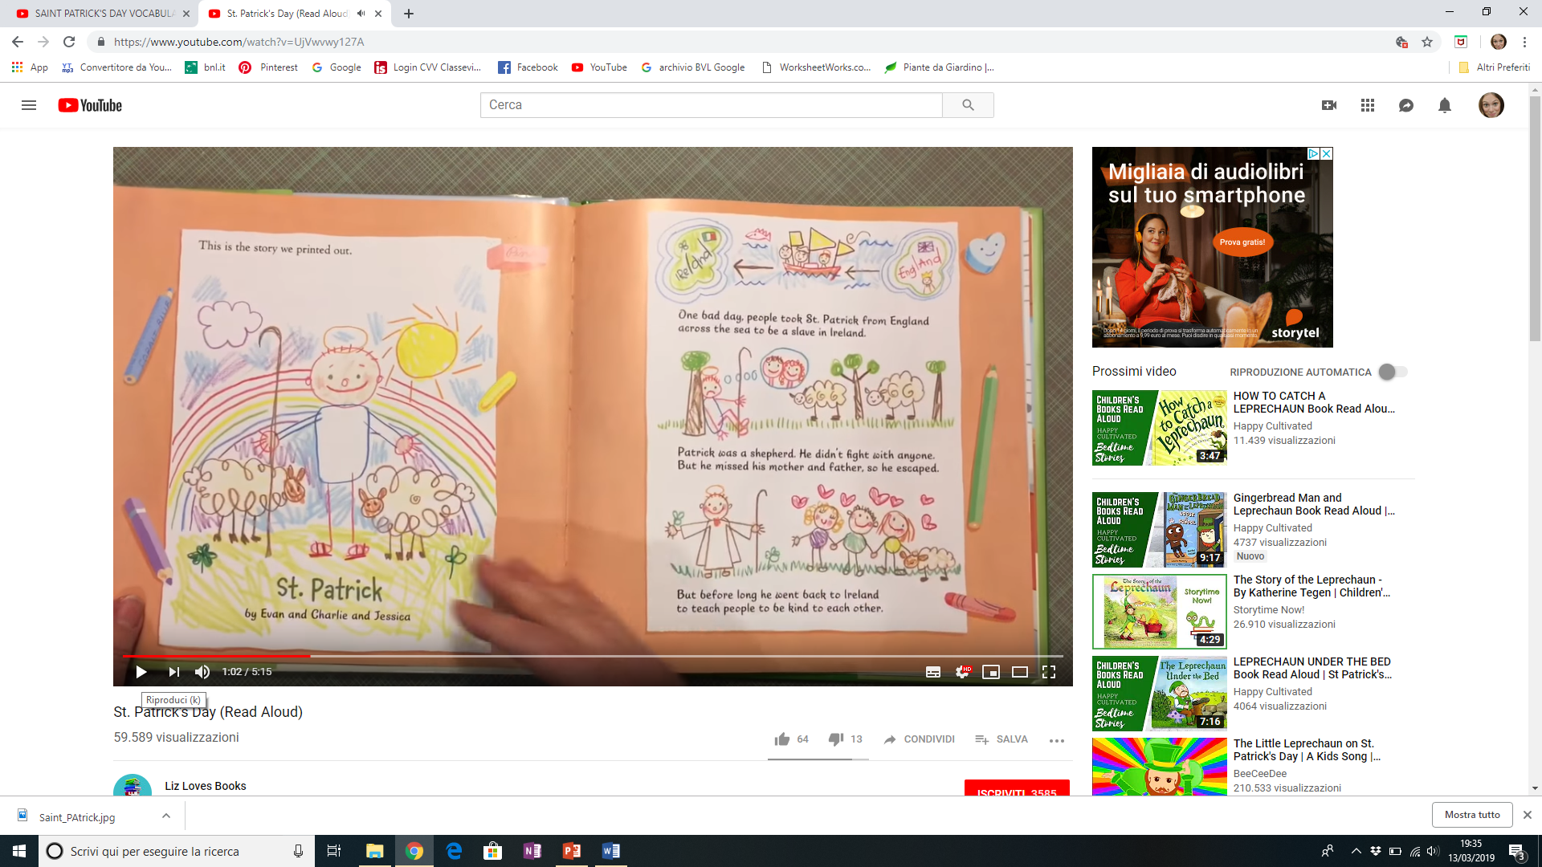

ONE DAY PIRATES TOOK PATRICK
FROM ENGLAND TO BE A SLAVE IN IRELAND.
PATRICK WAS A SHEPHERD
IRELAND
…BUT HE MISSED HIS
MOTHER AND FATHER
SO HE ESCAPED!
ENGLAND

Slide 3


PATRICK BECAME A PRIEST
HE WENT BACK TO IRELAND
TO TEACH IRISH PEOPLE ABOUT GOD USING A SHAMROCK

Slide 4
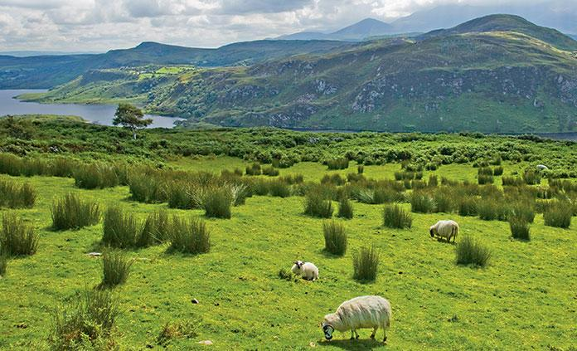
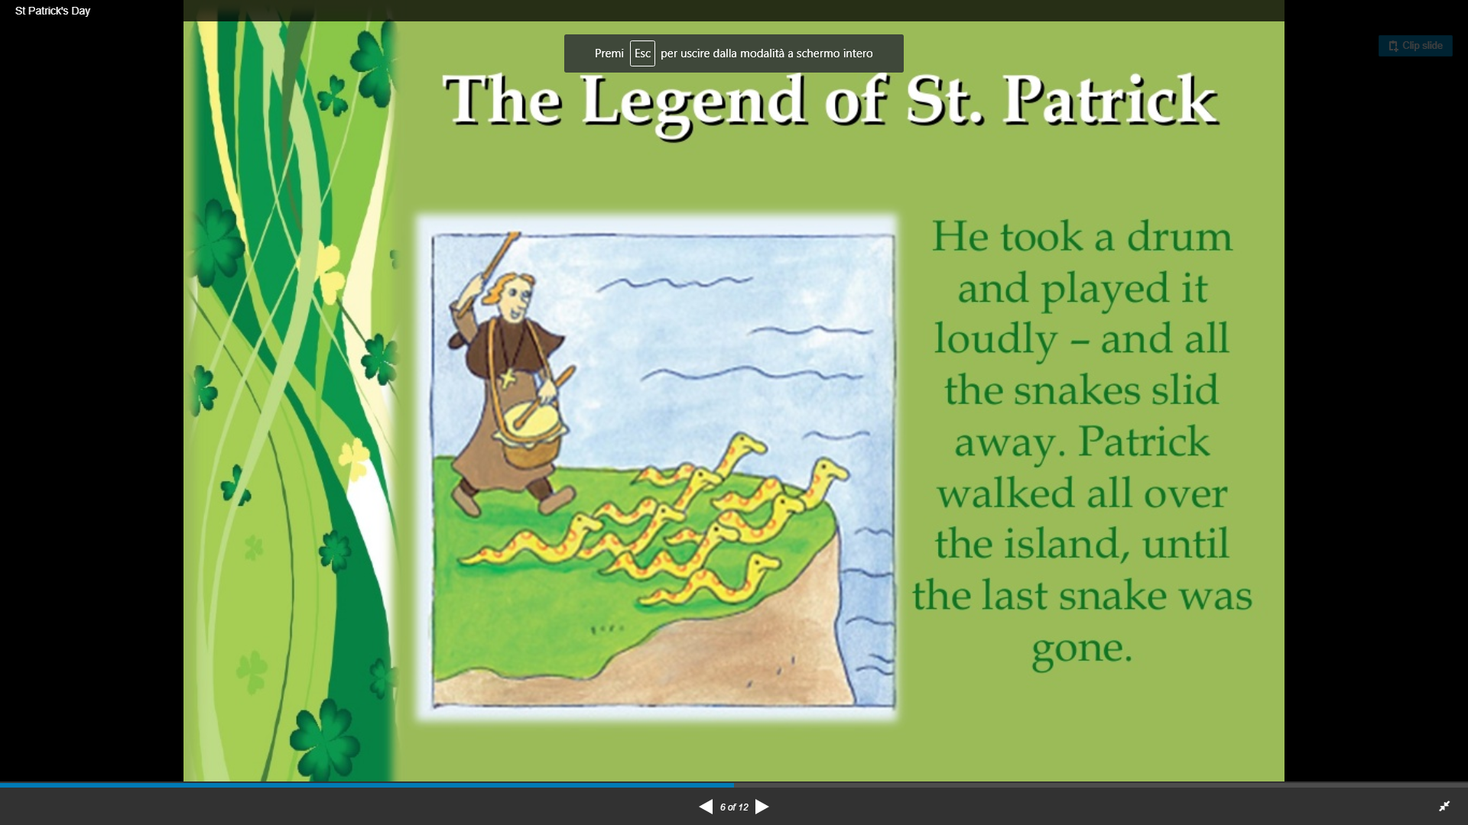
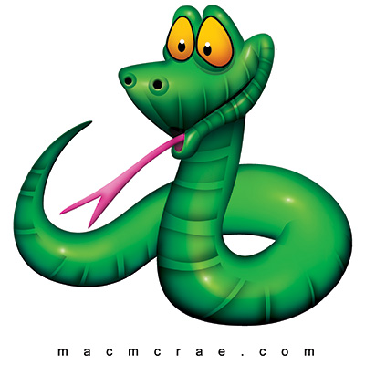
DO YOU KNOW WHY THERE ARE NO SNAKES IN IRELAND?
NO
SNAKES
ONE LEGEND SAYS THAT PATRICK
DROVE ALL THE SNAKES OUT OF IRELAND.

Slide 5
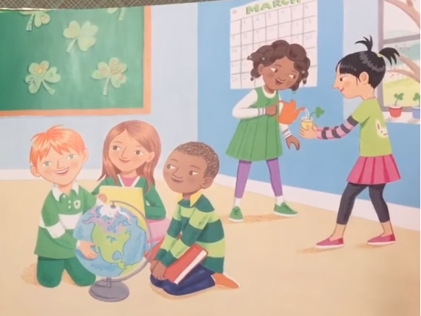

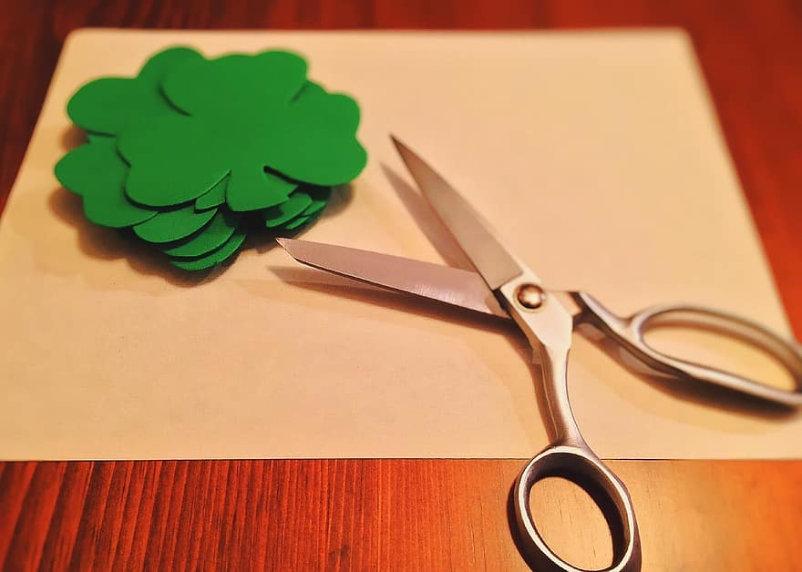
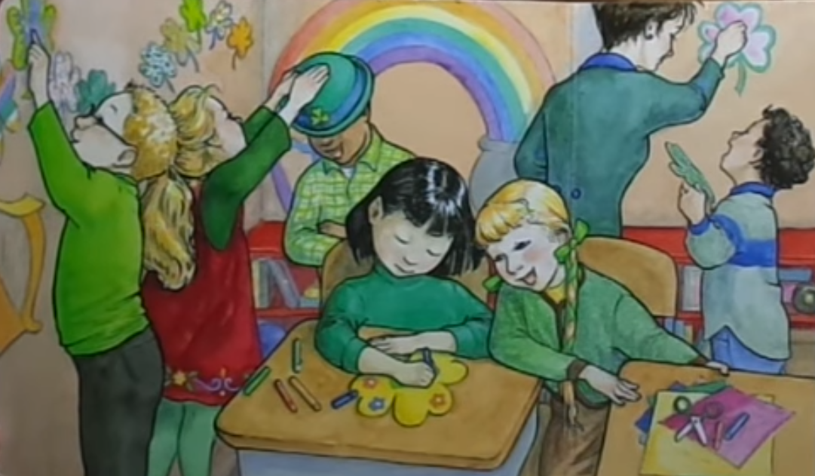
WE MAKE PAPER SHAMROCKS
AND RAINBOWS
DRESS
T-SHIRT
SHOES
TROUSERS
EVERYONE WEARS SOMETHING GREEN.

Slide 6
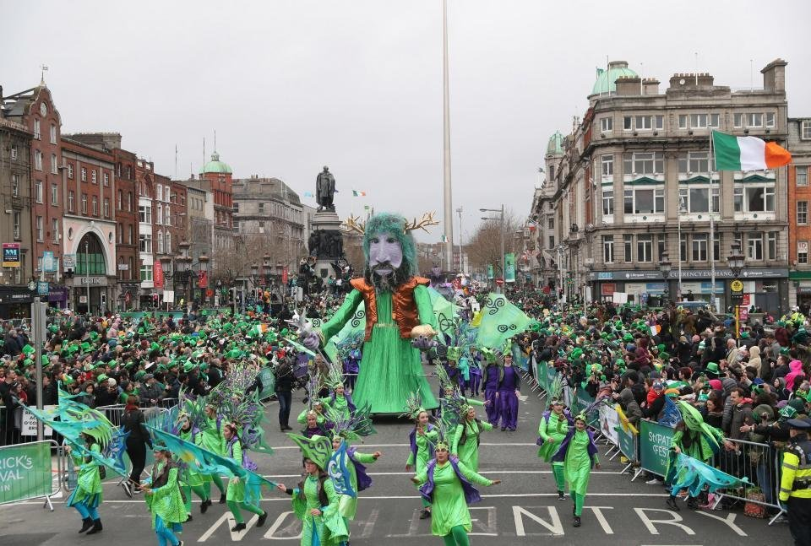

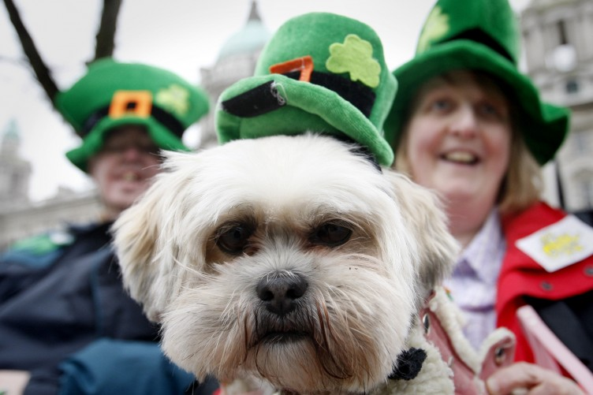
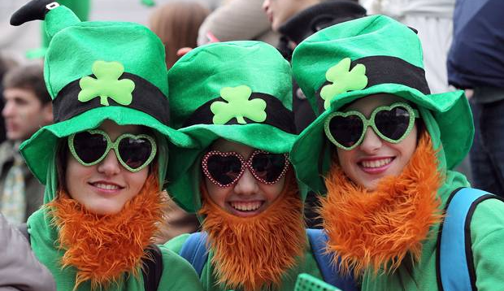
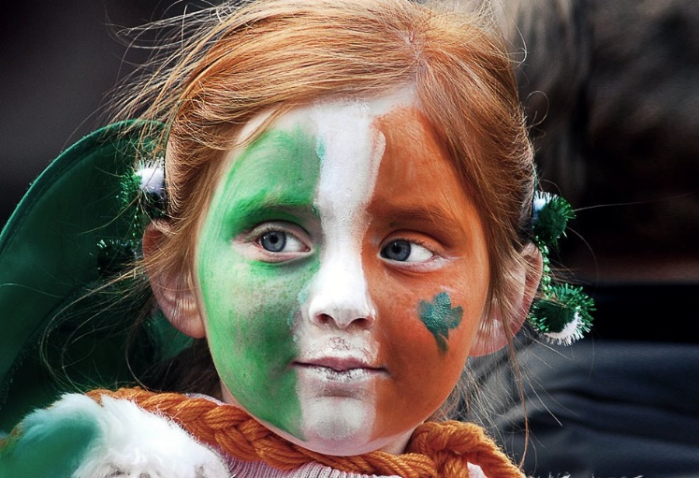
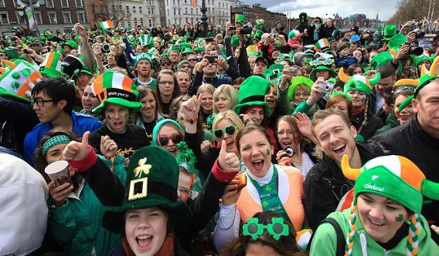
CHICAGO
U.S.A.
MANY TOWN HAVE SAINT
PATRICK’S DAY PARADES
MONTRÉAL
CANADA
DUBLIN
IRELAND
ITALY

Slide 7
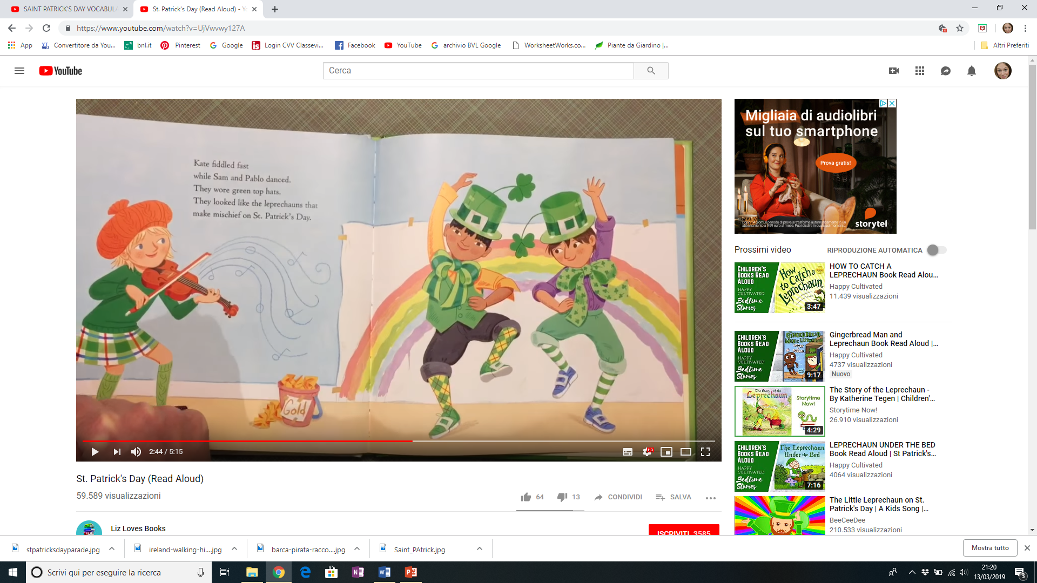
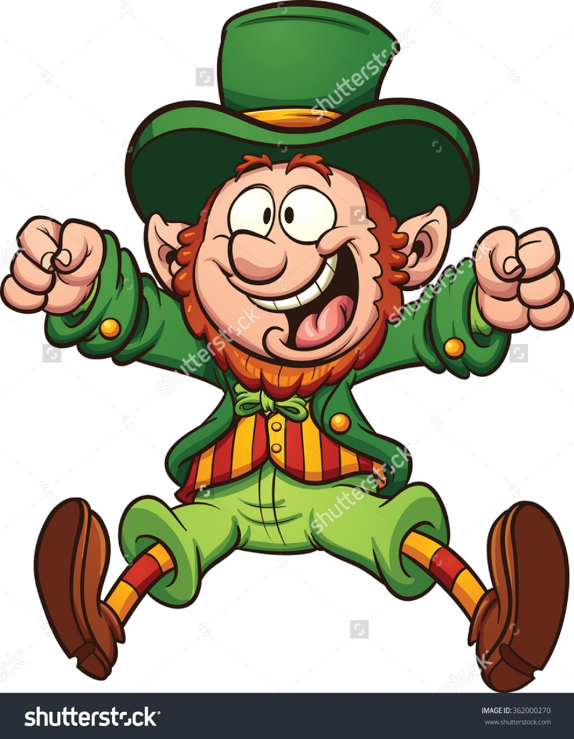



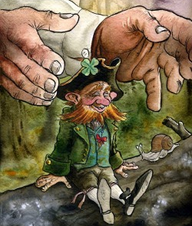

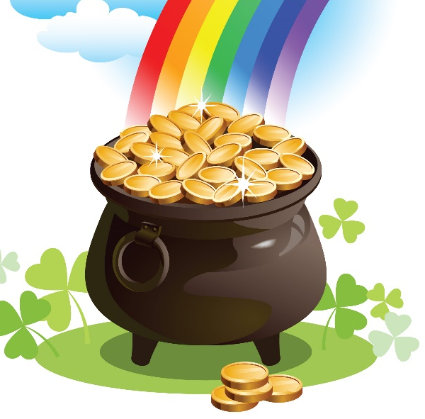
CATCH
ON SAINT
PATRICK’S DAY
WE DANCE AND SING ABOUT LEPRECHAUNS.
LEPRECHAUNS
POT OF GOLD

Slide 8
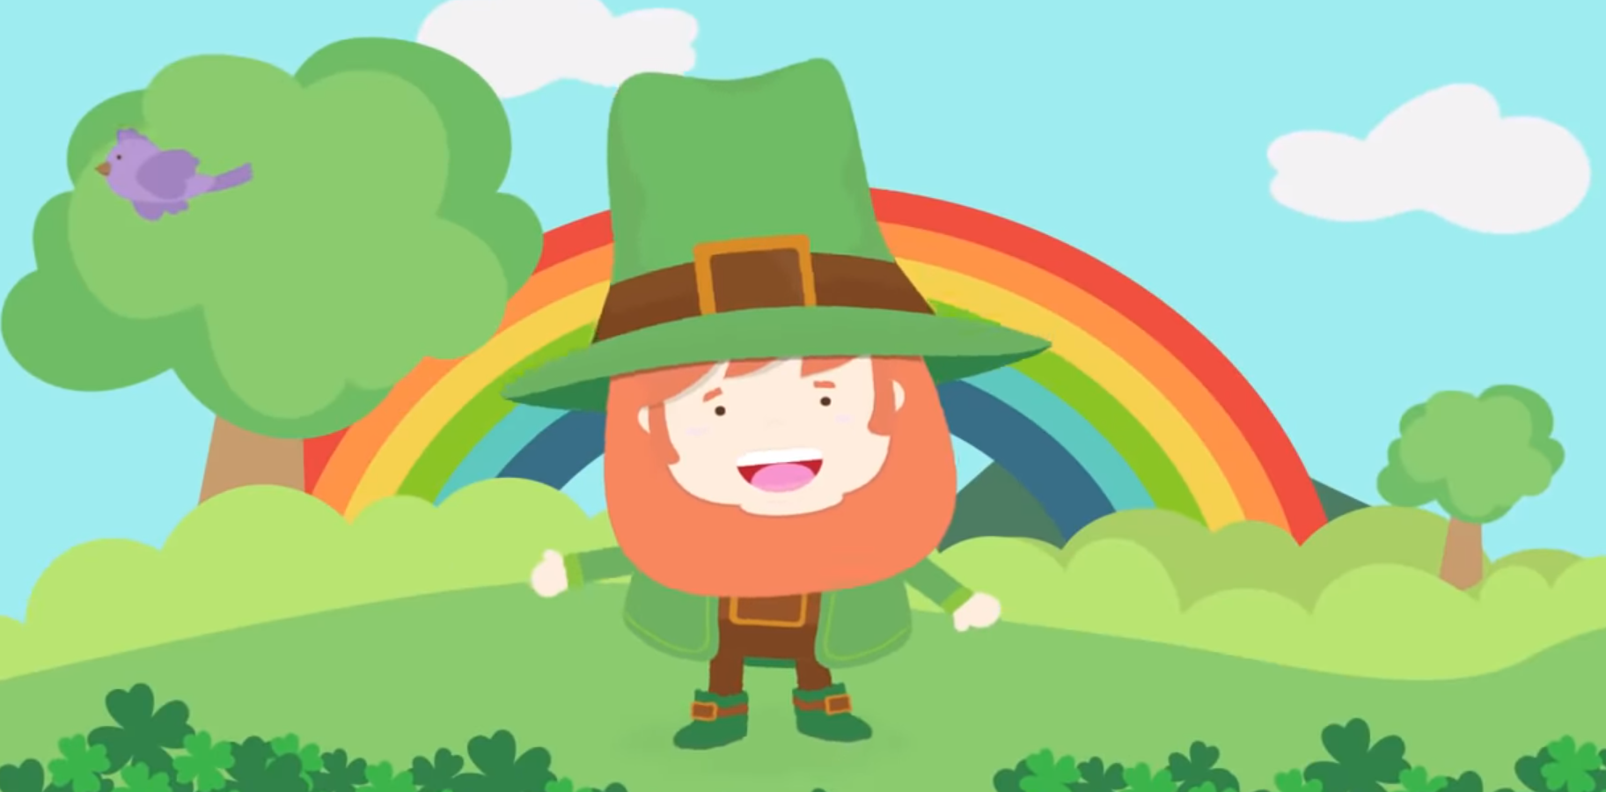

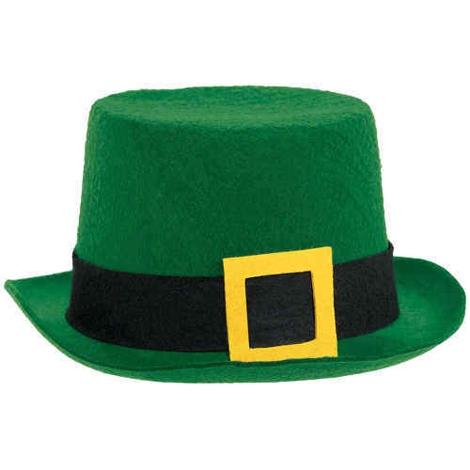



Slide 9
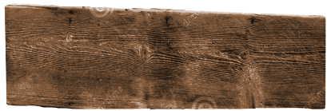
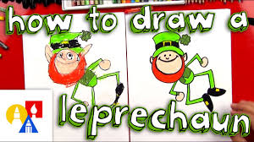

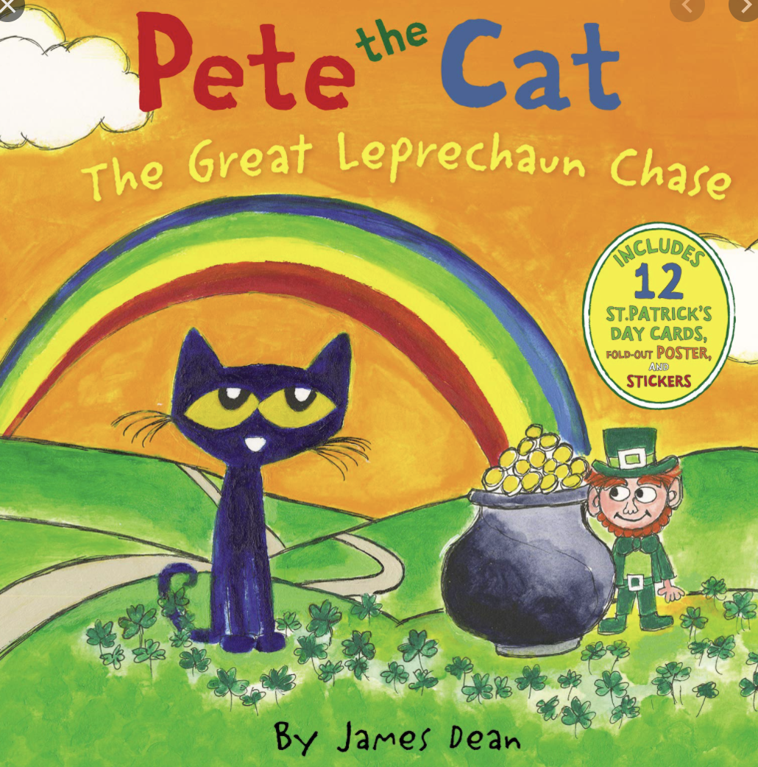




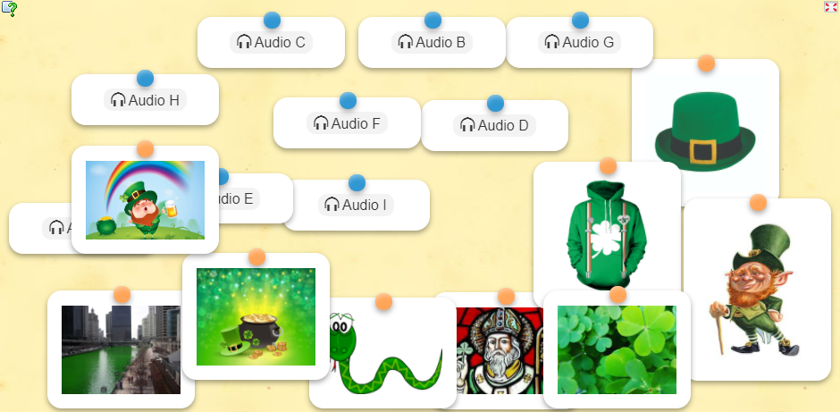


DRAWING
science
BOOK
irish dance
GAMES

