Slide 1
St. Patrick’s Day Scavenger Hunt

Slide 2
Directions:
You will have 30 seconds to find an item for each slide.
We will do the slides one at a time.
Let’s have some Irish-themed fun!

Slide 3




Teacher Notes:
If your students need more than 30 seconds, swap out the time with one of these:
This slide is hidden from presenting.
And here’s the 30 second one in case you change your mind.

Slide 4

Additional Teacher Note
If you want to limit or manage the amount of time for sharing, add the one or two minute timer (from the previous slide) to the slide for sharing.
Do you know how to make a copy of this for yourself? If you don’t, watch the video below.

Slide 5
Let’s Go!
Ready???

Slide 6

Find something green.

Slide 7
So… what did you find?
Find something green.

Slide 8
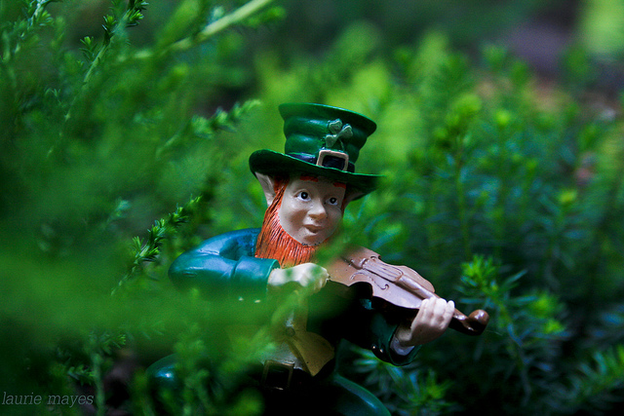
Find something a leprechaun could hide in.

Slide 9
So… what did you find?
Find something a leprechaun could hide in.

Slide 10

Find something the same shape as Ireland’s flag.

Slide 11
So… what did you find?
Find something the same shape as Ireland’s flag.

Slide 12
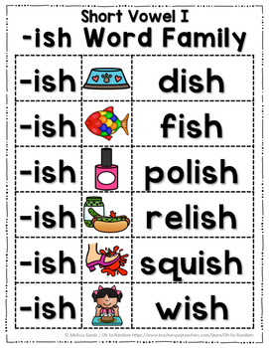
Find something that rhymes with Irish.

Slide 13
So… what did you find?
Find something that rhymes with Irish.

Slide 14
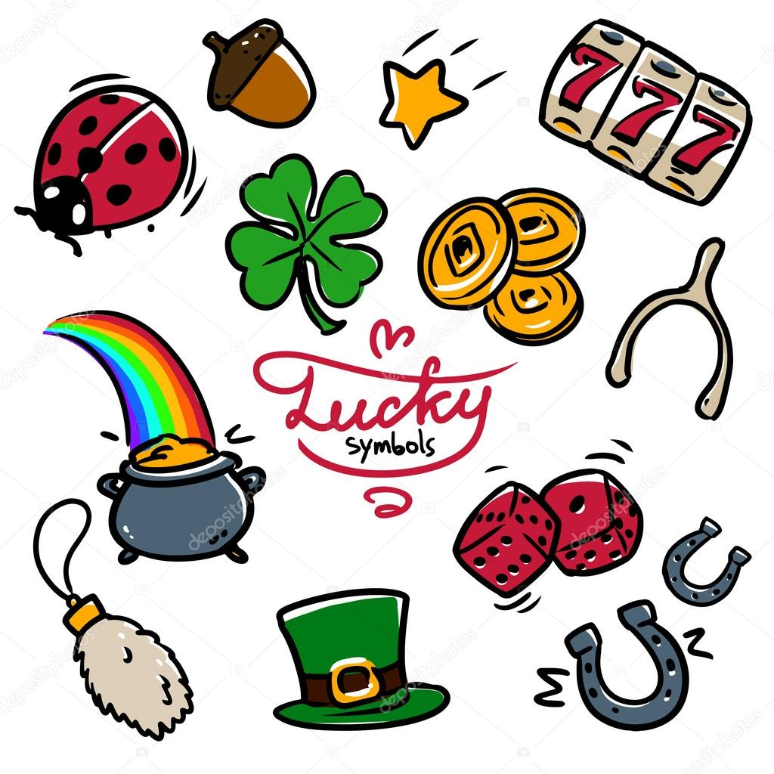

Find something that could bring good luck.

Slide 15
So… what did you find?
Find something that could bring good luck.

Slide 16

Find something that starts with the same letter as Patrick.

Slide 17
So… what did you find?
Find something that starts with the same letter as Patrick.

Slide 18

Find something with the number 3 on it.

Slide 19
So… what did you find?
Find something with the number 3 on it.

Slide 20

Find something you might find in a pot of gold.

Slide 21
So… what did you find?
Find something you might find in a pot of gold.

Slide 22
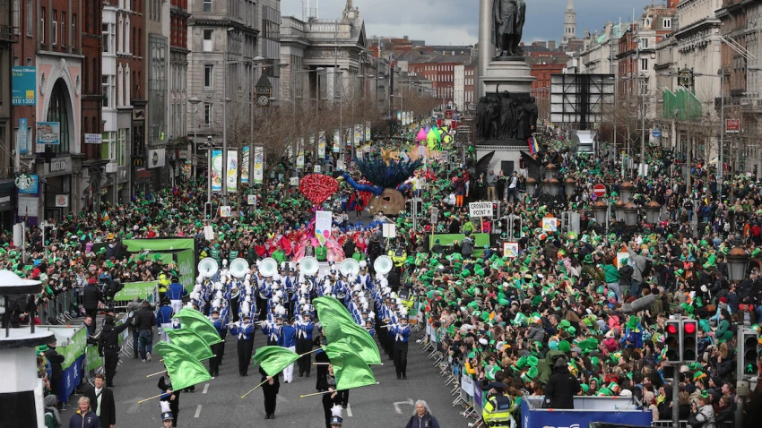
Find something you might see at a parade

Slide 23
So… what did you find?
Find something you might see at a parade

Slide 24
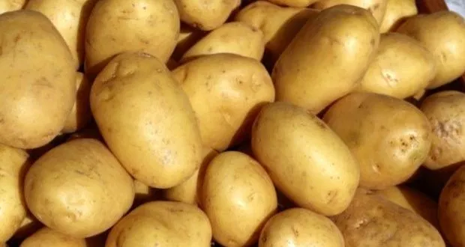
Find a potato or something made from a potato.

Slide 25
So… what did you find?
Find a potato or something made from a potato.

Slide 26
We did it!
Happy St. Patrick’s Day!

