Slide 1
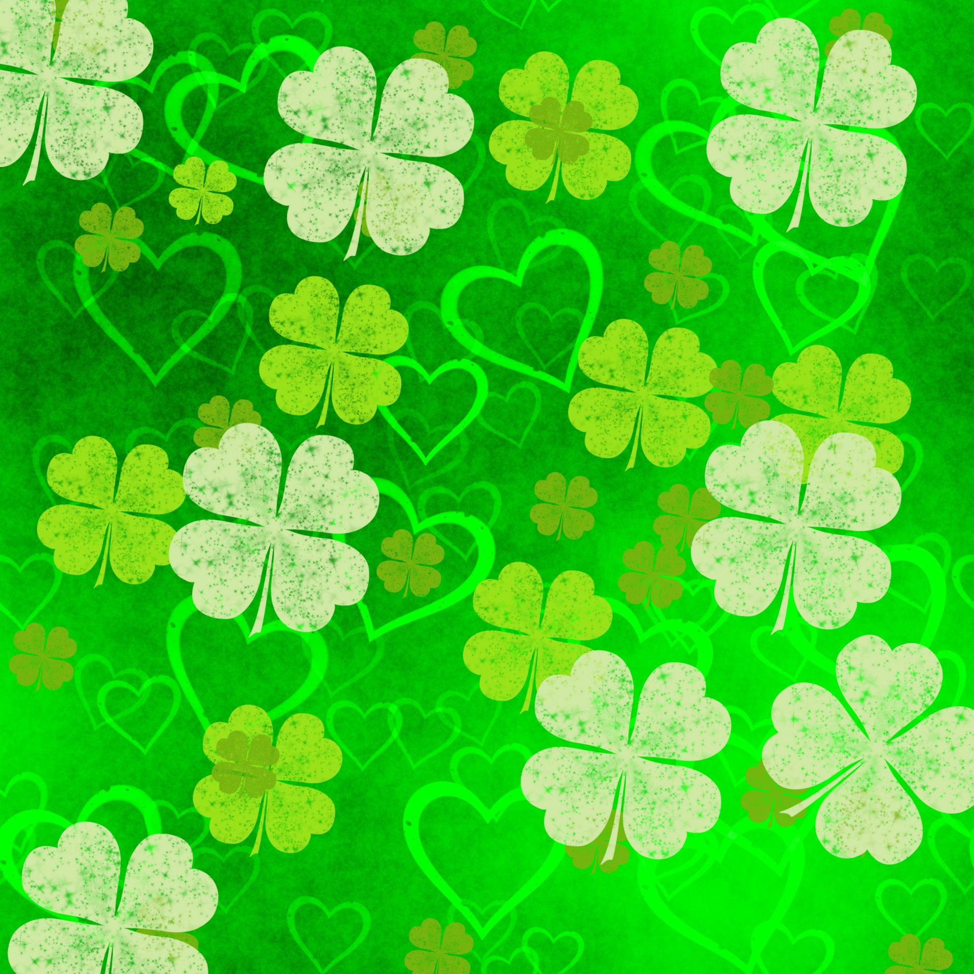

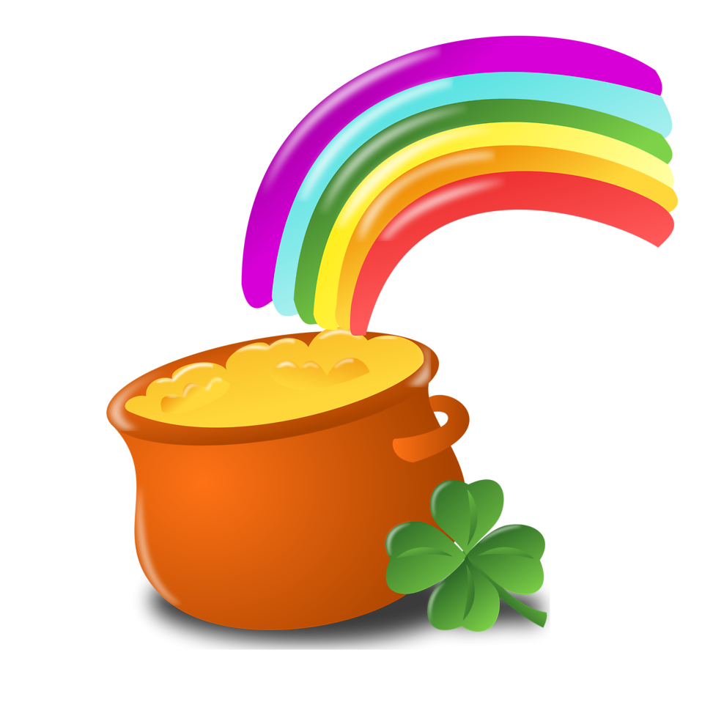
Would you rather?
St. Patrick’s Day Edition

Slide 2

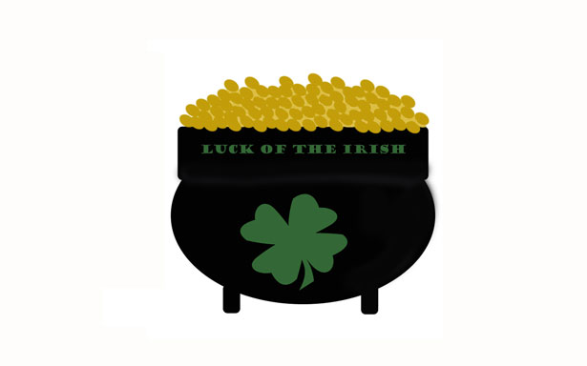
What Would You Rather
Do?
Have Good Luck for a Year
Find a Pot of Gold

Slide 3
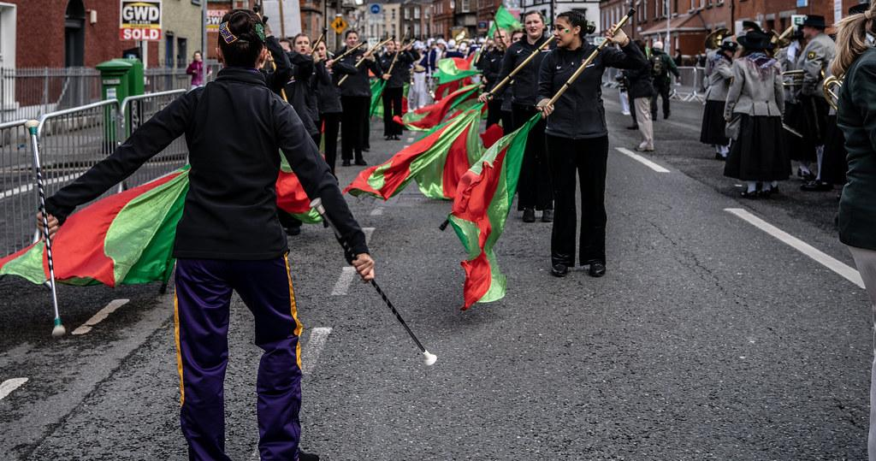
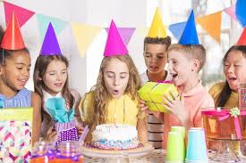
What Would You Rather
Do?
Go to a parade
Go to a party

Slide 4
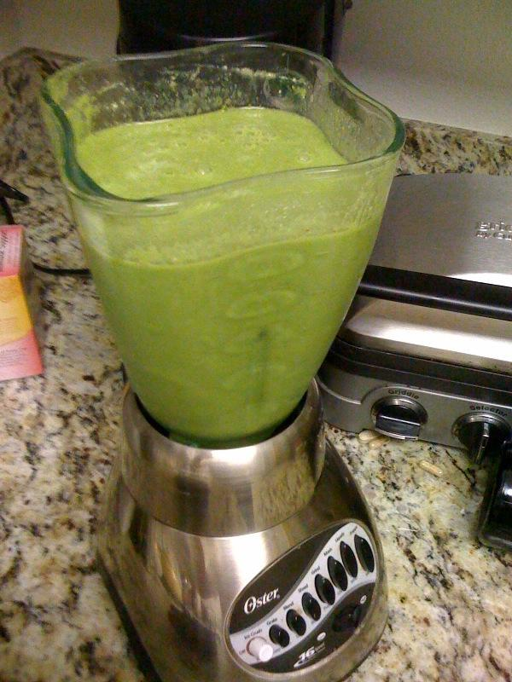
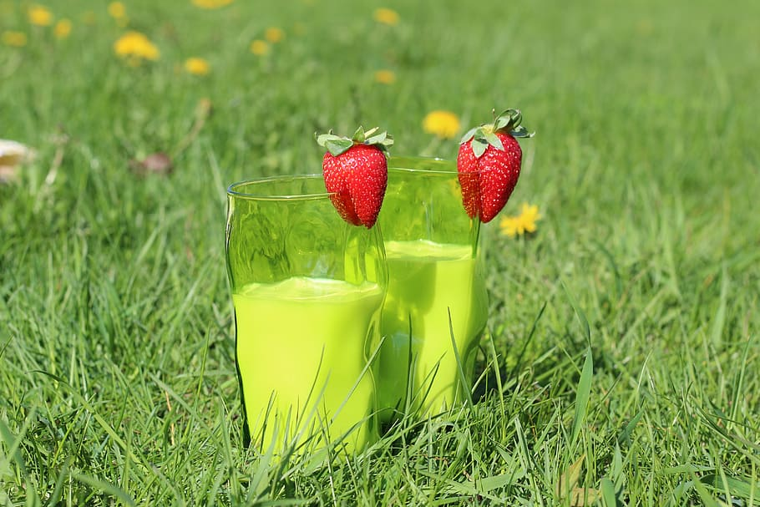
What Would You Rather
Do?
Drink a green fruit smoothie
Drink green milk

Slide 5

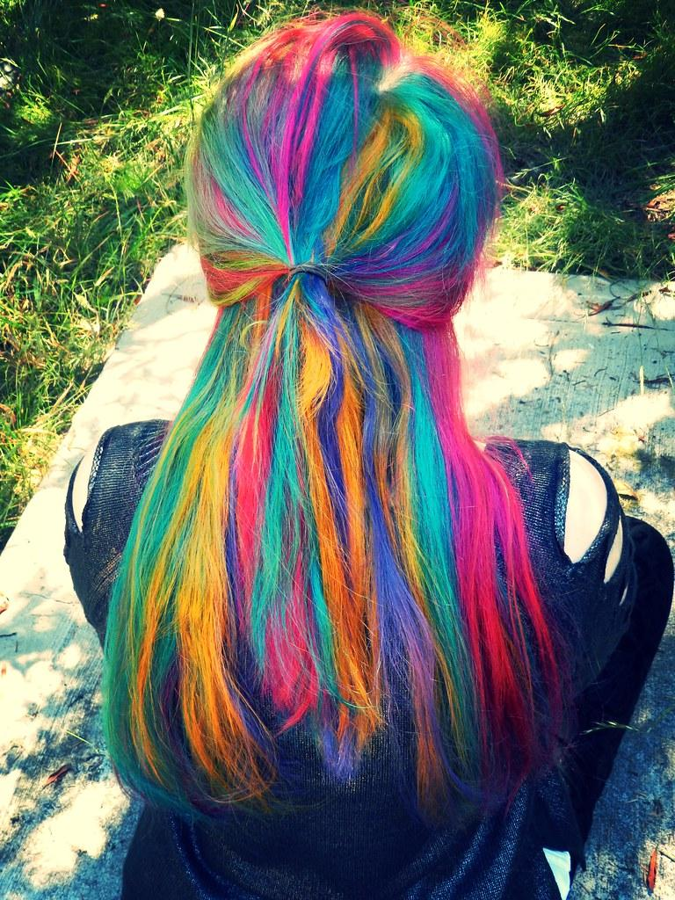
What Would You Rather
Do?
Have green hair
Have rainbow hair

Slide 6
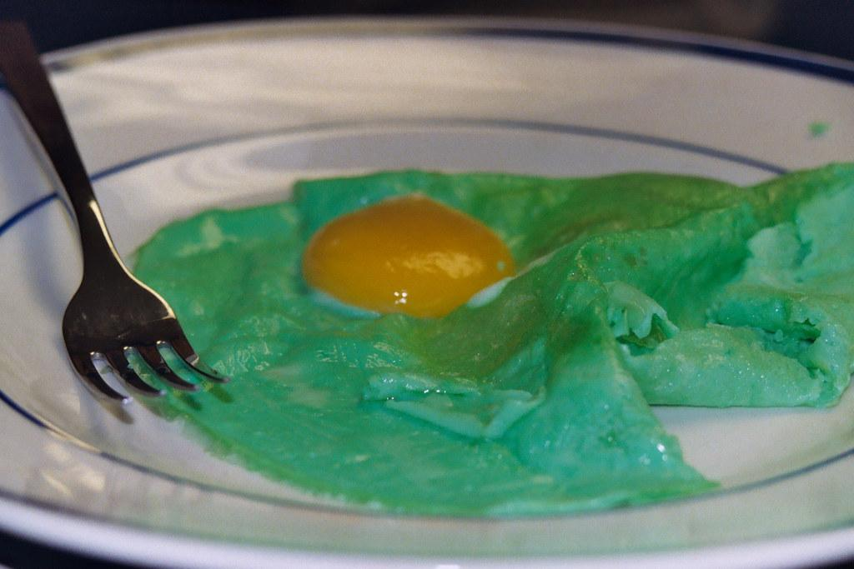
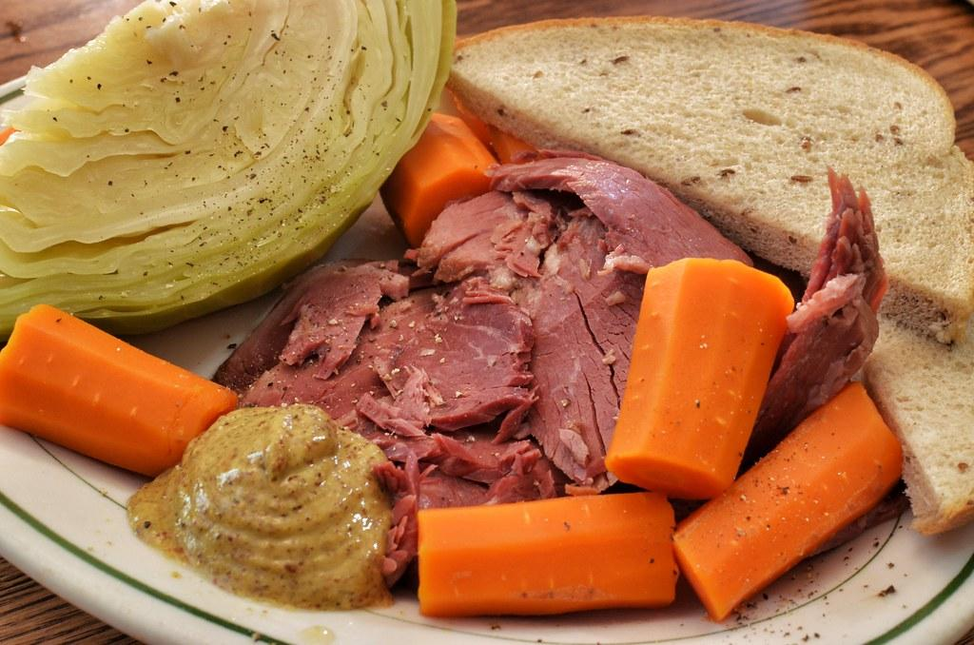
What Would You Rather
Do?
Eat green eggs and ham
Eat corned beef and cabbage

Slide 7
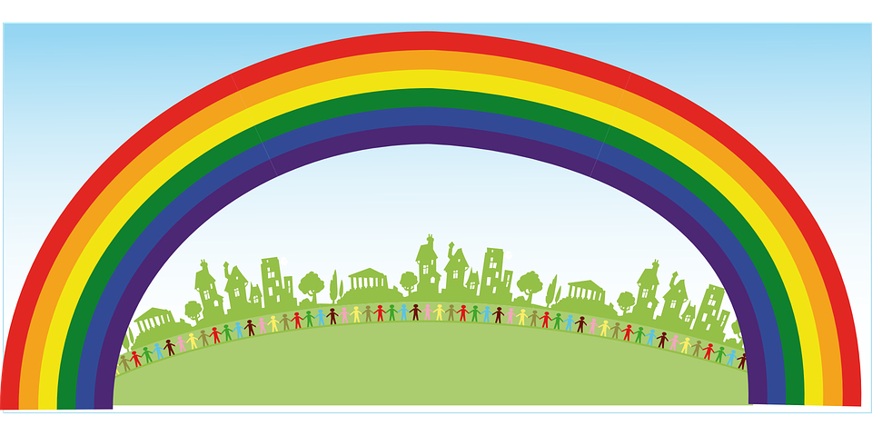
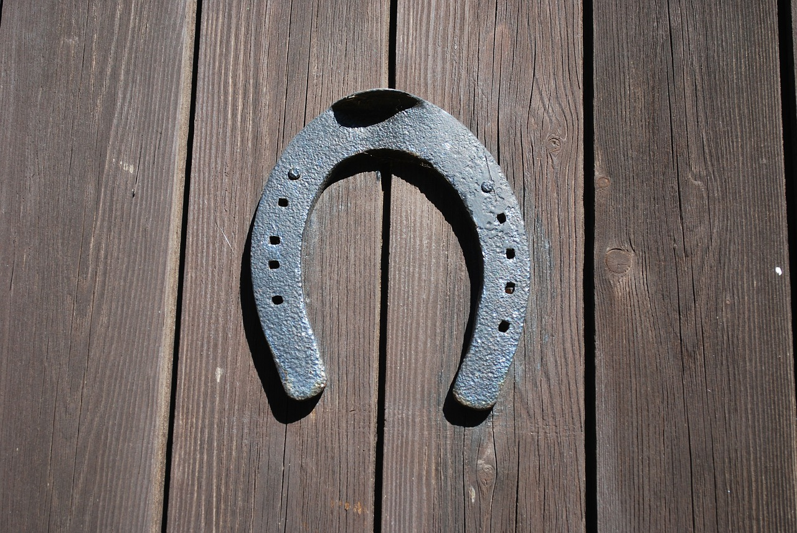
What Would You Rather
Do?
Have horseshoes for feet
Have rainbows for arms

Slide 8
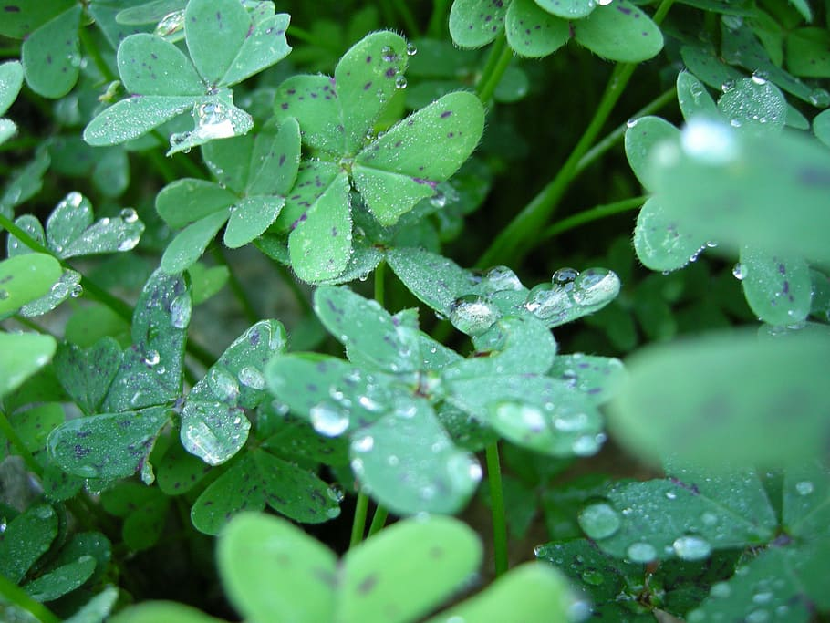
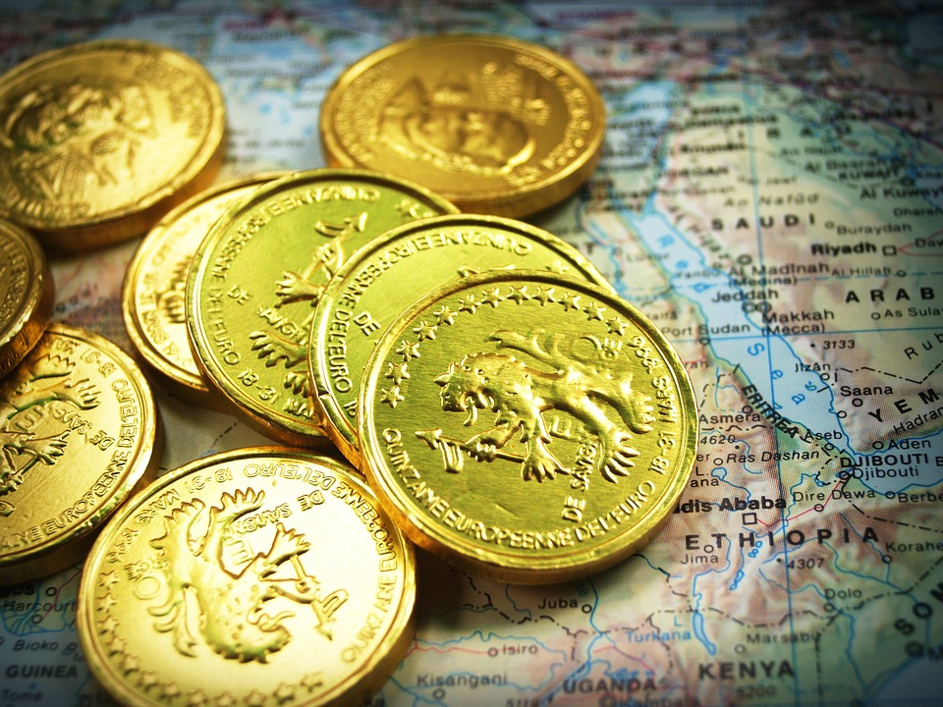
What Would You Rather
Do?
Have Shamrocks for hair
Have gold coins for eyes

Slide 9
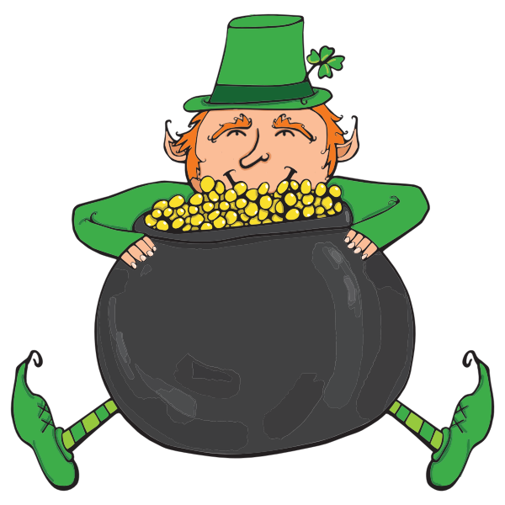
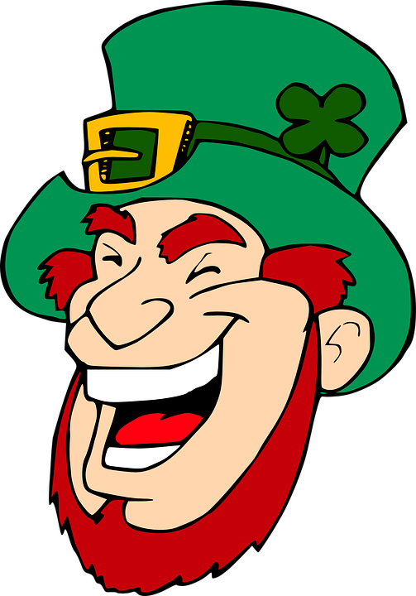
What Would You Rather
Do?
Catch a leprechaun
Be a leprechaun

Slide 10
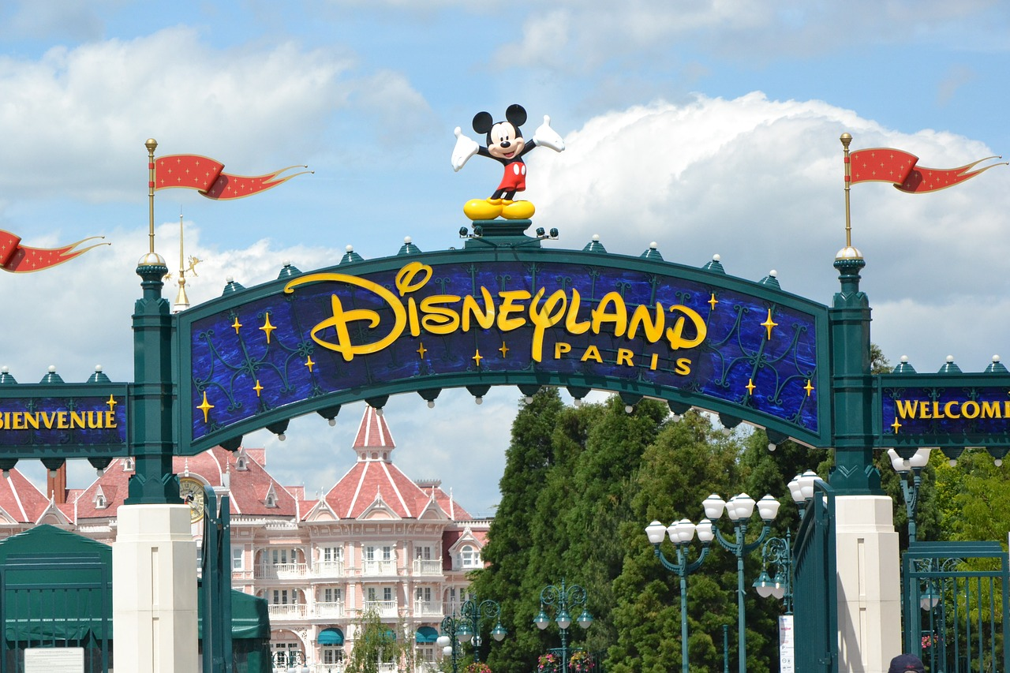
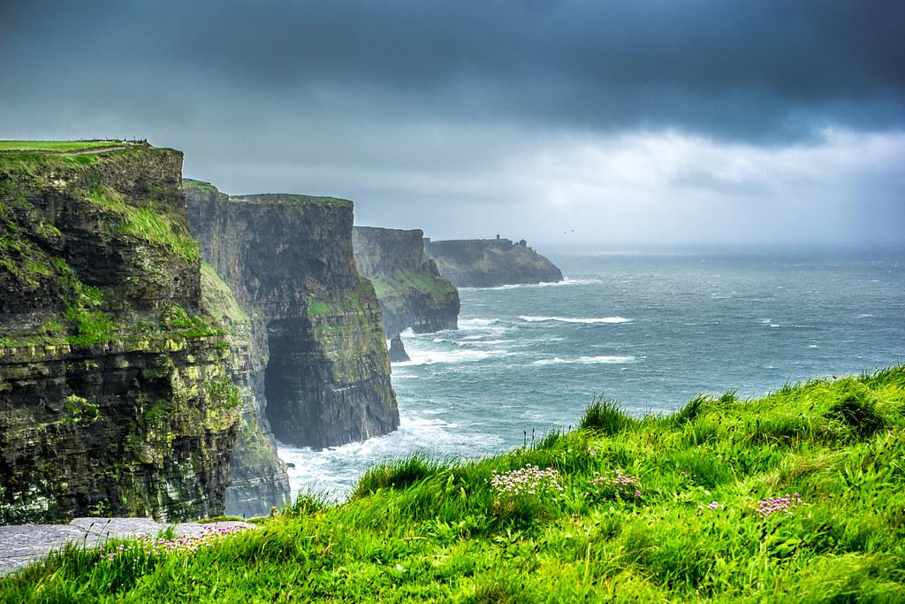
What Would You Rather
Do?
Spend a week in Ireland
Spend a week in Disneyland

Slide 11
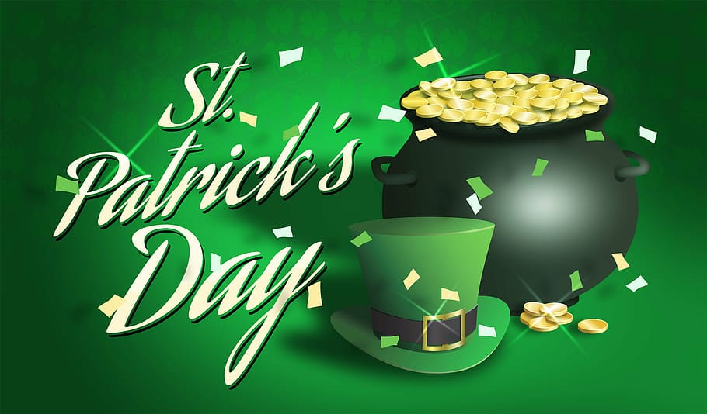

What Would You Rather
Do?
Celebrate St. Patrick’s Day
Celebrate Valentine’s Day

Slide 12
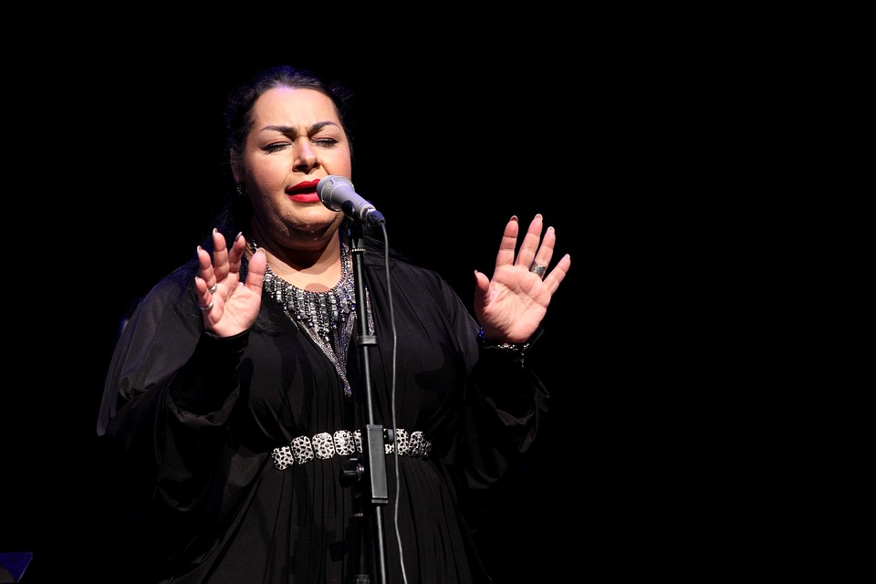
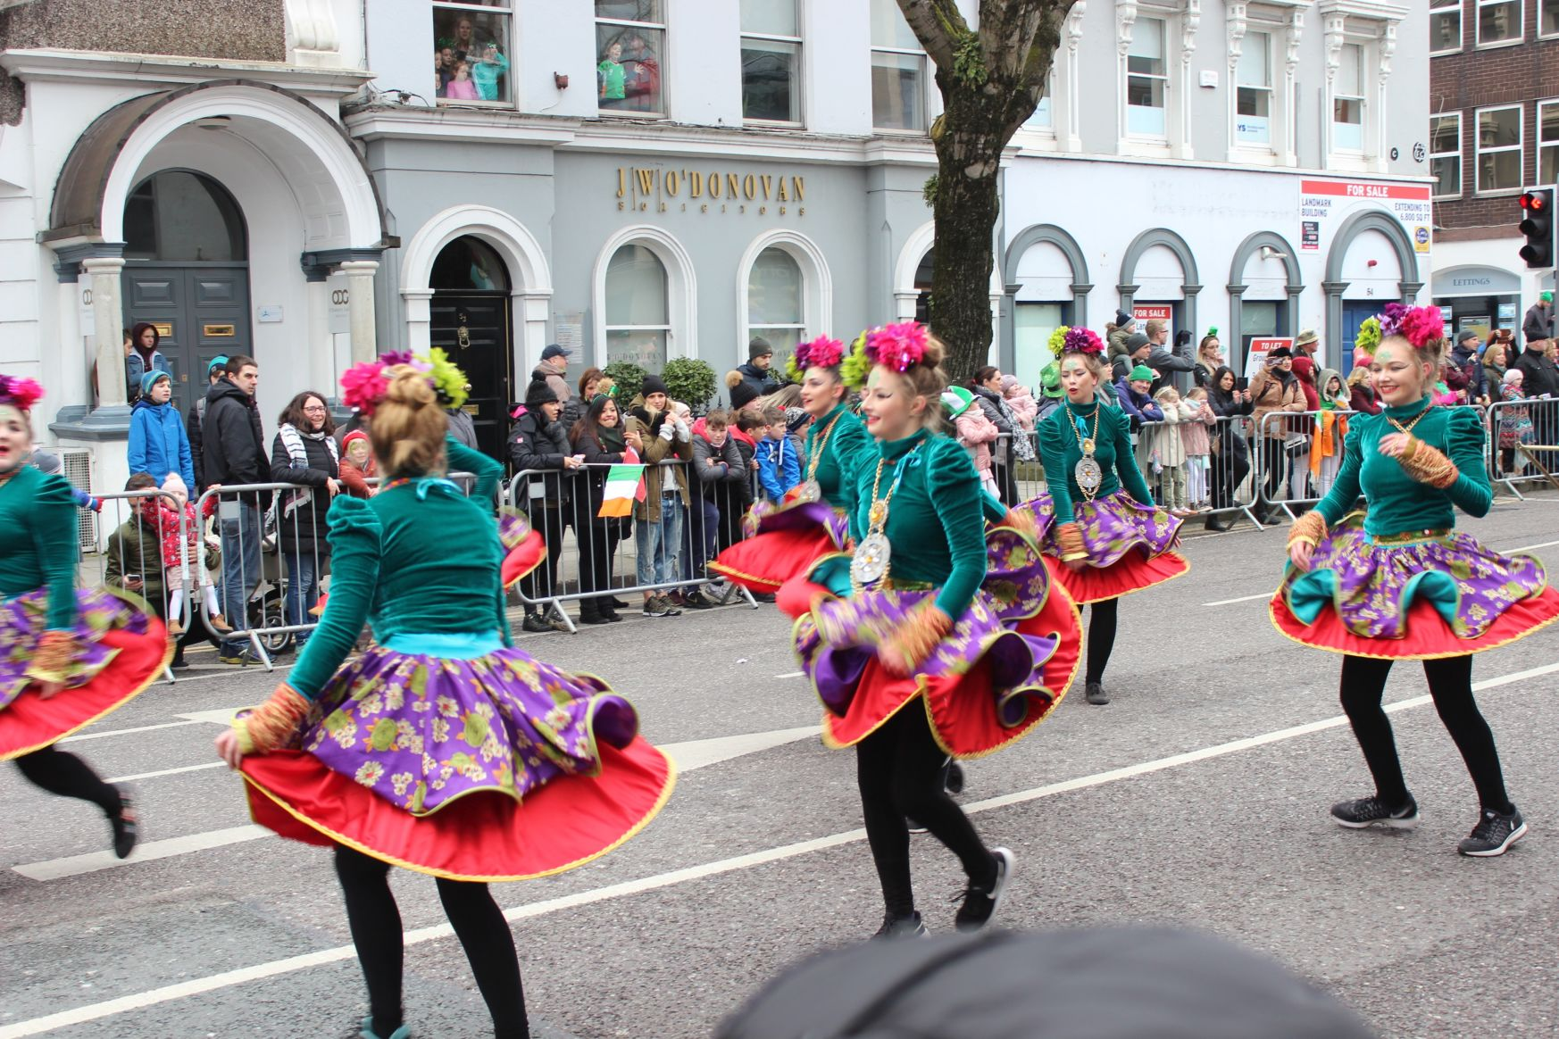
What Would You Rather
Do?
Lead in the St. Patrick’s Day parade
Sing on stage with your favorite singer

Slide 13

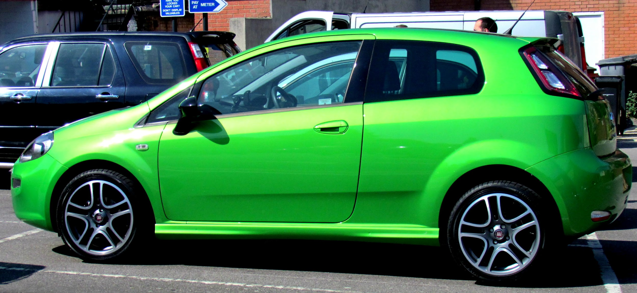
What Would You Rather
Do?
Live in a green house
Have a green car

Slide 14
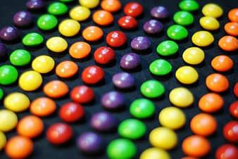
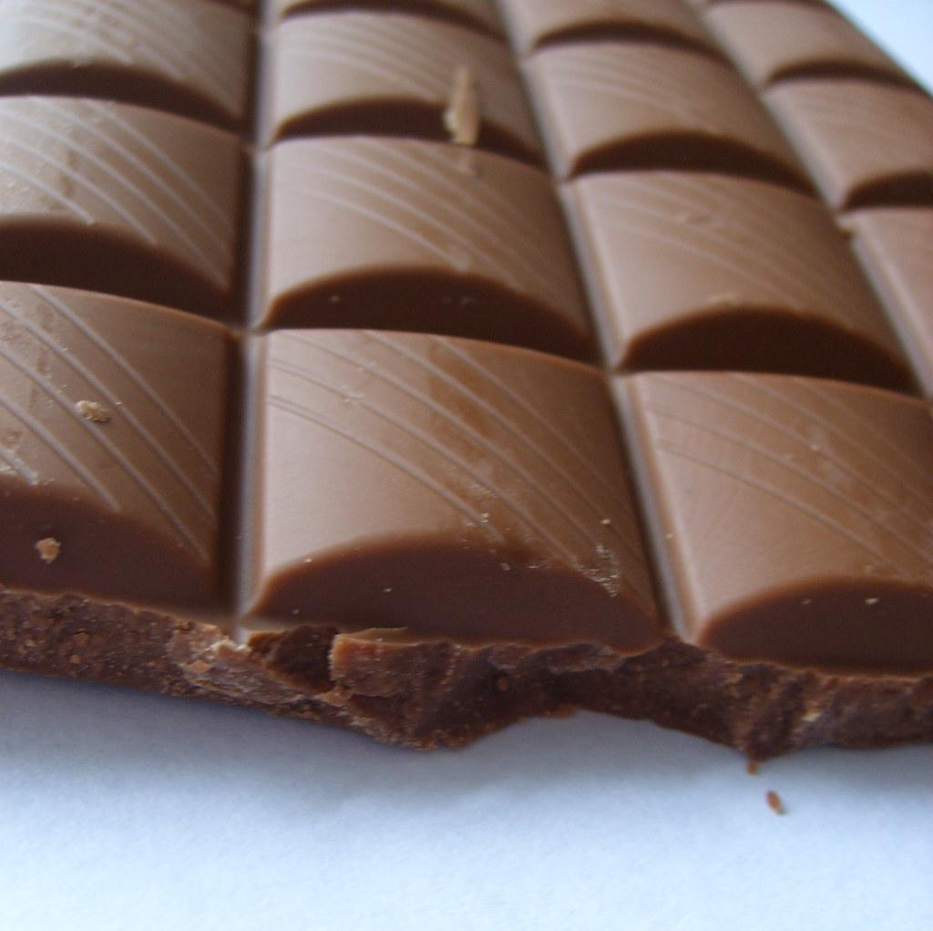
What Would You Rather
Do?
Have skittles for teeth
Have chocolate covered coins for ears

Slide 15
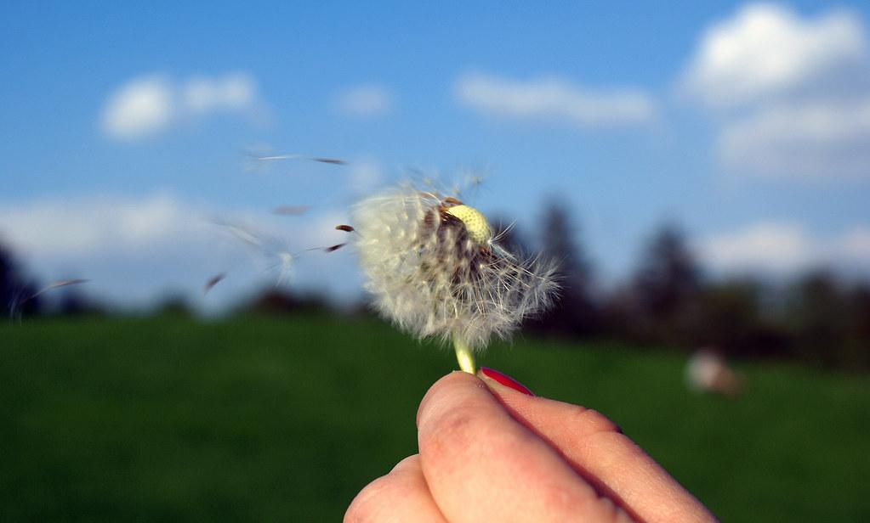
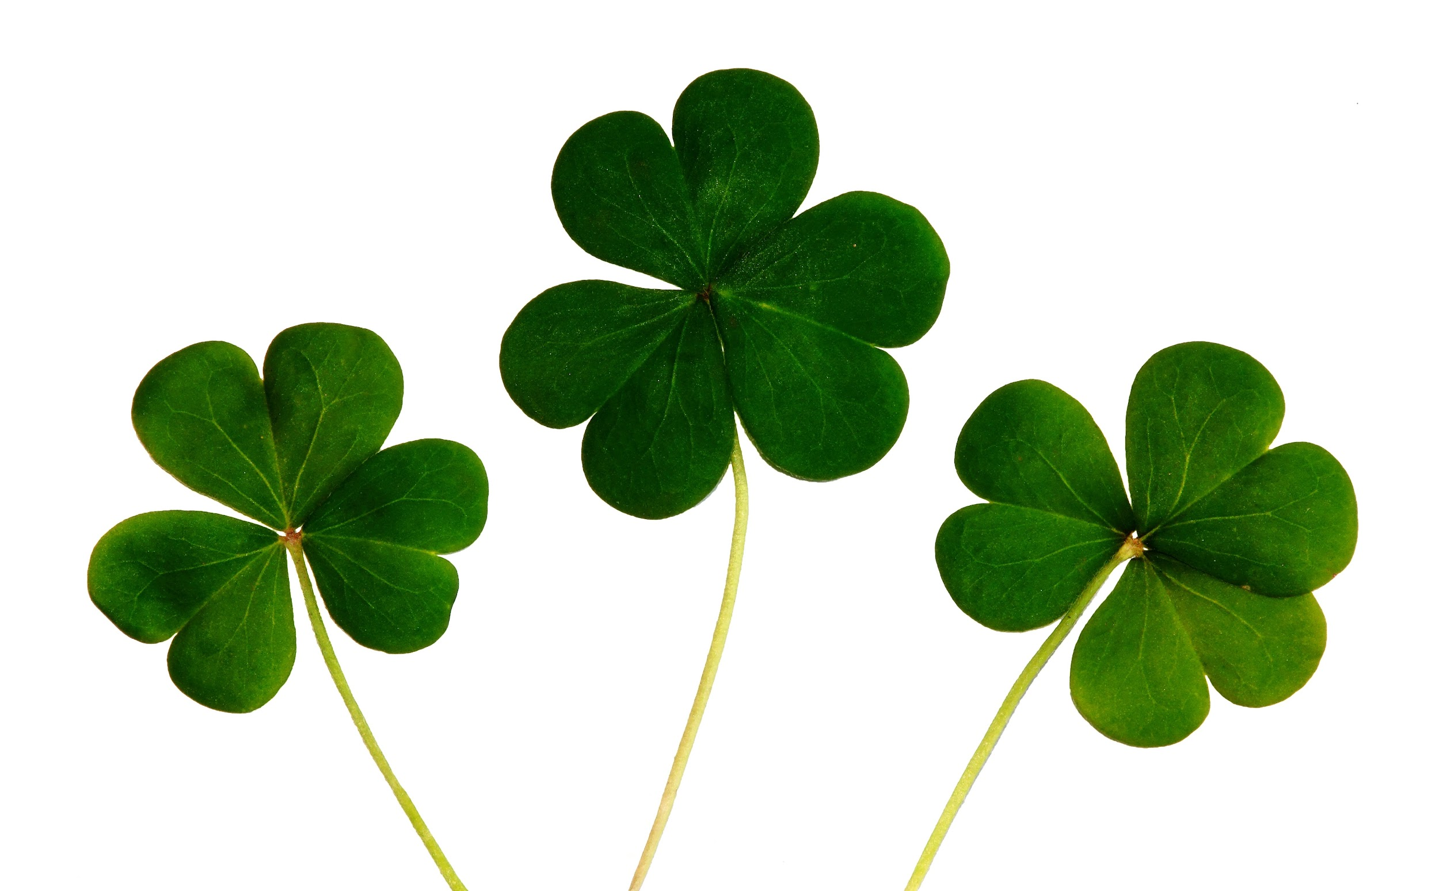
What Would You Rather
Do?
Have one wish granted for yourself
Grant 3 wishes to friends

Slide 16
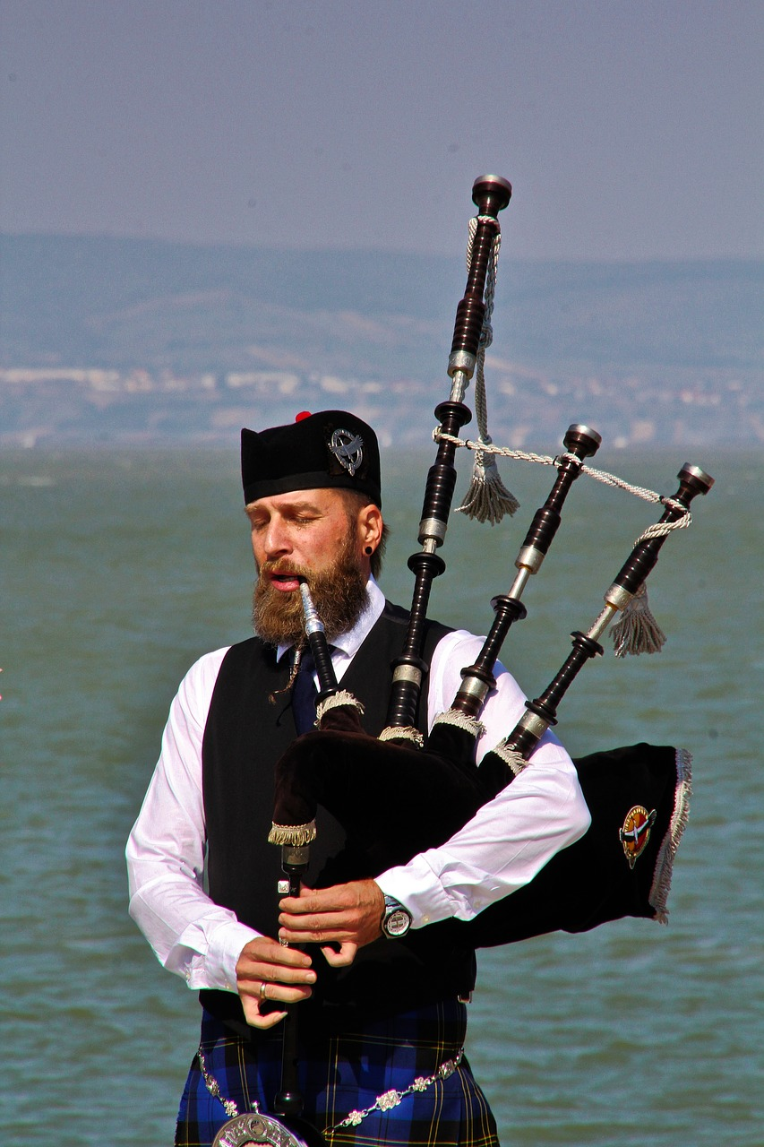
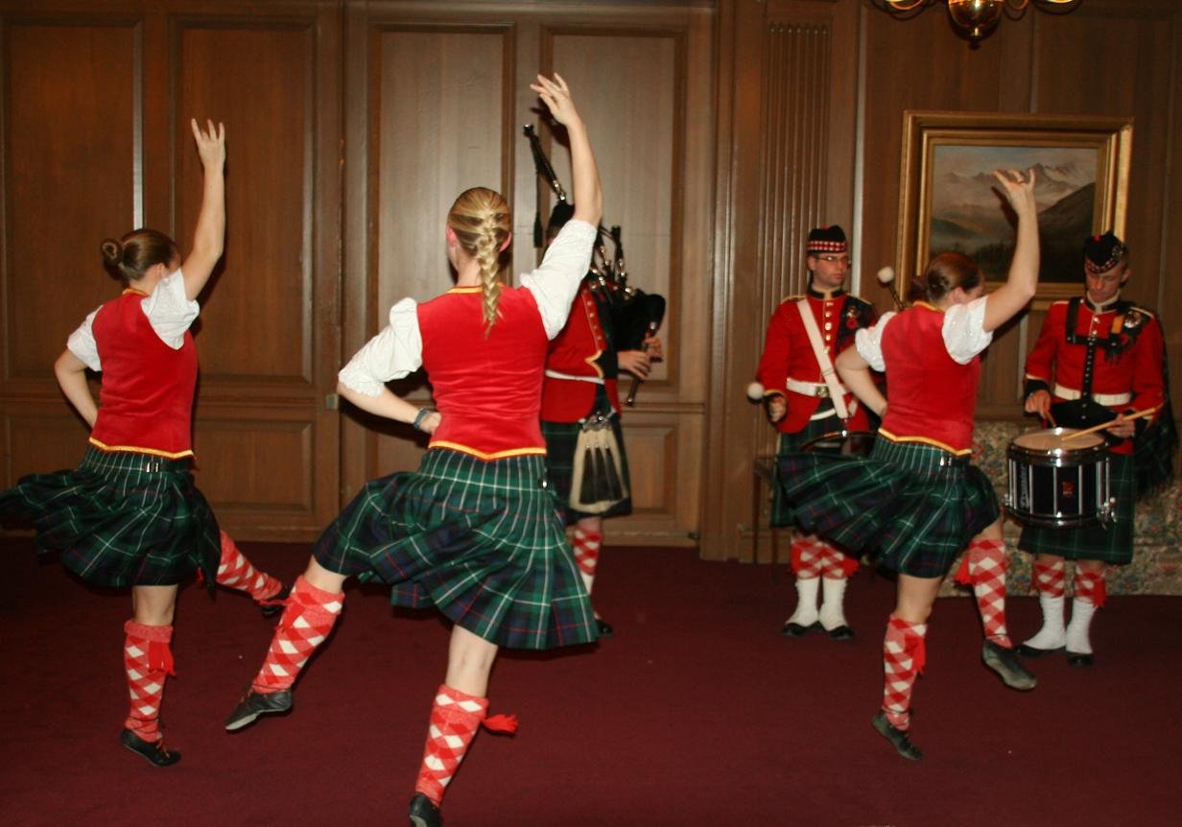
What Would You Rather
Do?
Learn an “Irish Jig”
Learn to play bagpipes

