Slide 1



Would you rather find…?
OR
A pot of gold
A 4-leaf clover

Slide 2
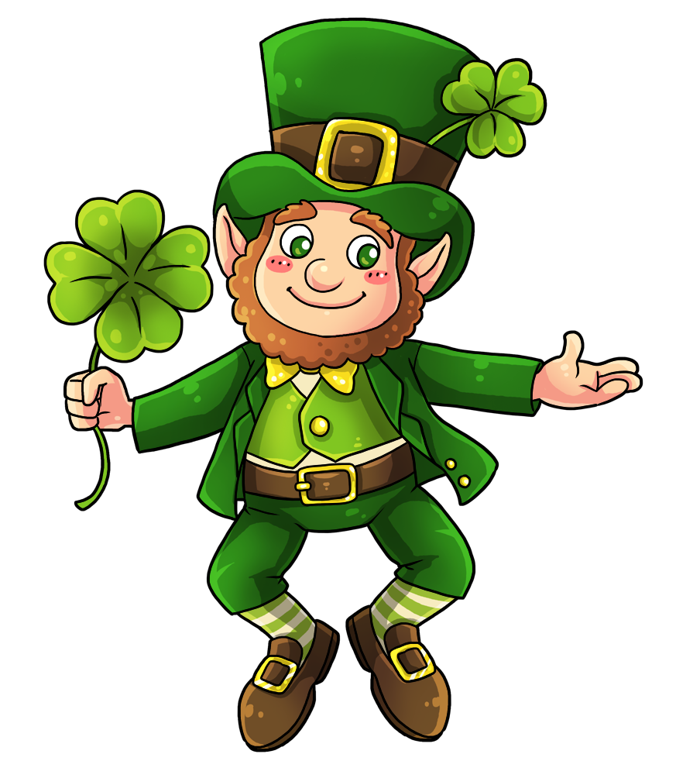
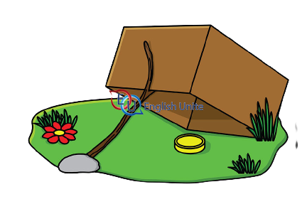
Would you rather…?
OR
Find a leprachaun
Be a leprachaun

Slide 3

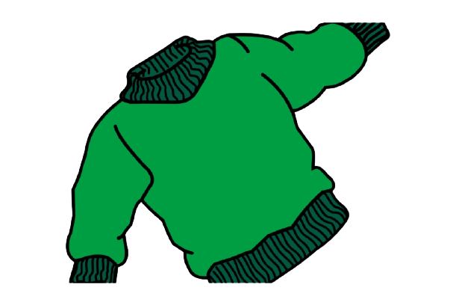
Would you rather…?
OR
Wear green clothes
Have green hair

Slide 4
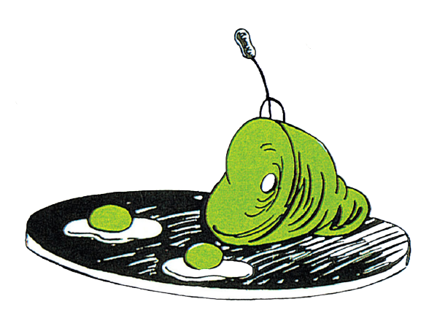
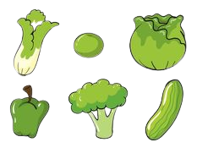
Would you rather eat …?
OR
Green eggs & ham
Green vegetables

Slide 5
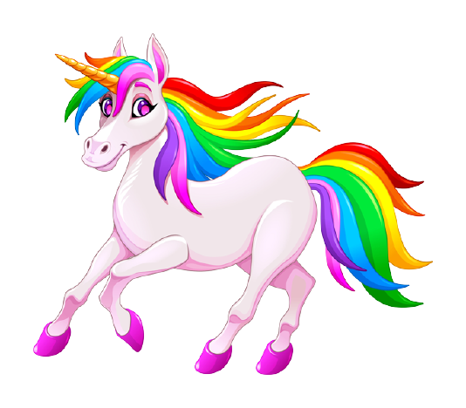

Would you rather…?
OR
Chase rainbows
Chase a unicorn

