Slide 1
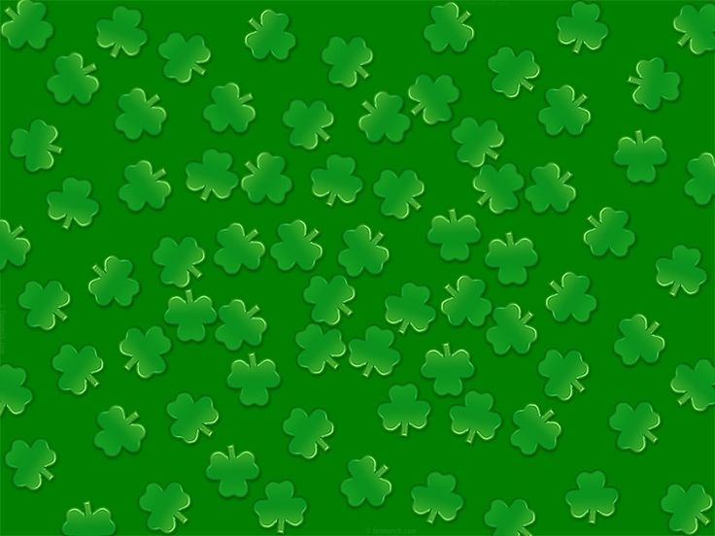

St. Patrick’s Day
Unscramble

Slide 2
ahMcr

Slide 3
dogo kucl

Slide 4
oabrniw

Slide 5
enrge

Slide 6
pto fo dglo

Slide 7
evlorc

Slide 8
rpha

Slide 9
leardnl

Slide 10
camgi

Slide 11
rogaen

Slide 12
iswh

Slide 13
eadcn

Slide 14
aurnclpeeh

Slide 15
gpsrni

Slide 16
tasni

Slide 17
jig

Slide 18
cramh

Slide 19
aapedr

Slide 20
reBnaly otnSe

