Slide 1

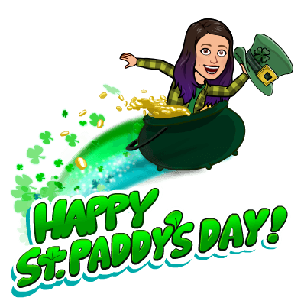
St. Patrick’s Day
SCAVENGER HUNT

Slide 2


Wishing you the LUck o’ the irish!

Slide 3

Can you find...
...something GREEN that you can write with?

Slide 4
Can you find...
...something with a shamrock or clover?

Slide 5
Can you find...
...a GOLD coin or a penny?

Slide 6
Can you find...
...something with a RAINBOW?

Slide 7
Can you find...
...something GREEN that you eat?

Slide 8
Can you find...
...something that FLIES?

Slide 9
Can you find...
...something GREEN that you can wear?

Slide 10
Can you find...
...something LUCKY?

Slide 11
Can you find...
...something shiny?

Slide 12
Can you find...
...a GREEN toy?

Slide 13
Can you find...
🍀 a GREEN toy
🍀 something SHINY
🍀 something LUCKY
🍀 GREEN and wearable
🍀 something that FLIES
🍀 something GREEN you eat
🍀 something RAINBOW
🍀 a GOLD coin or penny
🍀 a SHAMROCK (or CLOVER)
🍀 a GREEN writing utensil

