Slide 1



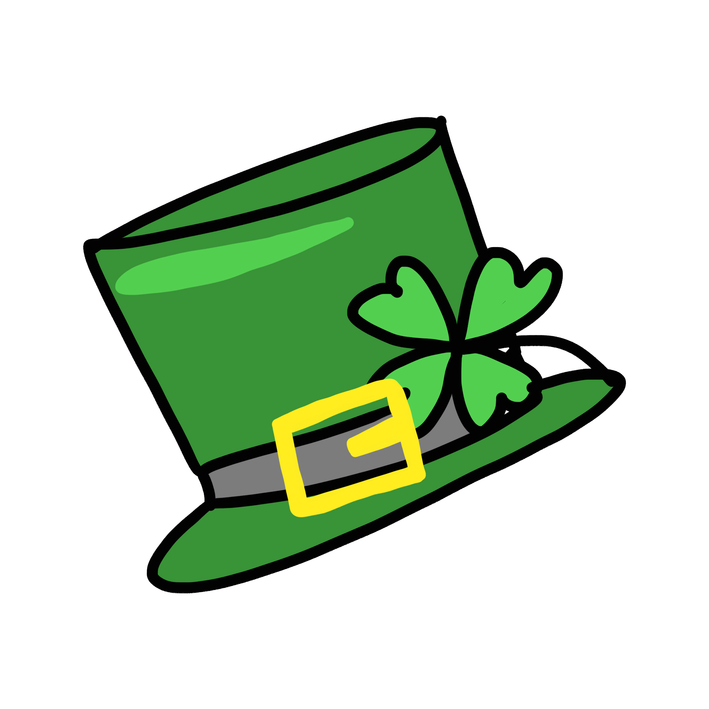
St. Patrick’s Day
Scavenger Hunt

Slide 2


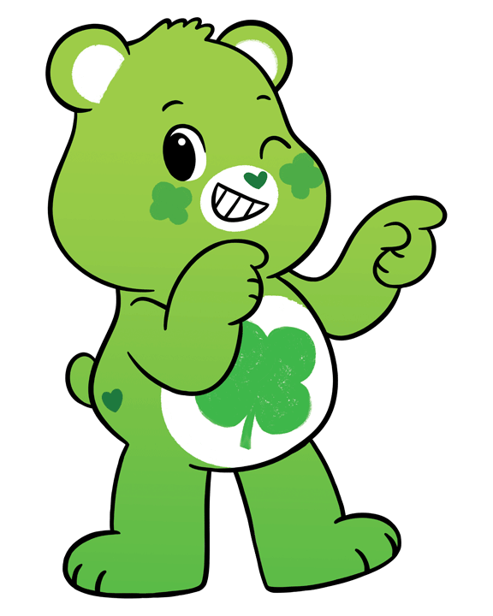
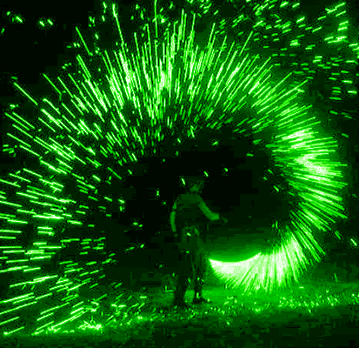
Find something green!

Slide 3

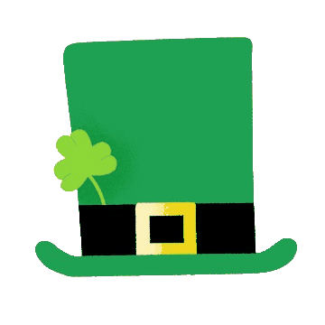
Find your favorite hat!

Slide 4


Find something that starts with the same letter as:

Slide 5

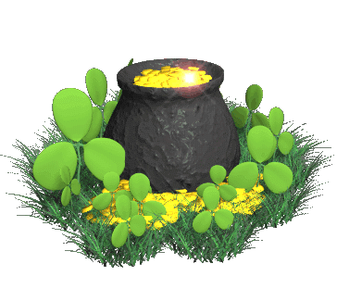
Find something that rhymes with gold.

Slide 6

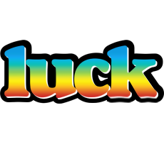
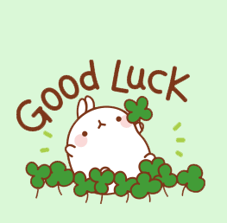
Find something that ends with the same
sound as:

Slide 7

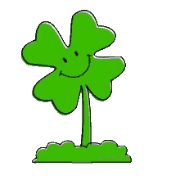
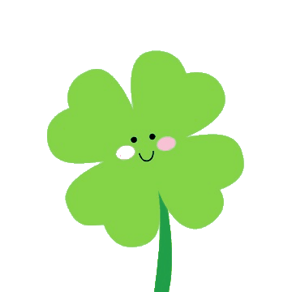
Find something with four corners.

Slide 8

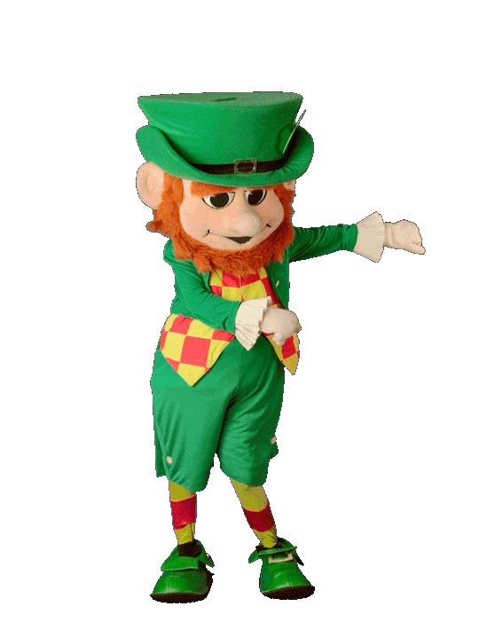
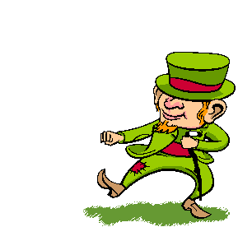
Show me your best dance move!

Slide 9


Would You
Rather?

Slide 10



Would You Rather?
Ride in a
flying car
Ride a
unicorn

Slide 11

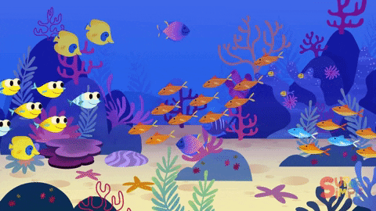
Would You Rather?
Live in the clouds
Live underwater

Slide 12
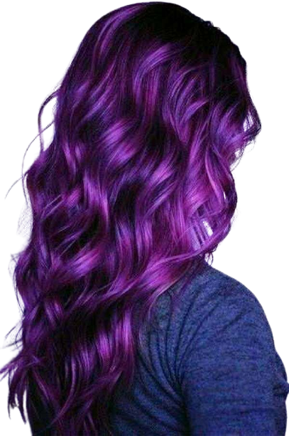
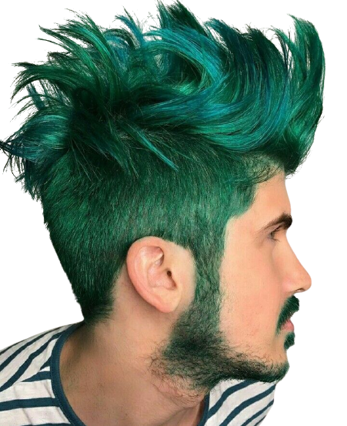
Would You Rather?
Purple Hair
Green Hair

Slide 13
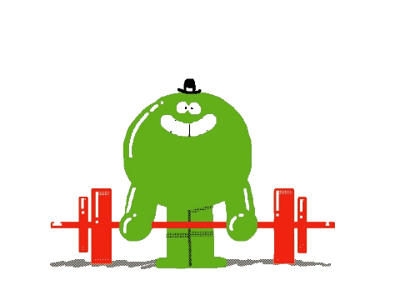
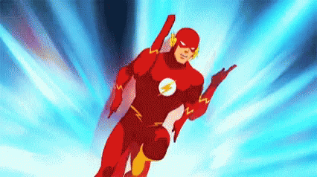
Would You Rather?
Super Strong
Super Fast

Slide 14
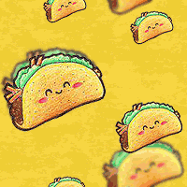
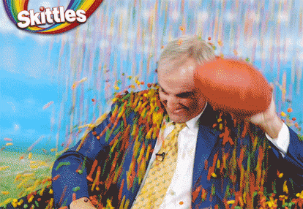
Would You Rather?
Rain Tacos
Rain Skittles

Slide 15


Would You Rather?
Have a pirate ship
Your own airplane

Slide 16
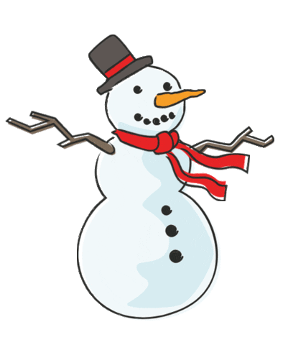
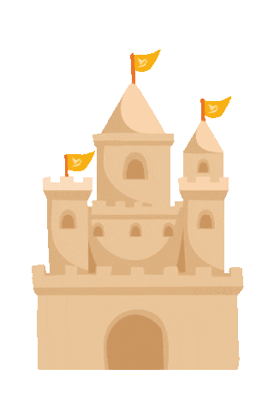
Would You Rather?
Build a Snowman
Build a Sandcastle

