Slide 1

St. Patrick’s Day Scavenger Hunt
By Niki Furfaro

Slide 2
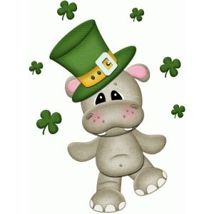
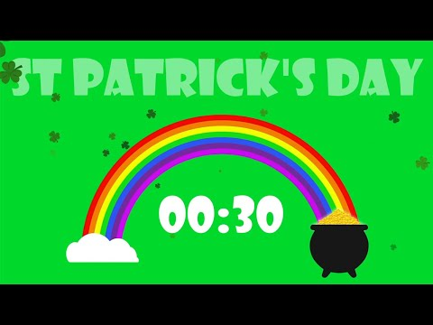

A leprechaun always wears a hat. Find your favourite hat!

Slide 3

Finding a four leaf clover is very rare and lucky! Find something with 4 sides!

Slide 4
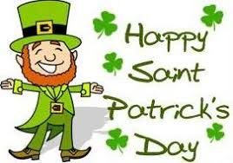
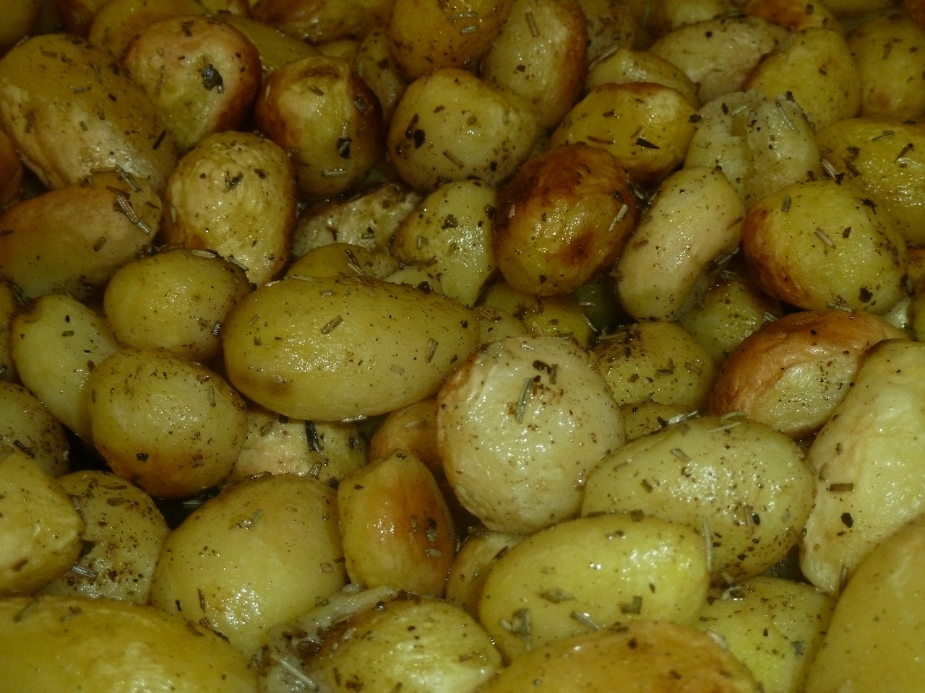

Leprechauns love to eat potatoes. Find something you love to eat.

Slide 5
Leprechauns are very small. Find something that is small.

Slide 6
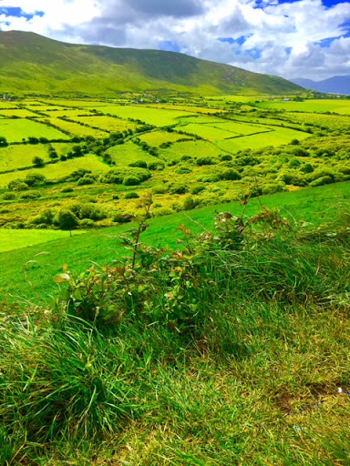

Ireland is know as the Emerald Isle because the land has so many shades of green. It rains A LOT!
Find something green!

Slide 7
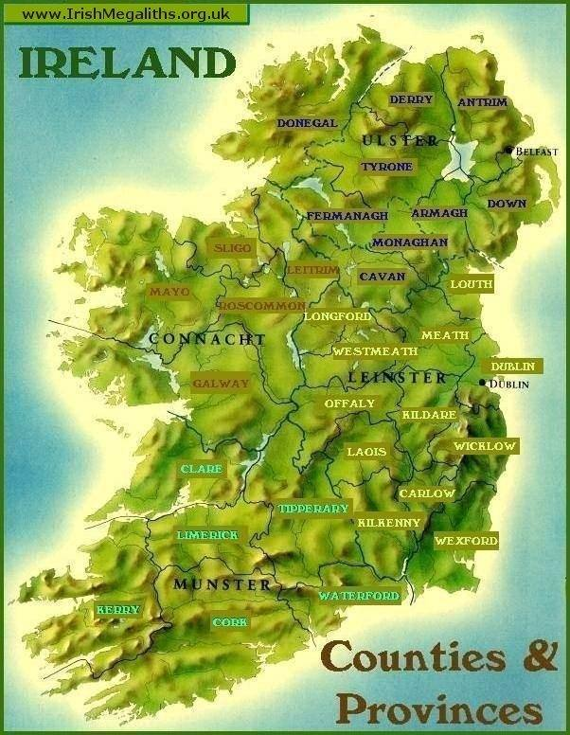
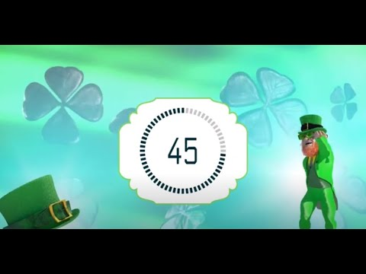
Ireland is far away across the Atlantic ocean. Find something
from far away!

Slide 8

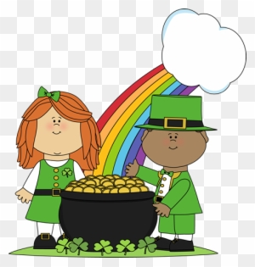
Find something that starts with the letter L for leprechaun!

Slide 9

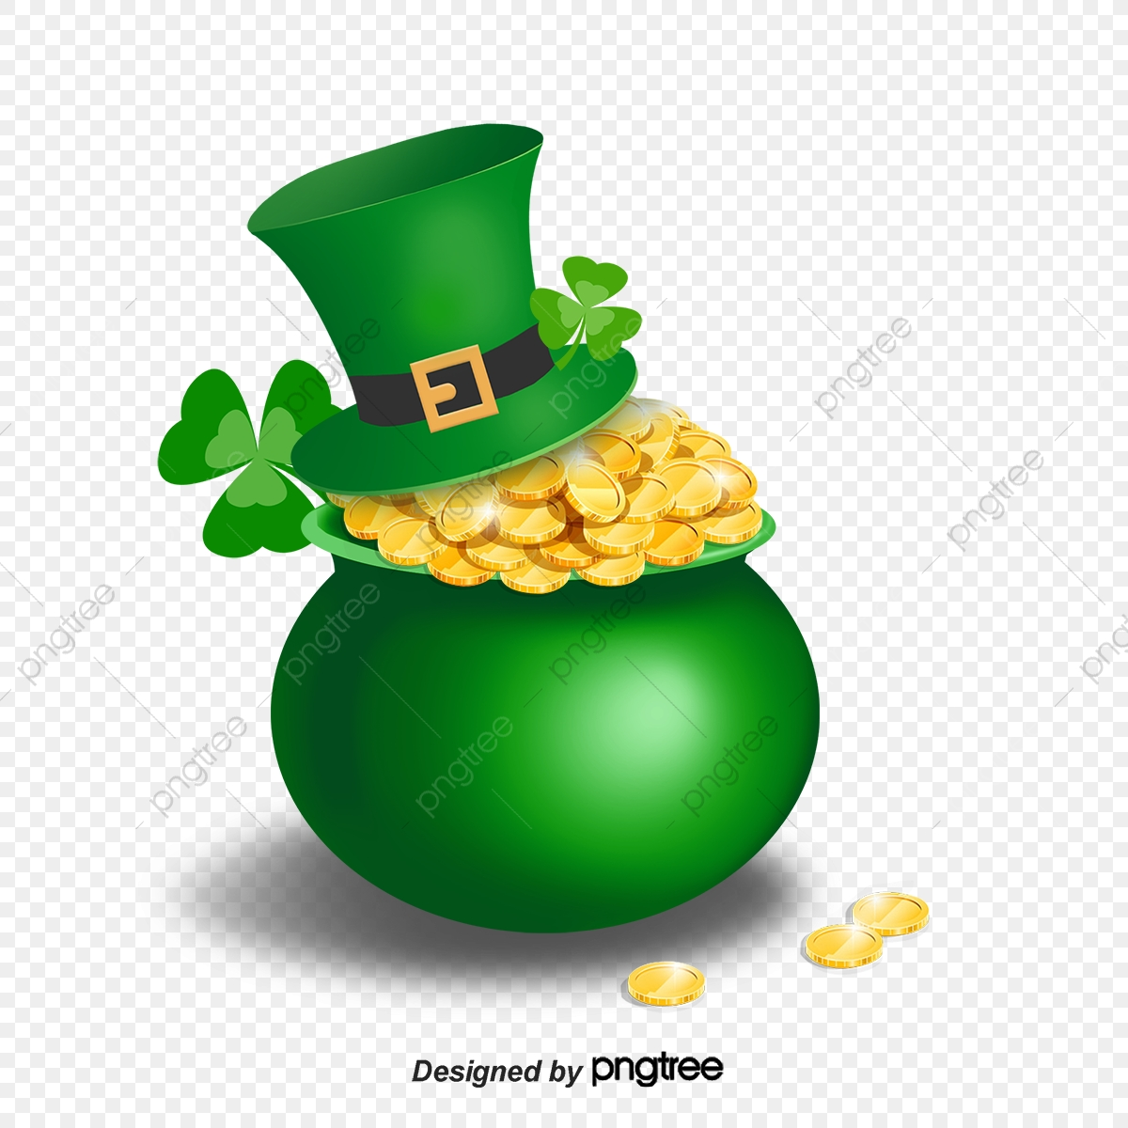
Leprechauns keep their gold in a pot at the end of the rainbow. Find something you would put in a pot.

Slide 10

Horseshoes and four leaf clovers are lucky! Find something that brings you good luck!

Slide 11
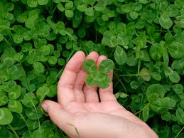
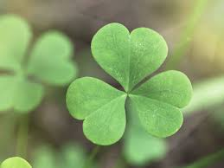
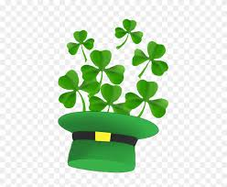
Find something that starts with the letter S for shamrock!

Slide 12
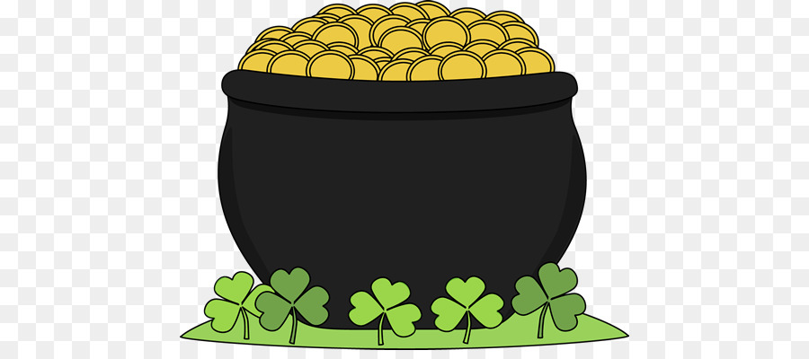
Gold is very precious to a leprechaun! Find something that is as precious as gold to you!

Slide 13

Leprechauns hide their gold at the end of a rainbow. Find something with as many colours of the rainbow as you can!

Slide 14
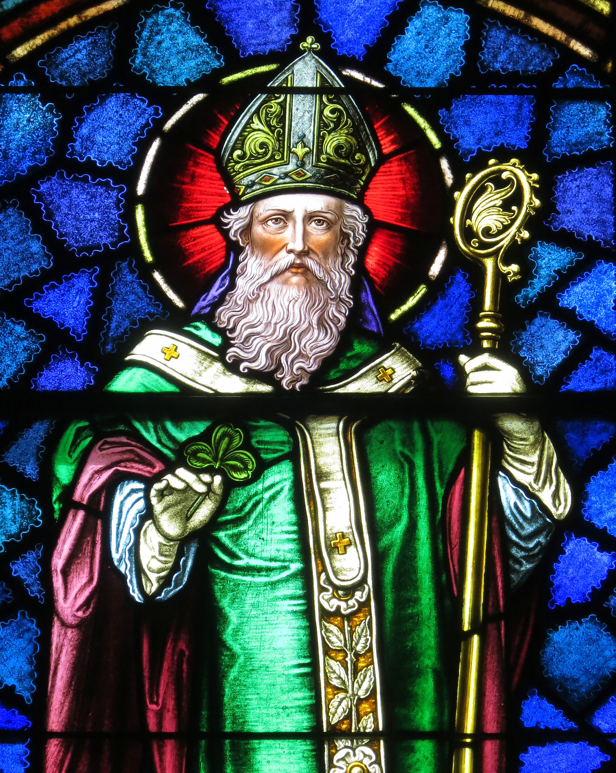
St. Patrick chased all of the snakes out of Ireland and taught people about the Trinity- the Father, the Son and the Holy Spirit. He used the shamrock as an example. 3 leaves but 1 leaf.
Find something that has 3 parts.

Slide 15

Leprechauns love anything shiny! Find something shiny!

Slide 16
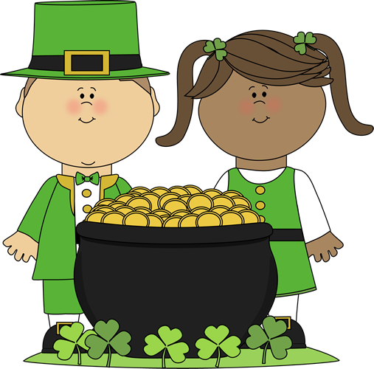
The job of a leprechaun is to make and repair shoes. Find your favourite shoes!

Slide 17
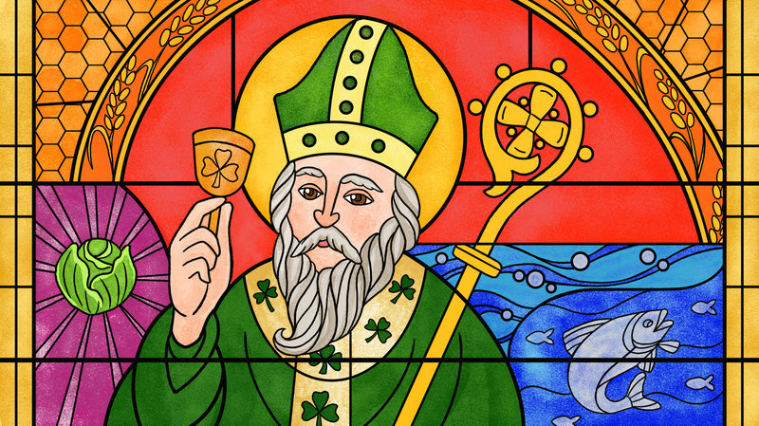



St. Patrick was a man of great faith! Find something that shows your faith.
T

Slide 18

St. Patrick’s Day celebrations are a lot fun! Find something that you find fun!
Happy St. Patrick’s Day!

Slide 19
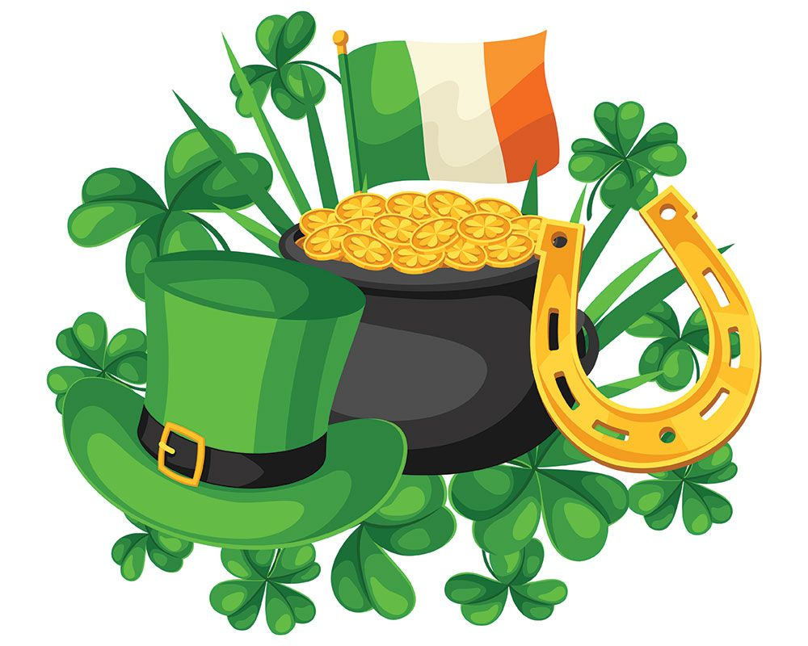

AsA
The leprechaun’s gold coins are round. Find something round.

Slide 20
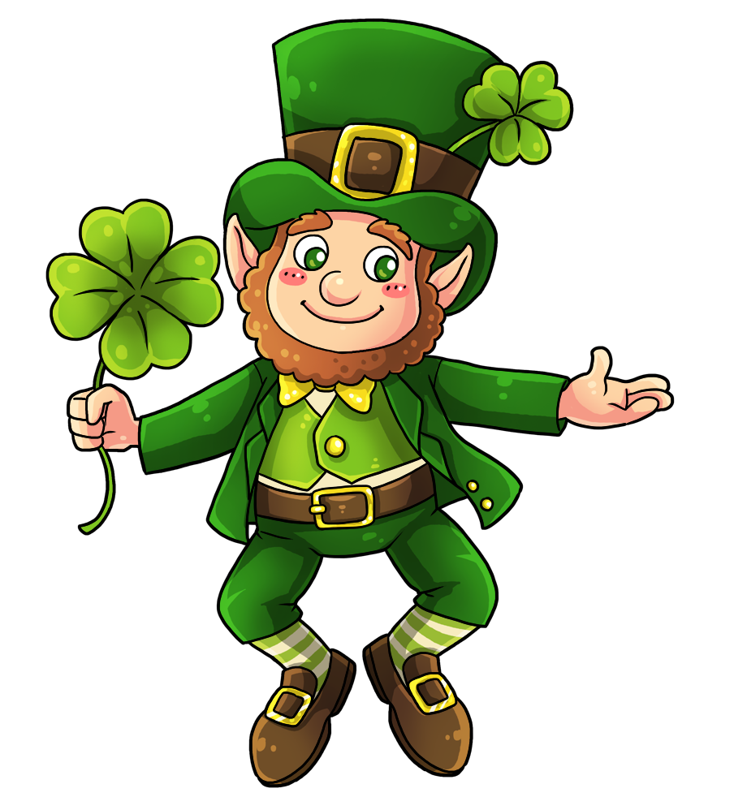


Leprechauns like to play tricks for a laugh. Find something you find funny!

Slide 21
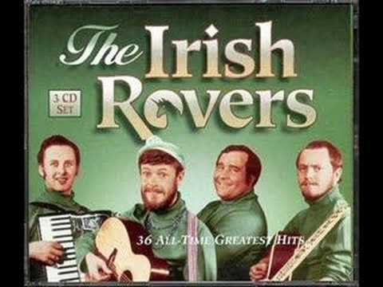
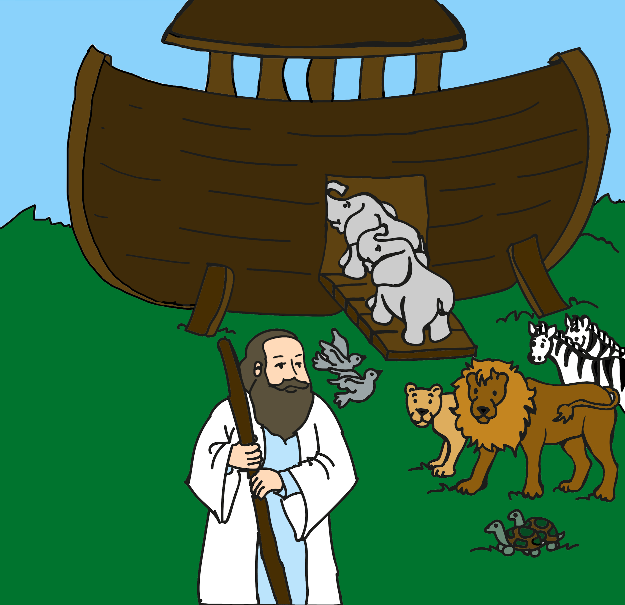
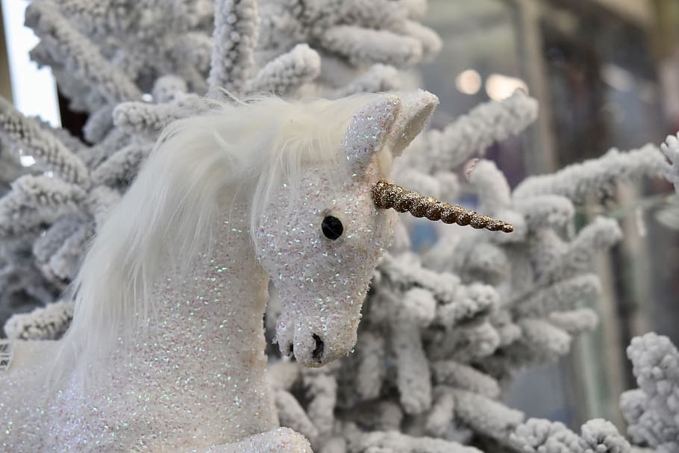
The Unicorn by the Irish Rovers

Slide 22
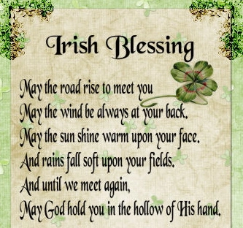

Slide 23

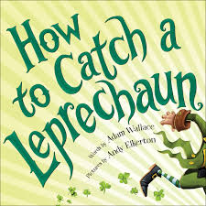

https://www.youtube.com/watch?v=jLlwvu8hsrA&ab_channel=StorytimeNow%21 The Luckiest Leprechaun by Justine Korman
https://www.youtube.com/watch?v=LdKTCtypLlw&ab_chann=HappyCultivated
How To Catch A Leprechaun by Adam Wallace
This book is
In Epic too
https://www.youtube.com/watch?v=U4kOZS2MFXA&ab_channel=StorytimeNow%21 The Luckiest St. Patrick’s Day Ever by Teddy Slater
Read Alouds

Slide 24

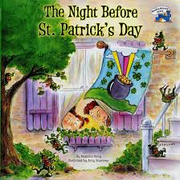
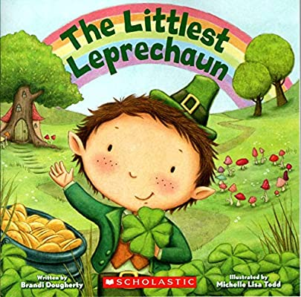
Twas the Night Before St. Patrick’s Day
By Natasha Wing
https://www.youtube.com/watch?v=OoOlo5AX_oI&ab_channel=StorytimeNow%21
The Littlest Leprechaun by Michelle Lisa Todd
https://www.youtube.com/results?sp=mAEB&search_query=the+littlest+leprechaun

Slide 25

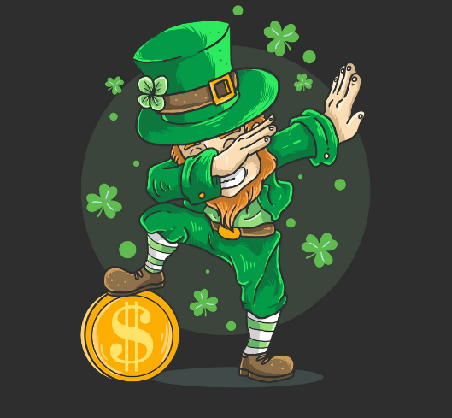

May the luck of the Irish always be with you! Happy St. Patty’s Day! Niki Furfaro

