Slide 1



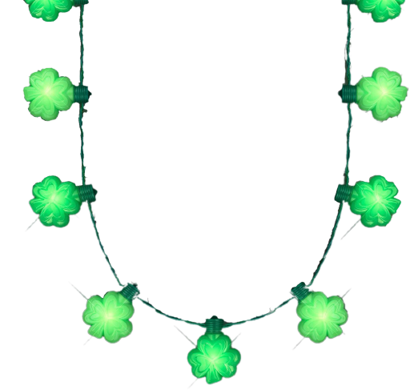
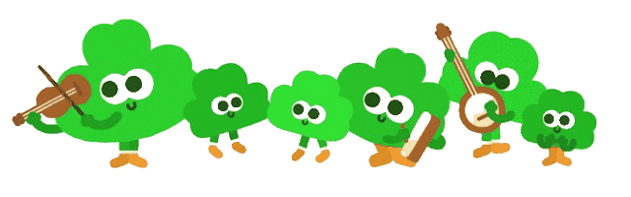
Are you ready to rhyme?
Start

Slide 2
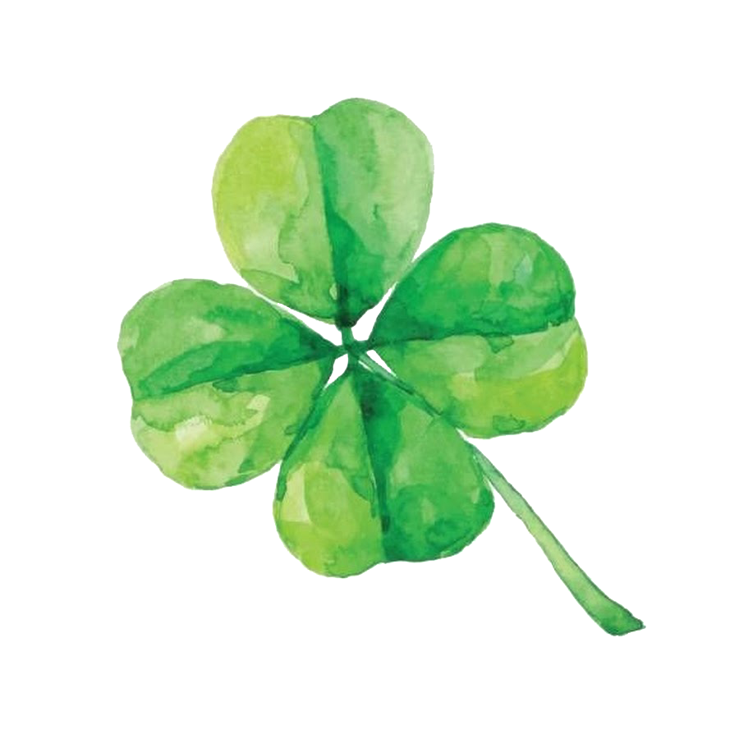



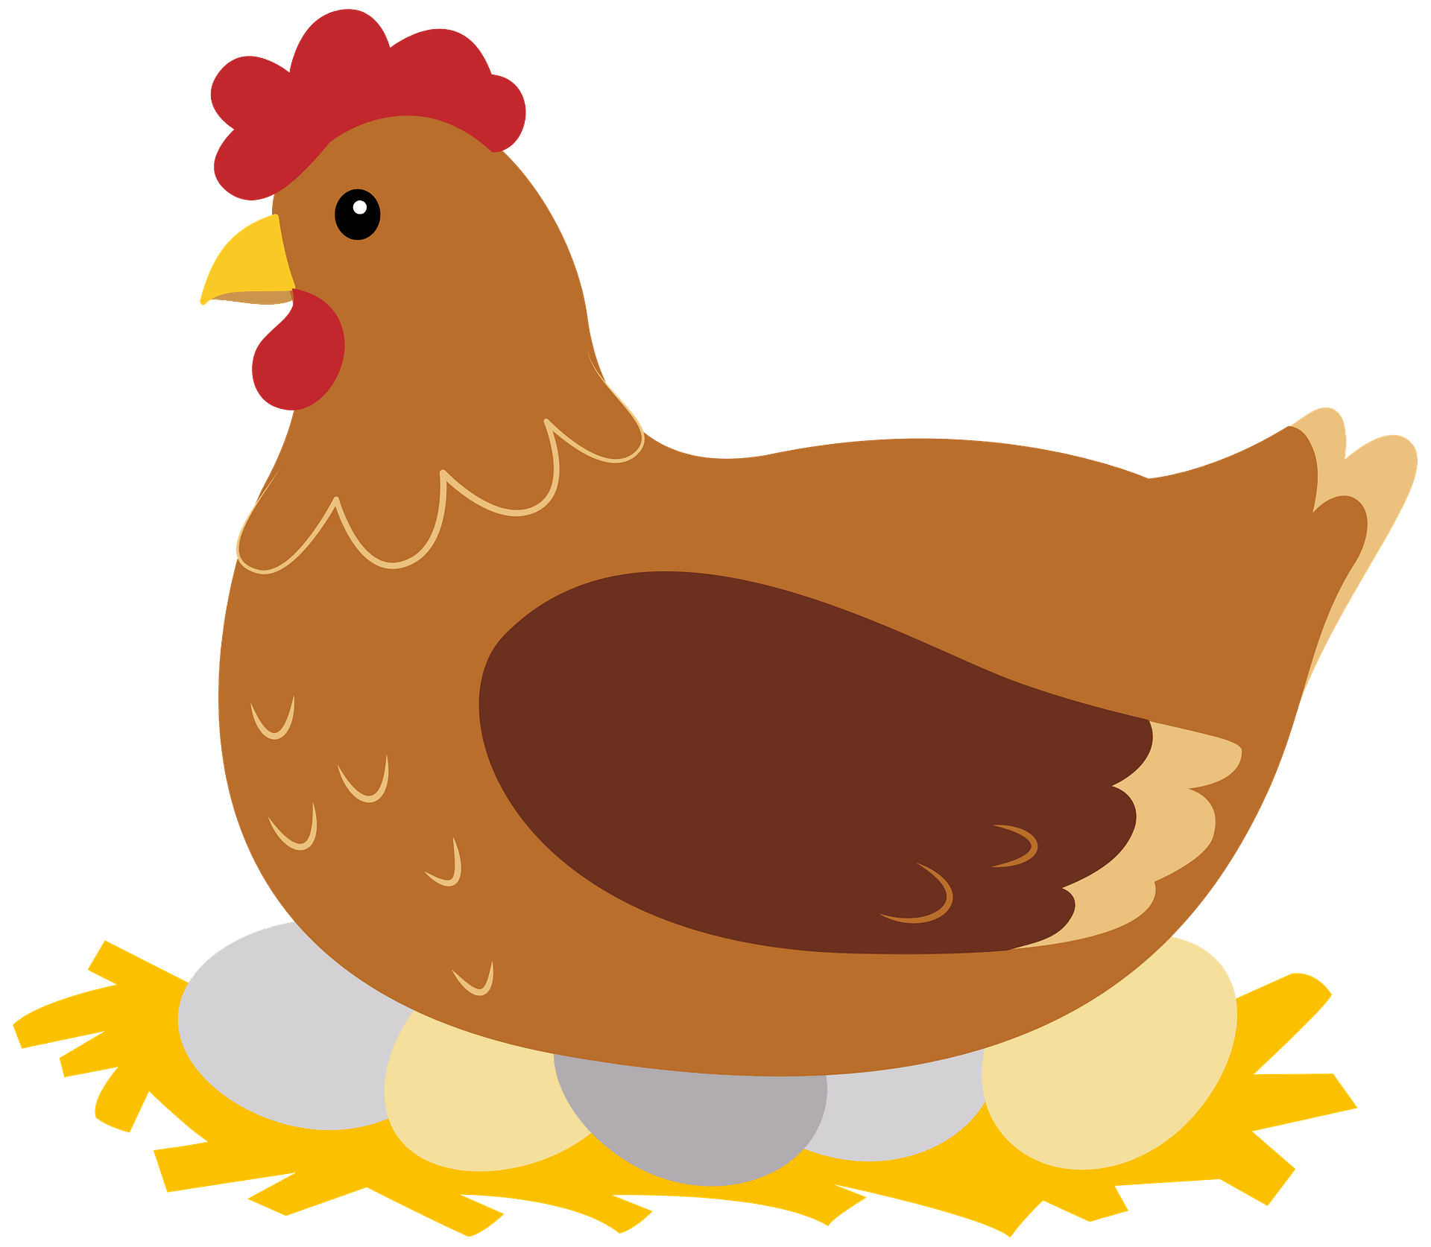


Notes:
Pen, hen

Slide 3
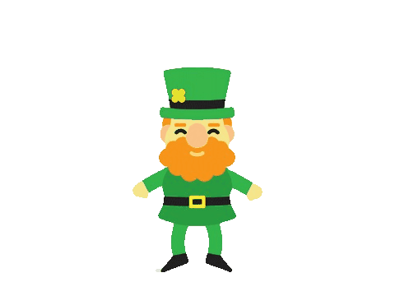

pen
hen
Next
Notes:
Pen, hen

Slide 4


pen
hen
Next
Notes:
Pen, hen

Slide 5


Notes:
bat ,bunny

Slide 6
bat
bunny
Next
Notes:
bat ,bunny

Slide 7
bat
bunny
Next
Notes:
Pen, hen

Slide 8

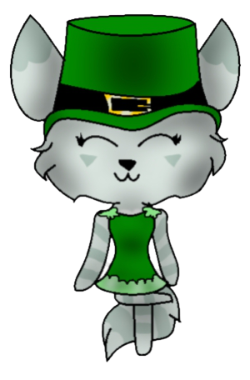
Notes:
Hat, cat

Slide 9
hat
cat
Next
Notes:
Hat, cat

Slide 10
hat
cat
Next
Notes:
Hat, cat

Slide 11
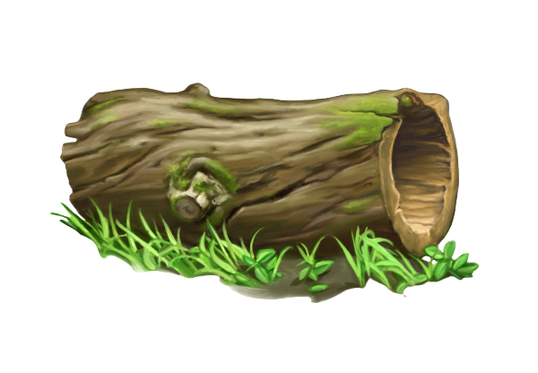
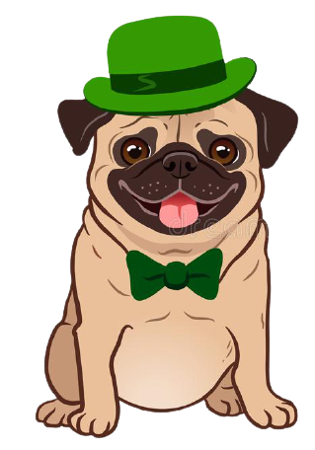
Notes:
Log, dog

Slide 12
log
Next
dog
Notes:
Log, dog

Slide 13
lob
dog
Next
Notes:
Log, dog

Slide 14

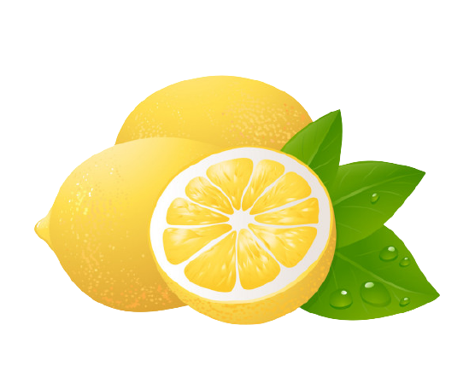
Notes:
Leprechaun, lemon

Slide 15
leprechaun
Next
lemon
Notes:
Leprechaun, lemon

Slide 16
leprechaun
Next
lemon
Notes:
Leprechaun, lemon

Slide 17


Notes:
Flag, rag

Slide 18
flag
bunny
Next
Notes:
Flag, rag

Slide 19
flag
rag
Next
Notes:
Flag, rag

Slide 20
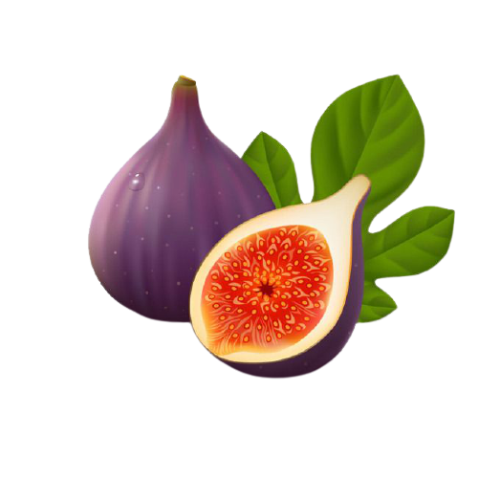

Notes:
Fig, ring

Slide 21
fig
ring
Next
Notes:
Fig, ring

Slide 22
fig
Ring
Next
Notes:
Fig, ring

Slide 23


Notes:
Jam, sad

Slide 24
jam
Next
sad
Notes:
Jam, sad

Slide 25
jam
sad
Next
Notes:
Jam, sad

Slide 26

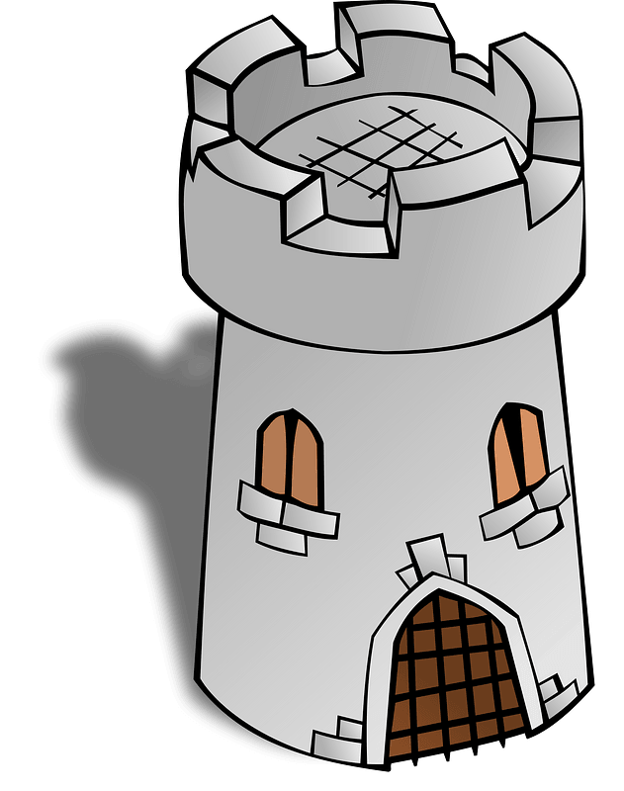
Notes:
Flower, tower

Slide 27
flower
Next
tower
Notes:
Flower, tower

Slide 28
flower
tower
Next
Notes:
Flower, tower

Slide 29
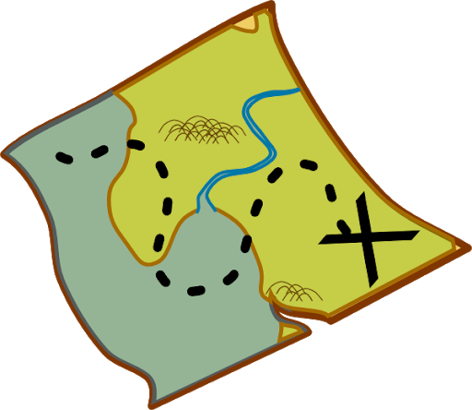

Notes:
Map, mad

Slide 30
map
mad
Next
Notes:
Map, mad

Slide 31
map
mad
Next
Notes:
Map, mad

Slide 32
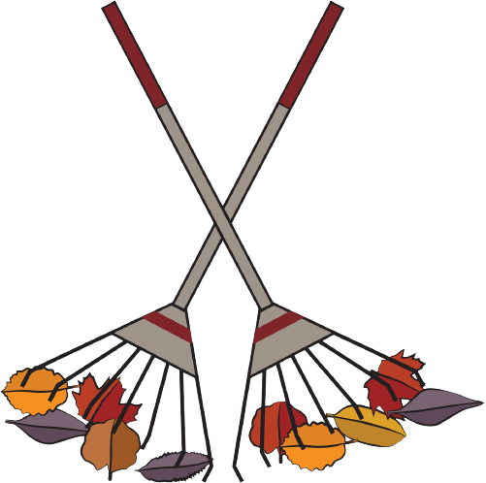
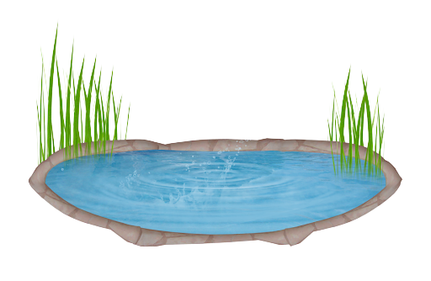
Notes:
Rake, lake

Slide 33
rake
Next
lake
Notes:
Rake, lake

Slide 34
rake
lake
Next
Notes:
Rake, lake

Slide 35

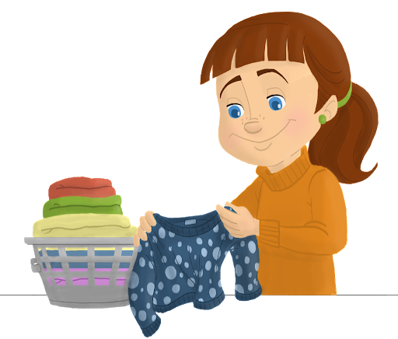
Notes:
gold , fold

Slide 36
gold
Next
fold
Notes:
gold , fold

Slide 37
gold
Next
fold
Notes:
gold , fold

Slide 38



Notes:
Grin, dig

Slide 39
grin
Next
dig
Notes:
Grin, dig

Slide 40
grin
Next
dig
Notes:
Grin, dig

Slide 41


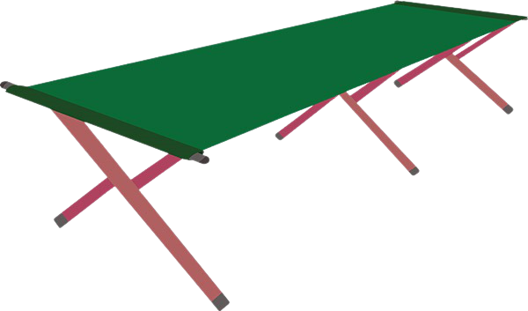
Notes:
Pot, cot

Slide 42
pot
Next
cot
Notes:
Pot, cot

Slide 43
pot
cot
Next
Notes:
Pot, cot

Slide 44
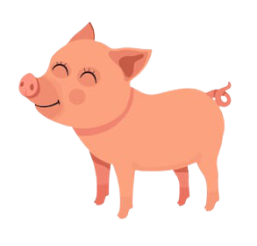
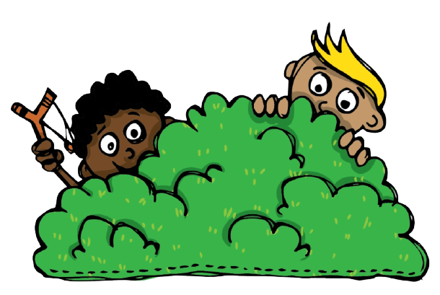
Notes:
Pig, hid

Slide 45
pig
hid
Next
Notes:
Pig, hid

Slide 46
pig
hid
Next
Notes:
Pig, hid

Slide 47
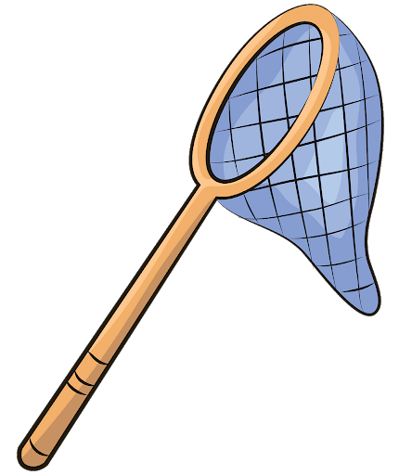
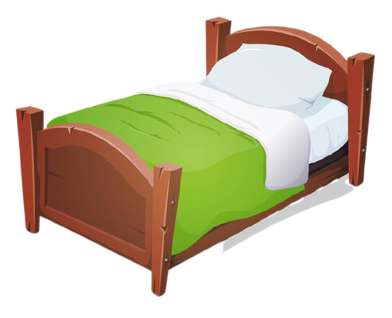
Notes:
Net, bed

Slide 48
net
Next
bed
Notes:
Net, bed

Slide 49
net
bed
Next
Notes:
Net, bed

Slide 50
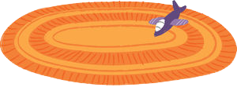

Notes:
Rug, mug

Slide 51
rug
Next
mug
Notes:
Rug, mug

Slide 52
rug
mug
Next
Notes:
Rug, mug

Slide 53

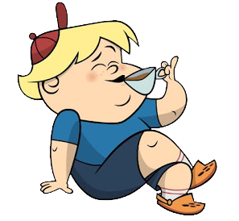
Notes:
Squid, sip

Slide 54
Squid
Next
sip
Notes:
Squid, sip

Slide 55
squid
sip
Next
Notes:
Squid, sip

Slide 56

Notes:
Honey, bunny

Slide 57
honey
Next
bunny
Notes:
Honey, bunny

Slide 58
honey
bunny
Next
Notes:
Honey, bunny

Slide 59
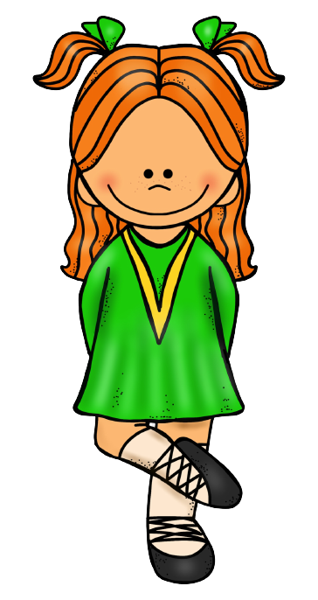

Notes:
Jig, wig

Slide 60
jig
End
wig
Notes:
Jig, wig

Slide 61
jig
End
End
wig
Notes:
Jig, wig

Slide 62


You did an amazing job!
Play again

