Slide 1
Happy St. Patrick’s Day!
March 17th, 2022

Slide 2

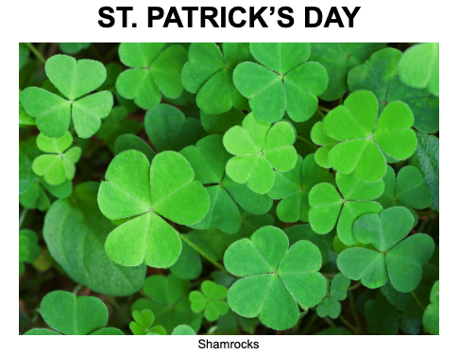

Slide 3


Slide 4
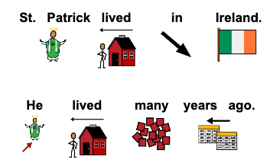

Slide 5
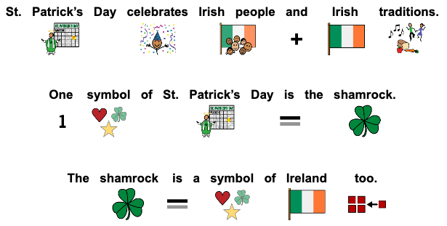

Slide 6
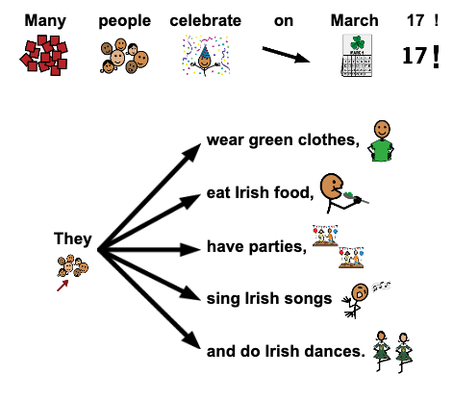

Slide 7


Slide 8


Slide 9


Slide 10


Slide 11
Thanks!
Do you have any questions?
addyouremail@freepik.com
+91 620 421 838
yourcompany.com
Please keep this slide for attribution

