Slide 1


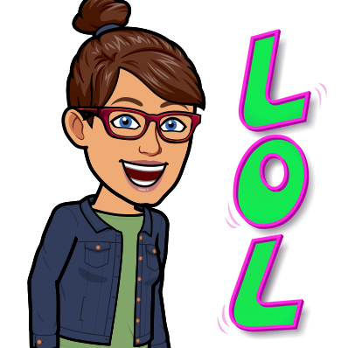

St. Patrick’s Day Jokes!

Slide 2
How should you greet someone on St. Patrick’s Day??

Slide 3

Irish you a happy
St. Patrick’s Day!!!!

Slide 4
Why shouldn’t you iron
a 4 leaf clover?

Slide 5
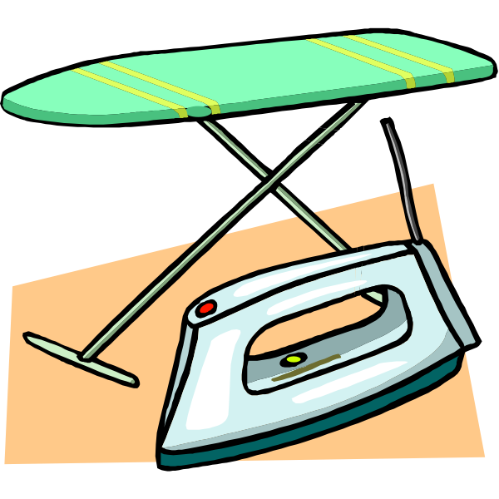
You might press your luck!!!!!

Slide 6
Knock. Knock.
Who’s there?
Warren.
Warren Who?
……….

Slide 7

Warren any green today?

Slide 8
What did the leprechaun say on March 17th?

Slide 9
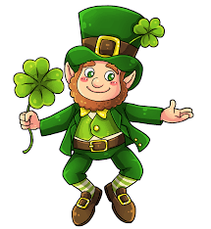
Irish you a happy St. Patrick’s Day!!!!

Slide 10
What’s Irish and
stays out all night?

Slide 11

Paddy O’ Furniture!!!!

Slide 12
What’s do you call Dwayne Johnson’s stunt double?

Slide 13
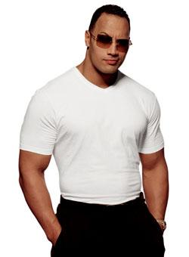
The SHAMrock!!!!

Slide 14
What kind of spells do
leprechauns use?

Slide 15
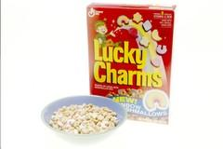
Lucky Charms!!!!

Slide 16
What do you call an Irish Spider?

Slide 17
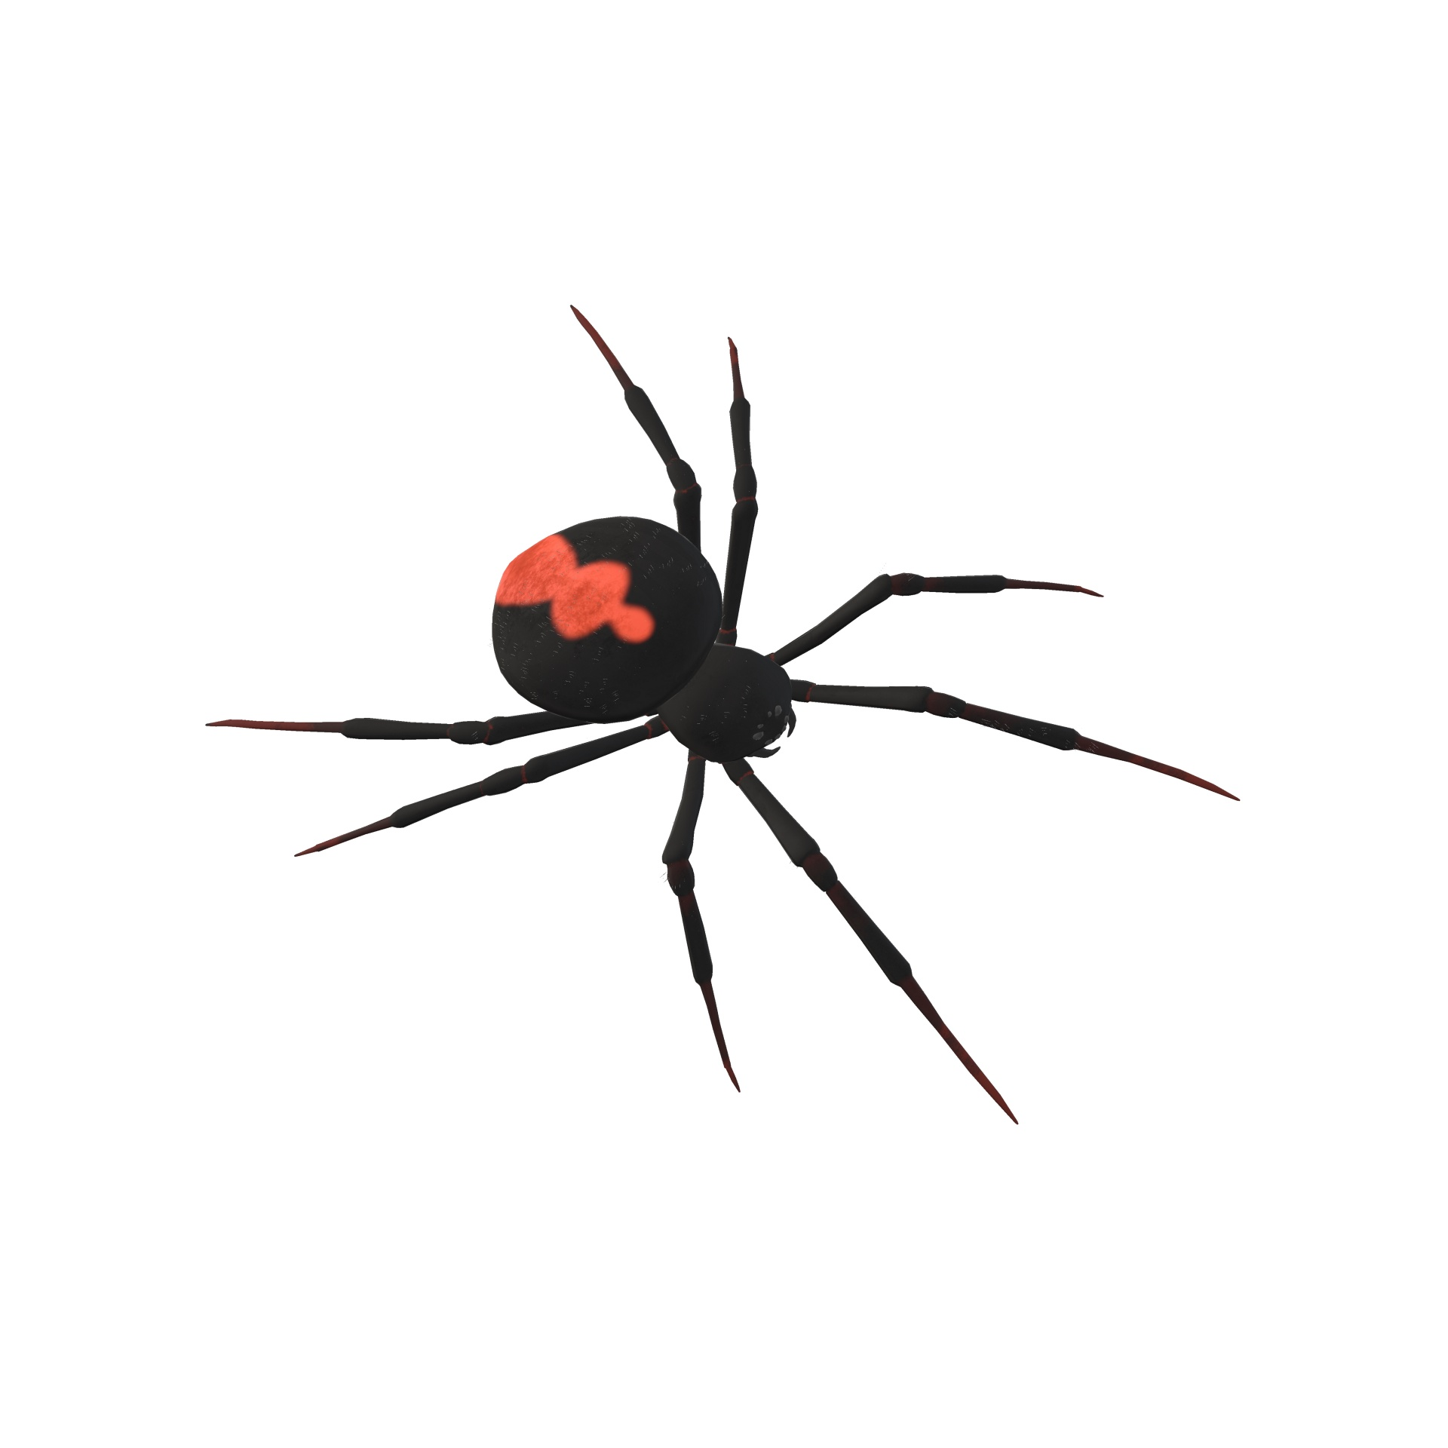
Paddy long legs!!!!

Slide 18
What did the leprechaun say when the video game ended?

Slide 19

GAME CLOVER!!!!!

Slide 20
Happy
St. Patrick’s Day!!!!

