Slide 1


What? Who? No, I’m not familiar with this “Ms. Swinton” character. I’m totally a leprechaun. I’m sure she’s amazing though.
Anyway, I need your help!
HI!
I’m a leprechaun!
CLICK
All sounds from zapsplat.com

Slide 2


So… The thing is…
I lost my gold.
I know that’s really bad. I just set it down somewhere, and now I can’t find it!
You’ll help me though,
RIGHT?!
YES!
NO!

Slide 3

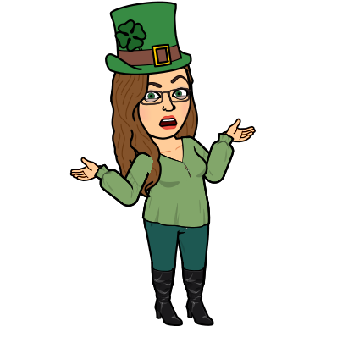

WHAT?! WHY NOT?!
YOU BIG MEANIE!
Well, if you’re doing this escape room, you don’t really have a choice. So too bad for you!
CLICK

Slide 4


WOOHOO!!!
Awesome!!! Thanks!!!!
The last place I remember having it was at my house, so probably start there!
CLICK

Slide 5


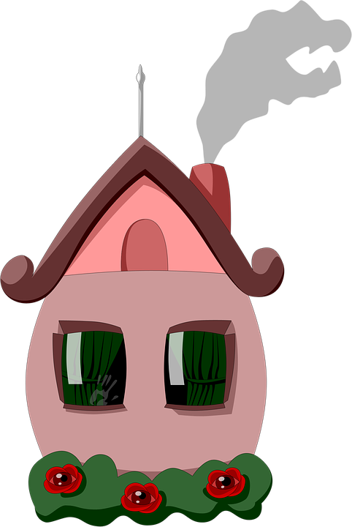


Click on the cottage to enter it.

Slide 6

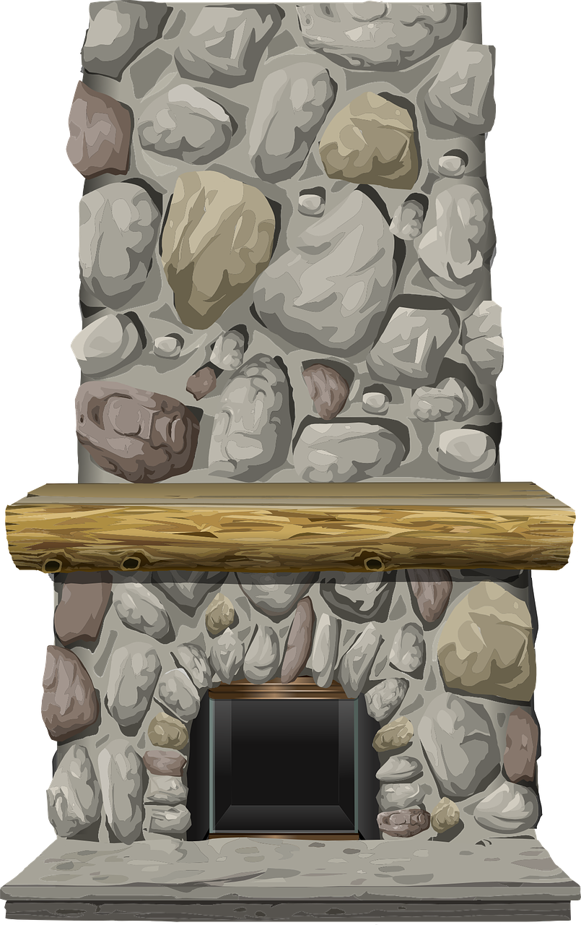





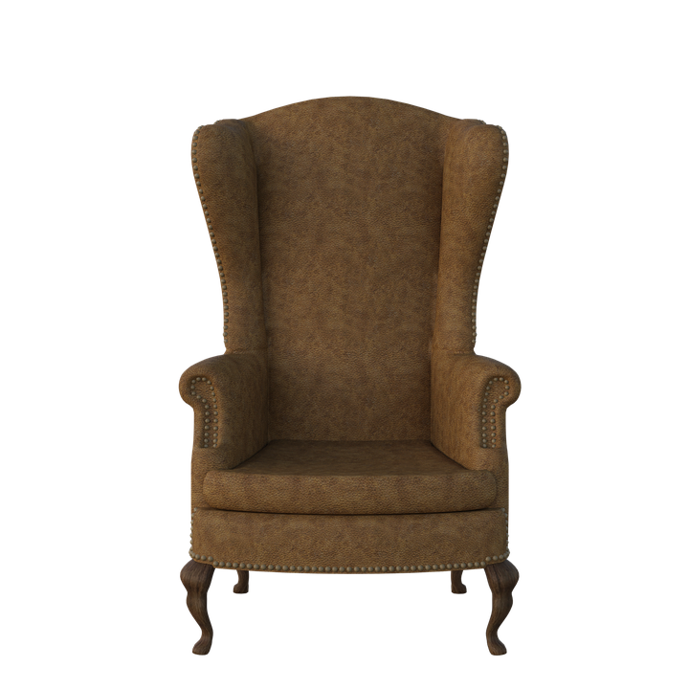


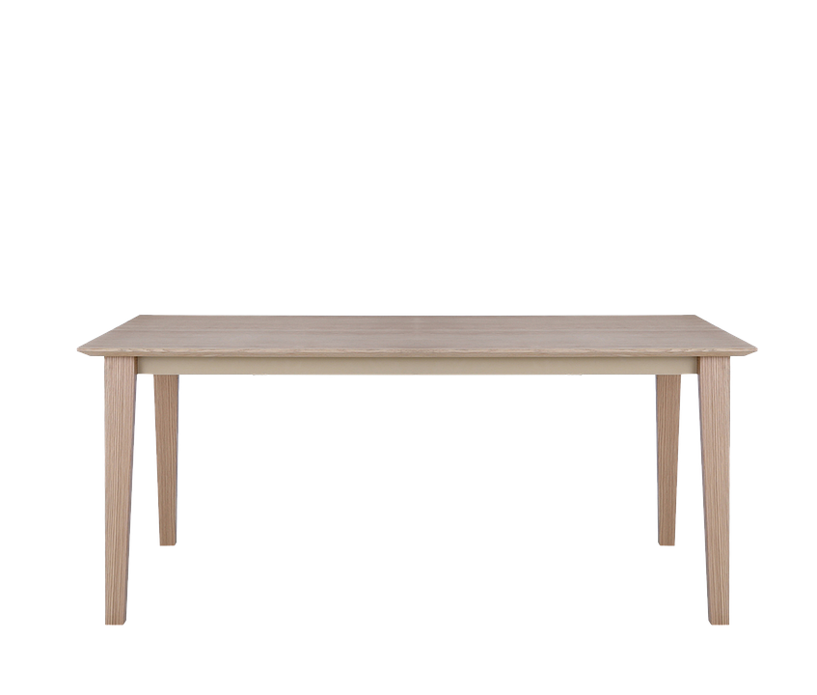



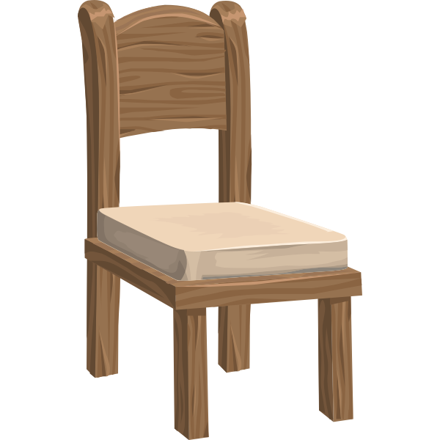






Well… You’d better start looking around, if you’re going to find my gold for me!
CLICK

