Slide 1

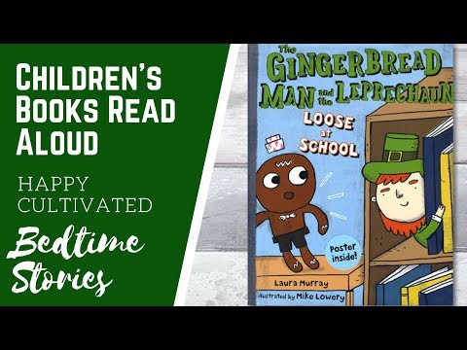

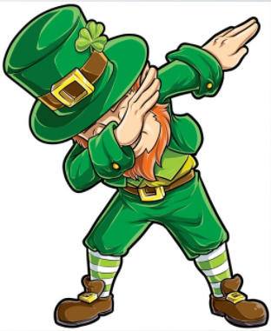
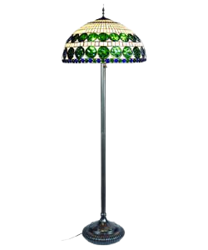



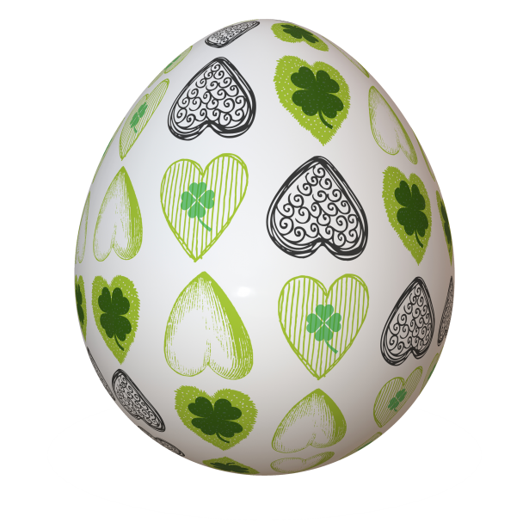



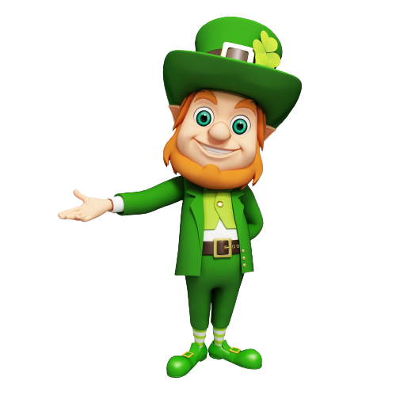

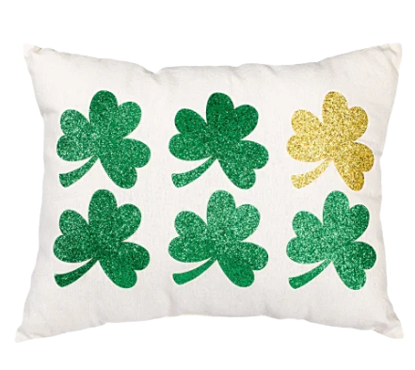
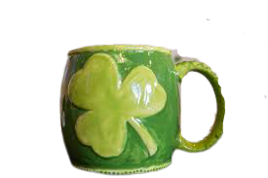
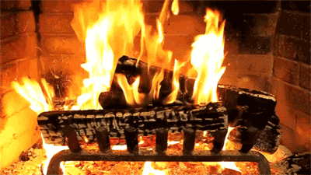


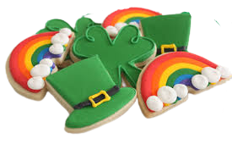

Welcome to me home! Enjoy a cookie I just baked for ya!
Listen to the story; “Gingerbread Man and Leprechaun Loose at School” above the fireplace then complete the slides that follow.

Slide 2
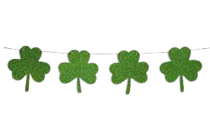

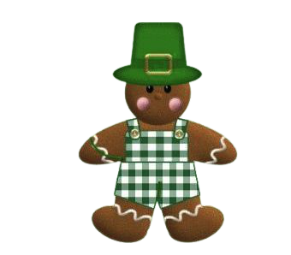
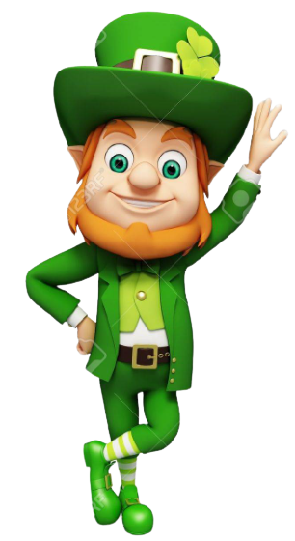
Characters
Problem
Type here.
Type here.
Setting
Solution
Type here.
Type here.

Slide 3
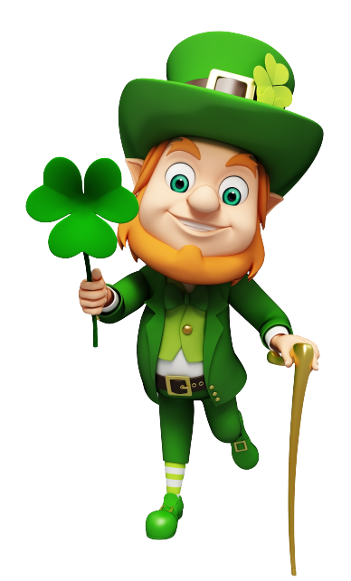
Let’s Compare and Contrast Our Characters
Gingerbread Man
Leprechaun
Type here.
Type here.
Type here.

Slide 4

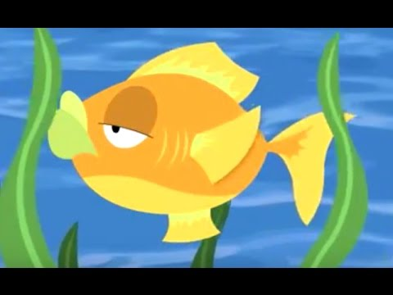
What is a Limerick?
Go to the next slide to read a limerick by Mrs. Ganoe. See if you can hear the rhyming words. Then it’s YOUR turn!

Slide 5
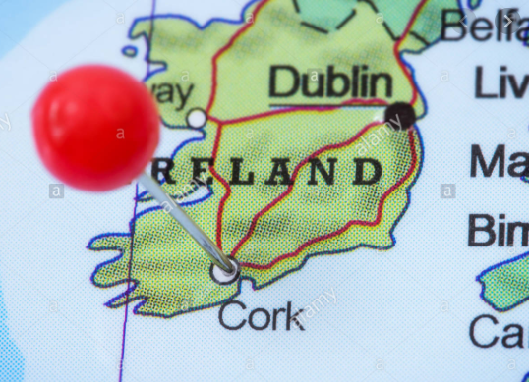
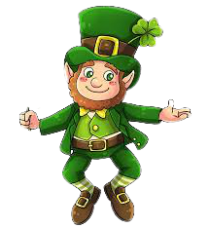

The Leprechaun From Cork
There once was a leprechaun from Cork.
Everyday he ate pork with a fork.
But whenever he ate,
he would always be late.
That hungry little leprechaun from Cork.
By - Mrs. Ganoe
AABBA Pattern

Slide 6
On the next couple of slides are two limericks you can choose to do together as a class or have the student complete with a partner in a breakout room or independently. You could even do the first one together and assign the second one.
I color coded the boxes for the words that are to rhyme to help make it a little easier for the students.

Slide 7
Title: Type here.
There once was a child from .
Who liked to play ball in the .
He’d play with the .
He’d jump, run, and .
At night he would rest and then .

Slide 8
Title: Type here.
My favorite animal is the .
I like it because it can .
I wish I could have .
It would be so much .
But my mom said, “No way it’s too .

Slide 9


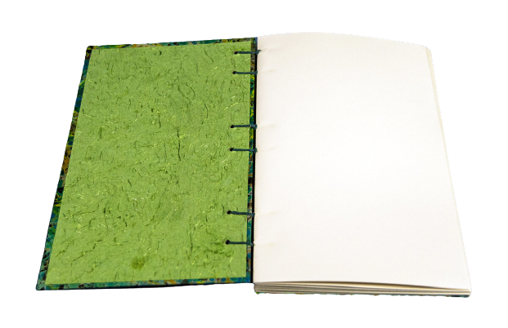

Help! I’m stuck in me pot o’gold! If ya help me get unstuck, I’ll give ya free gold and three wishes!
Directions: In the journal below, either type or write and insert the three wishes you would ask the leprechaun. Remember to write in complete sentences.
My Three
Wishes
Type here.
2. Type here.
3. Type here.

Slide 10

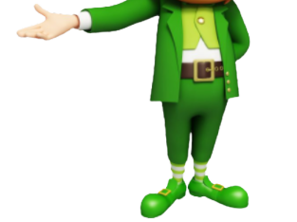
Directions: Pretend that you are a leprechaun. Have a parent take a picture of you from the neck up. Have them insert it onto the leprechaun then place the hat on your head. Respond to the writing prompt by telling me where you would hide your pot of gold if you were a leprechaun and why you would choose that spot.
If I was a leprechaun, I would hide my pot of gold (Type here).

Slide 11


I am Lucky Because...
I am lucky because (Type here)
I am lucky because (Type here)
I am lucky because (Type here)
I am lucky because (Type here)

Slide 12

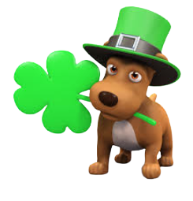
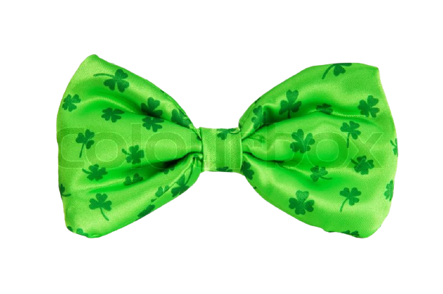

ABC Order Shamrocks
Directions: The little puppies love to collect shamrocks! Help them by placing the shamrocks in ABC order and place them under each puppy.
green
rainbow
magic
shamrock
luck
gold

Slide 13
Please Help Me Find My Bowtie
Directions: Read the word on each puppy’s clover. Find the bowtie that matches. Click and drag it onto the puppy.
mint
friend
blank
find
green
gold
trust
frost
must
cost
blend
plank
sold
mind
seen
print

Slide 14



My 5 Star Sentences
Directions: Choose four of the words from the rhyming activity on the previous slide and write a 5 star sentence for each.

Slide 15

Three Wishes for You
Directions: On the next slide is a story about a leprechaun but it’s missing some words. The Leprechaun needs your help in finding the correct words that are missing to help the story make sense. Are you up for the challenge? You can do it!!!

Slide 16
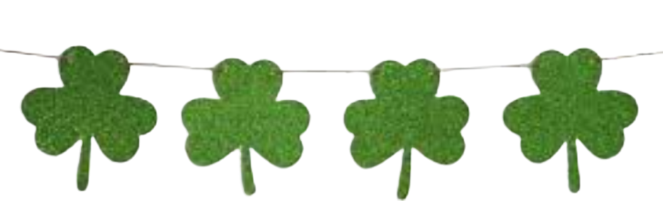
Directions: Read the story. As you read and come to a green box, look at the word list and try to find the word that would fit to make sense in the sentence. Click and drag it on top of the green box.
One day, a little was playing with his .
They to go on the when they saw a
man all in green run in back of a . The boy and his
friend the little man to come out. The little man did
as he was asked. He told the boys that he was for
his pot of and that if they could him he
would grant them three . They were !
help
looking
friend
small
boy
went
gold
swings
asked
tree
happy
wishes

Slide 17


How to Catch a Leprechaun

Slide 18
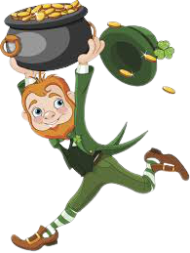

How I Would Catch a Leprechaun
First,
Next,
Then,
Last,

Slide 19
A Leprechaun Trap
What does the boy want to
do? Type here.
2. Who helped the boy? Type
Here.
3. What is the first thing the boy
and his dad did? Type here.
4. What did the boy put under
the box? Type here.
5. What is the last thing the boy
and his dad did to the trap?
Type here.
6. Why is the boy excited to
catch the leprechaun? Type
here.
I want to catch a leprechaun. My dad helped
me set up a trap. First, we found an empty
box. We turned it upside down. My dad told
me to find a stick outside. He put it under the
box. Next, we put some fake gold in the box. I
really hope it works! I have so many
questions I want to ask the leprechaun!

Slide 20




Shamrock Fact Families
Directions:
Find the missing number on each shamrock so that the numbers when added equal the sum at the top of the shamrock.
Type the facts for each shamrock fact family.
25
12
16
15
8
9

Slide 21
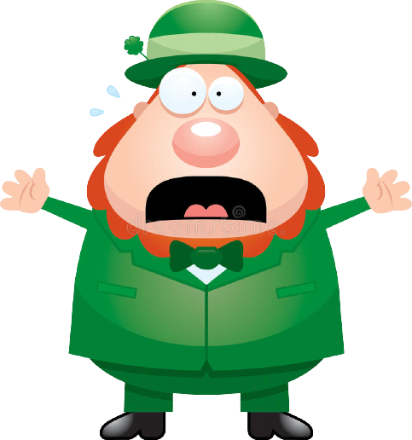






Oh dear me!!! I’ve gotten me pots of gold all mixed up! Would ya help me by placing the correct gold coin above each pot of gold? I’d sure appreciate it!
+
+
+
+
85
134
93
103

Slide 22
Directions: Look at the numbers on the pots of gold. Solve each of the equations on the gold coins and place them above the pot that they belong.
20
17
12
20-3
16+4
10+10
25-5
6+6
5+12
3+9
20-8
9+8

Slide 23

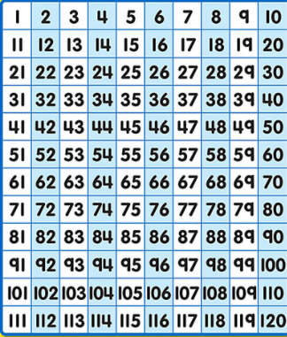

50
60
Help me get to the pot of gold by collecting the gold coins. You must skip count by 5s and type the number on the coin. Use the 120 number chart to help you. Good Luck!
~ Larry Leprechaun
25
15

Slide 24






2
Skip Count by 2s and the gold is for you!

Slide 25
4
Skip Count by 4s and all the gold is yours!

Slide 26

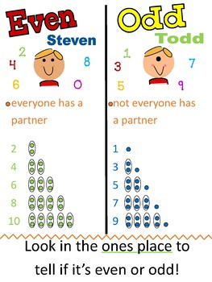
Directions:
Look at the numbers on each gold coin. Use the, “Even and Odd” poster to help if needed and sort the coins into the, “Even” or “Odd” pots of gold.
Good Luck!
~ Leo Leprechaun
-
Try Your Luck - Even or Odd?
21
16
43
98
34
29
86
EVEN
9
ODD
15
104
113
71
102
48

Slide 27

Order the Numbers from Greatest to Least
Directions:
Order the numbers from greatest to least by clicking and dragging them into the yellow boxes.
5
31
16
78
43

Slide 28
Order the Numbers from Greatest to Least
Directions:
Order the numbers from greatest to least by clicking and dragging them into the yellow boxes.
9
27
63
18
38

Slide 29
Order the Numbers from Greatest to Least
Directions:
Order the numbers from greatest to least by clicking and dragging them into the yellow boxes.
8
15
42
10
27

Slide 30
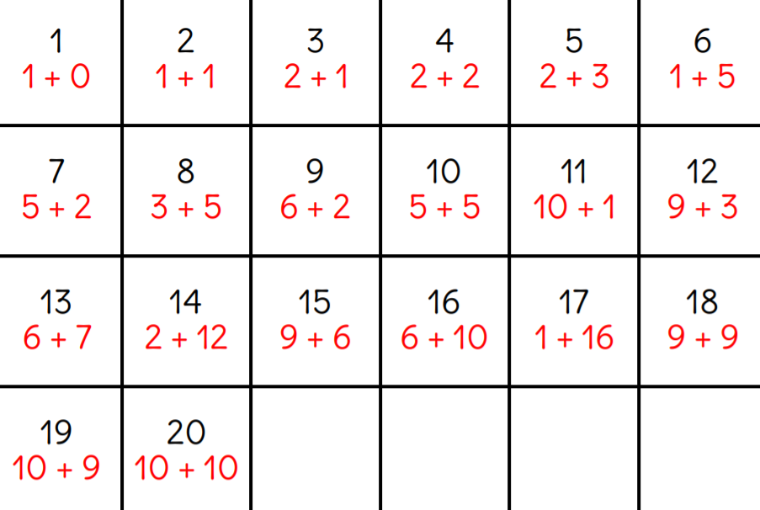
Teacher Bingo Calling Card

Slide 31
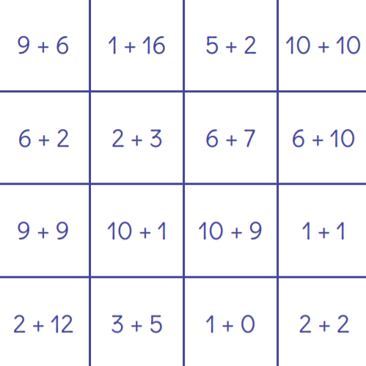

Slide 32
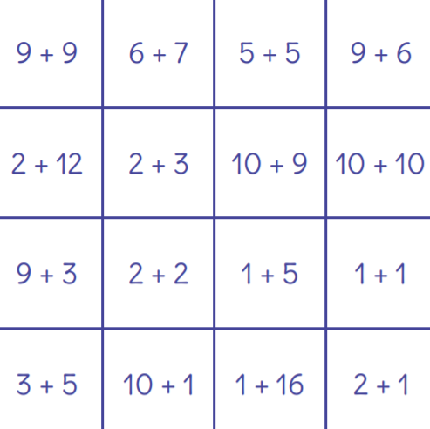

Slide 33
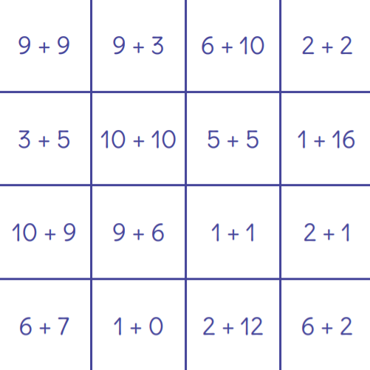

Slide 34
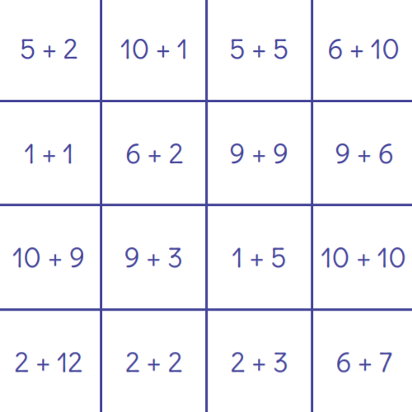

Slide 35
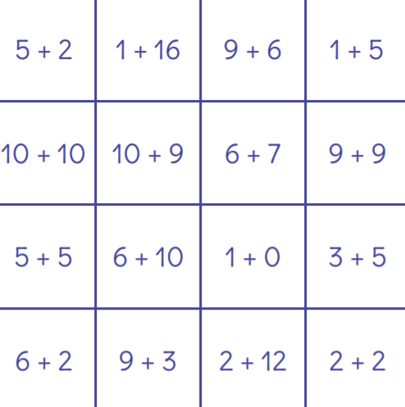

Slide 36
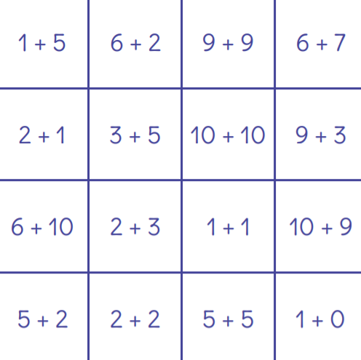

Slide 37
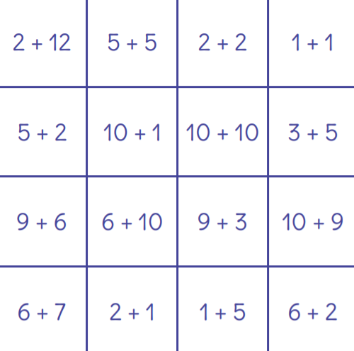

Slide 38
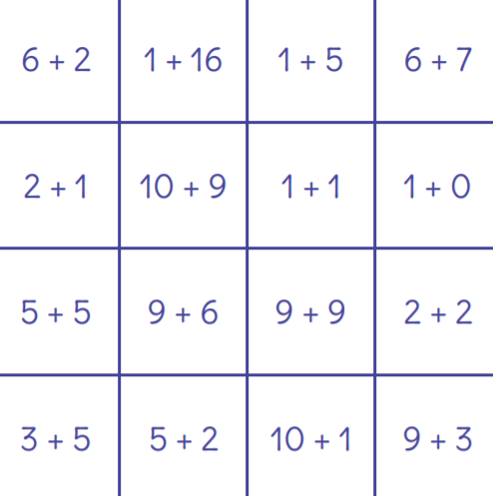

Slide 39
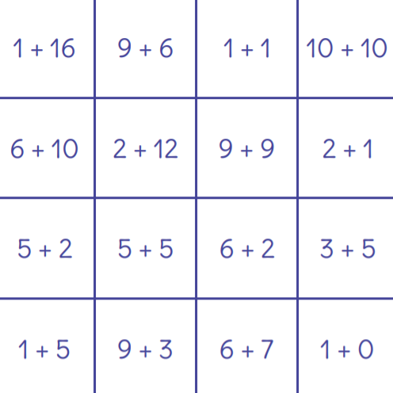

Slide 40
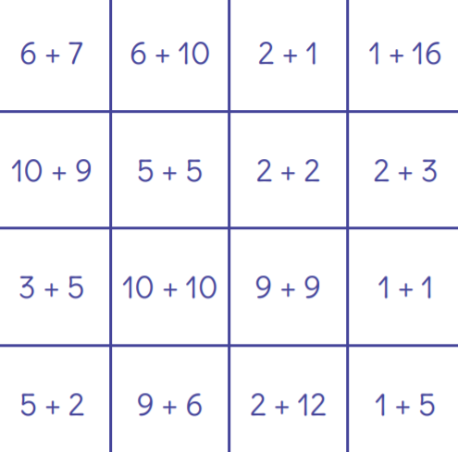

Slide 41
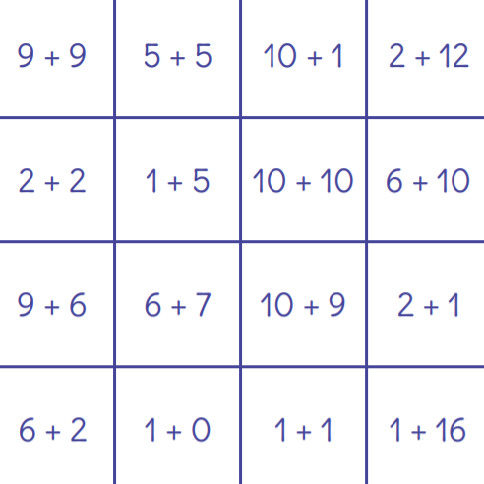

Slide 42
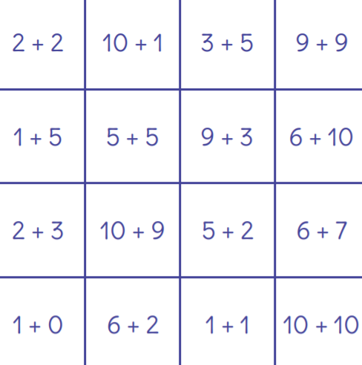

Slide 43
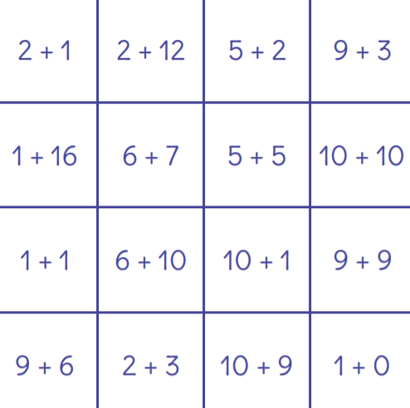

Slide 44
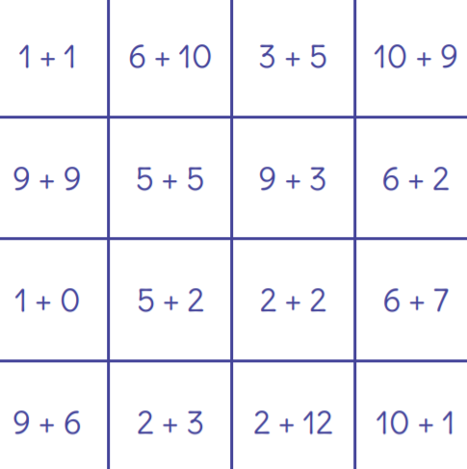

Slide 45
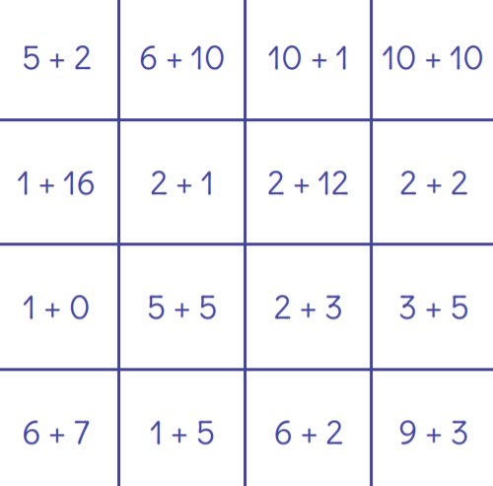

Slide 46
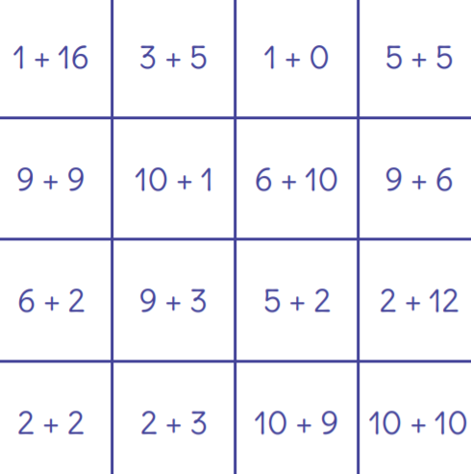

Slide 47
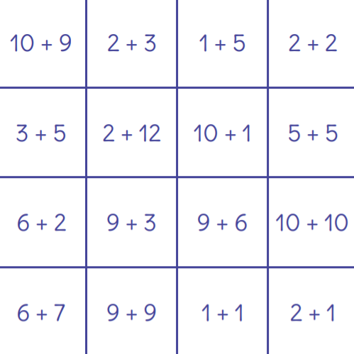

Slide 48
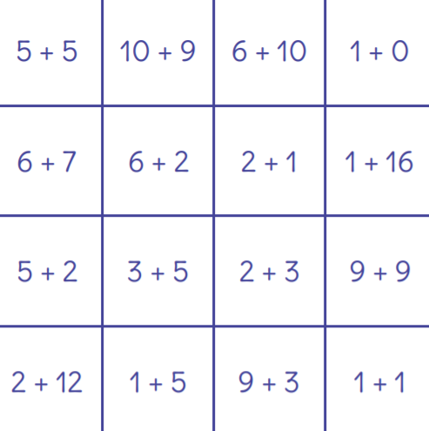

Slide 49
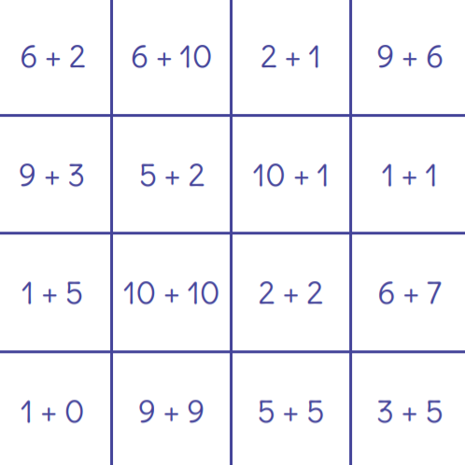

Slide 52



It’s time for a Scavenger Hunt
on this St. Patty’s Day. How many things can you find? Are you ready to play?
The items to find are coming up next so just try your hardest and do your best! It’s all about fun; that’s all that’s it … no need to worry not one little bit.

Slide 53
Find something that is shiny.

Slide 54
Find a penny.

Slide 55
Find something that is green.

Slide 56
Find something that can fly.

Slide 57
Find something that is gold or yellow.

Slide 58

St. Patrick’s Day Fizzy Pots Science Experiemnt
(Solid, Liquid, Gas)
On the next few slides, you will see the materials and steps needed to conduct a science experiment- to find out what happens when various ingredients are combined. You will be able to observe all three states of matter: solid, liquid, and gas. Have fun!!!
The video above is to be viewed by the teacher ahead of time if needed. You can also use this after the experiment is over to show the students.

Slide 59
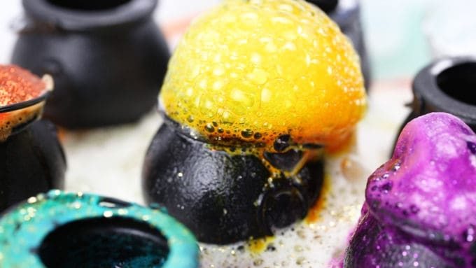
Materials Needed
Baking Soda
White Vinegar
Food Coloring
6 Small Black Pots (or 1 pot is fine too!)
Glitter and Fake Gold Coins (optional)
Baster, squeeze bottle or ladle
Tray

Slide 60
How to Prepare Your Fizzy Pots
STEP 1: Start by setting out a tray with your six little black leprechaun pots! You can do a rainbow of colors or you can simply set up one pot for this fizzy experiment.
STEP 2: Next, you want to add food coloring to your pots! You can even throw in some coloring mixing skills here if you have the standard red, yellow, blue, and green liquid food coloring bottles. Alternatively, you can color 6 containers of vinegar that the kids can slowly pour into each pot of baking soda (after step 3 is complete).
STEP 3: Once the food coloring is added or if you have decided to use separate containers for colored vinegar, go ahead and scoop in baking soda.
Step 4: Time to observe what happens when you add the vinegar to the pots. Mix up a rainbow of fizzy fun with a simple combination of baking soda and vinegar.

Slide 61
Tips for Best Experiment
For the best eruptions, the ones that make the kids squeal, you want to add a good amount of vinegar at one time. Pouring from a small cup or a full meat baster works best! A small eye dropper will not be as dramatic.
Additionally, you will want to make sure to have extra baking soda and vinegar on hand if you have the time. From my experiences, this baking soda vinegar activity is a real hit, and kids will want to repeat it over and over again.
If you don’t have vinegar, try lemon juice! It’s all about mixing an acid and a base so lemon or lime juice works too for the acid! However, vinegar is more cost-effective.
Another variation to try is baking powder and water as this also produces a bubbling reaction but not as awe-striking! Though, it would be fun to compare and contrast with older kids.

Slide 62
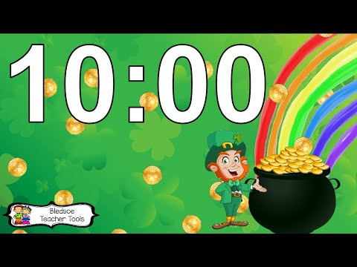
Happy St. Patrick’s Day!
Directions: How many words can you make using the letters in the words, “Happy St. Patrick’s Day?” This is a great activity to do in a breakout room with a partner! For a challenge, see how many you can find in 10 minutes using the timer.

Slide 63

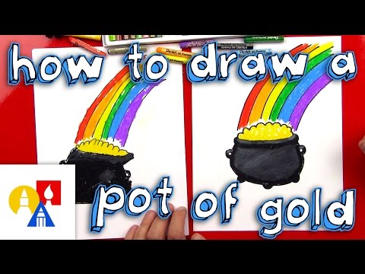
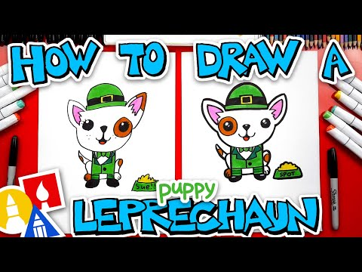
St. Patrick’s Day Directed Drawings

Slide 64

St. Patrick’s Day Would You Rather…
The next slides are from a FREE resource on TPT. I felt rather than recreating, I’d just share as is but wanted to give credit to Rachel Lynette (Creator). You can play this game however you’d like but when I do it on Zoom, I like to have the children do exercises so if they choose one thing they may have to do jumping jack. If they choose the other thing then they have to pretend they’re lifting weights. This is just a way to get some extra movement in which is so important.

Slide 65



Slide 66


Slide 67


Slide 68


Slide 69


Slide 70
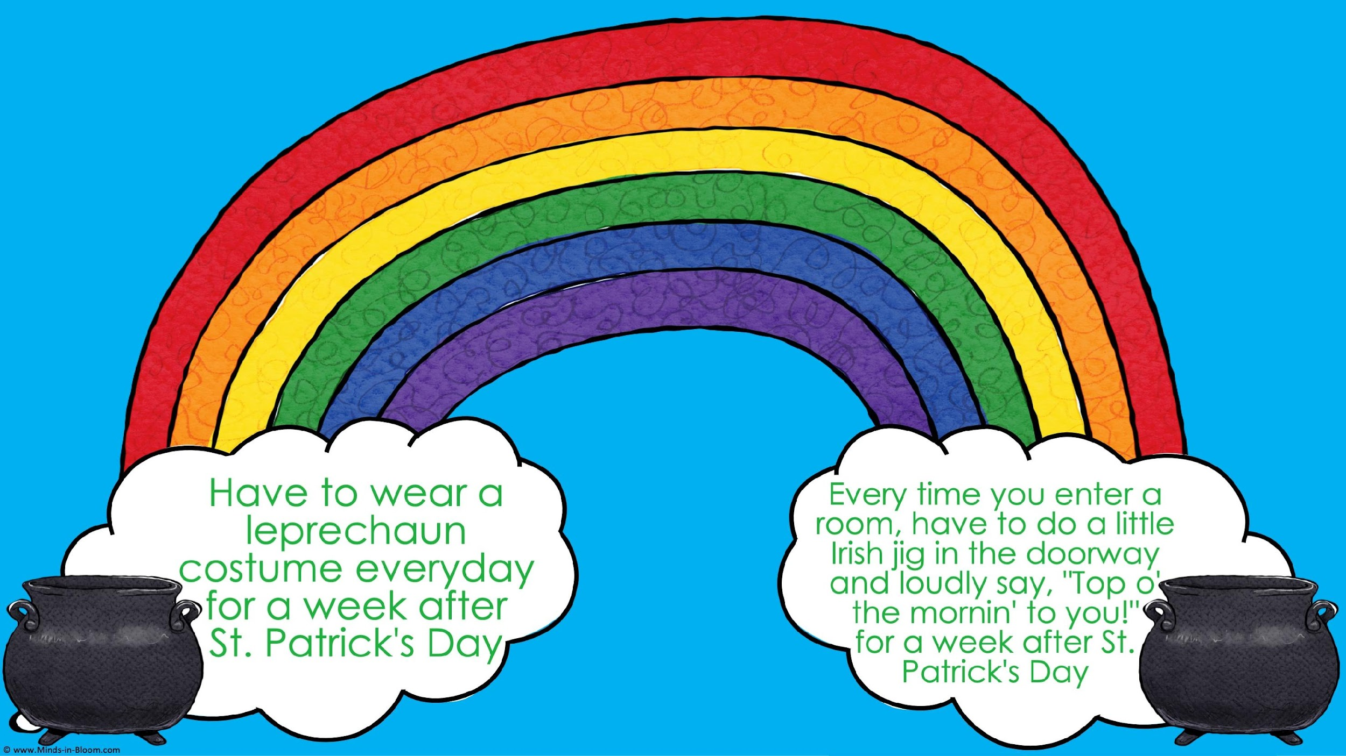

Slide 71


Slide 72


Slide 73


Slide 74


Slide 75


Slide 76


Slide 77


Slide 78


Slide 79








Let’s Dance!

Slide 80


Let’s Take a Virtual Field Trip to Ireland!

Slide 81




















Click on the books to hear a story.
Click on me to hear Irish music.

Slide 82

Find the Sneaky Leprechaun
Click on me to hear Irish music.
Directions: Each time you find a hiding leprechaun, circle him with the red circle. There are 8 total. Best of Luck!!!

Slide 83
Teacher Answer Key
Click on me to hear Irish music.

