Slide 1
St Paul Island Reindeer
  Activity key

Slide 2
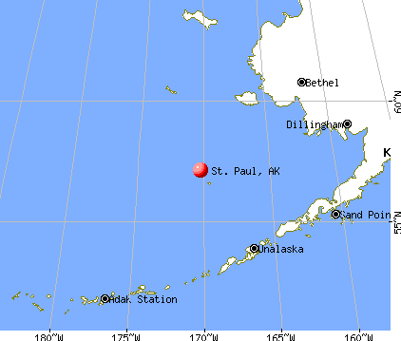
Notes:
St Paul island is far from land – reindeer were brought there by humans
http://pics2.city-data.com/city/maps5/frt3441.png

Slide 3
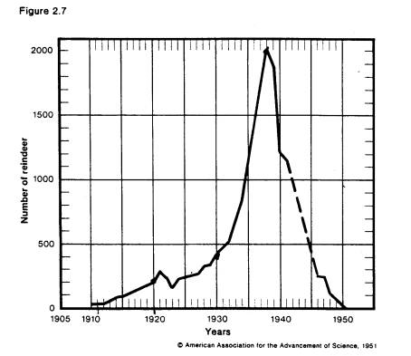
St. Paul Island Reindeer trends
Include years and approximate numbers in analysis:
Reindeer population starts low (1909) when reindeer first come to island
Slow growth at the start(1910-1925)
Moves into exponential growth and climbs high (1925-1938)
Large crash (1939)

Slide 4
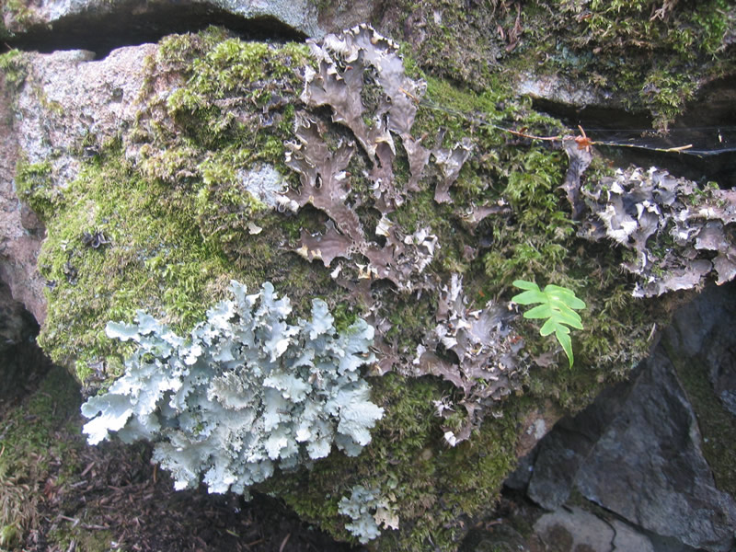
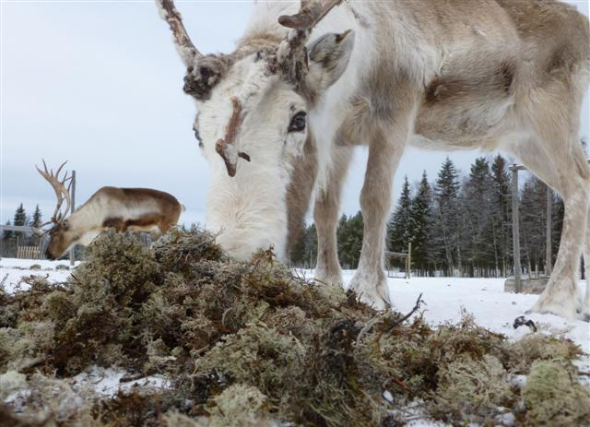
Conclusion parts to include
Immigration and emigration
  Hard for reindeer to come to/leave the island
  Also hard for predators to come in or leave
Causes of population change
  Reindeer dependent on food supply
    Lichens!
  Damage to habitat reduces supply
Notes:
Reindeer and lichen: http://naturallore.files.wordpress.com/2012/04/reindeer-eating-lichen-small.jpg
Lichen: http://www.fs.fed.us/wildflowers/beauty/lichens/images/foliose_on_rocks_lg.jpg

Slide 5
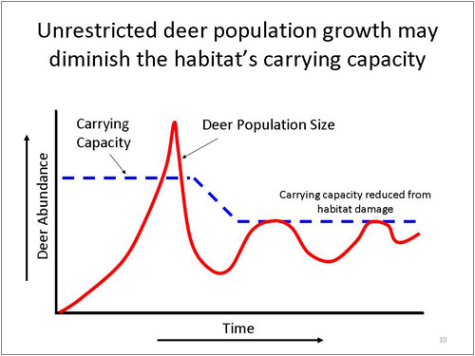
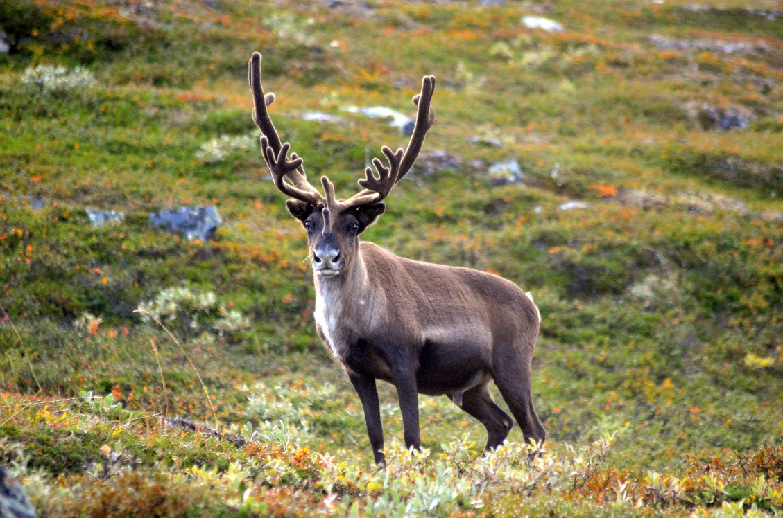
Carrying capacity
  Variable depending on habitat
  When habitat damaged, carrying capacity drops
Predator-prey relationships
  Lack of predator on island
  Predators might help reduce the boom/bust cycle by keeping population at a lower (& more sustainable) level
Notes:
Carrying capacity: http://www.msudeer.com/img/dynamics/dynamics6.jpg
Predator-prey:

Slide 6
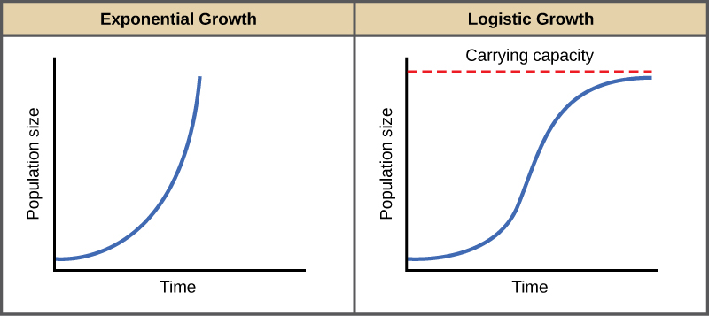
Exponential growth
  Occurs when food supply “unlimited” (relative to population)
  No limiting factors during exponential growth phases
Future predictions for population
  likely won’t reach same high peak
  If environment recovers, reindeer population might increase again
  Carrying capacity is decreased
  Still vulnerable to environmental damage
Notes:
http://cnx.org/content/m44872/latest/Figure_45_03_01.jpg

