Slide 1

St. patrick’s day Guess the zoomed in picture

Slide 2


Slide 3
St. patrick’s day hat

Slide 4


Slide 5
Gold coin

Slide 6
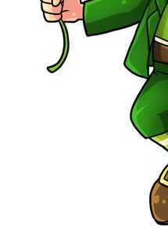

Slide 7
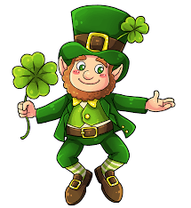
leprechaun

Slide 8


Slide 9
Pot of gold

Slide 10


Slide 11
rainbow

Slide 12


Slide 13
shamrock

Slide 14
You’re Finished!

